Slide 1
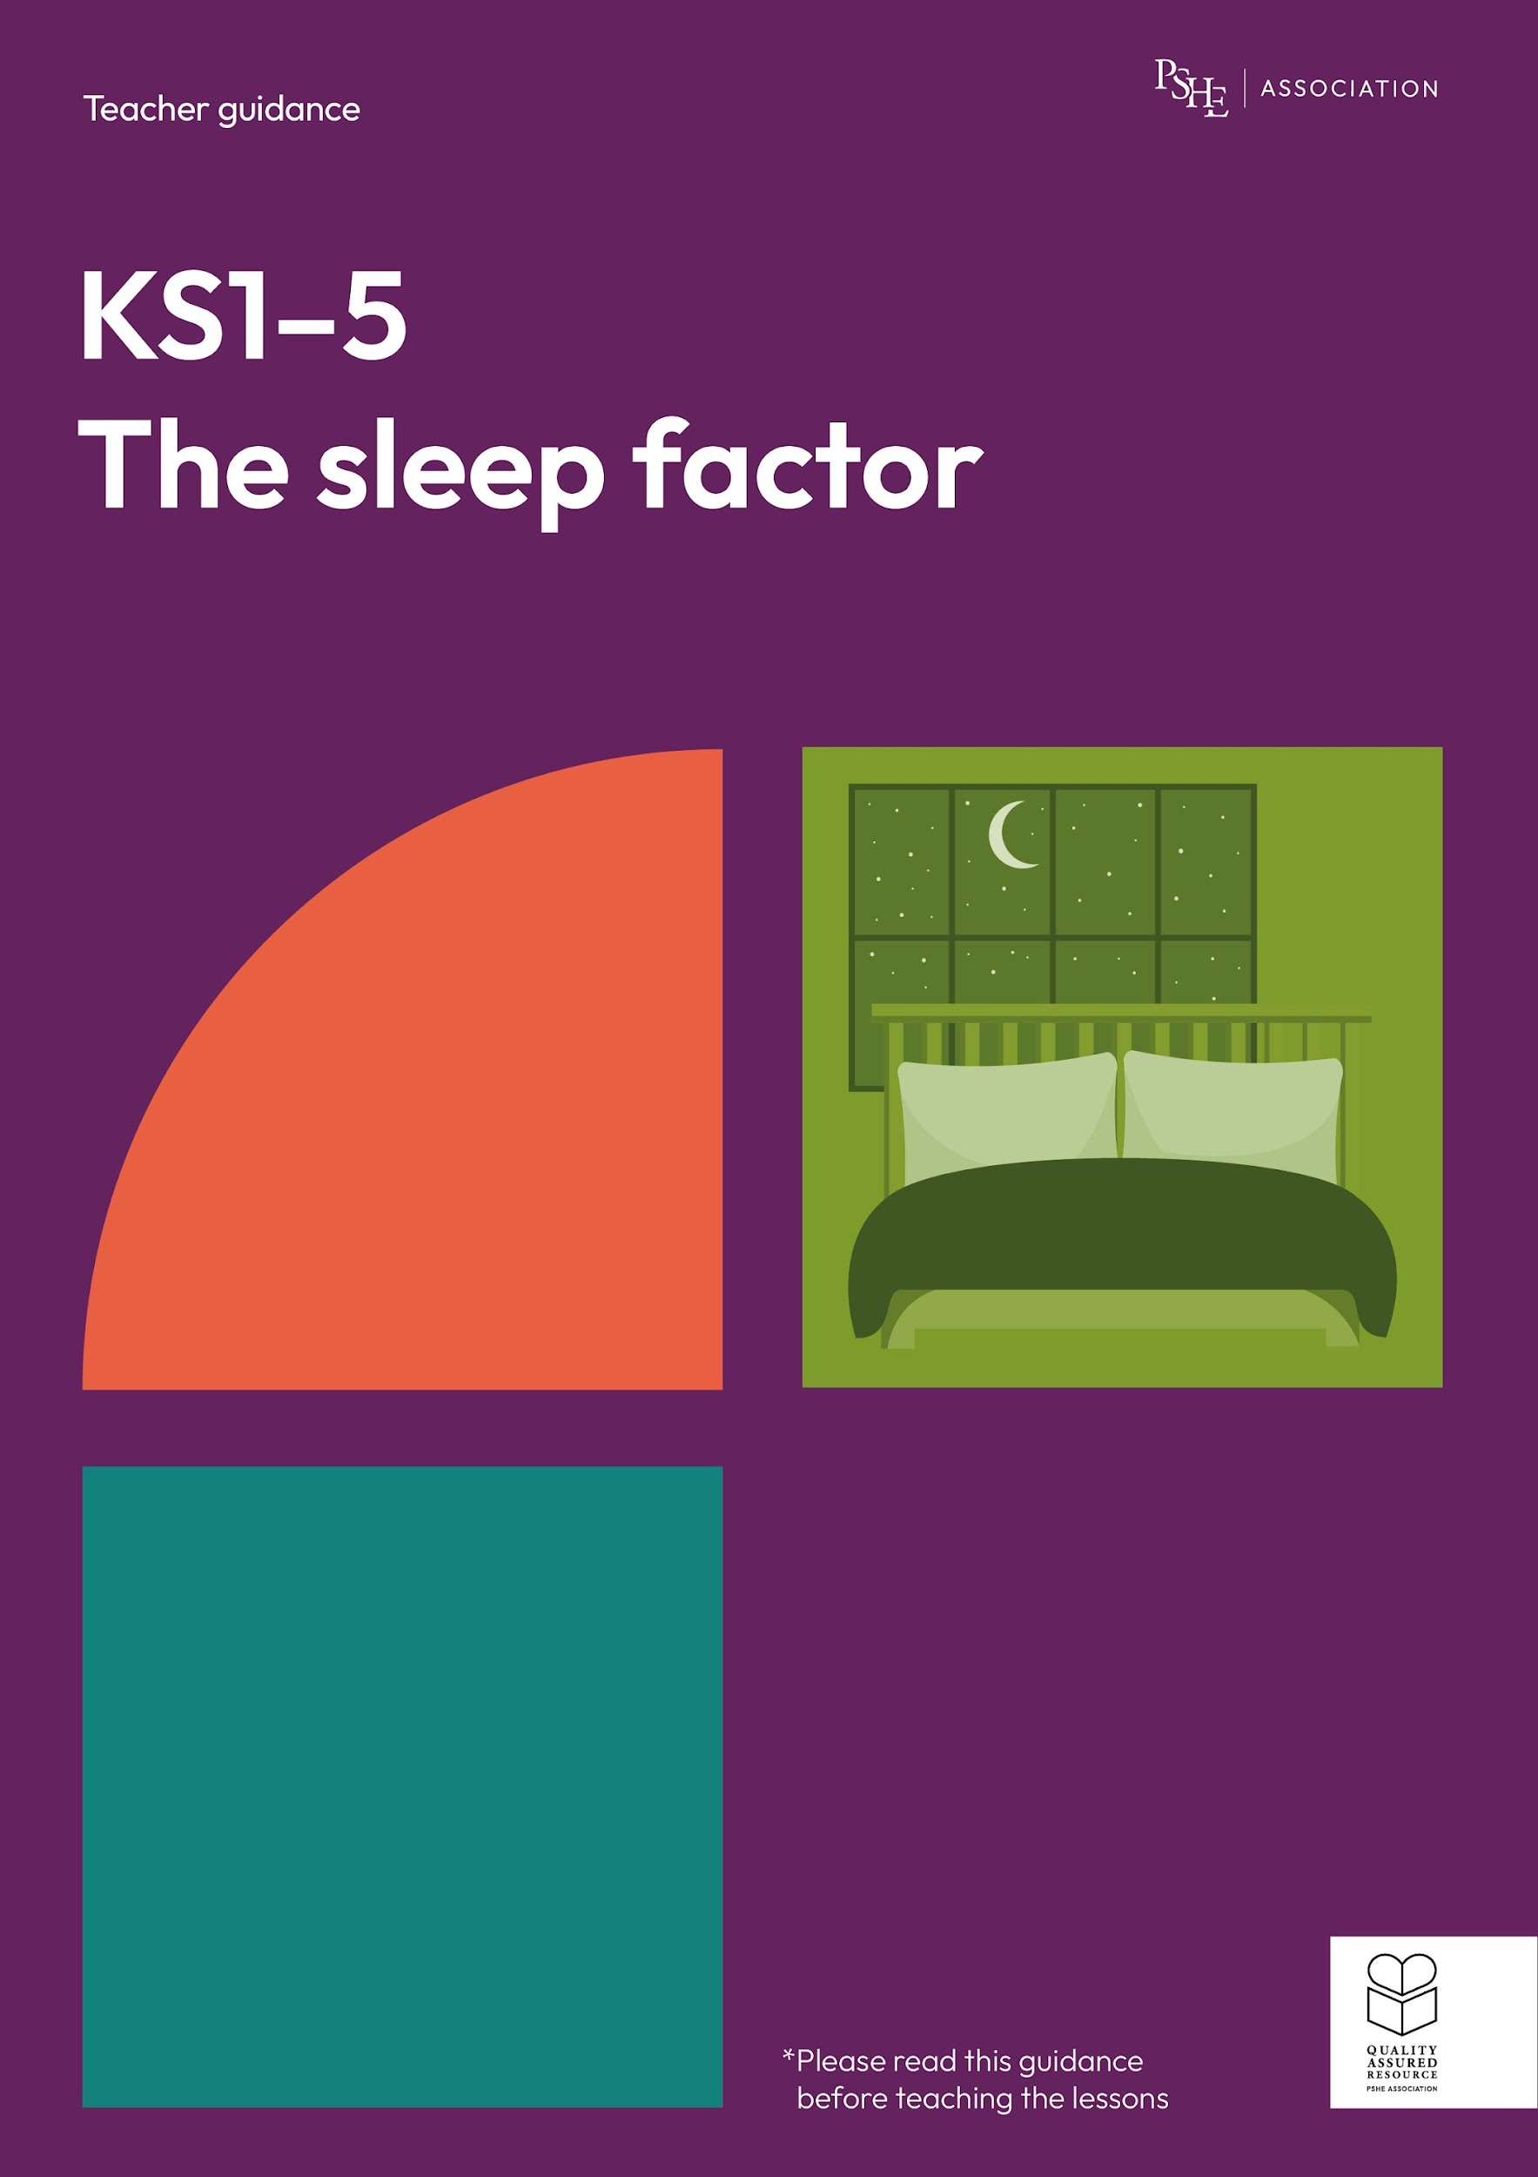
The sleep factor
Ready for sleep
KS1

Slide 2
Using this PowerPoint
The slides in this presentation are divided into two sections:
Teacher slides (purple) – provide key information regarding lesson preparation.
Pupil slides – provide a visual focus point for pupils during the lesson and delivery notes for teachers about the activities. Click ‘notes’ to view these.
Ensure that you select ‘Use Presenter View’ under the ‘Slide Show’ tab – this will allow you to preview the teaching notes on your monitor while the main presentation is displayed on a screen/smartboard.

Slide 3


Support and challenge
The lesson includes suggestions for challenge and support activities, to help you differentiate appropriately for your class.
Support activities are adapted to be more accessible for those who need it.
Challenge activities deepen and extend learning for those who need more challenge or who finish the activity quickly.
Look for these icons on the pupil slides. See delivery notes for details of the activities.
Challenge
Support

Slide 4
Context
This lesson for key stage 1 explores the importance of sleep and considers what young children can do to foster helpful bedtime habits that can support good quality sleep.
No lesson should be taught in isolation, but always as part of a planned, developmental PSHE education programme. This lesson would work well as part of broader learning on healthy lifestyles including physical wellbeing, preparing for transition to key stage 2, or during teaching about mental wellbeing.

Slide 5
To learn about the things that will help us to fall asleep and get a good night’s sleep.
Pupils will be able to:
suggest some reasons why sleep is important
identify things that might stop someone getting to sleep
describe some things that might help someone get to sleep

Slide 6
Box or envelope for questions
Resource 1: What’s our starting point?
[one per pupil]
Resource 2: Mia’s story [one per class]
Resource 3: Sorting headings
[one cut-up set per pair]
Resource 4: What can Mia do to rest and relax? [one cut-up set per pair]
Resource 5: Mia’s new bedtime routine [one cut-up set per pair]

Slide 7
Lesson summary
Activity | Description | Timing
Introduction | Introduce learning objective and outcomes, set up the question box and revisit ground rules. | 5 mins
Baseline assessment | To demonstrate their understanding, pupils complete a draw and write about getting ready for sleep. | 10 mins
Mia’s story | The class listen to a story and identify reasons why the character is having difficulty falling asleep. | 15 mins
What can Mia do to rest and relax? | Pairs identify some good and not so good ways to rest and relax before bedtime. | 10 mins
Mia’s new bedtime routine | Pairs suggest a relaxing bedtime routine for Mia. | 10 mins
Endpoint assessment | To demonstrate their learning, pupils revisit the baseline activity and add to, or change, their ideas. | 5 mins
Reflecting and signposting | Pupils reflect on their learning and where to seek support in and out of school. | 5 mins

Slide 8
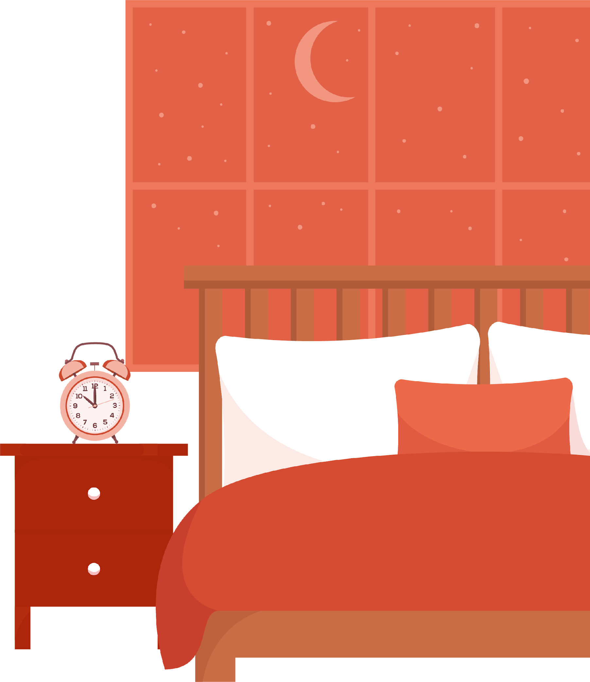
Ready for sleep
KS1

Slide 9
Notes:
Teacher notes – Introduction (5 mins, slides 9-10)
Establish or revisit ground rules. Explain that if pupils have worries or questions during or after the lesson that they do not want to raise in front of the class, they can speak to you individually or write their question on a piece of paper, anonymously or with their name, and put it in the question box.

Slide 10
We are learning about the things that will help us to fall asleep and get a good night’s sleep.
We will be able to:
suggest some reasons why sleep is important
identify things that might stop someone getting to sleep
describe some things that might help someone get to sleep
Notes:
Teacher notes – Introduction (5 mins, slides 9-10)
Introduce the learning objective and outcomes. Explain that today’s lesson will explore things people can do to rest and relax so they are ready for bedtime.

Slide 11
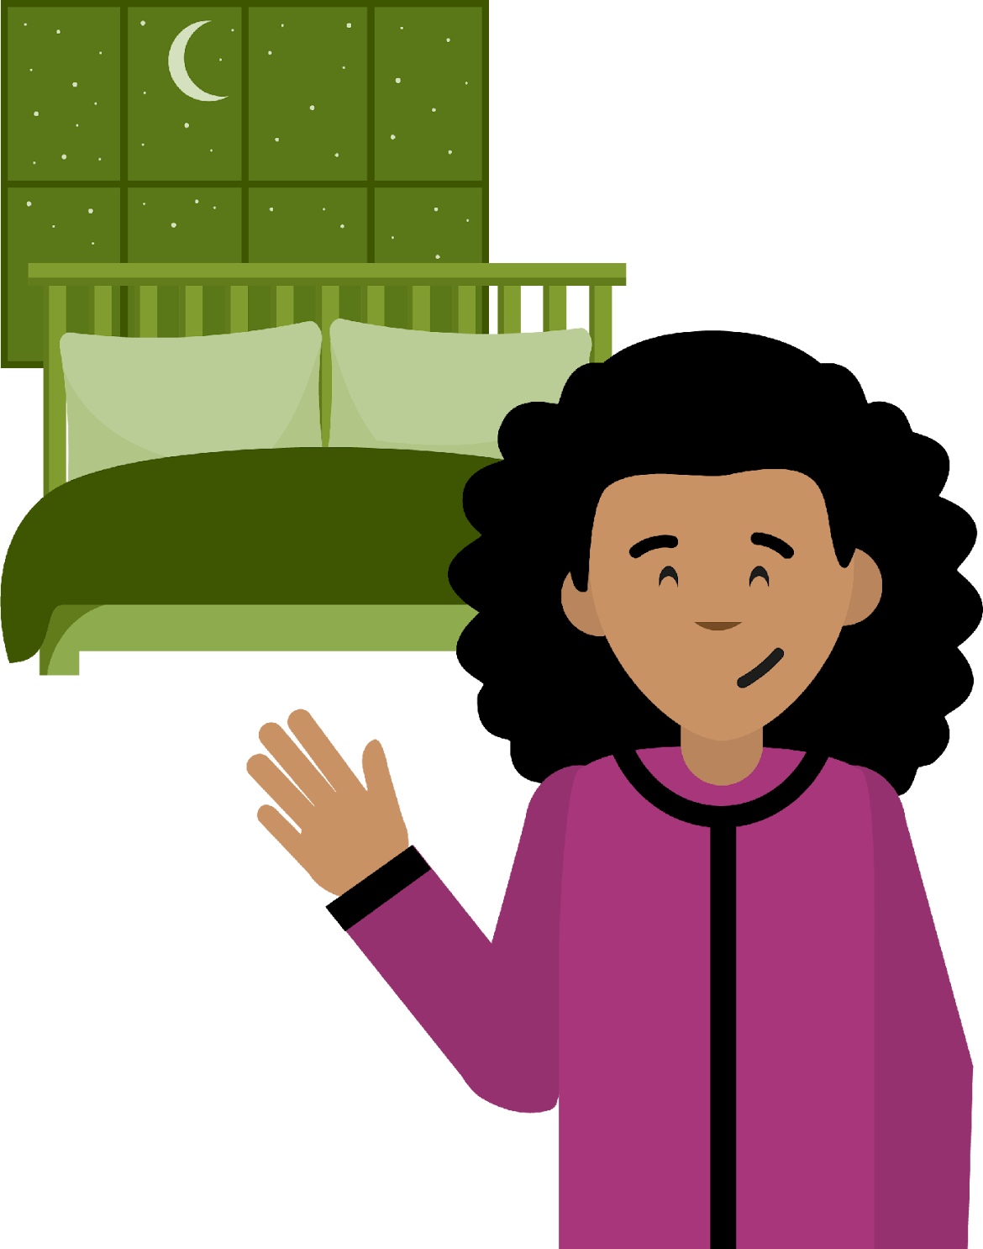
What’s our starting point?
It is Mia’s bedtime
Draw and/or write your ideas:
What could Mia do to get ready to sleep?
Is there anything that could make it hard for Mia to get to sleep?
If she has a good night’s sleep, how will Mia feel the next day?
Notes:
Teacher notes – Baseline assessment activity (10 mins)
Show the slide and give pupils a copy of Resource 1: What’s our starting point? Ask pupils to draw or write in response to the three questions about Mia’s bedtime. They should work on their own without any further prompts or examples, to give a true reflection of their current understanding. You may wish to read the questions aloud in turn, allowing the class time to respond.
Circulate during the activity to get a sense of pupils’ starting points and aim to adapt teaching in the lesson to address any gaps or misconceptions that arise. Keep their sheets as this activity will be returned to at the end of the lesson.

Slide 12




Why we sleep
If she has a good night’s sleep, how will Mia feel the next day?
A good night’s sleep will help Mia to…
feel rested
feel calm
feel happy
be ready to learn
Notes:
Teacher notes – Mia’s story (15 mins, slides 12-14)
Explain that during the lesson, pupils will be helping Mia with her sleep. Ask pupils to share their responses to the third question from the baseline assessment activity: If she has a good night’s sleep, how will Mia feel the next day?
Take some ideas and then share the images on the slide to reinforce some key reasons why sleep is important.

Slide 13
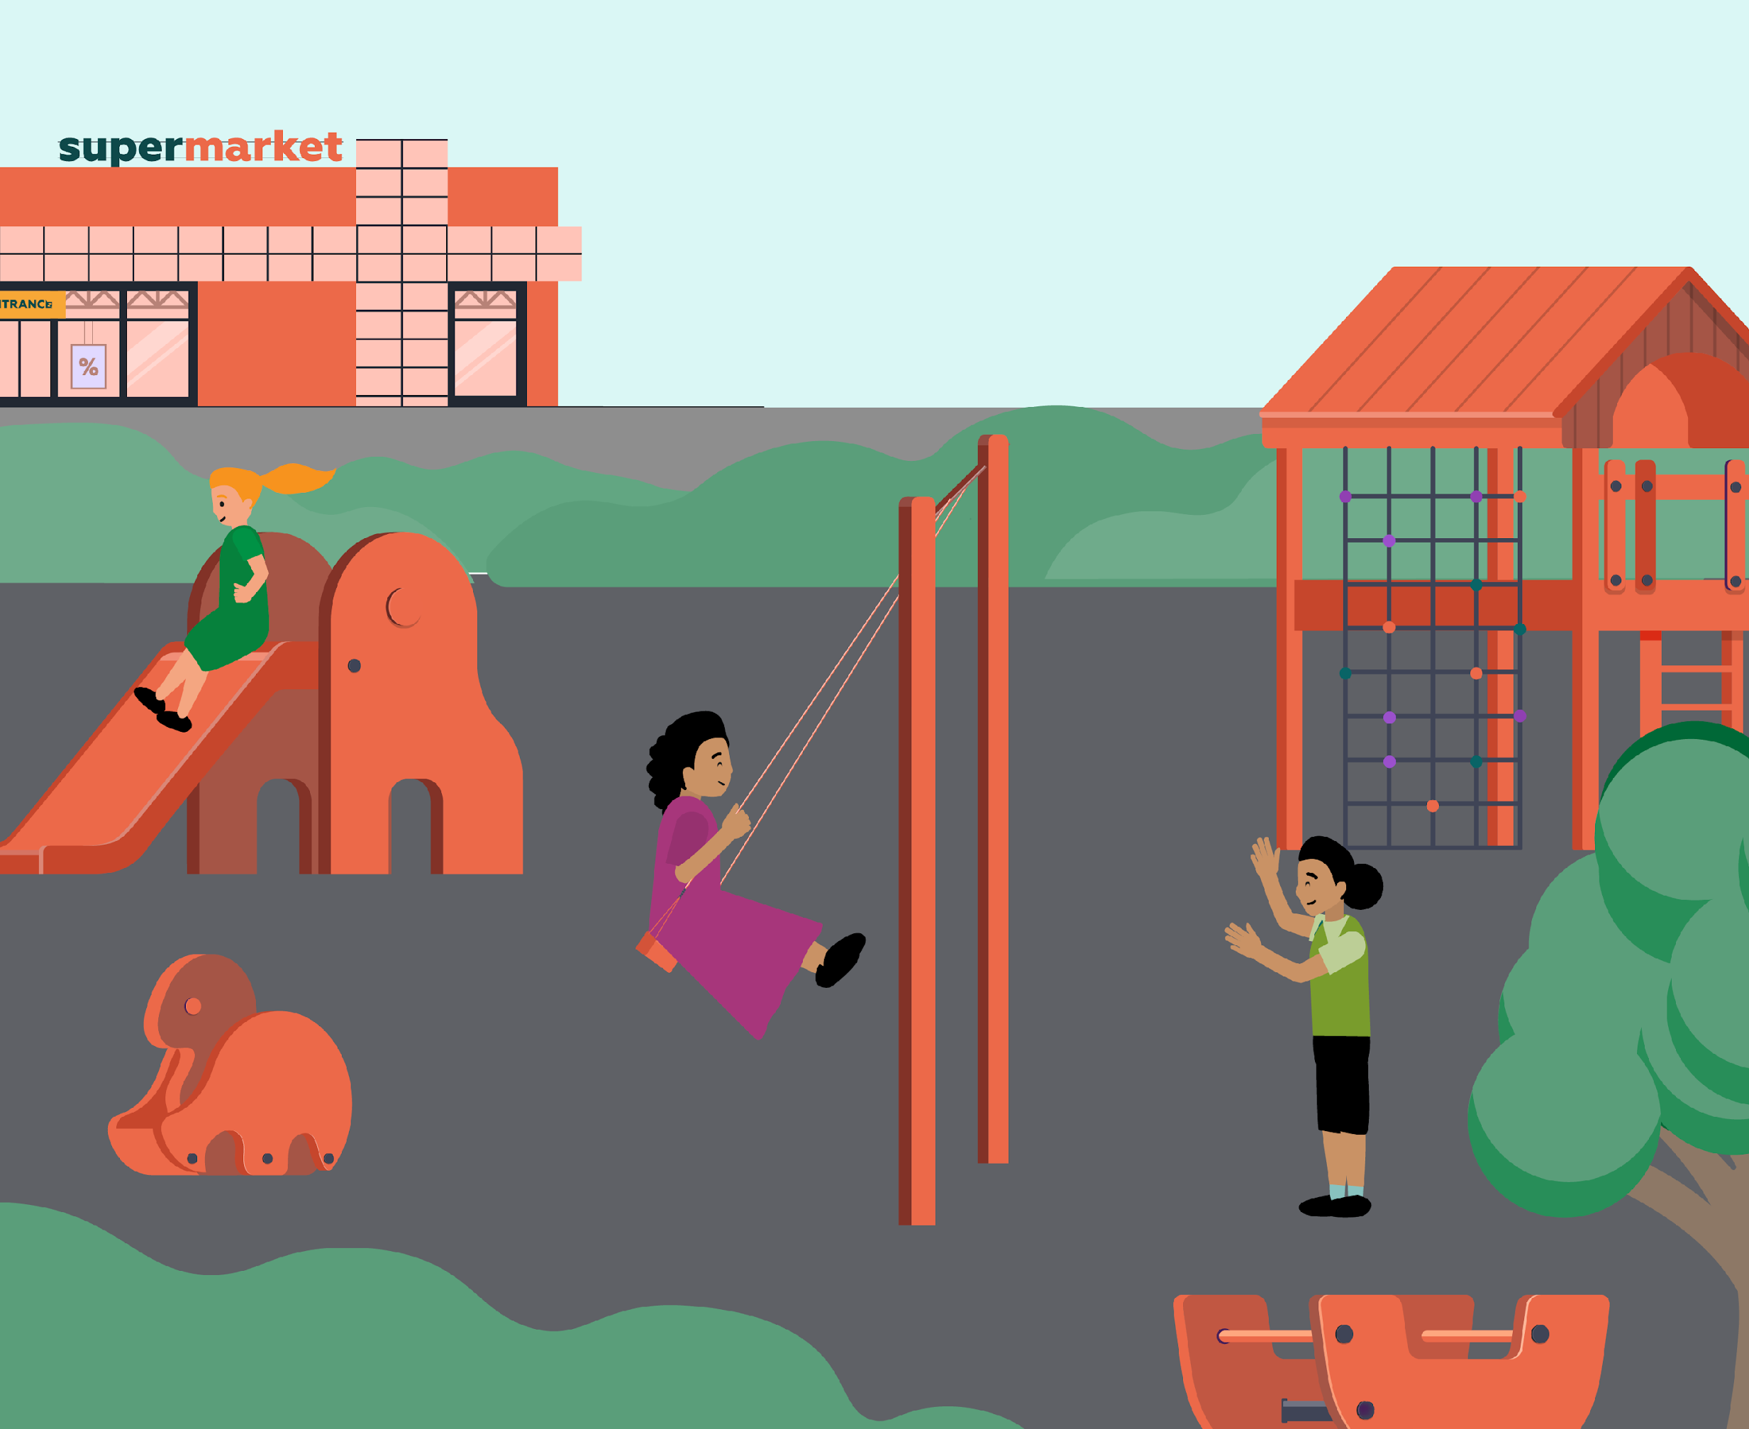
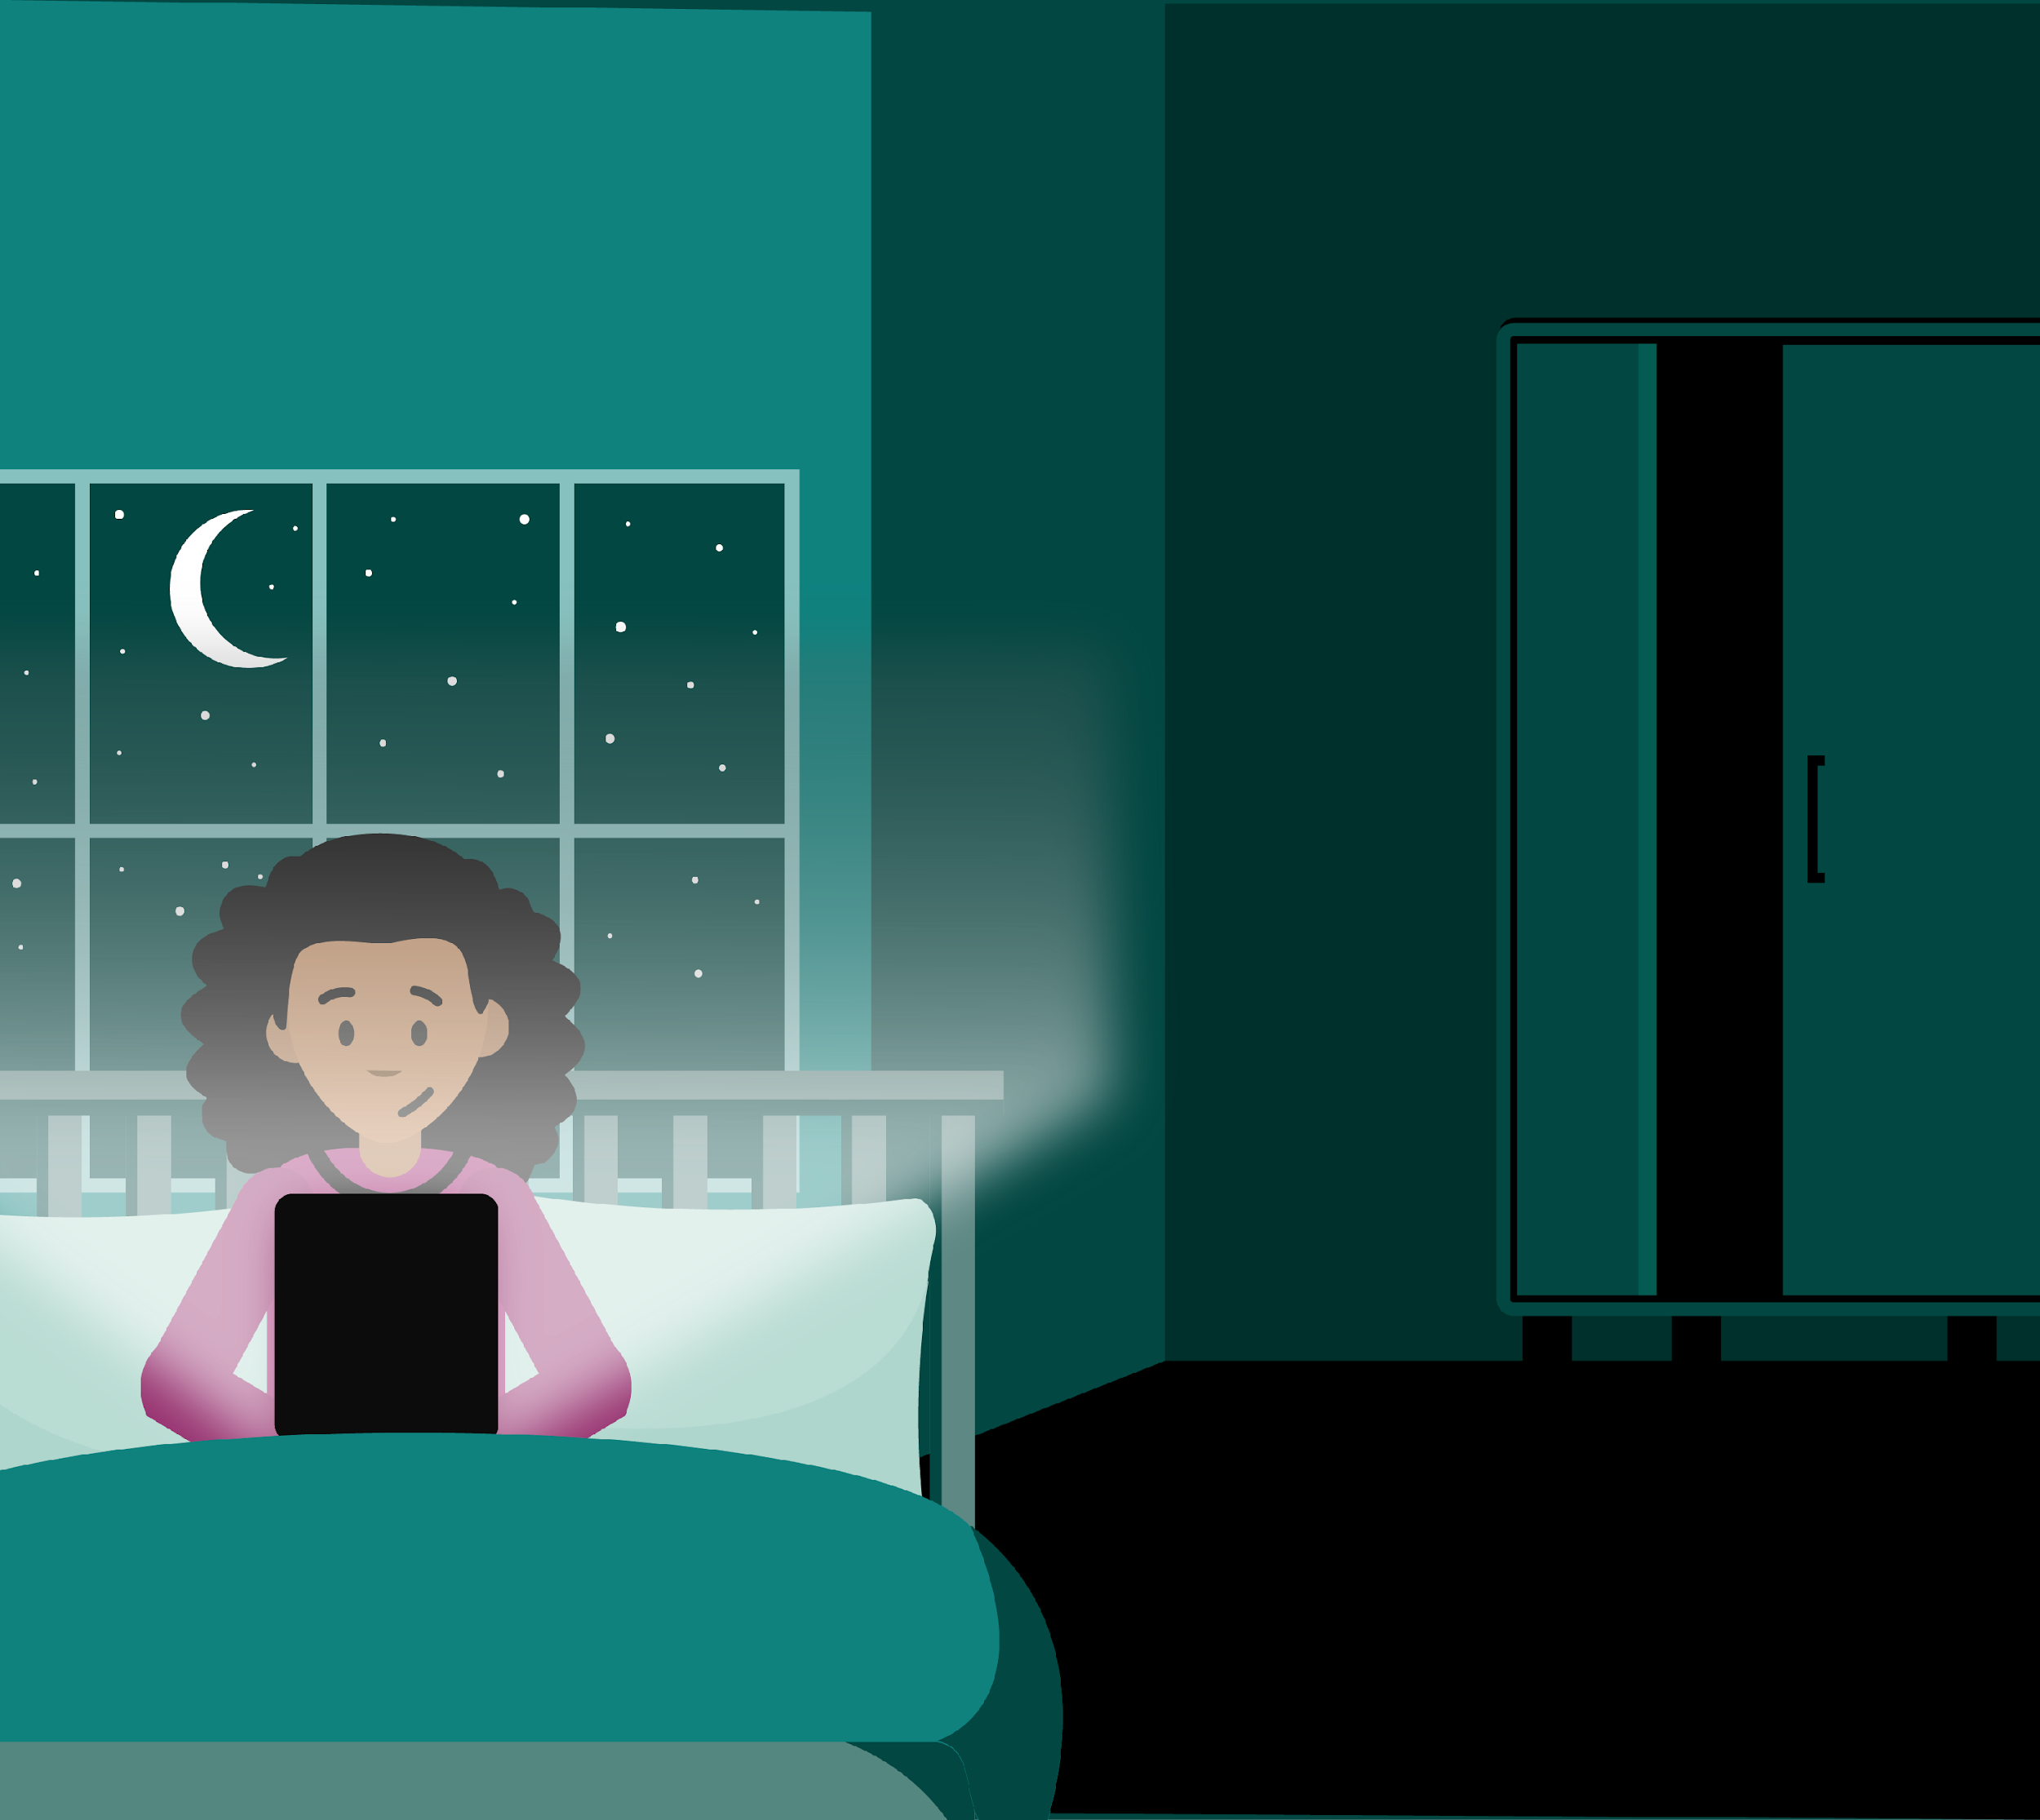
Mia’s story
Now, listen to the story once more.
Can you listen out for anything that is keeping Mia awake?
You’re going to hear Mia’s story.
Listen carefully, as there will be some questions at the end.
Notes:
Teacher notes – Mia’s story (15 mins, slides 12-14)
Tell pupils that you are going to read them a story about Mia’s day and bedtime. They will need to listen carefully, as after the story you will be asking them some questions. Read Resource 2: Mia’s story to the class.
Ask some brief questions to check pupils’ understanding and emphasise that bedtime can look different for different families. For example:
What does Mia’s mum say every night to show Mia that it is time for her to go to sleep? (night-night and sweet dreams)
What might other families say or do? (answers will vary)
Mia has lost the snuggly that usually helps her to fall asleep, what might this snuggly be? (for example, a favourite pillow, a special blanket, a toy or teddy)
Does everyone have a special snuggly? (no – some children might find it useful to have something like a blanket or toy to help them sleep, but other children might not)
Explain that different families might have different routines for bedtime. Sometimes families have special words or customs that they do at bedtime. This can help to mark the end of the day and shows that it’s time for sleep.
Click to reveal the next instructions and explain that the class are going to hear the story once more – this time they should listen out for anything that is keeping Mia awake or making it hard for her to fall asleep. When you have finished reading the story, ask pairs to discuss some of the things that are keeping Mia awake.

Slide 14

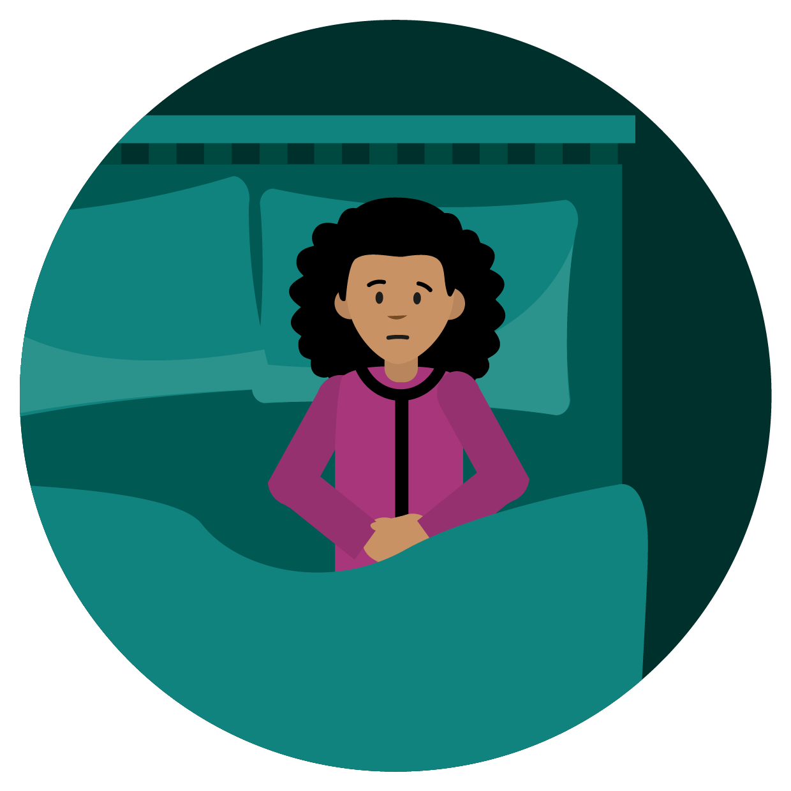
Things that keep Mia awake
Mia’s story
Notes:
Teacher notes – Mia’s story (15 mins, slides 12-14)
Take feedback from volunteers using the spider diagram on slide 14 to record pairs’ ideas, grouping them into categories as you go.
Pupils’ suggestions, and possible categories, could include:
Busy body: jumpy legs, tummy ache – this tummy ache sounds like it could come from worrying, or it could come from being unwell, thirsty or hungry may be a result of being worried about something/feeling unwell/thirsty or hungry
Busy mind: thinking about lots of different things, worrying about the babysitter coming
Surroundings: noise (grown-ups talking downstairs), not having her snuggly, screens before bedtime
Nighttime fears: of the dark/being alone
Emphasise that lots of people will sometimes have trouble getting to sleep, and there can be different reasons for this (for example, feeling a bit scared at nighttime). Highlight that often, the things that people get scared of at night aren’t very scary during the day – for example, Mia isn’t scared of her wardrobe in the day or of being on her own.

Slide 15
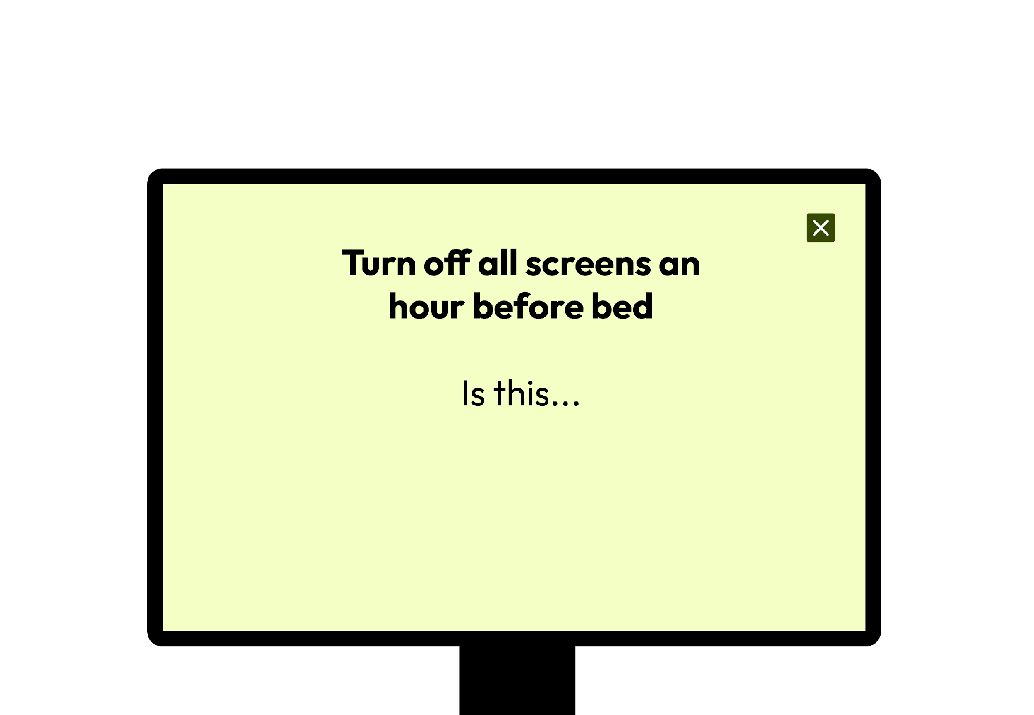


What can Mia do to rest and relax?
Good for relaxing
Not good for relaxing
Notes:
Teacher notes – What can Mia do to rest and relax before bedtime? (10 mins, slides 15-18)
Explain that luckily, there are some simple things Mia can do to help her get to sleep. This includes taking some time to rest and relax before bed. Emphasise that time to relax before bed will help everybody with feeling ready to sleep – but it’s especially useful after a busy day like Mia’s! Give pairs the headings from Resource 3: Sorting headings, and ask them to sort the cut-up cards from Resource 4: What can Mia do to rest and relax? into two categories (using sorting rings, if helpful):
good for relaxing
not good for relaxing
You may wish to model an example first using this slide.
Support: Ask pairs to focus on finding actions that would help Mia to relax. When they find one, they should hold onto it. Once they have finished, they could look at the cards that are left and discuss, are these ideas going to help Mia relax for bedtime or not?
Challenge: Ask pairs to write down their own idea to help Mia relax. They could then suggest ways that the ‘not good for relaxing’ ideas could be made good for relaxing (e.g. instead of a silly, energetic dance, Mia could do some calming stretches).

Slide 16
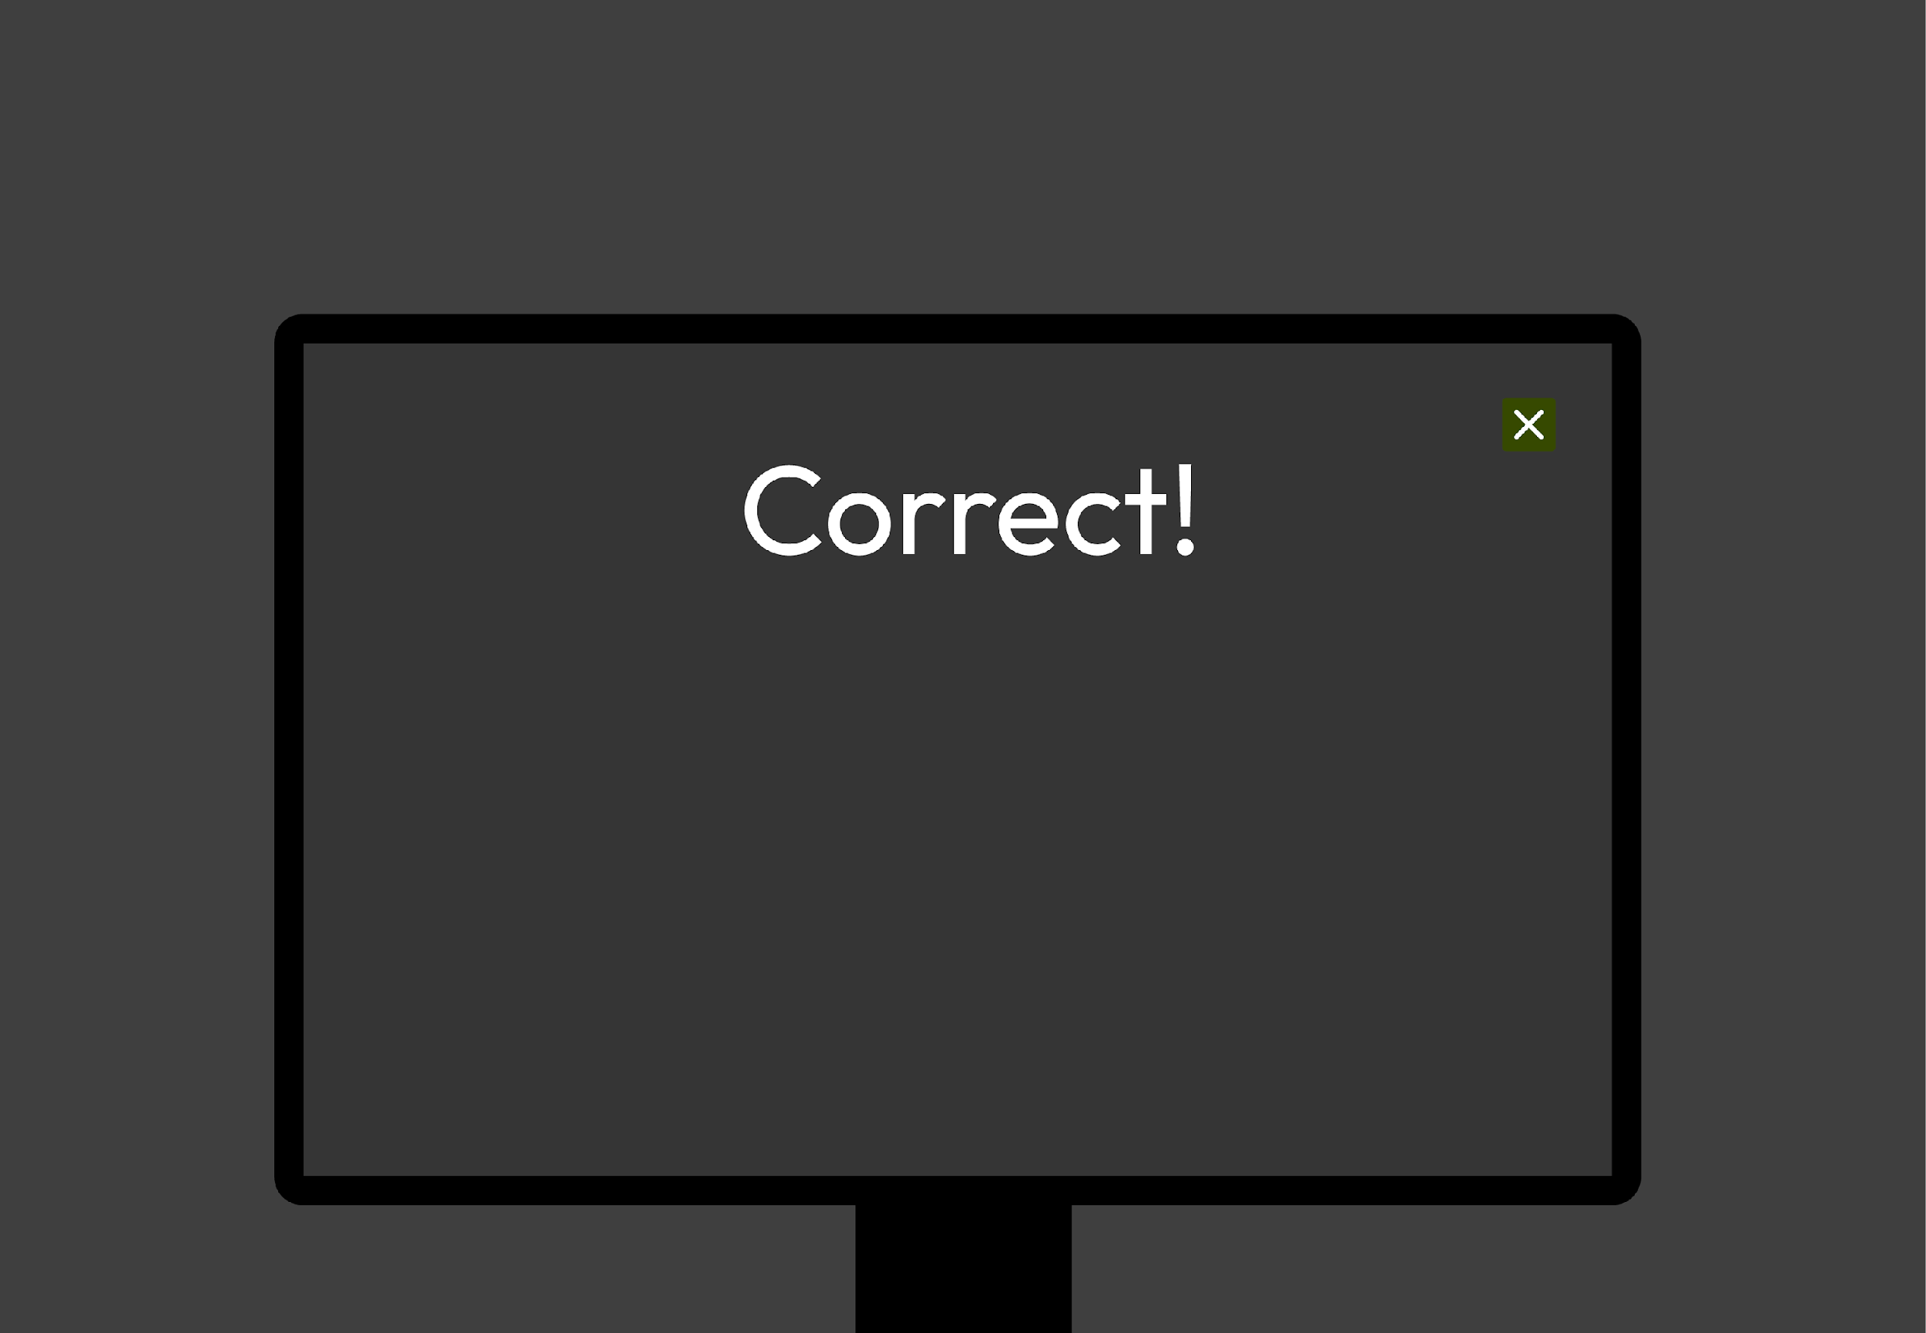



What can Mia do to rest and relax?
Turning off all screens before bed is…
Good for relaxing
Not good for relaxing
Notes:
Teacher notes – What can Mia do to rest and relax before bedtime? (10 mins, slides 15-18)
Explain that luckily, there are some simple things Mia can do to help her get to sleep. This includes taking some time to rest and relax before bed. Emphasise that time to relax before bed will help everybody with feeling ready to sleep – but it’s especially useful after a busy day like Mia’s! Give pairs the headings from Resource 3: Sorting headings, and ask them to sort the cut-up cards from Resource 4: What can Mia do to rest and relax? into two categories (using sorting rings, if helpful):
good for relaxing
not good for relaxing
You may wish to model an example first using this slide.
Support: Ask pairs to focus on finding actions that would help Mia to relax. When they find one, they should hold onto it. Once they have finished, they could look at the cards that are left and discuss, are these ideas going to help Mia relax for bedtime or not?
Challenge: Ask pairs to write down their own idea to help Mia relax. They could then suggest ways that the ‘not good for relaxing’ ideas could be made good for relaxing (e.g. instead of a silly, energetic dance, Mia could do some calming stretches).

Slide 17







What can Mia do to rest and relax?
Good for relaxing:
Turn off all screens an hour before bed.
Have a cuddle
Talk to someone about worries
Try to go to bed at the same time each night
Read a book
Listen to calm music
Make up a song or words to make any imaginary monsters disappear
Notes:
Teacher notes – What can Mia do to rest and relax before bedtime? (10 mins, slides 15-18)
Use this slide, and the next to take feedback.

Slide 18




What can Mia do to rest and relax?
Not good for relaxing:
Have sweets or a fizzy drink.
Watch an exciting film.
Do a silly, energetic dance.
Go to bed
really late.
Notes:
Teacher notes – What can Mia do to rest and relax before bedtime? (10 mins, slides 15-18)
Explain that sugary food or drink, screens and lots of energetic movement close to bedtime can all stop someone from getting to sleep easily. Make sure pairs have removed these actions (that are not good for relaxing) from their card piles, before moving onto the next activity.

Slide 19


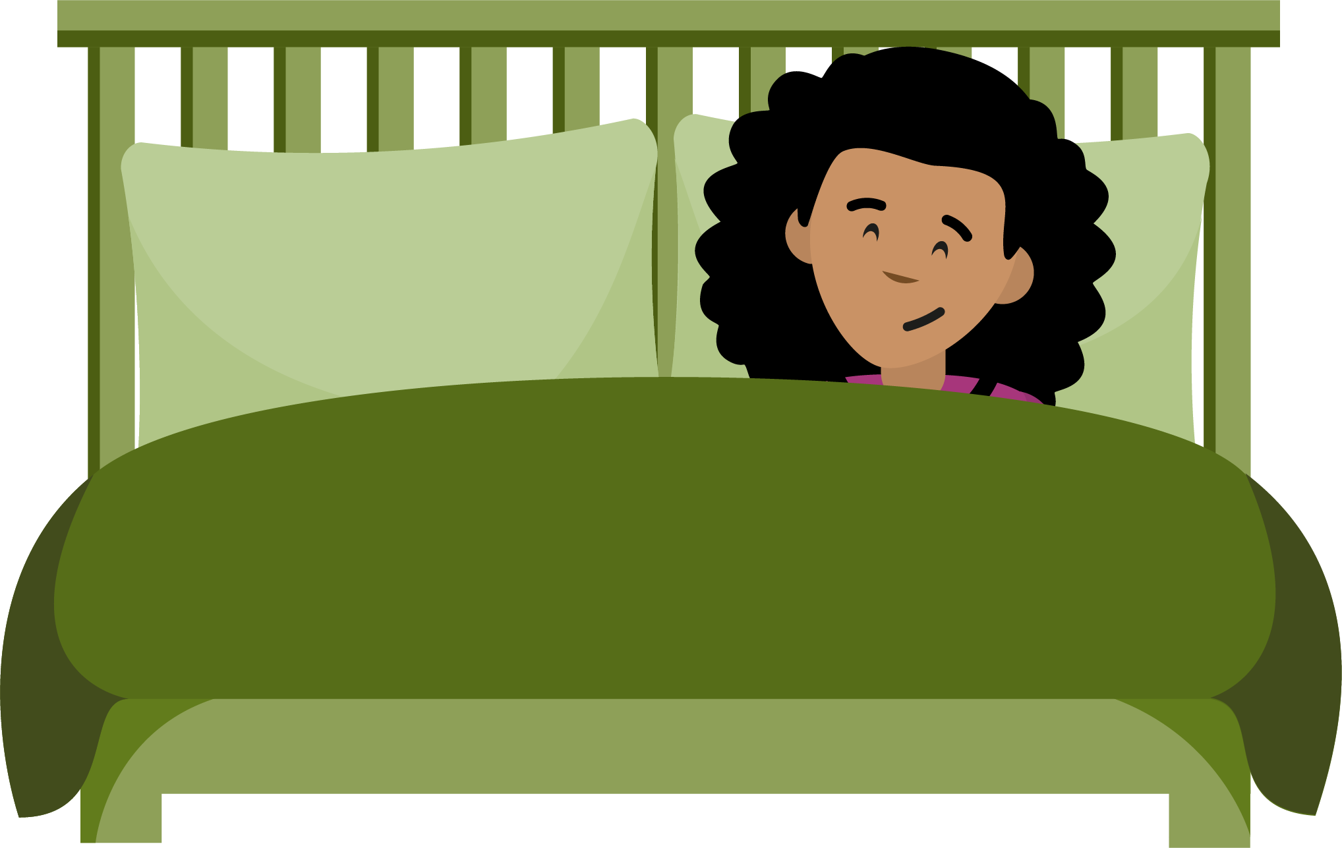


Mia’s new bedtime routine
Have you heard the word ‘routine’ before?
A bedtime routine is what someone does every evening to help them get ready for bed.
Can you plan a calm and relaxing bedtime routine
for Mia?
Notes:
Teacher notes – Mia’s new bedtime routine (10 mins)
Explain that other actions – like trying to go to bed at the same time each day – can help Mia to relax and get ready for bed. This can also help Mia with her bedtime routine. Ask pupils to raise their hand if they have heard the word ‘routine’ before and ask volunteers what they think this means. Click to reveal the definition of bedtime routine.
Ask pairs to create a calm and relaxing bedtime routine to help Mia get ready for sleep. They can use the cards that were good for relaxing from the previous activity, as well as the cards from Resource 5: Mia’s new bedtime routine. Circulate during the activity to see pairs’ ideas.
Highlight that everyone will have created slightly different bedtime routines – and there is no right answer as different families and children will do different things to get ready for bed. Finally, ask the class what adults might do to tell children it’s time to start getting ready for bedtime (for example, they might tell them to get into their pyjamas or they might say words like, ‘Nearly bedtime – let’s get ready!).
Challenge: Ask pairs to discuss and agree the three most important parts of the bedtime routine that they have created and be ready to explain their thinking.

Slide 20
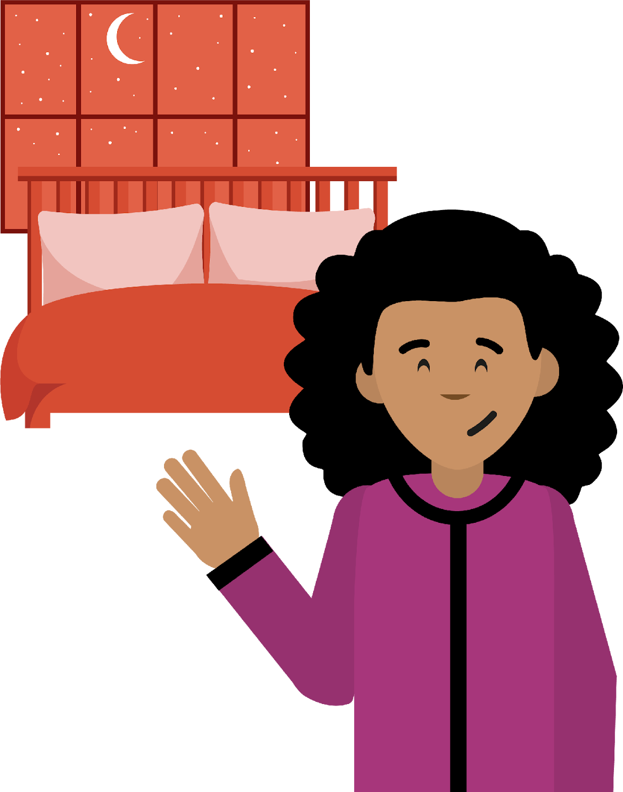
Where are we now?
Go back to the ‘What’s our starting point?’ activity.
Use a different color pen or pencil to add to your draw
and write.
Is there anything else that you would like to add?
Is there anything that you would like to change?
Without sharing, pick one thing you have learnt about today that you would like to try in your own bedtime routine.
Notes:
Teacher notes – Endpoint assessment and reflection (5 mins)
Remind pupils of the learning outcomes and give them back their copies of Resource 1: What’s our starting point from the beginning of the lesson. In a different colour pen or pencil, ask them to add any new learning, or make any changes to their responses from the start of the lesson on why sleep is important and things that can make it harder or easier to get to sleep.
This assessment activity will help provide information about pupils’ progress and highlight any gaps that may need addressing in future lessons.
Reflection: Click to reveal the reflection prompt on the slide and ask pupils to silently think about one thing they learnt this lesson that they would like to try in their own bedtime routine. As this is a private reflection, pupils should not share their ideas.

Slide 21


Who can help?
If you have trouble with sleep or have worries about sleep, speaking to an adult can help.
You can:
speak to a parent, carer, or other trusted adult outside of school – someone you feel comfortable talking to
speak to a teacher, a helper, or other trusted staff member in school
I’m worried
about sleep…
Notes:
Teacher notes – Signposting support (5 mins)
Reassure pupils that lots of people find it hard to get to sleep or wake up sometimes, including adults.
Make sure pupils know that if they are worried about sleep or if they often find it hard to sleep, they should:
speak to a parent, carer, or other trusted adult outside of school – someone they feel comfortable talking to
speak to a teacher, a helper, or other trusted staff member in school
If any questions from the question box have not yet been answered, and if time allows, you may wish to address these now.

Slide 22
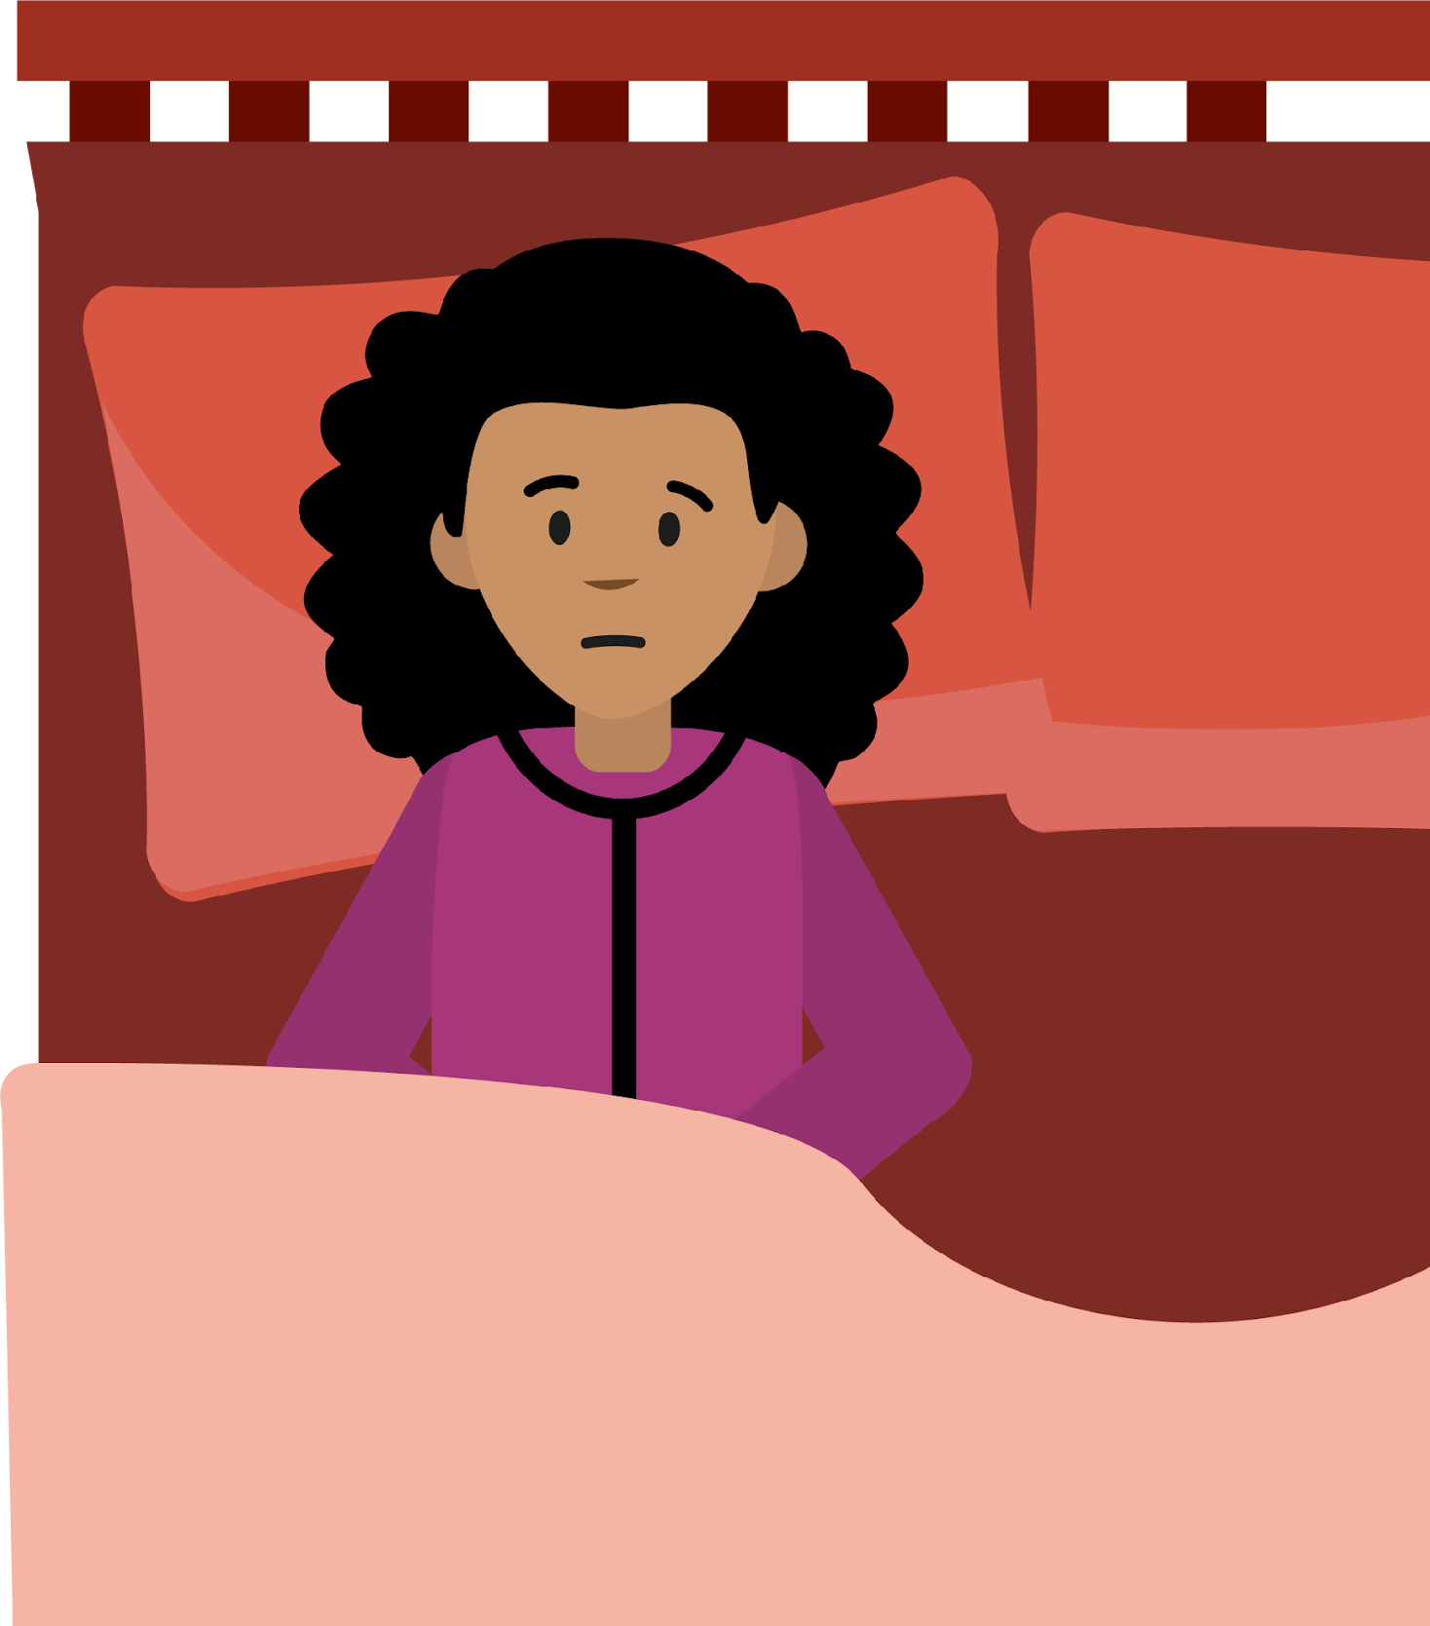
More activities
Mia has woken up in the middle of the night.
What could help her
feel better?
What could help her to go back to sleep?
Notes:
Teacher notes – More activities: Getting back to sleep
Explain that Mia has woken up in the middle of the night. Ask them to discuss or record in pairs or small groups, what ideas they have to help her feel better and go back to sleep.

