Slide 1
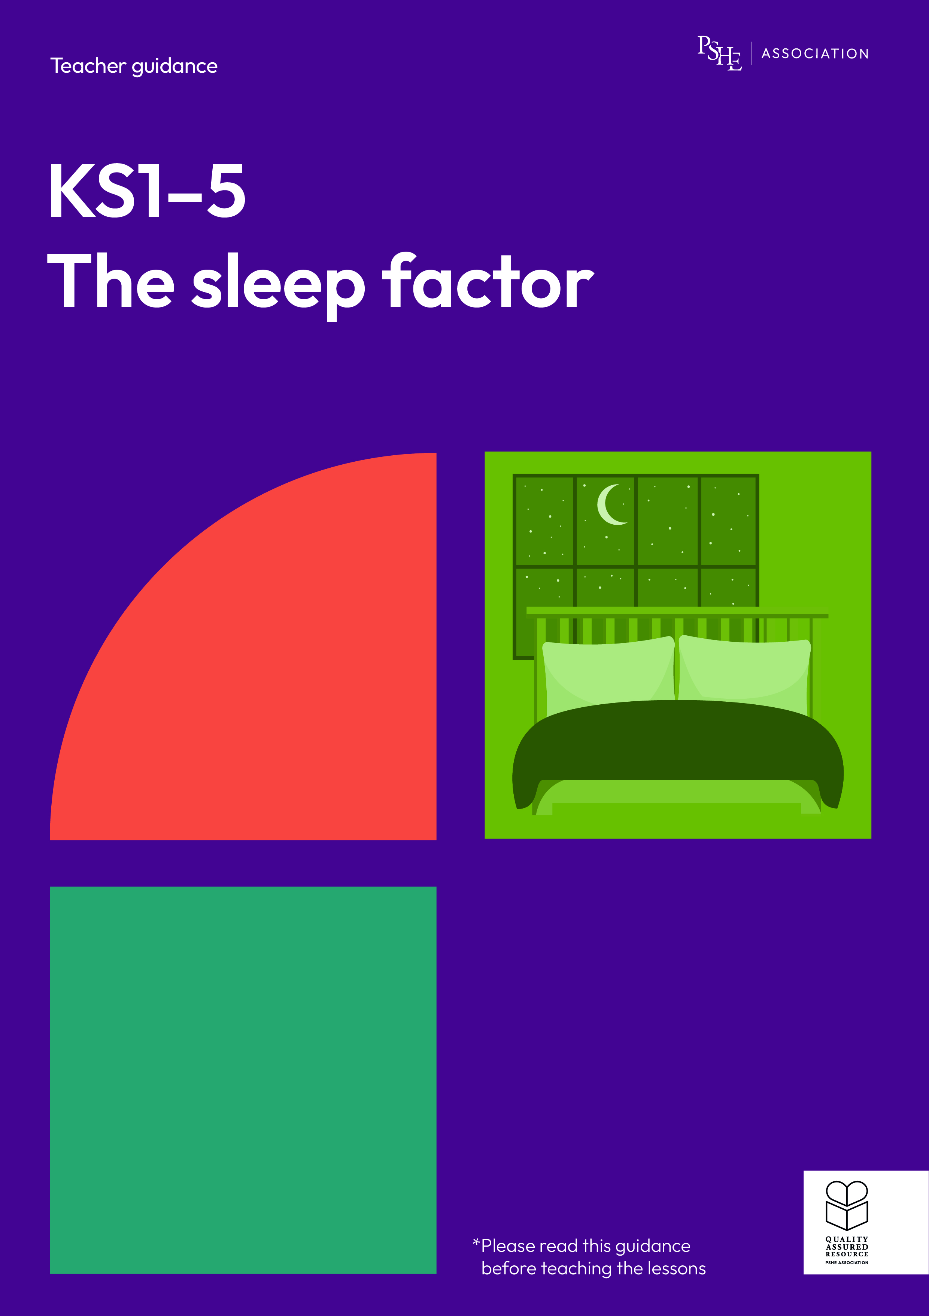
The sleep factor
Healthier sleep habits
KS3

Slide 2
Using this PowerPoint
The slides in this presentation are divided into two sections:
Teacher slides (purple) – provide key information regarding lesson preparation.
Student slides – provide a visual focus point for students during the lesson and delivery notes for teachers about the activities. Click ‘notes’ to view these.
Ensure that you select ‘Use Presenter View’ under the ‘Slide Show’ tab – this will allow you to preview the teaching notes on your monitor while the main presentation is displayed on a screen/smartboard.

Slide 3


Support and challenge
The lesson includes suggestions for challenge and support activities, to help you differentiate appropriately for your class.
Support activities are adapted to be more accessible for those who need it.
Challenge activities deepen and extend learning for those who need more challenge or who finish the activity quickly.
Look for these icons on the pupil slides. See delivery notes for details of the activities.
Challenge
Support

Slide 4
Context
This lesson for key stage 3 explores the importance of high-quality sleep - particularly as students begin secondary school, when routines, schedules and pressures are likely to change.
No lesson should be taught in isolation, but always as part of a planned, developmental PSHE education programme. This lesson would work well within broader learning on healthy, balanced lifestyles, or learning about the transition from primary to secondary school. It builds on the key stage 1 and 2 lessons in the pack.

Slide 5
To learn about healthier sleep habits.
Students will be able to:
explain the impact of sleep on health and wellbeing
identify factors that can reduce sleep quality
describe a range of strategies for ensuring healthier sleep patterns

Slide 6
Box or envelope for questions
Blank postcards
Resource 1: Sleep quiz [one per student]
Resource 1a: Sleep quiz - teacher answers [for teacher reference only]
Resource 2: Sleep scenarios [one scenario per group]

Slide 7
Lesson summary
Activity | Description | Timing
Introduction | Introduce learning objective and outcomes, set up the question box and revisit ground rules. | 2 mins
Baseline assessment | Students respond to an opinion statement about sleep. | 5 mins
Sleep quiz | Pairs answer a series of questions about sleep and its impact on health and wellbeing. | 15 mins
Sleep scenarios | Students review scenarios and consider the quality of characters’ sleep, as well as the consequences of poor-quality sleep. | 15 mins
Sleep strategies | Groups suggest a range of strategies to promote high-quality sleep. | 10 mins
Endpoint assessment | To demonstrate their progress, students advise a character about healthier sleep habits. | 10 mins
Signpost support | Respond to student questions and signpost sources of support. | 3 mins

Slide 8
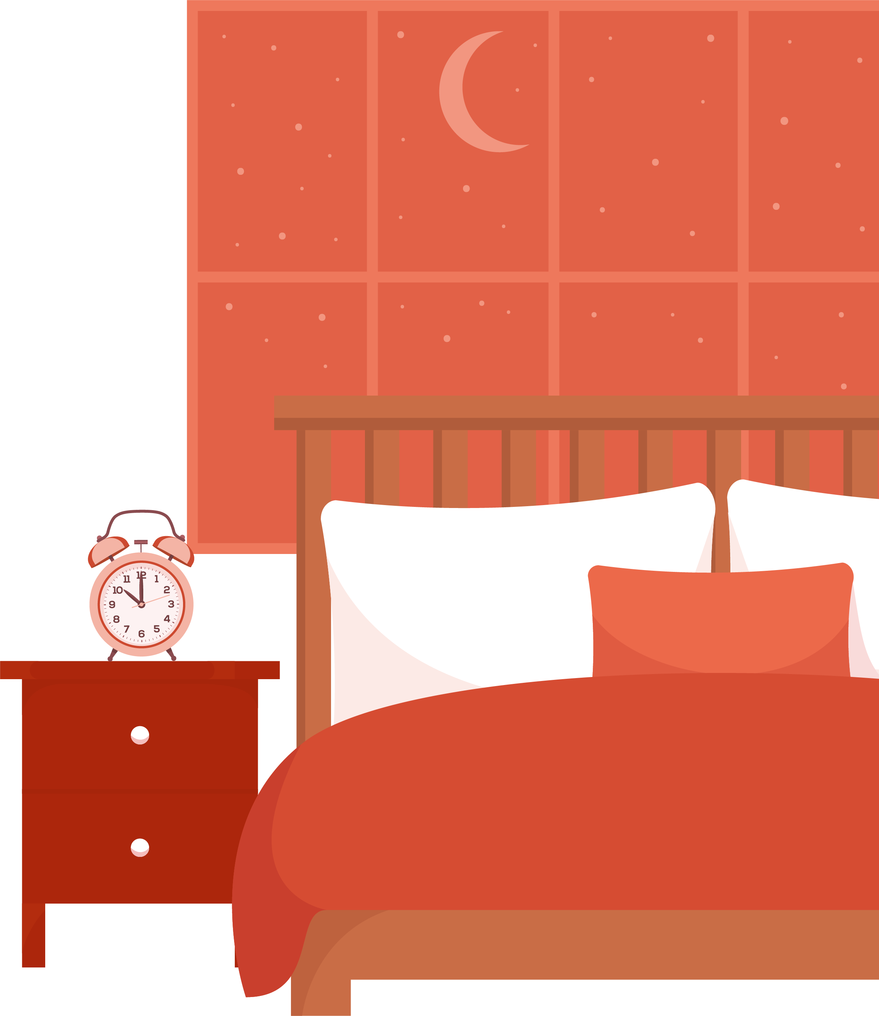
Healthier sleep habits
KS3

Slide 9
Notes:
Teacher notes – Introduction (2 mins, slides 9-10)
Establish ground rules and make students aware of the question box, which will be available throughout the lesson. Explain that if they have worries or questions during or after the lesson that they do not want to raise in front of the class, they can write their question on a piece of paper, anonymously or with their name, and put it in the question box.

Slide 10
We will learn about healthier sleep habits.
We will be able to:
explain the impact of sleep on health and wellbeing
identify factors that can reduce sleep quality
describe a range of strategies for ensuring healthier sleep patterns
Notes:
Teacher notes – Introduction (2 mins, slides 9-10)
Introduce the learning objective and outcomes.
Explain that this lesson will explore the importance of - and habits to help achieve – healthier sleep, particularly during adolescence.

Slide 11


What’s our starting point?
Do you agree, partially agree or disagree with this statement?
Write this down on your post-it note and add at least one reason why.
I think sleep can impact how you feel, but you either sleep well, or you don’t – there’s not much you can do to change that.
Notes:
Teacher notes – Baseline assessment activity (5 mins, slide 11)
Ask students to respond to the opinion: “I think sleep can impact how you feel, but you either sleep well, or you don’t – there’s not much you can do to change that”. They should write a quick response to this statement, saying whether they agree, partially agree, or disagree and providing at least one reason for their view.
Ask them to bring these to the front and organise them broadly into groups; to reflect those that agree, or disagree, or are somewhere in the middle. Share some representative responses with the group. This will help you to gauge the class’s attitudes towards healthier sleep habits. You can then consider which attitudes may need to be particularly addressed through your teaching.

Slide 12
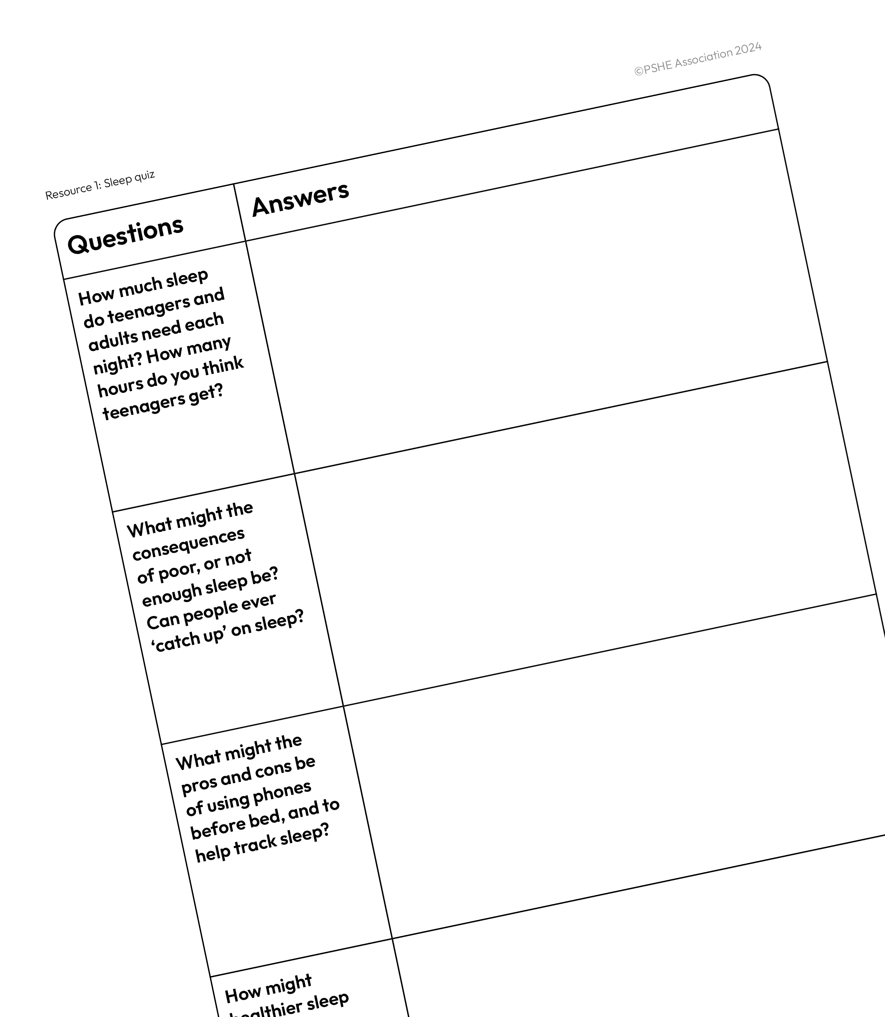




Sleep quiz
What do you know about healthier sleep habits?
In pairs, answer the questions on your sheet.
Notes:
Teacher notes – Sleep quiz (15 mins, slide 12)
In pairs, give students Resource 1: Sleep quiz and ask them to answer the questions based on what they know, or think they know, about sleep.
Circulate during the activity to see what students think, before taking feedback from the class. Use Resource 1a: Sleep quiz – teacher answers to challenge misconceptions and provide additional information.
Support: Ask students to focus on questions 2 and 4 in this quiz, focusing on the consequences of poor sleep and the benefits of high-quality sleep.
Challenge: Ask students to discuss how someone’s sleep habits might change throughout the year. For example, do they think the seasons changing has any impact on sleep habits? How might sleep be different for young people in the school holidays?

Slide 13

Sleep scenarios
In your group, read the scenario and discuss:
How high quality do you think your character’s sleep is?
What habits might be preventing your character from getting high-quality sleep?
What might be the consequences for your character if they don’t get high-quality sleep?
Notes:
Teacher notes – Sleep scenarios (15 mins, slide 13)
In small groups, give students one of the characters from Resource 2: Sleep scenarios.
Ask them to read the scenario and discuss:
how high quality they think their character’s sleep is
any habits or other factors that might be preventing their character from getting high-quality sleep
possible consequences for their character, of not getting high-quality sleep.
Take feedback, drawing out the key learning points for each character:
Klaudia is not getting enough high-quality sleep; she is currently only getting 7 hours a night. Instead of eating dinner after homework club, she is waiting until much later, which is inadvisable. She is also looking at a screen before bed, which might stop her from being able to get to sleep easily. This lack of sleep might affect her performance in school and at basketball practice.
Benji has very erratic sleep patterns, which mean he isn’t consistently getting enough high-quality sleep. Drinking caffeinated drinks (especially in the afternoon) and napping late in the day might be preventing him for getting high-quality sleep at night. Similarly, sleeping in at weekends means that his sleep routine is disrupted. This is having an impact on Benji’s relationships, both at home and school, and is preventing him from focusing in lessons.
Ryan is getting some sleep, but the quality of this is being disrupted by his worrying at night. As Ryan does not organise his school bag in the evening before settling down to sleep, he wakes up worrying about what he needs to do the next day. He may not have changed his sleep routine to accommodate his new secondary school schedule (for example by going to bed earlier), and this means he does not sleep for long enough. As a result of his lack of sleep, he is getting into trouble at school, and worrying more and more.
Shaznay might sometimes get high-quality sleep, but this is being impacted by her phone. Regular disturbances during the night and looking at backlights before sleep lead to poorer quality sleep overall. This affects how tired and alert she feels the next day, which might impact how well she is able to focus on other things.
Support/Challenge: Consider which scenarios to give different groups; Klaudia and Shaznay’s scenarios may provide additional challenge for students, while Ryan’s may be more accessible.

Slide 14


Sleep strategies
What techniques or strategies could someone use to get better sleep?
Make a list of any habits or strategies that could help someone get high-quality sleep.
Notes:
Teacher notes – Sleep scenarios (10 mins, slides 14-15)
In the same groups, ask students to create a list of any habits or strategies that the characters could use to promote high-quality sleep.
Take feedback, creating a class list of Dos and Don’ts. Students should put a ‘tick’ next to any strategies or habits mentioned by another group, until all ideas are on the class list.
Students might suggest:
Dos
Keep to the same sleep routine on weekends as during the week.
Eat a small snack before bed, if hungry, as this can help with falling asleep and improve sleep quality.
Practise meditation, visualisation and mindfulness techniques before bed, to help relax.
Have a set ‘wind down’ routine before bed.
Read or have a cup of herbal tea before bed.
Keep a sleep diary to find out what helps with high quality sleep and what prevents sleep.
Don’ts
Don’t take naps late in the day, or that last a long time. Naps should only be used if absolutely necessary. It is much better to try to improve the quality and length of night-time sleep.
Don’t consume lots of caffeine, especially later in the day. Caffeine can give the body a temporary energy boost, but it can have significant detrimental effects over time, including on sleep.
Don’t have electronic devices in the bedroom that can disrupt sleep or keep someone awake until late at night.
Don’t exercise strenuously before bed, as this can make someone feel more awake and alert.
Don’t leave the curtains open when trying to get to sleep, especially in summer when it is lighter outside for longer.
Don’t eat a large meal before bed.
Support: To support discussions, give students the following prompts:
What should the bedroom environment be like for good sleep?
What activities should be avoided before sleep?
What routines might make someone feel calm, relaxed and ready for sleep?
What could someone do if they were struggling to fall asleep?

Slide 15
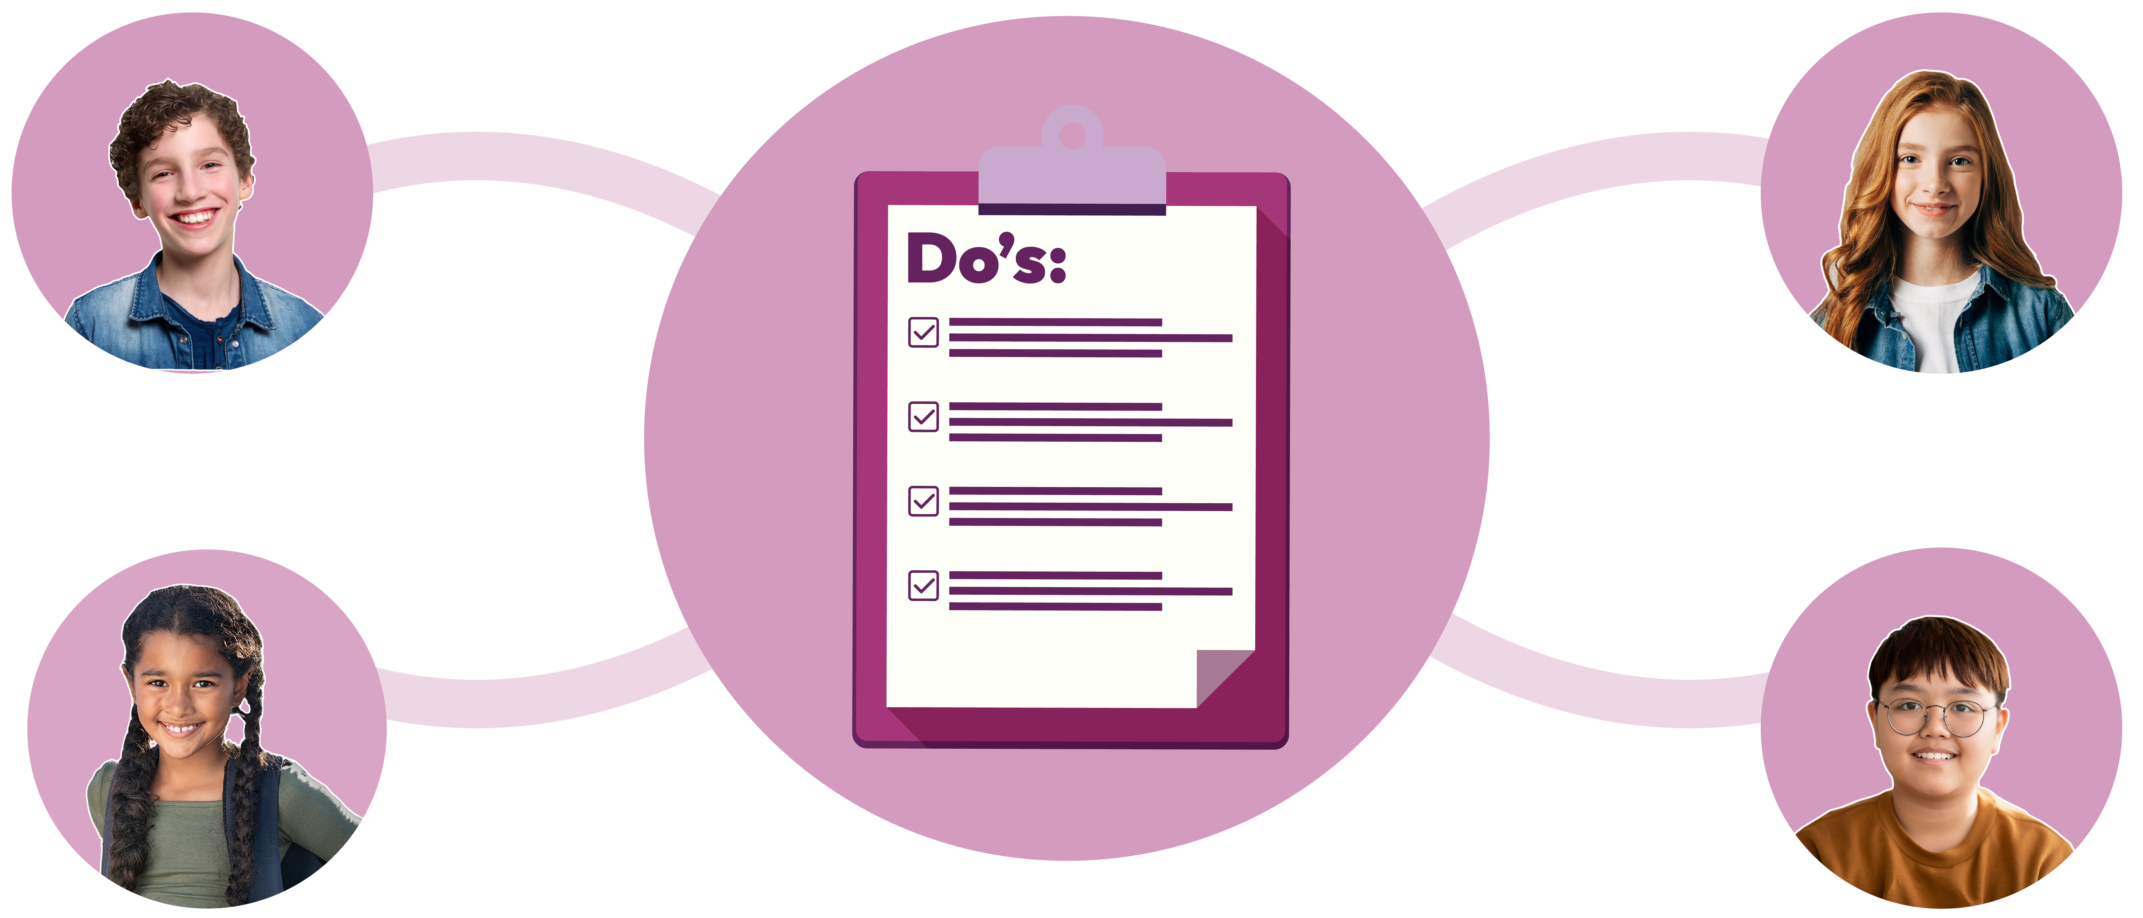
Sleep strategies
How might the characters benefit from following the ‘Dos’?
Notes:
Teacher notes – Sleep scenarios (10 mins, slides 14-15)
Finally, ask the class how the characters might benefit from following the ‘Dos’ and take feedback.
Students might suggest: improvements in their short and long-term memory, finding it easier to focus and pay attention, feeling in a better mood or more upbeat, improvements in athletic performance, improvements in their relationships at home and at school.

Slide 16

What has been learnt?
Pick one of the characters from the sleep scenarios and write them a short piece of advice, explaining:
the benefits of high-quality sleep
factors that can reduce sleep quality and the consequences of this
what they should do to support healthier sleep in future
Notes:
Teacher notes – Endpoint assessment (10 mins, slide 16)
Reminding students of the learning outcomes for the lesson, ask them to pick one of the characters from the sleep scenarios and write them a short piece of advice, explaining:
the benefits of high-quality sleep
factors that can reduce sleep quality and the consequences of this
what they should do to support healthier sleep in future.
Review these after the lesson to assess their progress and identify any misconceptions or gaps that still need addressing in future lessons.

Slide 17


Sources of support
For more advice or support related to healthier sleep:
speak to a trusted adult at home, such as a parent or carer.
speak to a tutor, head of year,
or other trusted staff member in the school.
I need your help with something . . .
Something's worrying me,
can I talk to you?
I have something that’s been bothering me . . .
Notes:
Teacher notes – Signposting support (3 mins, slides 17-18)
If any questions from the question box have not yet been answered, and if time allows, you may wish to address these now. Remind students that it is common for sleep patterns to change during adolescence, but ensure they know where they can seek help and advice, both now and in the future, if they are worried or concerned about their sleep. Students seeking further guidance can:
speak to a parent, carer, or other trusted adult outside of school
speak to a tutor, head of year or other trusted staff member in school

Slide 18
Sources of support
The Evelina London Children’s Hospital website: www.evelinalondon.nhs.uk/our-services/hospital/sleep-medicine-department/how-to-sleep-well-for-teenagers.aspx
NHS: www.nhs.uk/every-mind-matters/mental-health-issues/sleep
Young Minds: www.youngminds.org.uk
Childline www.childline.org.uk; 0800 1111
I need your help with something . . .
Something's worrying me,
can I talk to you?
I have something that’s been bothering me . . .
Notes:
Teacher notes – Signposting support (3 mins, slides 17-18)
Find out more information at:
The Evelina London Children’s Hospital website: www.evelinalondon.nhs.uk/our-services/hospital/sleep-medicine-department/how-to-sleep-well-for-teenagers.aspx
NHS advice: www.nhs.uk/every-mind-matters/mental-health-issues/sleep
Young Minds: www.youngminds.org.uk
Childline: www.childline.org.uk; 0800 1111

Slide 19

More activities
Healthier sleep campaign
Create an advertising campaign to promote healthier sleep. This could include:
A poster or flyer to raise awareness
A tagline or slogan
A logo
An information leaflet
Notes:
Teacher notes – Extension activities (slide 19–20)
Healthier sleep campaign
Ask students to create an advertising campaign to promote healthier sleep. This could include some or all of the following elements:
a tagline or slogan
a logo
a poster or flyer to raise awareness
an information leaflet

Slide 20


More activities
Healthier sleep action
Reflect on one thing you think you could change about your evening routine to promote higher quality sleep.
Notes:
Teacher notes – Extension activities (slide 19–20)
Healthier sleep in action
Ask students to reflect on one thing they think they could change about their evening routine to promote better sleep — examples might include: turning off their phone, meditating, reading a book (not a screen) before bed, eating or exercising earlier, avoiding caffeinated drinks. Challenge them to try to stick to this change for one week. You could also encourage them to write a short reflection about any changes they have noticed to their sleep (or other benefits) by the end of the week.

