Slide 1

The sleep factor
The importance of sleep
KS4

Slide 2
Using this PowerPoint
The slides in this presentation are divided into two sections:
Teacher slides (purple) – provide key information regarding lesson preparation.
Student slides – provide a visual focus point for students during the lesson and delivery notes for teachers about the activities. Click ‘notes’ to view these.
Ensure that you select ‘Use Presenter View’ under the ‘Slide Show’ tab – this will allow you to preview the teaching notes on your monitor while the main presentation is displayed on a screen/smartboard.

Slide 3


Support and challenge
The lesson includes suggestions for challenge and support activities, to help you differentiate appropriately for your class.
Support activities are adapted to be more accessible for those who need it.
Challenge activities deepen and extend learning for those who need more challenge or who finish the activity quickly.
Look for these icons on the pupil slides. See delivery notes for details of the activities.
Challenge
Support

Slide 4
Context
This lesson for key stage 4 helps young people to understand the importance of sleep and the impact of lifestyle choices on sleep quality.
No lesson should be taught in isolation, but always as part of a planned, developmental PSHE education programme. This lesson would work well within broader learning on healthy, balanced lifestyles and builds on the key stage 1, 2 and 3 lessons in the pack.

Slide 5
To learn about the importance of sleep and strategies to maintain healthier sleep habits.
Students will be able to:
explain the importance of sleep for wellbeing and brain function
assess how lifestyle choices can affect sleep quality
analyse how a range of strategies can support healthier sleep patterns

Slide 6
Box or envelope for questions
Resource 1: Helpful and less helpful sleep behaviours [one per student]
Resource 2: Consequences of poor sleep habits [one cut-up set per group]

Slide 7
Lesson summary
Activity | Description | Timing
Introduction | Introduce learning objective and outcomes, set up the question box and revisit ground rules. | 2 mins
Baseline assessment | Students demonstrate their understanding of sleep behaviours by responding to a scenario. | 10 mins
How much sleep? | The class consider barriers and challenges related to high quality sleep. | 5 mins
Consequences of poor sleep habits | Groups suggest how characters in different situations might be impacted by a lack of sleep. | 15 mins
Managing sleep difficulties | Students collate ideas about what supports quality sleep and suggest what different characters might do. | 20 mins
Endpoint assessment | Students revisit the baseline scenario and write advice to the character. | 5 mins
Signpost support | Respond to student questions and signpost sources of support. | 3 mins

Slide 8
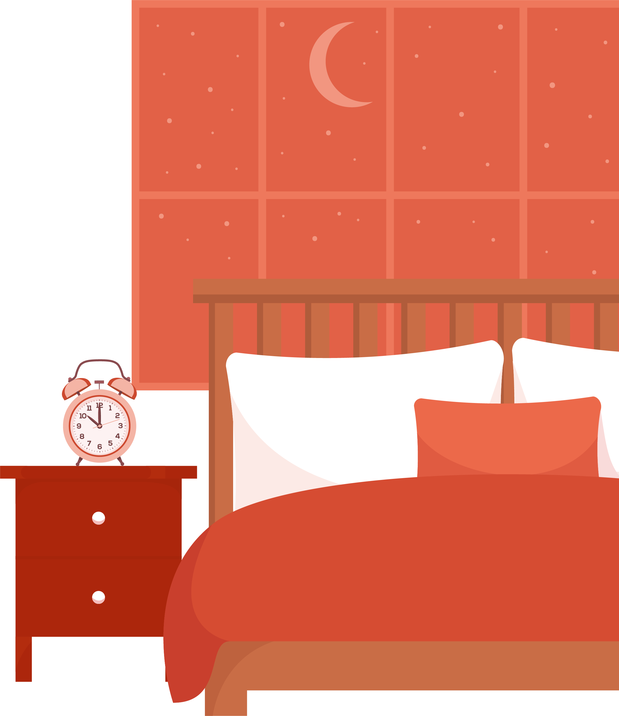
The importance of sleep
KS4

Slide 9
Notes:
Teacher notes – Introduction (2 mins, slides 9-10)
Establish ground rules and make students aware of the question box, which will be available throughout the lesson. Explain that if they have worries or questions during or after the lesson that they do not want to raise in front of the class, they can write their question on a piece of paper, anonymously or with their name, and put it in the question box.

Slide 10
We will learn about the importance of sleep and strategies to maintain good sleep habits.
We will be able to:
explain the importance of sleep for wellbeing and brain function — particularly during adolescence
explain how lifestyle choices can affect sleep quality
describe a range of strategies for ensuring appropriate sleep patterns and suggest advice for those struggling to sleep.
Notes:
Teacher notes – Introduction (2 mins, slides 9-10)
Introduce the learning objective and outcomes.
Explain that this lesson will explore the importance of - and habits to help achieve – healthier sleep, particularly during adolescence.

Slide 11

Abe’s sleep pattern
Highlight in one colour, anything that Abe is doing to promote a healthier sleep pattern.
Highlight in a different colour, anything Abe is doing that might detract from a healthier sleep pattern.
How might a lack of sleep affect Abe’s wellbeing?
What strategies could Abe use to help manage the less helpful behaviours identified?
Notes:
Teacher notes – Baseline assessment activity (5 mins, slide 11)
Hand out Resource 1: Helpful and less helpful sleep behaviours. Ask pupils to read through Abe’s scenario and highlight behaviours which both help and detract from a healthier sleep pattern, in two different colours. Then, ask them to answer the questions on the resource:
How might a lack of sleep affect Abe’s wellbeing?
What strategies could Abe use to help manage the less helpful behaviours identified?
Discuss responses as a class and establish students’ current knowledge and understanding. They should not add anything to their own responses during the discussion. Consider how any gaps or misconceptions will be addressed in the lesson, for example, if students are unsure about the impacts of poor-quality sleep on Abe, you may wish to spend more time exploring the consequences of poor sleep habits.
Ask students to put Resource 1 to one side, as they will revisit this at the end of the lesson.

Slide 12
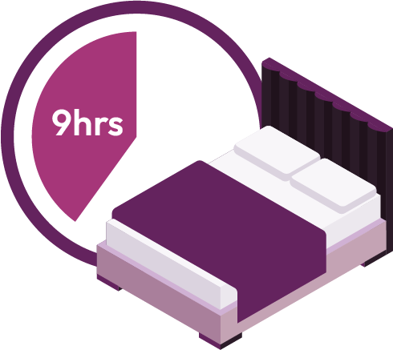
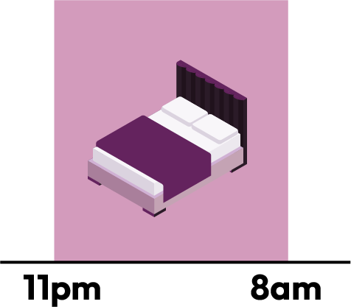
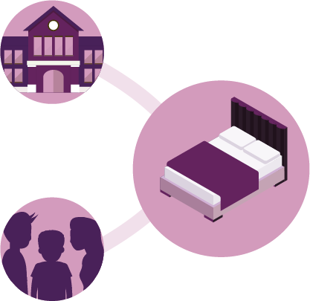


How much sleep?
What are the biggest barriers to young people getting enough sleep?
What might someone’s sleep environment (e.g. their bedroom) be negatively impacted by?
Teenagers need approximately 9 hours
sleep per night.
At around age 14, there is a natural shift to a later sleep pattern (around 11pm to sleep and 7-8am to rise).
This natural cycle can easily be impacted by social and academic commitments which disrupt the natural sleep pattern.
Notes:
Teacher notes – How much sleep? (5 mins, slide 12)
Share the information on the slide about how much sleep teenagers need each night and, in groups, ask students to discuss the following questions:
What do you think are the biggest barriers to young people getting enough sleep?
What might someone’s sleep environment (e.g. their bedroom) be negatively impacted by?
Take feedback. Students may suggest:
Barriers might include: going to bed late due to attending clubs, completing homework, having a part-time job; staying up late gaming, talking to friends, using social media, watching videos or shows online.
Someone’s sleep environment might be negatively impacted by: a TV, games consoles, phones and other technology being present. Someone might also share a bedroom, or live somewhere where noise from outside travels in.

Slide 13
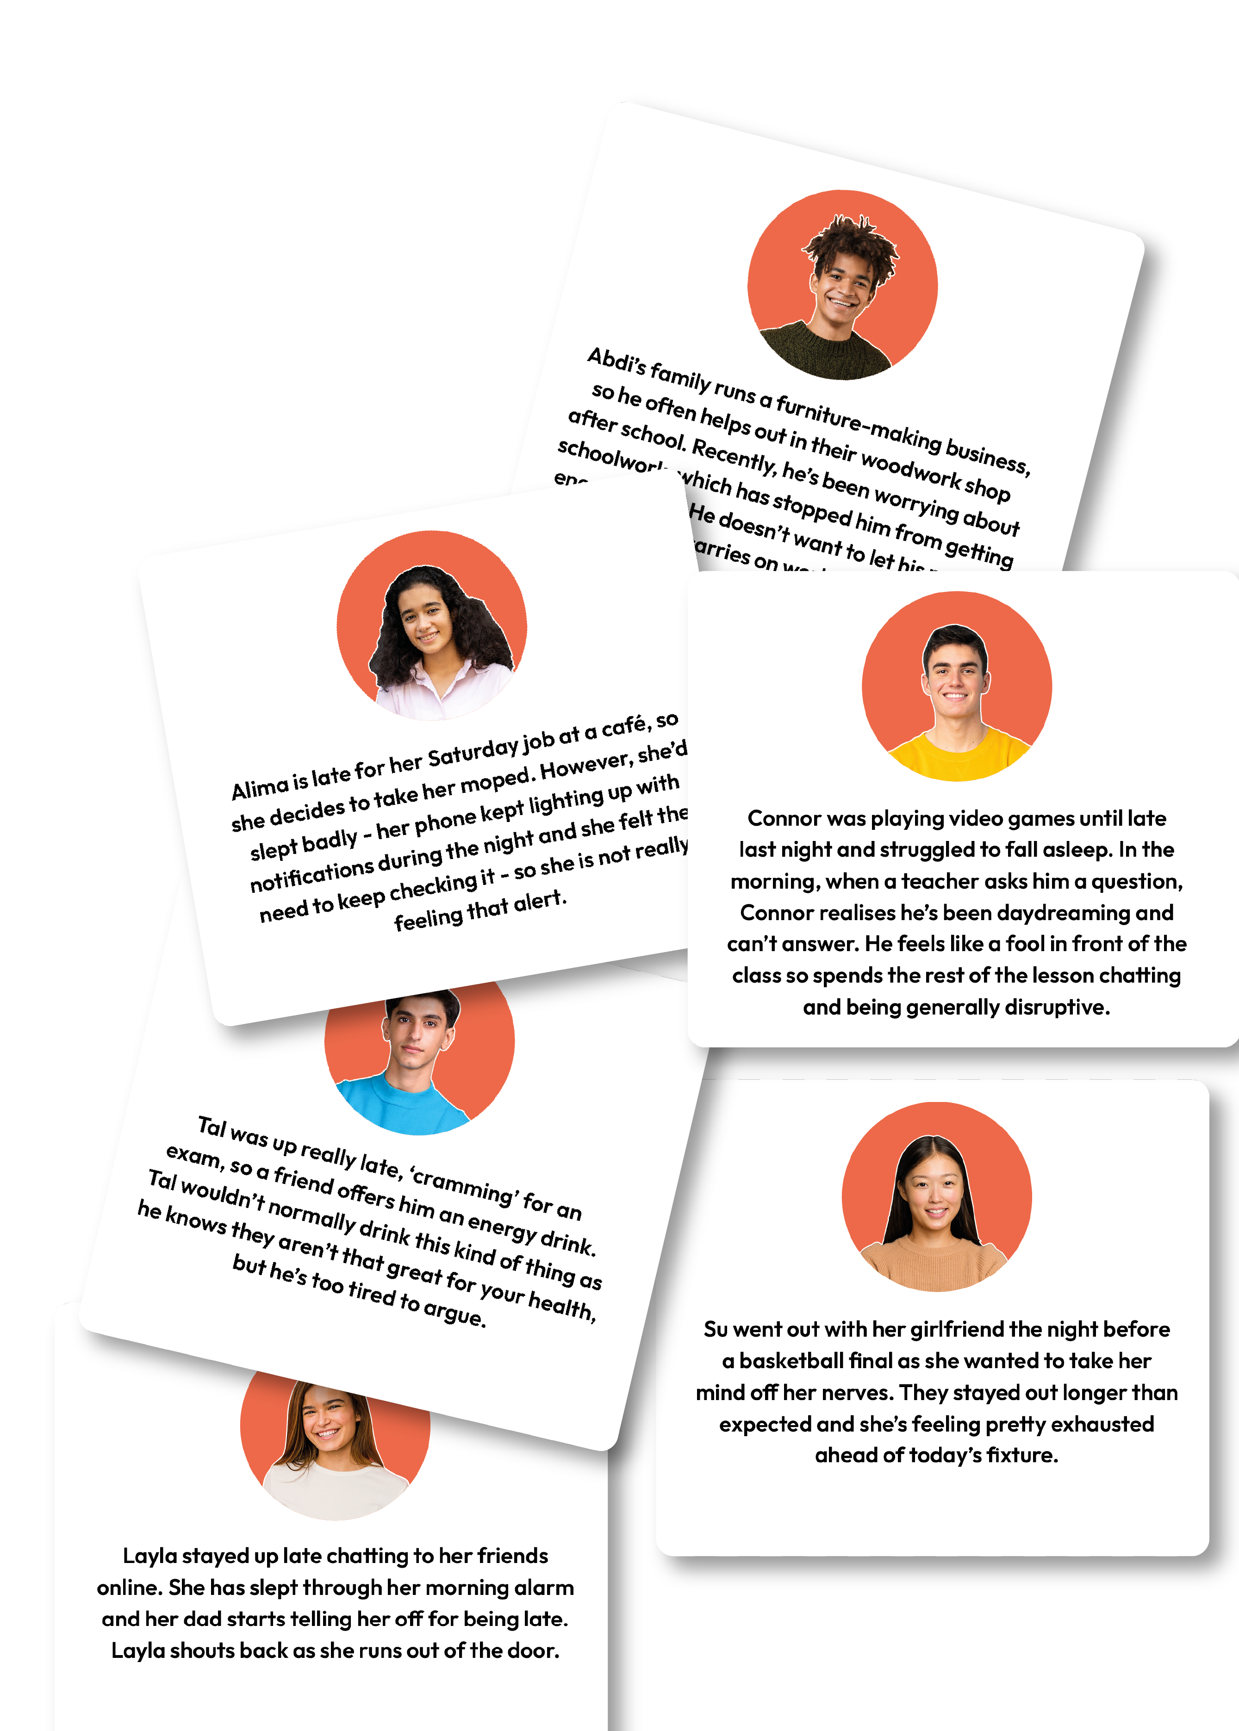
Consequences of poor sleep habits
In your groups, discuss:
Why do you think your character isn’t getting high quality sleep?
What might the consequences of poor sleep be on your character’s wellbeing and brain function?
Notes:
Teacher notes – Consequences of poor sleep habits (15 mins, slides 13-18)
In groups, give students one scenario from Resource 2: Consequences of poor sleep habits. Ask them to discuss why they think their character isn’t getting high-quality sleep and what the potential consequences of their character’s poor sleep habit(s) might be on their wellbeing and brain function.
Take feedback from each group, ensuring all scenarios are discussed, before sharing the supporting information on slides 14-18.
Support: Ask students to focus on Layla or Alima, as these scenarios are more accessible to all students.
Challenge: Ask students to discuss what examples of sleep ‘safety’ in society they are aware of, for example, signs on the road or rules in workplaces.
Students may suggest: road signs reminding drivers to take a break, rules about how long lorry or coach drivers can drive without a break, how long a working shift can be and how much time someone must have off between work shifts.

Slide 14

Consequences of poor sleep habits
The pre-frontal cortex:
The pre-frontal cortex in the brain (the part responsible for decision-making) normally allows us a chance to think about our reactions before we do something.
But if we are tired, this ‘brake’ on our emotional reactions no-longer functions, so we can end up lashing out or acting without thinking.
Lack of sleep has been shown to affect concentration, memory, information processing and reasoning.
Notes:
Teacher notes – Consequences of poor sleep habits (15 mins, slides 13-18)
The pre-frontal cortex normally allows us a chance to think about our reactions before we do something. But if we are tired, this ‘brake’ on our emotional reactions no-longer functions so we can end up lashing out or acting without thinking. Lack of sleep has been shown to affect concentration, memory, information processing and reasoning.

Slide 15



Consequences of poor sleep habits
Operating machinery:
Working with machines and power-tools whilst tired is very risky
A recent study found that being awake for 17 to 19 hours can impair ability more than being over the drink-driving limit.
Researchers found that reaction times in a series of tests were up to 50% slower in people deprived of sleep, compared with the same people being given increasing doses of alcohol.
Notes:
Teacher notes – Consequences of poor sleep habits (15 mins, slides 13-18)
Working with machines and power-tools whilst tired is very risky – a recent study found that being awake for 17 to 19 hours can impair ability more than being over the drink-driving limit. Researchers found that reaction times in a series of tests were up to 50% slower in people deprived of sleep compared with the same people being given increasing doses of alcohol. This doesn’t mean it’s okay to drink then operate machinery, simply that lack of sleep can be dangerous when using tools and machinery!

Slide 16

Consequences of poor sleep habits
Performance in sports:
Attainment in sports is very much affected by lack of sleep.
Reaction time, stamina, and the capacity for strategic thinking are affected, so players don’t look as ‘on the ball’ — they are more likely to miss shots or passes and positioning may be poor.
Research also shows that poor sleep means an increased risk of sports-related injuries.
Notes:
Teacher notes – Consequences of poor sleep habits (15 mins, slides 13-18)
Attainment in sports is very much affected by lack of sleep. Reaction time, stamina, and the capacity for strategic thinking are affected, so players don’t look as ‘on the ball’ — they are more likely to miss shots or passes and positioning may be poor. Research also shows that poor sleep means an increased risk of sports-related injuries.

Slide 17

Consequences of poor sleep habits
Energy drinks:
Energy drinks can give a temporary feeling of alertness, but this is lost quite quickly and the person drinking them is likely to find themselves less able to concentrate than if they hadn’t had one at all.
Caffeine boosts can also affect a person’s ability to sleep well by disrupting the circadian rhythm (sleep cycle).
Sleep during exam season is incredibly important - research has shown that better outcomes are often linked to more sleep, not less.
Notes:
Teacher notes – Consequences of poor sleep habits (15 mins, slides 13-18)
Energy drinks can give a temporary feeling of alertness, but this is lost quite quickly and the person drinking them is likely to find themselves less able to concentrate than if they hadn’t had one at all. Caffeine boosts like this can also affect a person’s ability to sleep well by disrupting the circadian rhythm (sleep cycle). Sleep during exam season is incredibly important - research has shown that better outcomes are often linked to more sleep, not less.

Slide 18

Consequences of poor sleep habits
Reaction time:
A lack of sleep slows reaction time, affects the ability to process information and impairs memory.
In one study, driving while sleepy was found to have the potential to double someone’s risk of a car accident.
Notes:
Teacher notes – Consequences of poor sleep habits (15 mins, slides 13-18)
A lack of sleep slows reaction time, affects the ability to process information and impairs memory. In one study, driving while sleepy was found to have the potential to double someone’s risk of a car accident.
Emphasise that poor-quality sleep, or a lack of sleep, can have a real impact on someone’s brain function and that this is turn can affect someone’s wellbeing; this is particularly true during adolescence. It is therefore important to identify issues with sleep and find ways to support healthier sleep habits.

Slide 19
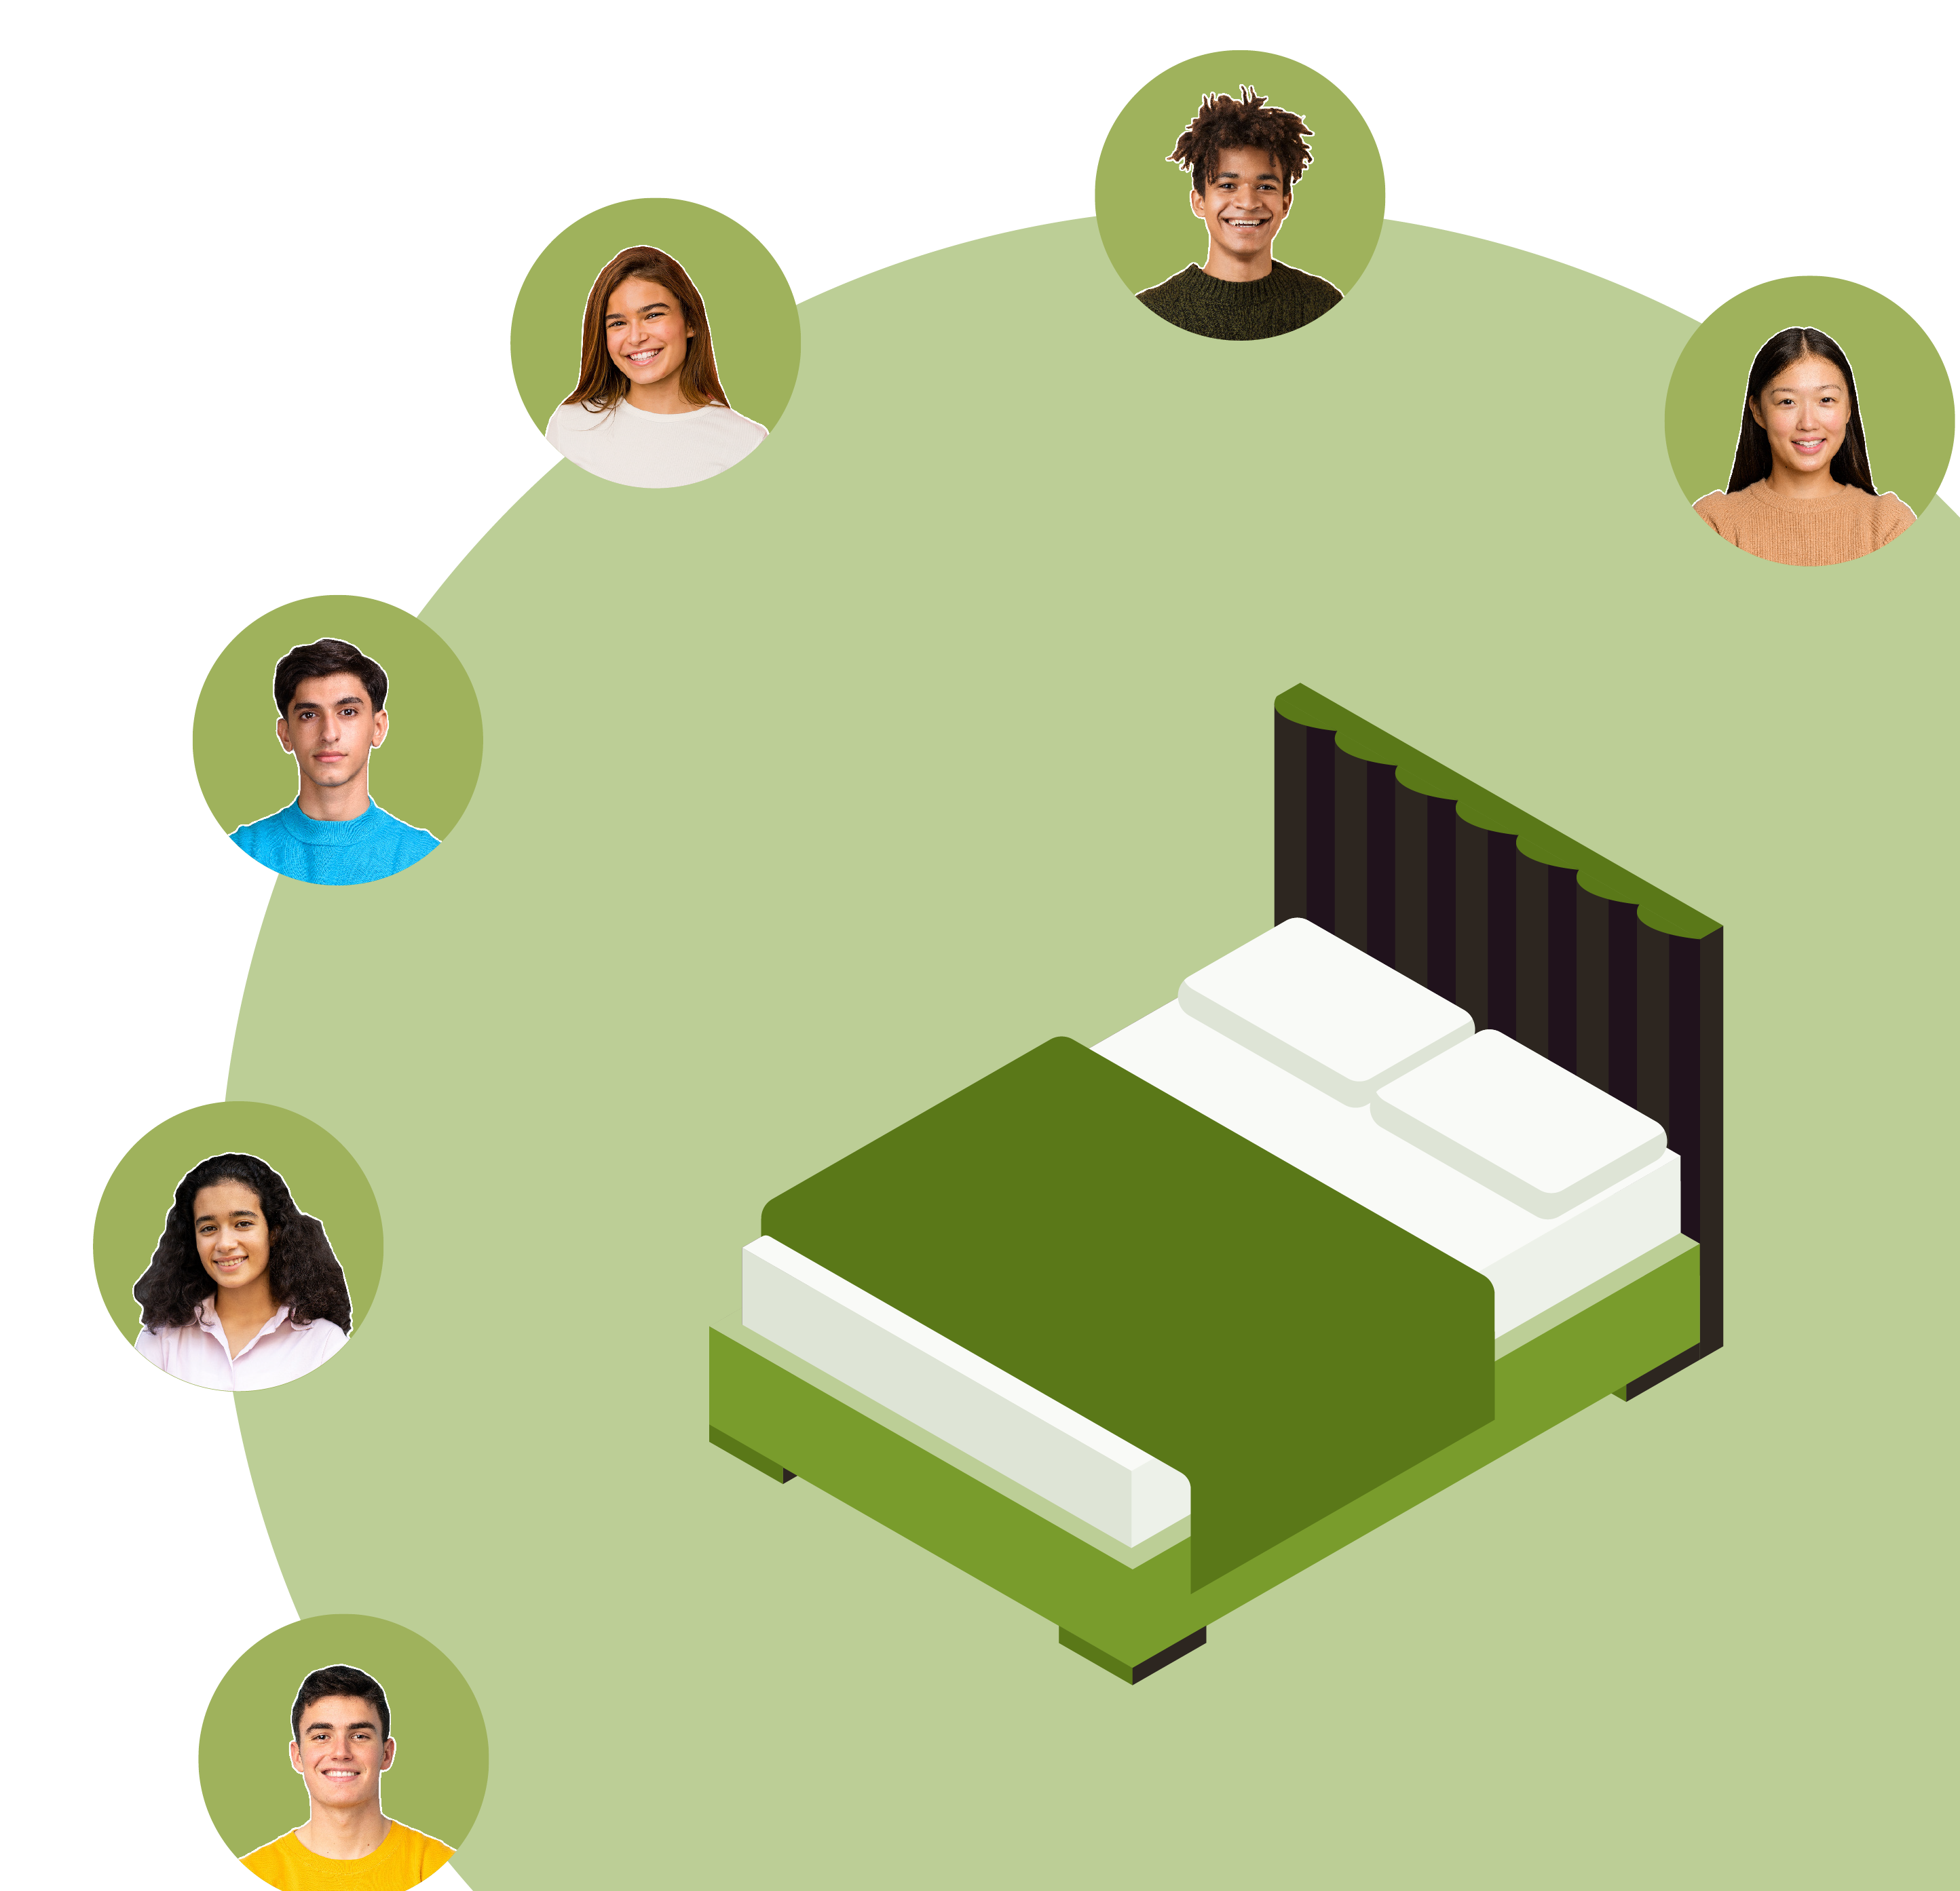
Managing sleep difficulties
In your groups, brainstorm ideas about:
how the characters might ensure that they get high-quality sleep
how they might manage any difficulties they are having with sleeping.
Notes:
Teacher notes – Managing sleep difficulties (20 mins, slides 19-23)
In the same groups, ask students to brainstorm ideas about how the characters might ensure that they get high-quality sleep, or how they might manage any difficulties they are having with sleeping. Take feedback and create a whole class mind map (some suggestions are on the next slide).
Support: Prompt students with questions such as: What activities should be avoided before sleep (for example, eating a large meal)? What routines might make someone feel calm, relaxed and ready for sleep?
Challenge: Ask students to rank the behaviours from most to least likely to encourage sleep. This is likely to be based on students’ personal opinions and experiences, so answers will vary.

Slide 20










Managing sleep difficulties
Try to stick to a sleep routine, during the week and on weekends
Avoid pressing the ‘snooze’ button
Avoid taking naps late in the day, or that last a long time
Eat a small snack before bed, if hungry, but avoid eating a large meal
Eat breakfast in the morning and avoid energy drinks
Avoid watching TV and using screens which produce blue light waves
Notes:
Teacher notes – Managing sleep difficulties (20 mins, slides 19-23)
Draw out the key learning if students don’t suggest these points:
Try to stick to a sleep routine, during the week and on weekends, to ensure consistent sleep patterns. Getting ‘an early night’ can be counterproductive if it is a change of sleep pattern, as the level of sleep hormone is unlikely to be high enough to encourage sleep — this means a person is more likely to struggle to sleep and may therefore be unable to sleep, even at their normal bedtime. Similarly, pressing the ‘snooze’ button can again mean disrupting the normal sleep pattern, so it’s best to avoid this if possible. Experts suggest that people find it easier to wake naturally in 90-minute cycles — so an alarm should be set to wake someone up after 9 hours, or 7.5 hours’ sleep if having a one-off late night.
Avoid taking naps late in the day, or that last a long time. Naps should only be used if absolutely necessary. It is much better to try to improve the quality and length of night-time sleep.
Eat a small snack before bed, if hungry, as this can help with falling asleep and improve sleep quality but avoid eating a large meal as this can make it more difficult to sleep.
Eat breakfast in the morning - not eating breakfast increases the likelihood of sugar cravings and energy dips which are already potential problems due to lack of sleep — this is why someone might consume junk food and energy drinks when they are feeling tired. Such food/drinks can then disrupt the sleep cycle further, so are best avoided.
Avoid watching TV and using screens which produce blue light waves that disrupt the release of sleep hormones. Someone might also install a blue light filter on their devices.
[Continued on next slide]

Slide 21






Managing sleep difficulties
Practise meditation, visualisation and mindfulness techniques
Have a set ‘wind down’ routine before bed
Read or have a cup of herbal tea and avoid stimulating activities 60–90 minutes before bed.
Keep a sleep diary
Avoid oversleeping at weekends
Practise relaxation/deep breathing or other techniques if struggling to fall or stay asleep
Notes:
Teacher notes – Managing sleep difficulties (20 mins, slides 19-23)
Practise meditation, visualisation and mindfulness techniques before bed, to help relax.
Have a set ‘wind down’ routine before bed, for example, prepare for the next day (pack school bag, make lunch), read or have a cup of herbal tea, and avoid stimulating activities 60-90 minutes before bed.
Keep a sleep diary to find out what helps with high quality sleep and what prevents sleep and adjust sleep routines accordingly.
Avoid oversleeping at weekends. It’s suggested that for every hour lost/gained when travelling across time zones, it takes the body one day to catch up - oversleeping at the weekend can have a similar effect. Having a lie in for three hours can take the body three days to catch up to this sleep pattern change (social jet lag).
Practise muscle relaxation or deep breathing techniques if struggling to fall or stay asleep. If someone wakes up in the night and cannot get back to sleep, it is also recommended that they get up and go to a different room, read or listen to music, and then try going to sleep again about 20 minutes later.

Slide 22






Managing sleep difficulties
Which strategy might be most helpful for your character?
What might your character do next?
Notes:
Teacher notes – Managing sleep difficulties (20 mins, slides 19-23)
Finally, ask students to assess which strategy might be most helpful for their character and discuss what action their character might take next.

Slide 23






Managing sleep difficulties
Layla
It would help for Layla and her dad to talk about a better morning routine to avoid similar occurrences.
Abdi
It is important that Abdi discusses this with his parents, so that he and his family are not put at risk when using the tools and machinery without enough sleep.
Su
Su might do something different to relax before
her next game but could take a short nap the morning of the game.
Tal
Tal should avoid drinking energy drinks in future and focus on sticking to a revision timetable.
Alima
It’s really important that Alima does not drive if she does not feel alert enough to do so, as this could be very dangerous for Alima and other road users.
Connor
Connor should take steps
to stop this happening again, catch up on the work missed and take responsibility for his behavior.
Notes:
Teacher notes – Managing sleep difficulties (20 mins, slides 19-23)
Take feedback from each group.
Students might suggest a range of strategies from the class list; there are no right or wrong answers. But it’s important that someone finds strategies that work for them; they might have to try a few before they find the best one.
Actions the characters might take next include:
Layla and her dad might find it helpful to talk about a better morning routine together
Abdi should discuss how tired he’s been feeling with his parents, so that he and his family are not subject to unnecessary risk when using the tools and machinery in the woodwork shop
Su might consider doing something different to relax before her next game, but could take a short nap the morning of the final, as long as this is no more than 30 minutes long
Tal should avoid drinking energy drinks in future and focus on sticking to a revision timetable, so that he feels less need to ‘cram’ before his exams
Alima should not drive if she does not feel alert enough to do so
Connor should take responsibility for his behaviour, rather than distracting others to mask his embarrassment
Highlight that if any of the characters want to change their sleep habits, it takes approximately 4 weeks to establish a new sleep routine. If a person is struggling to adapt their sleep pattern, they can try shifting their alarm by 10 minutes each week.

Slide 24
What have we learnt?
Think back to Abe from the start of the lesson.
Revisit your sheet, annotate your initial thoughts making any changes and adding in new learning in a different colour.
Write at least three pieces of useful advice for Abe to help him sleep better in future.
Notes:
Teacher notes – Endpoint assessment (10 mins, slide 24)
Remind students of the learning outcomes and ask them to revisit the baseline scenario involving Abe. Ask students to annotate their original work to show any changes in opinion or to add in any new learning in a different colour, to demonstrate their new learning on the importance of sleep for wellbeing and brain function, how lifestyle choices can affect sleep quality and the strategies that can support healthier sleep patterns. All students should then write at least three pieces of advice to help Abe sleep better.
This assessment activity will help provide information about students’ progress and highlight any gaps that may need addressing in future lessons.

Slide 25


Sources of support
For more advice or support related to healthier sleep:
speak to a trusted adult at home, such as a parent or carer.
speak to a tutor, head of year,
or other trusted staff member in the school.
I need your help with something . . .
Something's worrying me,
can I talk to you?
I have something that’s been bothering me . . .
Notes:
Teacher notes – Signposting support (3 mins, slides 25-26)
If any questions from the question box have not yet been answered, and if time allows, you may wish to address these now. Ensure that students know where they can seek help and advice, both now and in the future, if they are worried or concerned about their sleep. Students seeking further guidance can:
speak to a parent, carer, or other trusted adult outside of school
speak to a tutor, head of year or other trusted staff member in school

Slide 26
Sources of support
The Evelina London Children’s Hospital website: www.evelinalondon.nhs.uk/our-services/hospital/sleep-medicine-department/how-to-sleep-well-for-teenagers.aspx
NHS: www.nhs.uk/every-mind-matters/mental-health-issues/sleep
The Teen Sleep Hub: www.teensleephub.org.uk
Young Minds: www.youngminds.org.uk
Childline: www.childline.org.uk; 0800 1111
I need your help with something . . .
Something's worrying me,
can I talk to you?
I have something that’s been bothering me . . .
Notes:
Teacher notes – Signposting support (3 mins, slides 25-26)
Find out more information at:
The Evelina London Children’s Hospital website: www.evelinalondon.nhs.uk/our-services/hospital/sleep-medicine-department/how-to-sleep-well-for-teenagers.aspx
NHS advice: www.nhs.uk/every-mind-matters/mental-health-issues/sleep
The Teen Sleep Hub: www.teensleephub.org.uk
Young Minds: www.youngminds.org.uk
Childline: www.childline.org.uk; 0800 1111

Slide 27


More activities
Sleep survey
Plan and carry out a survey of family and close friends about their sleep patterns.
You could collect information about:
Bedtimes
Hours of sleep
Bedtime routines
Ways to overcome sleep difficulties
Notes:
Teacher notes – Extension activities (slide 27)
Sleep research
Plan and conduct a survey of close friends and family about their sleep patterns. This could include questions about how much they sleep, when they sleep, how they prepare for sleep, techniques they use if struggling to sleep etc.
Ensure any follow up discussions from this activity are suitably distanced to ensure young people do not share personal or sensitive details.

