Slide 1

The sleep factor
Managing sleep independently
KS5

Slide 2
Using this PowerPoint
The slides in this presentation are divided into two sections:
Teacher slides (purple) – provide key information regarding lesson preparation.
Student slides – provide a visual focus point for students during the lesson and delivery notes for teachers about the activities. Click ‘notes’ to view these.
Ensure that you select ‘Use Presenter View’ under the ‘Slide Show’ tab – this will allow you to preview the teaching notes on your monitor while the main presentation is displayed on a screen/smartboard.

Slide 3


Support and challenge
The lesson includes suggestions for challenge and support activities, to help you differentiate appropriately for your class.
Support activities are adapted to be more accessible for those who need it.
Challenge activities deepen and extend learning for those who need more challenge or who finish the activity quickly.
Look for these icons on the pupil slides. See delivery notes for details of the activities.
Challenge
Support

Slide 4
Context
This lesson for key stage 5 students is designed to promote healthy sleep habits following on from the key stage 1–4 Sleep Factor lessons. This lesson focuses on managing sleep as young people prepare to live more independent lives, considering the impact of sleep in both professional and personal contexts.
No lesson should be taught in isolation, but always as part of a planned, developmental PSHE education programme. This lesson is best used within the context of a unit of work on healthy, balanced lifestyles, or during sessions on transition.

Slide 5
To learn about managing sleep routines independently, and the impact of sleep on professional and personal wellbeing.
Students will be able to:
explain the challenges of independently managing sleep routines while transitioning into work or higher education
analyse the impact of sleep on productivity and wellbeing in both personal and professional contexts
develop individual and societal strategies that promote positive sleep habits

Slide 6
Box or envelope for questions
Resource 1: Sleep habits for work
(one per small group)
Resource 1a: Sleep habits for work
(teacher support)
Resource 2: Case studies
(one of the two case studies per student)
Resource 2a: Sleep challenges
(support option, as required)
Resource 2b: Case studies
(teacher support)

Slide 7
Lesson summary
Activity | Description | Timing
Introduction | Introduce learning objective and outcomes, set up the question box and establish ground rules. | 5 mins
Baseline assessment | Students respond to a quote, demonstrating their understanding of the impact of sleep in both personal and professional contexts. | 5 mins
The bigger picture | In groups, students complete a matching activity about the impact of sleep on the economy and workplace productivity. | 5 mins
Sleep habits | Students develop strategies to promote healthy sleep habits that can be applied in the workplace. | 10 mins
Case studies | Students identify characters’ sleep related challenges, discuss consequences, and offer advice. | 15 mins
Hot seating | In pairs, students explore the benefits of changing sleep habits and potential barriers to change. | 10 mins
Reflection and endpoint assessment | Students revisit the baseline activity and reflect on their own sleep habits. | 5 mins
Signpost support | Respond to student questions and signpost sources of support. | 5 mins

Slide 8

Managing sleep independently
KS5 lesson

Slide 9
Notes:
Teacher notes – Introduction (5 mins, slides 9-10)
Establish ground rules with the class and make students aware of the question box, which will be available throughout the lesson. Explain that if they have worries or questions during or after the lesson, that they do not want to raise in front of the class, they can write their question on a piece of paper, anonymously or with their name, and put it in the question box.

Slide 10
To learn about managing sleep routines independently, and the impact of sleep on professional and personal wellbeing.
Students will be able to:
explain the challenges of independently managing sleep routines while transitioning into work or higher education
analyse the impact of sleep on productivity and wellbeing in both personal and professional contexts
develop individual and societal strategies that promote positive sleep habits
Notes:
Teacher notes – Introduction (5 mins, slides 9-10)
Introduce the learning objective and outcomes and explain that today’s lesson will explore the impact of sleep in personal and professional contexts and how strategies can be used to manage sleep independently.

Slide 11

Initial ideas
Being in charge of one of the world’s largest companies, 6 hours sleep is all I need. Shouldn’t that be enough for everyone?
What might be problematic about this statement for the individual and their workplace?
Write down your ideas.
Notes:
Teacher notes – Baseline assessment (5 mins)
Share the quote on the slide and ask students to write down why this opinion may be problematic for both the individual or their workplace.
As this is a baseline assessment, students should work independently. Do not provide prompts or further explanation at this point, in order to get a true reflection of their starting points. Once completed, ask for feedback to establish their current knowledge, ideas and misconceptions, and consider how these will be addressed in the lesson. For example, students might say that more productive people sleep for fewer hours, in which case more time might be spent on discussing the case studies, or the hot seating task to explore challenges and strategies related to sleep habits.

Slide 12






Impacts of insufficient sleep on work life
Impacts of insufficient sleep may include:
Delayed
cognitive
ability
Reduced
energy and
motivation
Increased
chance of
engaging in
risk-taking behaviour
Increased
irritability
Increased risk
of workplace and driving accidents
Increased
chance of
being unwell due
to impaired immunity
Notes:
Teacher notes – The bigger picture (5 mins, slides 12-19)
Using slides 12-13 introduce students to the possible impacts of insufficient sleep and the data on the wider economic and societal effects of sleep deprivation.
Link to research:
Why Sleep Matters: Quantifying the Economic Costs of Insufficient Sleep | RAND
GDP definition:
www.bankofengland.co.uk/explainers/what-is-gdp

Slide 13

The bigger picture
Research has been carried out to find out the impact insufficient sleep could be having on the economy.
The research focused on:
Impact on workers’ productivity
Economic costs in terms of lost GDP
Gross domestic product (GDP)
A measure of the size and health of a country’s economy over a period of time (usually one quarter or one year).
Notes:
Teacher notes – The bigger picture (5 mins, slides 12-19)
Link to research:
Why Sleep Matters: Quantifying the Economic Costs of Insufficient Sleep | RAND
GDP definition:
www.bankofengland.co.uk/explainers/what-is-gdp

Slide 14












The bigger picture
Match the billions lost per year due to insufficient sleep for each country
Canada
Germany
Japan
United Kingdom
United States
$411bn
$138bn
$60bn
$50bn
$21.4bn
Notes:
Teacher notes – The bigger picture (5 mins, slides 12–19)
As a class, ask students to match each economic cost of sleep deprivation to the correct country on the map.

Slide 15
The bigger picture
Match the billions lost per year due to insufficient sleep for each country
Canada
Germany
Japan
United Kingdom
United States
$21.4bn
(1.35% of GDP)
$50bn
(1.86% of GDP)
$60bn
(1.56% of GDP)
$138bn
(2.92% of GDP)
$411bn
(2.28% of GDP)
© PSHE Association 2024
Notes:
Teacher notes – The bigger picture (5 mins, slides 12–19)
As a class, ask students to match each economic cost of sleep deprivation to the correct country on the map.

Slide 16



The bigger picture
Sleep deprivation is linked to lower productivity at work, which results in a significant amount of working days being lost each year.
Higher
Higher or Lower?
In the United Kingdom
200,000 working days are lost each year
In Japan
600,000 working days are lost each year
Notes:
Teacher notes – The bigger picture (5 mins, slides 12–19)
Next, show students the number of work hours lost due to insufficient sleep in the UK. As a class, ask students to vote whether the value for the next country is high or lower before the next value is displayed, and repeat the activity until all five countries have been revealed.
Challenge: Ask students to discuss what other national and global figures could be reduced by more people getting sufficient sleep.
Students may suggest: accidents in the work place, incidents on the road, mental health, consumer data (sugary drinks, sleeping pills and caffeine products).

Slide 17

The bigger picture
Sleep deprivation is linked to lower productivity at work, which results in a significant amount of working days being lost each year.
Higher
Higher or Lower?
In the USA
In Japan
1,200,000 working days are lost each year
600,000 working days are lost each year
Notes:
Teacher notes – The bigger picture (5 mins, slides 12–19)
Next, show students the number of work hours lost due to insufficient sleep in the UK. As a class, ask students to vote whether the value for the next country is high or lower before the next value is displayed, and repeat the activity until all five countries have been revealed.
Challenge: Ask students to discuss what other national and global figures could be reduced by more people getting sufficient sleep.
Students may suggest: accidents in the work place, incidents on the road, mental health, consumer data (sugary drinks, sleeping pills and caffeine products).

Slide 18

The bigger picture
Sleep deprivation is linked to lower productivity at work, which results in a significant amount of working days being lost each year.
Lower
Higher or Lower?
In the USA
In Canada
1,200,000 working days are lost each year
80,000 working days are lost each year
Notes:
Teacher notes – The bigger picture (5 mins, slides 12–19)
Next, show students the number of work hours lost due to insufficient sleep in the UK. As a class, ask students to vote whether the value for the next country is high or lower before the next value is displayed, and repeat the activity until all five countries have been revealed.
Challenge: Ask students to discuss what other national and global figures could be reduced by more people getting sufficient sleep.
Students may suggest: accidents in the work place, incidents on the road, mental health, consumer data (sugary drinks, sleeping pills and caffeine products).

Slide 19

The bigger picture
Sleep deprivation is linked to lower productivity at work, which results in a significant amount of working days being lost each year.
Higher
Higher or Lower?
In Germany
In Canada
200,000 working days are lost each year
80,000 working days are lost each year
Notes:
Teacher notes – The bigger picture (5 mins, slides 12–19)
Next, show students the number of work hours lost due to insufficient sleep in the UK. As a class, ask students to vote whether the value for the next country is high or lower before the next value is displayed, and repeat the activity until all five countries have been revealed.
Challenge: Ask students to discuss what other national and global figures could be reduced by more people getting sufficient sleep.
Students may suggest: accidents in the work place, incidents on the road, mental health, consumer data (sugary drinks, sleeping pills and caffeine products).

Slide 20
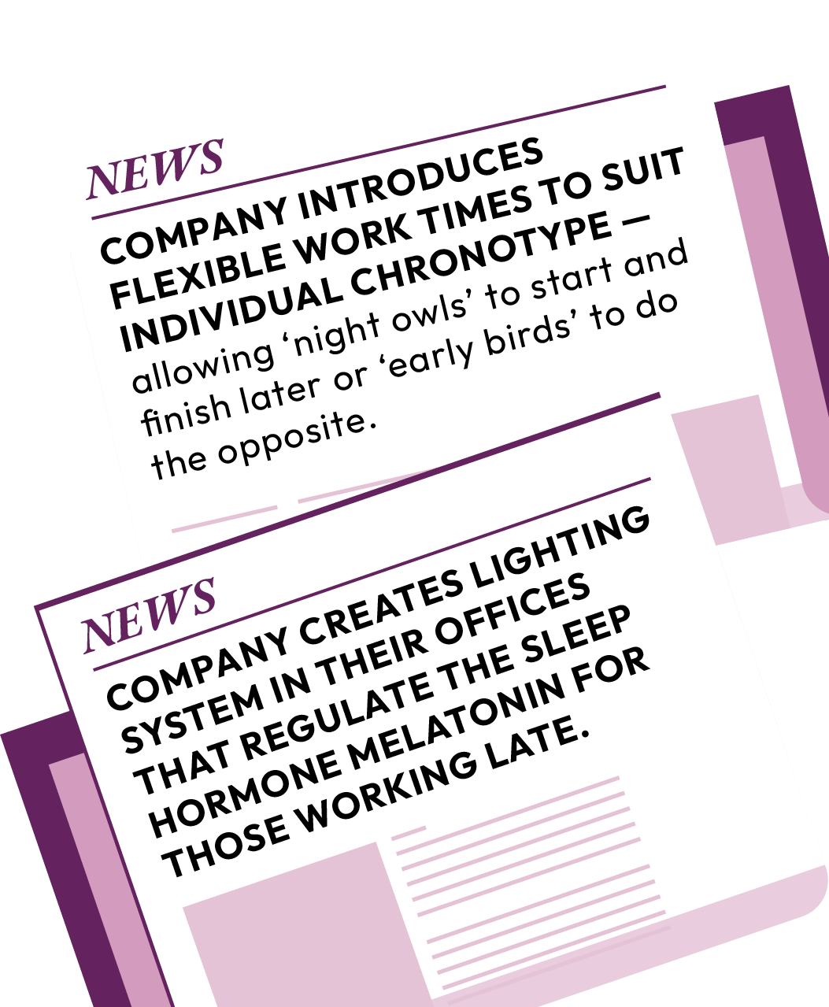
Sleep habits
How can employers and education providers help promote healthy sleep?
For each healthy sleep habit, what could be put in place to support employees or students?
Chronotype
Natural inclination of your body to sleep at a certain time, or what most people understand as being an early bird versus a night owl
Notes:
Teacher notes – Sleep habits (10 mins)
Using the slide, share the examples of changes companies have made to promote healthy sleep habits for employees. These help reduce the impact of insufficient sleep on workplace productivity and increase staff wellbeing.
Next, using Resource 1: Sleep habits for work, ask students in small groups to read through the habits that help promote good sleep, and fill in the table suggesting actions employers or education providers could take to help employees or students improve each habit.
Take feedback, using Resource 1a: Sleep habits for work - teacher answers, to help guide the discussion.
Students are likely to have a wide range of suggestions which may or may not be realistic, however, the key learning is to be aware of the habits that promote good sleep and consider how to manage these in a work or study environment.
Chronotype definition:
https://www.sleepfoundation.org/how-sleep-works/chronotypes

Slide 21


Case studies
Read through the case studies and consider:
What sleep related challenges are Samay and Hannah facing?
What advice could help them improve their sleep?
Swap and feedback
Notes:
Teacher notes – Case studies (15 mins)
Give each student one of the case studies from Resource 2: Case studies (where possible divide the two case studies evenly between the class). Ask students to read through the case study and answer the questions on the sheet. Students should consider the new sleep related challenges the character is facing, any consequences of not having enough sleep, and then offer advice to the character.
Next, pair students up with someone that completed the other case study. Ask students to feedback the sleep challenges, consequences and advice for the characters to each other.
Circulate during the activity using Resources 2b: Case studies - teacher answers to check learning and support paired discussions .
Support: Ask students to complete Resource 2a: Sleep challenges

Slide 22

Hot seating
Create questions to ask Samay or Hannah, that encourage them to think about making positive changes to their sleep habits.
Take turns in pairs to act as the interviewer and the character (either Samay or Hannah).
Consider
motivations to change sleep habits
possible barriers to making changes
drawbacks to making changes
overcoming challenges
Notes:
Teacher notes – Hot seating (10 mins)
Put students in pairs, with each student in the pair having worked on a different case study in the previous task. Share the prompts on the slide to help the students create interview questions in their pairs; the questions must encourage the character to consider the barriers to changing their sleep habits, what the consequences of changes their sleep habits could be (both positive and negative) and what the motivations are for the character to make the changes.
Ask one student in each pair to act as the interviewer and the other student to answer the questions as the character from the case study.
After 5 minutes, ask the pairs to swap roles and repeat the interview task.
Circulate during the task to gather feedback:
Although students will have very different responses to the interview questions, they will be able to practise the skill of identifying barriers to changing sleep patterns, such as the social pressures of wanting to go out, or gaming with friends, but also identify motivations that can help change behaviour, such as wanting to do well academically or professionally and improve their health and wellbeing, or wanting to reduce conflict with their families.

Slide 23
Final thoughts
Revisit the quote from the start of the lesson and add new ideas in a different colour.
Have your initial thoughts changed?
What new learning can you add to support your view?
Being in charge of one of the world’s largest companies, 6 hours sleep is all I need. Shouldn’t that be enough for everyone?
Notes:
Teacher notes – Endpoint assessment and reflection (5 mins, slides 23–24)
Ask students to revisit their baseline assessment. They should make any changes to their original ideas or add in any new learning from the lesson in a different colour pen. To support students with this, remind them of the learning outcomes, especially what they have learnt about productivity in the workplace, and education, based on sleep quality. By this stage students should all be able to confidently challenge the CEO’s perception of productivity. This assessment activity will help provide information about student progress and also highlight any gaps that may need addressing in future lessons.

Slide 24

Reflection
Think about your own sleep habits and any changes you would like to make.
Are there any barriers to making changes to your current sleep habits?
What are your motivations to change your current sleep habits?
Notes:
Teacher notes – Endpoint assessment and reflection (5 mins, slides 23–24)
Ask students to think about their own sleep habits and any changes they would like to make. Students should consider any barriers to making the changes and their motivations to make the change. As this is a personal reflection, these responses should not be shared with the rest of the class.

Slide 25


Sources of support
For more advice and support you can speak to a tutor, head of year or trusted member of staff in school.
Or speak to a parent, carer or trusted adult outside of school.
I need your help with something . . .
Something's worrying me,
can I talk to you?
I have something that’s been bothering me . . .
Notes:
Teacher notes – Signposting support (5 mins, slides 25–26)
Ensure that students know where they can seek help and advice, both now and in the future, if they are worried or concerned about their sleep. Students seeking further guidance can:
speak to a parent, carer, or other trusted adult outside of school
speak to a tutor, head of year or other trusted staff member in school

Slide 26
Sources of support
Or visit
Young minds: www.youngminds.org.uk
NHS advice: www.nhs.uk/every-mind-matters/mental-health-issues/sleep
The Sleep Charity: www.thesleepcharity.org.uk/information-support/children/relaxation-tips/
The Evelina London Children’s healthcare: www.evelinalondon.nhs.uk/our-services/hospital/sleep-medicine-department/how-to-sleep-well-for-teenagers.aspx
The Teen Sleep hub: www.teensleephub.org.uk
I need your help with something . . .
Something's worrying me,
can I talk to you?
I have something that’s been bothering me . . .
Notes:
Teacher notes – Signposting support (5 mins, slides 25–26)
Or contact:
Young minds: www.youngminds.org.uk
NHS advice: www.nhs.uk/every-mind-matters/mental-health-issues/sleep
The Sleep Charity www.thesleepcharity.org.uk/information-support/children/relaxation-tips/
The Evelina London Children’s healthcare - www.evelinalondon.nhs.uk/our-services/hospital/sleep-medicine-department/how-to-sleep-well-for-teenagers.aspx
The Teen Sleep hub - www.teensleephub.org.uk

Slide 27

More activities
Create a whole school sleep campaign promoting the benefits of good quality sleep.
The campaign could include:
the benefits of sleep
strategies to promote sleep
ideas for realistic changes that could be made as a school to promote good quality sleep for students and staff
Notes:
Teacher notes – Extension activity - Sleep campaign
Ask students to create a whole school sleep campaign promoting the benefits of good quality sleep. The campaign could include:
the benefits of sleep
strategies to promote sleep
ideas for realistic changes that could be made as a school to promote good quality sleep for students and staff

