Slide 1

Drug education
Keeping safe
Year 1-2: Lesson 1

Slide 2
Using this PowerPoint
The slides in this presentation are divided into two sections:
Teacher slides (purple) – provide key information regarding lesson preparation.
Pupil slides – provide a visual focus point for pupils during the lesson and delivery notes for teachers about the activities. Click ‘notes’ to view these.
Ensure that you select ‘Use Presenter View’ under the ‘Slide Show’ tab – this will allow you to preview the teaching notes on your monitor while the main presentation is displayed on a screen/smartboard.

Slide 3


Support and challenge
The lesson includes suggestions for challenge and support activities, to help you differentiate appropriately for your class.
Support activities are adapted to be more accessible for those who need it.
Challenge activities deepen and extend learning for those who need more challenge or who finish the activity quickly.
Look for these icons on the pupil slides. See delivery notes for details of the activities.
Challenge
Support

Slide 4
Context
This is the first of three drug education lessons, for year 1-2. This lesson focuses on different things that go into bodies/onto skin and explores how to manage risk in relation to household products and medicines.

Slide 5
Developing subject knowledge
Key information on content related to these lessons can be found in the Year 1-2 Knowledge Organiser.
Advice on safe practice, dispelling common misconceptions, visitors to the classroom and other important information can be found in Teacher Guidance: Drug and alcohol education.
Data sources to inform your planning can be found within our document that outlines the approach of these lessons Evidence Review: Effective drug and alcohol education, along with advice regarding how to talk to young people about addiction, dependency and problematic substance use.

Slide 6
To learn about things that go into bodies and onto skin and how they can make people feel.
describe how the things that can go into a person’s body and onto their skin can change how people look and feel
identify that some things that go into or onto bodies can be harmful (or not so good for people) and how we know if something might be harmful
suggest basic strategies to respond to situations involving household products
recognise who to ask for help with things that can go into or onto bodies

Slide 7
Box or envelope for questions
Resource 1: Ideas list [one per pupil]
Resource 2: Picture cards
[one set per small group]
Resource 3: Amrit’s dilemma cards
[one card or set of cards per pair]
Resource 4: People that help us labels
[one set per class]
Resource 5: Hazard labels
[extension activity, as required - one set per pupil, pair or group]
Optional:
Collection of empty, washed medicine and household product bottles, containers and packets
Plastic hoops or boxes for sorting activity
Notes:
Be aware that some pupils in the class may have experienced accidents or misused medicines and household products. It is important to consider sensitivities and prior knowledge about specific pupils’ circumstances. If safeguarding concerns (such as possible neglect) arise during this lesson, these should be reported to the Designated Safeguarding Lead.

Slide 8
Lesson summary
Activity | Description | Timing
Baseline assessment activity | Establish or remind pupils of the ground rules and set up the ask-it-basket. Pupils list in two columns, things that are good for bodies and things that are not so good for bodies. | 10 mins
Introduction | Introduce the learning objective and outcomes. Pupils think about what can go into or onto a person’s body - label a body outline. | 10 mins
Good or not so good? | Pupils discuss how different things that go into bodies or onto skin can change how a person looks or feels. | 5 mins
Harmful or helpful? | Pupils categorise picture cards as helpful, harmful, or both to bodies then discuss how they know. | 10 mins
Amrit’s dilemma | Pupils read a dilemma and discuss how best to manage it. | 10 mins
Signposting support | Pupils consider who to ask for help in different scenarios and the importance of seeking help from a trusted adult. | 5 mins
Reflection and endpoint assessment | Pupils share one thing they have learned and add to their baseline assessment activity ideas list in the light of their new learning. | 10 mins

Slide 9


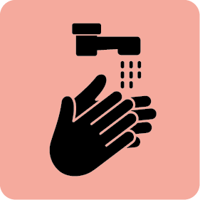
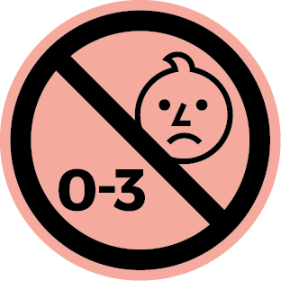

Keeping safe
Lesson 1

Slide 10
Notes:
Teacher notes – Baseline assessment (10 mins, slides 10-11)
Establish or remind pupils of the ground rules, highlighting any that are particularly pertinent for this lesson, such as ‘If we are worried about things that go into or onto bodies, we should tell the teacher. We can do this by writing our name on a piece of paper and putting it in the ask-it-basket so they can talk to us later, rather than telling the whole class.’

Slide 11



What’s our starting point?
Draw or list:
Things that are good for bodies
Things that are not so good for bodies
Notes:
Teacher notes - Baseline assessment (10 mins, slides 10-11)
To gauge pupils’ current understanding, give them Resource 1: Ideas list and, working on their own, ask them to draw or list:
Things that are good for bodies…
Things that are not so good for bodies…
As this is a baseline assessment, it is important to use neutral, non-guiding language and avoid giving any further information until the activity has been completed. Tell pupils that it does not matter if they don’t know or are unsure about something.
Tell pupils they should not yet fill in the ‘How do you know?’ box at the bottom of the sheet, as they will do this at the end of the lesson.

Slide 12
To learn about things that go into bodies and onto skin and how they can make people feel.
describe how the things that can go into a person’s body and onto their skin can change how people look and feel
identify that some things that go into or onto bodies can be harmful (or not so good for people) and how we know if something might be harmful
suggest basic strategies to respond to situations involving household products
recognise who to ask for help with things that can go into or onto bodies
Notes:
Teacher notes – Introduction (5 mins, slides 12-13)
Introduce the learning objective and outcomes.

Slide 13

Introduction
What might go into the ears?
What things might go into the nose?
What things might go onto the skin?
What things might go into the mouth?
Notes:
Teacher notes – Introduction (5 mins, slides 12-13)
Draw around a pupil on a large piece of paper (or draw a body outline on flipchart paper) and display. Draw on eyes, ears, nose, mouth. Ask pupils to think about all the different things that might go into or onto a person’s body. Record their responses on the body outline without commenting further.
Ask:
What things might go into the mouth?
What might go into the nose or ears?
What things might go onto the skin?
Pupil responses might include:
Things that go onto bodies: make-up, clothes, moisturiser/cream, water, tattoos, hugs/kisses, sand, jewellery, animal hair/licks, smoke, plasters, bubbles, medicines.
Things that go into bodies: food, water, fizzy drinks, sweets, medicines, fresh air, insect bites, injections, smoke.

Slide 14




Good or not so good?
Think about the example you have been given with your partner.
How does it change how the person looks and/or feels?
Is it good or not so good for bodies?
Notes:
Teacher notes – Good or not so good (5 mins)
Choose some examples from the annotated body outline for pupils to discuss in pairs. Ask pupils:
How does it change how the person looks and/or feels?
Is it good or not so good for bodies?
Explain that some things may be both good and not so good – notice what ideas the pupils come up with and whether pupils recognise that this can change when there is ‘too much… or not enough’ of something.

Slide 15
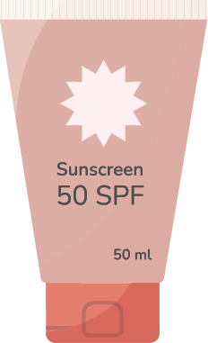

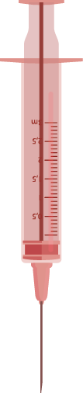
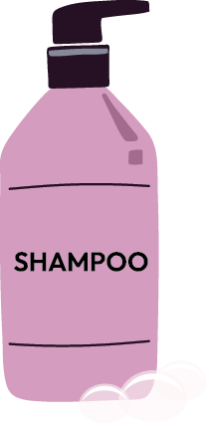


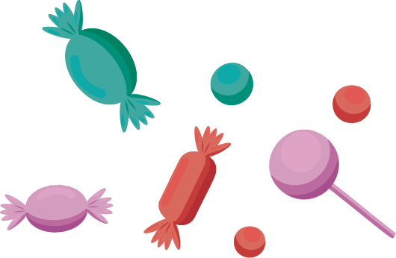

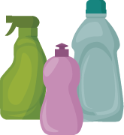


Helpful or harmful
Is the picture on the card helpful or harmful to bodies?
Sort the cards into two piles.
Harmful
Helpful
Notes:
Teacher notes – Helpful or harmful? (slides 15-16, 10 mins)
Working in small groups, ask pupils to sort the picture cards from Resource 2: Picture cards into groups according to whether the picture shown is helpful or harmful, or whether some can be both helpful and harmful to bodies.
If you prefer, empty and washed packaging could be used as the stimulus rather than picture cards, with hoops or boxes used for the sorting activity.
Observe pupils’ responses and discuss.
Suggestions to support pupils’ learning:
Helpful: fresh air, water, sunscreen.
Harmful: exhaust fumes, berries from the garden may be harmful if we don’t know what they are, or if they are safe to eat.
Both helpful and harmful: hygiene and cleaning products and medicines must be used safely otherwise they can be harmful; if someone eats too many sweets or drinks too much fizzy drink, it can damage their teeth or make them feel ill; doctors and nurses use syringes to give injections that help bodies stay healthy, but it is dangerous to pick up syringes if we see them lying on the ground.
Bring the class back together and discuss how we know whether something could be harmful for bodies.
Pupils might suggest: Labels and hazard symbols printed on boxes and bottles; where the product should be kept and how it should be used to keep people safe; a parent/carer says they are not allowed to touch it; can make someone ill if they have too much (e.g. sweets).
Support: Ask pupils to select only the items they think are harmful to bodies and try to explain why.
Challenge: Extend pupils’ thinking by asking more open questions:
Can they think of other examples?
Can the pupils explain when or why something is helpful or harmful for the body?
How do we know if something is helpful or harmful?

Slide 16
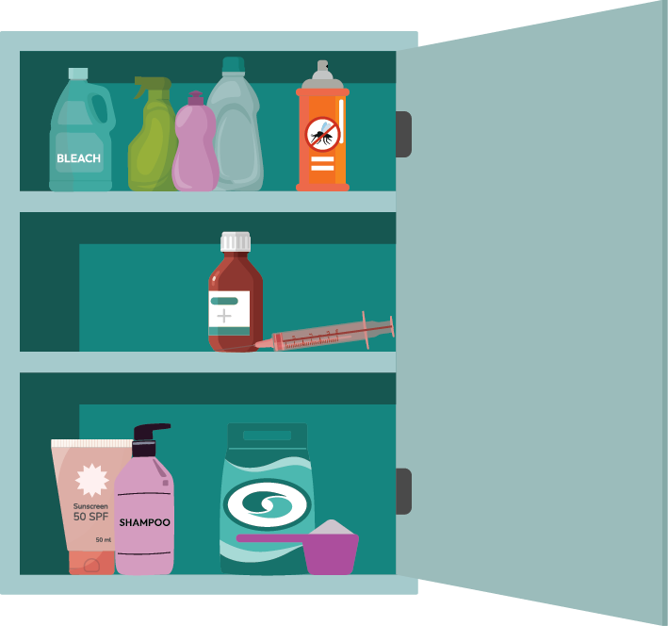
Helpful or harmful?
How do we know whether something might be harmful for bodies or not?
Notes:
Teacher notes – Helpful or harmful? (slides 15-16, 10 mins)
Bring the class back together and discuss how we know whether something could be harmful for bodies.
Pupils might suggest: Labels and hazard symbols printed on boxes and bottles; where the product should be kept and how it should be used to keep people safe; a parent/carer says they are not allowed to touch it; can make someone ill if they have too much (e.g. sweets).

Slide 17
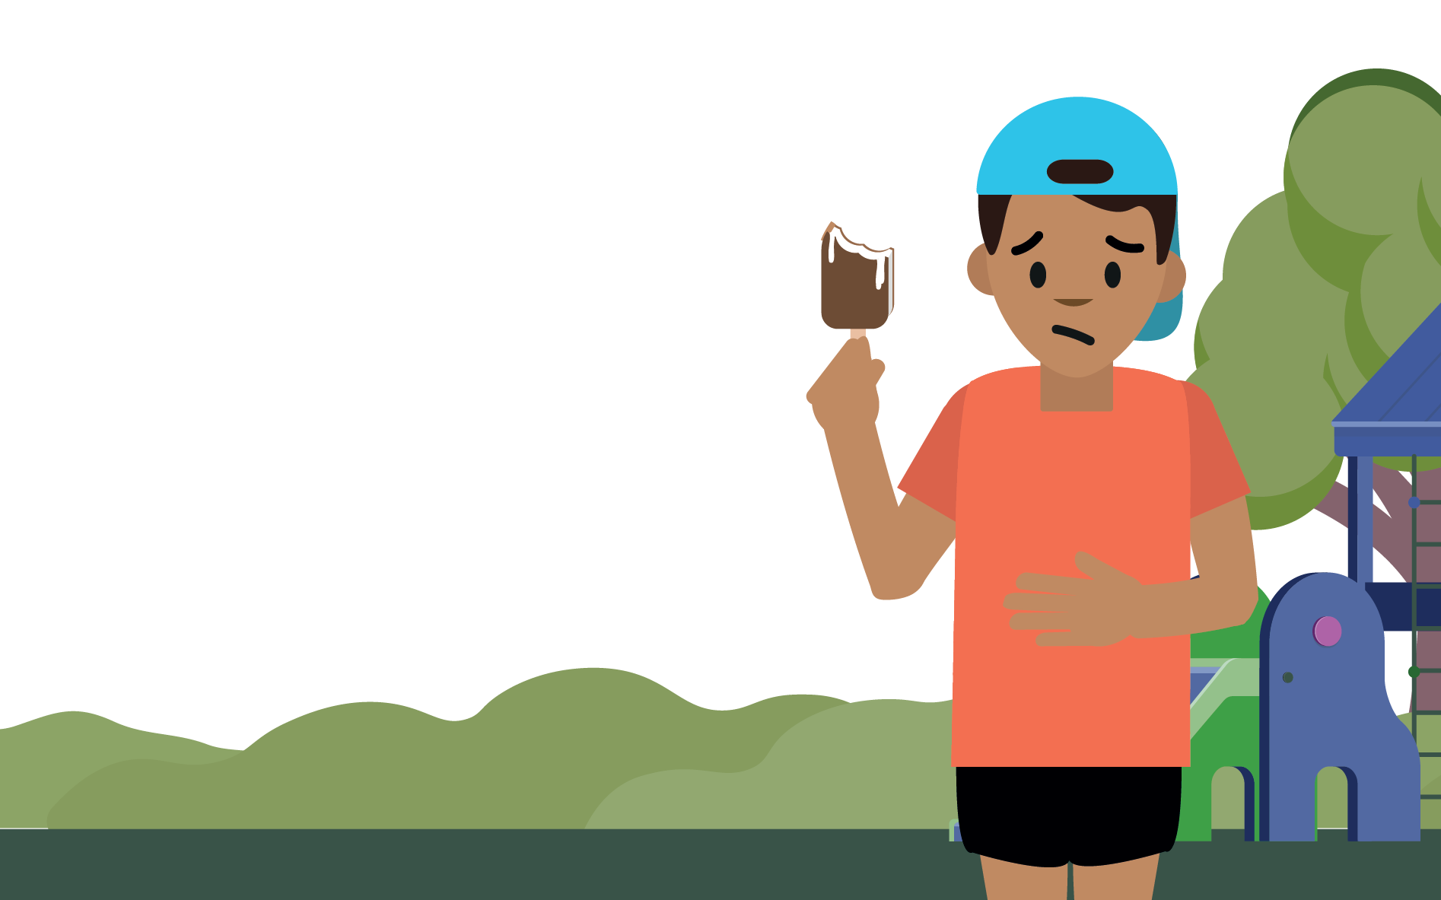
Amrit’s dilemma
Read the dilemma on
the card:
What would help Amrit?
What would not be helpful?
Now talk to another pair who had the same card about your answers, do you agree?
Notes:
Teacher notes – Amrit’s dilemma (10 mins)
In pairs, give pupils a card from Resource 3: Amrit’s dilemma cards. Pupils decide on the best answers to the following questions and record their responses on the card:
What would help Amrit?
What would not be helpful?
When completed, ask pupils to meet with another pair who discussed the same dilemma and compare answers. Repeat with an alternative dilemma.
Answers to Amrit’s dilemmas:
Helpful: b and avoid eating any more ice-cream / Not helpful: a and c
Helpful: c or parent/carer might put medical cream on it or add medical oil to a bath / Not helpful: a and b
Helpful: c and not touch it / Not helpful: a and b
Helpful: a and adult might put anti-septic cream on it / Not helpful: b and c
Helpful: a and then keep eye shut for a short time / Not helpful: b (rubbing the eye worsens the effect of the shampoo) and c
Support: Some scenarios are more common and require a less complex response (e.g. scenario 1, 4 and 5), so these could be allocated to pupils needing more support.
Challenge: Ask pupils to work through each of the dilemmas on the sheet on their own, then compare responses with a partner.

Slide 18
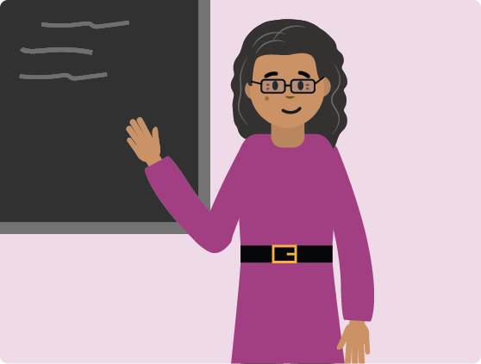
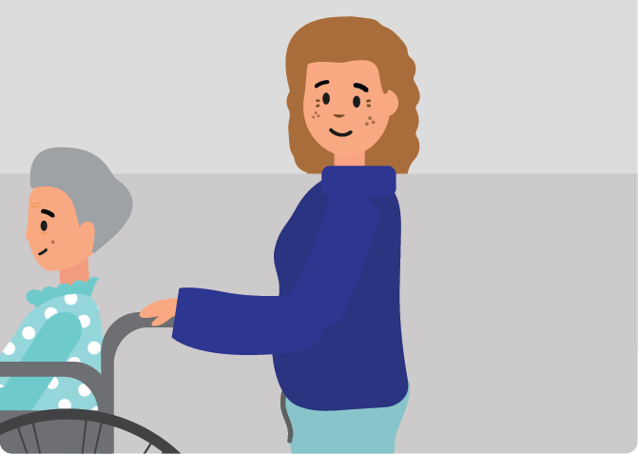

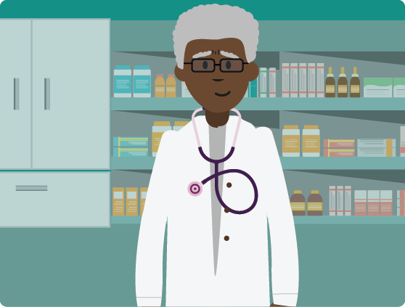
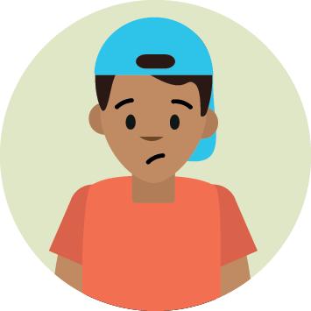

Who can help?
Teacher
Parent/carer
Listen to one of
Amrit’s dilemmas.
Who could help Amrit?
Stand next to the label showing the person who could help.
Friend
Doctor
No one
Someone else
Notes:
Teacher notes – Signposting support (5 mins)
Display Resource 4: People who help us labels around the classroom.
Choose one example from Resource 3: Amrit’s dilemma cards and ask pupils to stand next to the label showing the person who could help Amrit in the situation. Choose a few pupils to explain their thinking.
For example:
1. Feeling sick from eating too much ice-cream - a parent/carer or someone else (whoever is looking after them e.g. a grandparent)
2. Skin has spots on it - a teacher, parent/carer, a doctor
3. Liquid has been spilt in the shed - a parent/carer or someone else (whoever is looking after them)
4. Grazed knee from falling over - a friend could get help from an adult, a teacher, a parent/carer or someone else (e.g. midday assistant)
5. Shampoo in eye – parent/carer, or rinse it with water themselves and then tell parent/carer
Draw out that it is important that they tell ‘someone’, as telling ‘no-one’ could lead to further accidents or problems. They should always talk to an adult they trust (such as a parent/carer or teacher) if needed. Remind pupils they must never put something into their body or onto their skin if they don’t know what it is, or if they don’t have permission from their parent/carer.

Slide 19
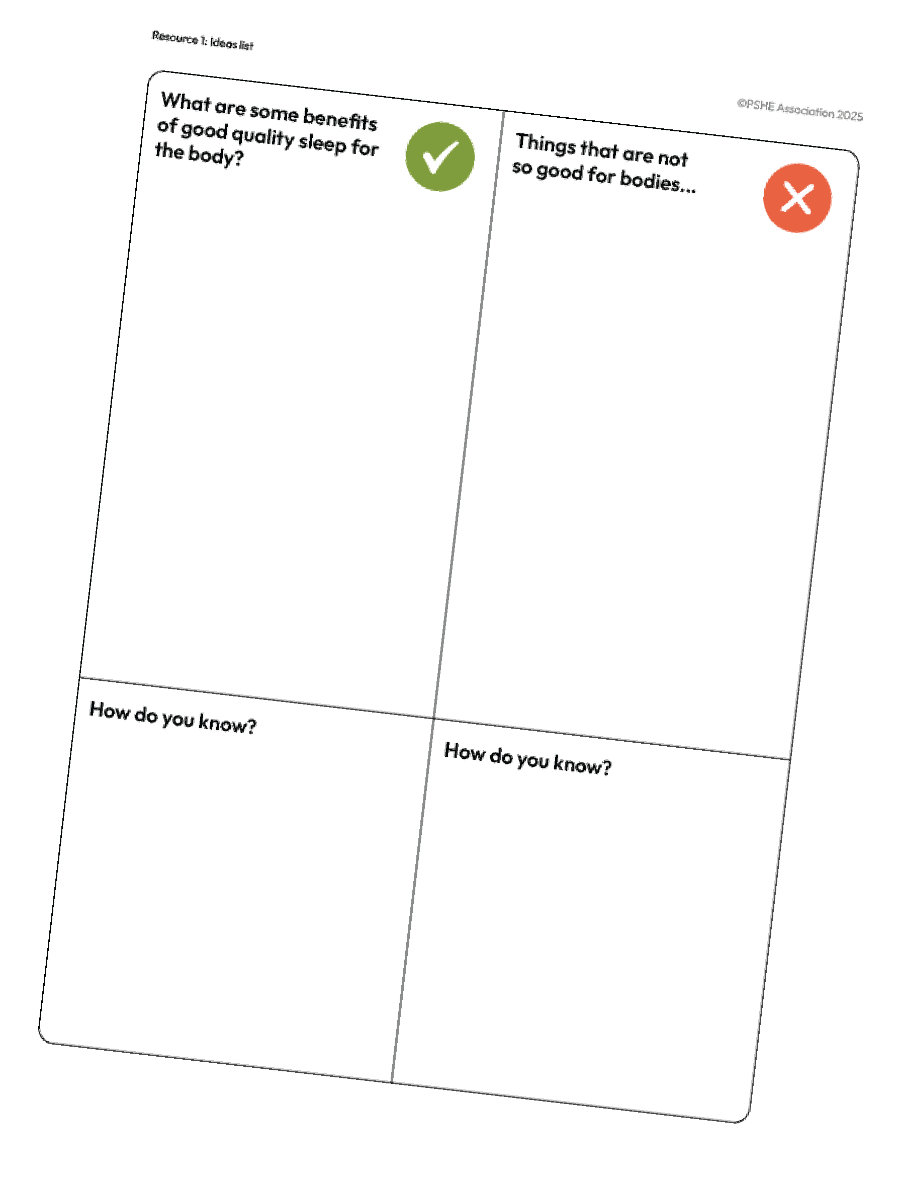
What have we learnt?
Share one thing you have learnt about things that go into or onto bodies.
Now go back to your
ideas list.
Is there anything you would like to change?
Is there anything you would like to add?
Next, add your ideas to the How do you know? box at the bottom of the sheet.
Notes:
Teacher notes - Reflection and endpoint assessment (5 mins)
Ask pupils to share one thing they have learnt about things that go into or onto bodies.
Then go back to their ideas lists they made at the beginning of the lesson. They should add to or amend their list in a different colour in the light of their new learning. Pupils should also include how they know whether something is helpful or harmful to bodies by adding their ideas to the box at the bottom of the sheet – How do you know?
Use this as evidence of learning and progress and to inform further teaching.

Slide 20






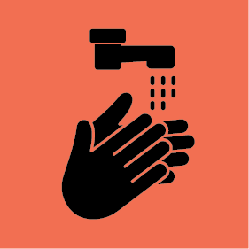

Hazards
Look at the hazard labels from common household products.
Can you match the hazard labels to their meanings?
Notes:
Teacher notes – Extension activity
Ask pupils to use Resource 5: Hazard labels individually, in pairs, or small groups, to match common hazard labels found on household products to their meanings and recognise why some products might be harmful to bodies.

