Slide 1
Drug education
Medicines and household products
Year 1-2: Lesson 3

Slide 2
Using this PowerPoint
The slides in this presentation are divided into two sections:
Teacher slides (purple) – provide key information regarding lesson preparation.
Pupil slides – provide a visual focus point for pupils during the lesson and delivery notes for teachers about the activities. Click ‘notes’ to view these.
Ensure that you select ‘Use Presenter View’ under the ‘Slide Show’ tab – this will allow you to preview the teaching notes on your monitor while the main presentation is displayed on a screen/smartboard.

Slide 3
Support and challenge
The lesson includes suggestions for challenge and support activities, to help you differentiate appropriately for your class.
Support activities are adapted to be more accessible for those who need it.
Challenge activities deepen and extend learning for those who need more challenge or who finish the activity quickly.
Look for these icons on the pupil slides. See delivery notes for details of the activities.
Challenge
Support

Slide 4
Context
This is the third of three drug education lessons, for year 1–2. This lesson focuses on safety rules at home and in familiar environments. Pupils also explore how to manage when feeling pressure to do something that looks like fun but might be harmful to their, or others’, bodies.

Slide 5
Developing subject knowledge
Key information on content related to these lessons can be found in the Year 1-2 Knowledge Organiser.
Advice on safe practice, dispelling common misconceptions, visitors to the classroom and other important information can be found in Teacher Guidance: Drug and alcohol education.
Data sources to inform your planning can be found within our document that outlines the approach of these lessons Evidence Review: Effective drug and alcohol education, along with advice regarding how to talk to young people about addiction, dependency and problematic substance use.

Slide 6
To learn about keeping safe around medicines and other household products.
state safety rules for the use of medicines and other household products
recognise risk in situations related to medicines and household products, including when there is pressure to do something which is unsafe or may cause someone to be unwell
identify what to do next in a situation that may involve risk
identify when asking for adult permission is required (in relation to medicines and household products)

Slide 7
Box or envelope for questions
Collection of empty, washed medicine and household product bottles, containers and packets, or selected pictures from Lesson 1 (Resource 2: Picture cards)
Resource 1: Safety rules [one set per class, cut up and stuck to wall in two rows (sentence starters and ends)]
Resource 2: Risk cards [one set per group, support option as required]
Resource 2a: Action cards [one set per pupil or small group]
Resource 3: Pressure cards [one set per class]
Notes:
Be aware that some pupils in the class may have experienced accidents with medicines and household products in the home.
This lesson includes pupils acting ‘in role’. To ensure role play is managed sensitively, provide a signal or countdown for pupils stepping ‘into role’ and another for coming ‘out of role’.

Slide 8
Lesson summary
Activity | Description | Timing
Introduction | Remind pupils of ground rules. Pupils look at different household products pictures or empty packaging and think about how these are used at home and school. | 5 mins
Baseline assessment activity | In pairs, pupils discuss safety rules involving the use of household products and medicines. | 5 mins
Safety rules | As a class or in small groups, pupils match sentence starters and endings to create a list of safety rules. | 10 mins
Risks and actions | Pupils read scenarios and identify the risk or danger, discuss why it’s unsafe and suggest what to do next. | 15 mins
What if…? | Pupils match ‘What if…?’ statements to scenarios and then role play the character managing the situation positively. | 15 mins
Signposting support | Highlight when to ask for help and who to ask. | 5 mins
Reflection and endpoint assessment | Pupils pair up and share their learning on safety rules, then meet with another pair, share and compare. | 5 mins

Slide 9
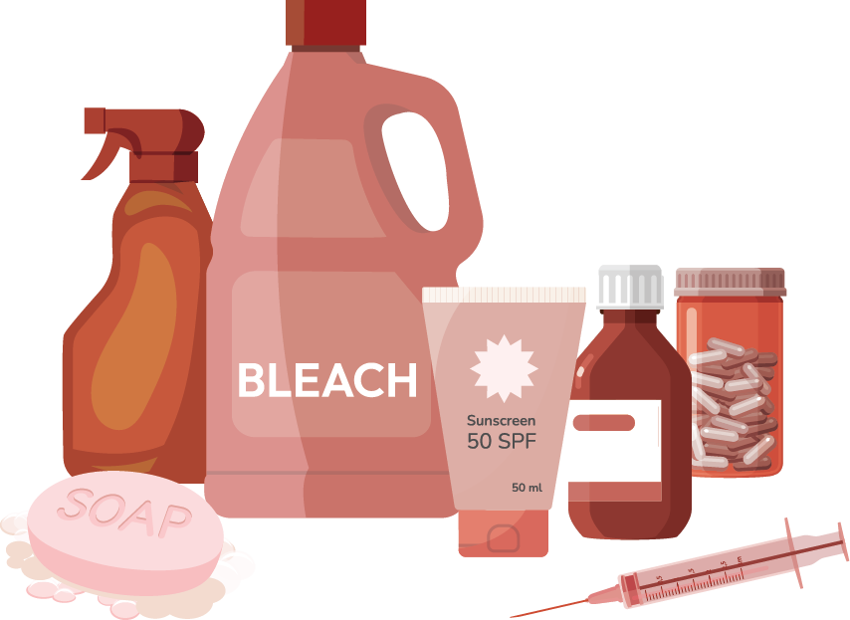
Medicines and household products
Lesson 3

Slide 10
Notes:
Teacher notes – Introduction (5 mins, slides 10-12) Remind pupils of the ground rules for PSHE education lessons. Highlight any particular to the lesson, such as ‘If anything comes up in this lesson that makes me worried about your safety at home or school, I will need to tell another teacher, to make sure you stay safe in the future’, or ‘If you are worried about something you can let me know by writing a note and putting it in the talk-to-the-teacher note-box.’

Slide 11
To learn about medicines, and the people who help someone to stay healthy.
identify what can make people feel better if not feeling well
explain that medicines come in different forms and are used in different ways
recognise that some medicines, such as vaccinations, can help prevent illness and disease and that some people need to take medicines every day to help them to stay healthy
identify who helps people to stay healthy and what they do
Notes:
Teacher notes – Introduction (5 mins, slides 10-12)
Introduce the learning objective and outcomes.

Slide 12
Introduction
Items like these are often found in our homes and at school.
What are they?
What are they used for?
Who might use them?
Where are they kept?
Notes:
Teacher notes – Introduction (5 mins, slides 10-12)
Display empty, washed packaging from household products, including cleaning products and medicines, or use pictures from Lesson 1 (Resource 2. Picture cards).
Explain that items like these can often be found in our homes and at school. Ask pupils to discuss:
What they are
What they are used for
Who might use them
Where they are kept.

Slide 13
What’s our starting point?
Talk to your partner
Are there any safety rules about using these products?
What are the safety rules?
Notes:
Teacher notes - Baseline assessment (5 mins) Ask pupils to discuss the following questions in pairs, then share their ideas with the class:
Are there any safety rules about using these products?
What are the safety rules?
Use this and the previous activity to gauge what they already know and think.
Pupil responses might include:
Be careful not to spill any – if any gets spilt clean it up immediately; don’t put it in your mouth; don’t put onto skin; if it goes in your eyes wash straight away and don’t rub them; don’t use it if it is not yours, check how much to use; check if you are allowed to use it; only an adult should use it or give it to you.

Slide 14
Safety rules
1
Listen to the start of each sentence.
2
Choose a card that finishes the sentence.
When using any medicine or product…
…follow the instructions to be safe.
Notes:
Teacher notes – Safety rules (10 mins, slides 14-16)
Display the sentence starters and endings from the safety rules from Resource 1: Safety rules on separate cards. Stick the sentence starters in one row on the wall and the sentence endings in a row below them.
Begin by reading each sentence starter aloud in turn. Ask for a volunteer to suggest a match for the sentence starter by choosing a sentence ending and moving the corresponding card to pair it with the starter. Once a volunteer makes a suggestion, ask the rest of the class if they agree with the match, encouraging students to talk about why they think the match is right or wrong. If the class agrees, leave the match as it is. If the class disagrees, move the ending card to another starter based on their suggestions. Then, share the solved rules.
This activity can instead be completed in small groups, however, ensure that all pupils see the solved safety rules before moving on to the next activity.
Solved safety rules:
"If someone sees a needle, they should tell an adult and not touch it."
"Medicines and cleaning products should be kept out of reach of children."
"It is important to use or take only what it says on the bottle or packet."
"If someone feels sick, not all medicine will help them, there are different types of medicine."
"People should always read the instructions before they use or take medicine."
"Medicines last for some time, so check the date on the packet or bottle."
"Children should not use medicines without an adult helping, unless told otherwise."
"If someone sees cleaning products on the floor, they should tell an adult and not touch it."
"Someone should only take medicine given to them by a doctor, not medicine the doctor has given to someone else."
"When using any medicine or product, follow the instructions to be safe.“
Challenge: Ask pupils to add the word “because” to the end of each rule and then explain why they think it is important to keeping safe.

Slide 15
Safety rules
If someone sees a needle, they should tell an adult and not touch it.
Medicines and cleaning products should be kept out of reach of children.
It is important to use or take only what it says on the bottle or packet.
If someone feels sick, not all medicine will help them, there are different types of medicine.
People should always read the instructions before they use or take medicine.
Notes:
Teacher notes – Safety rules (10 mins, slides 14-16)
Answers.

Slide 16
Safety rules
Medicines last for some time, so check the date on the packet or bottle.
Children should not use medicines without an adult helping, unless told otherwise.
If someone sees cleaning products on the floor, they should tell an adult and not touch it.
Someone should only take medicine given to them by a doctor, not medicine the doctor has given to someone else.
When using any medicine or product, follow the instructions to be safe.
Notes:
Teacher notes – Safety rules (10 mins, slides 14-16)
Answers part 2.

Slide 17
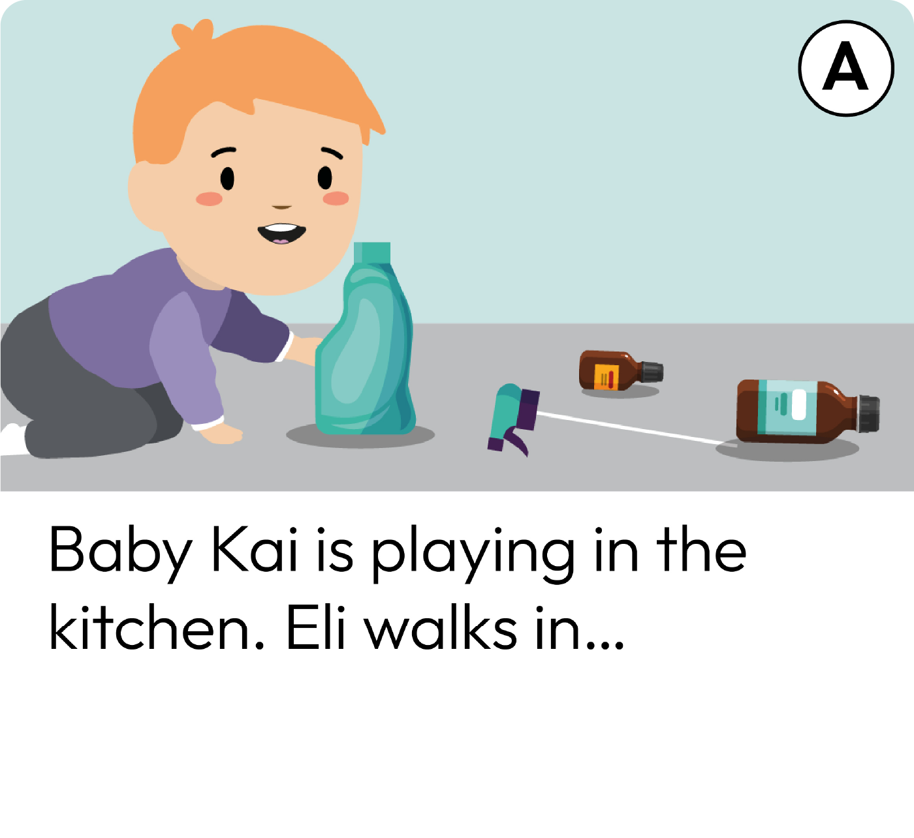
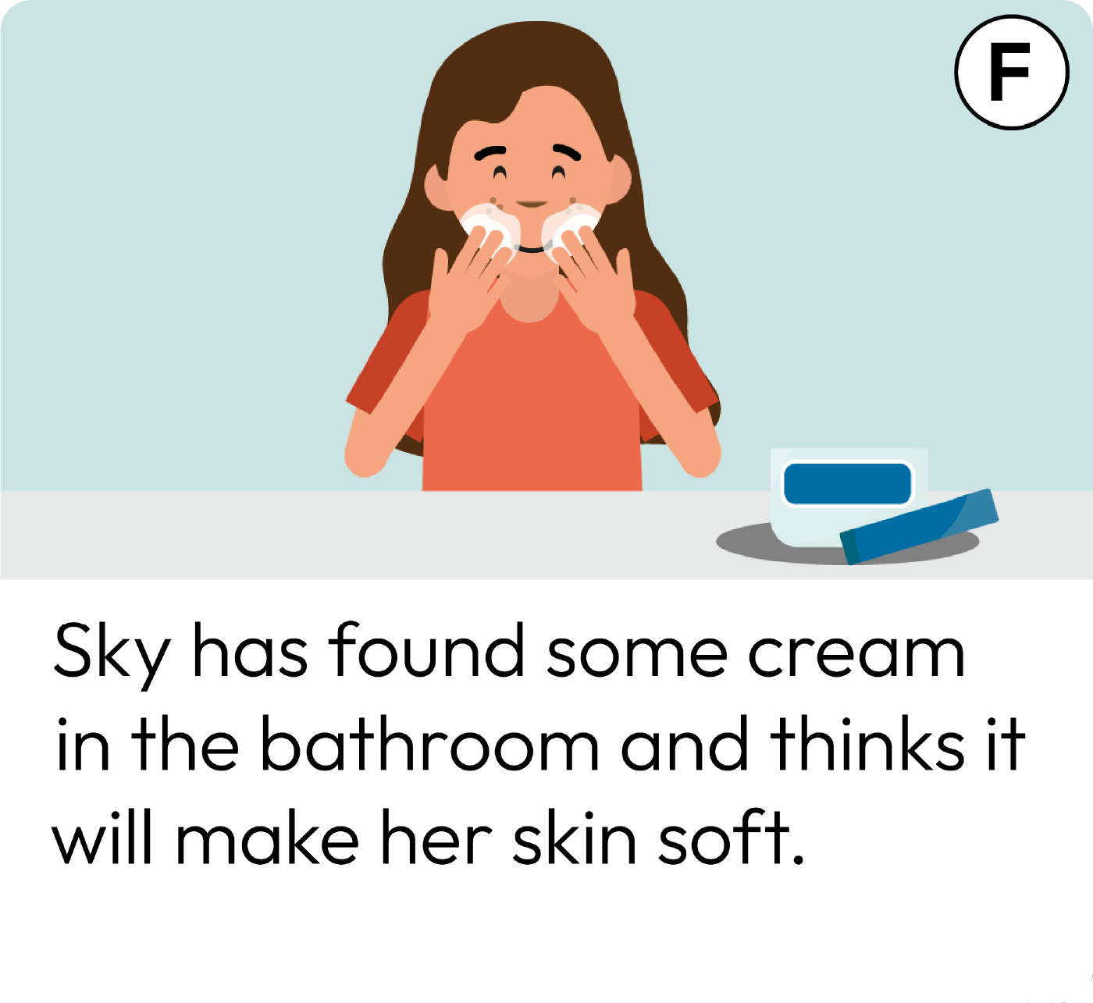
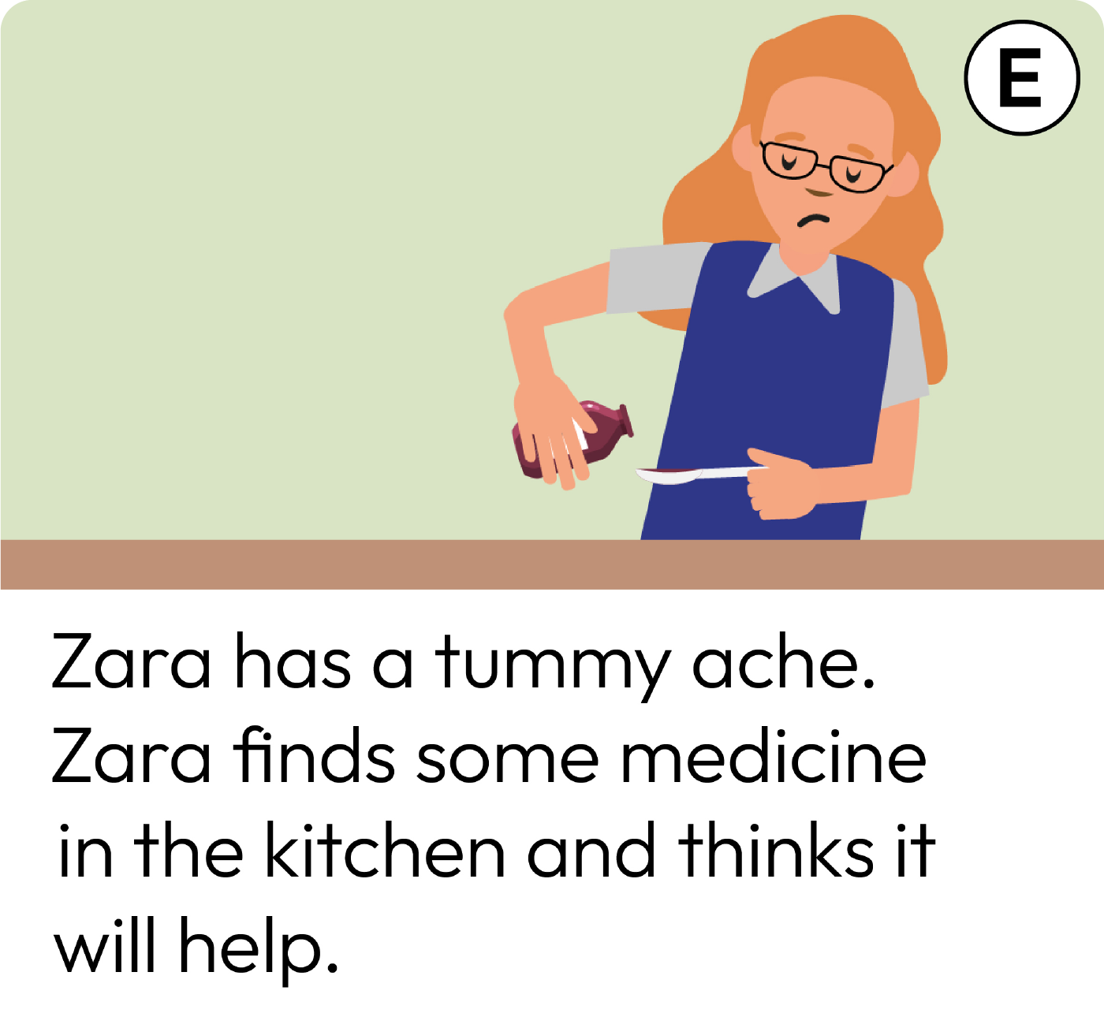
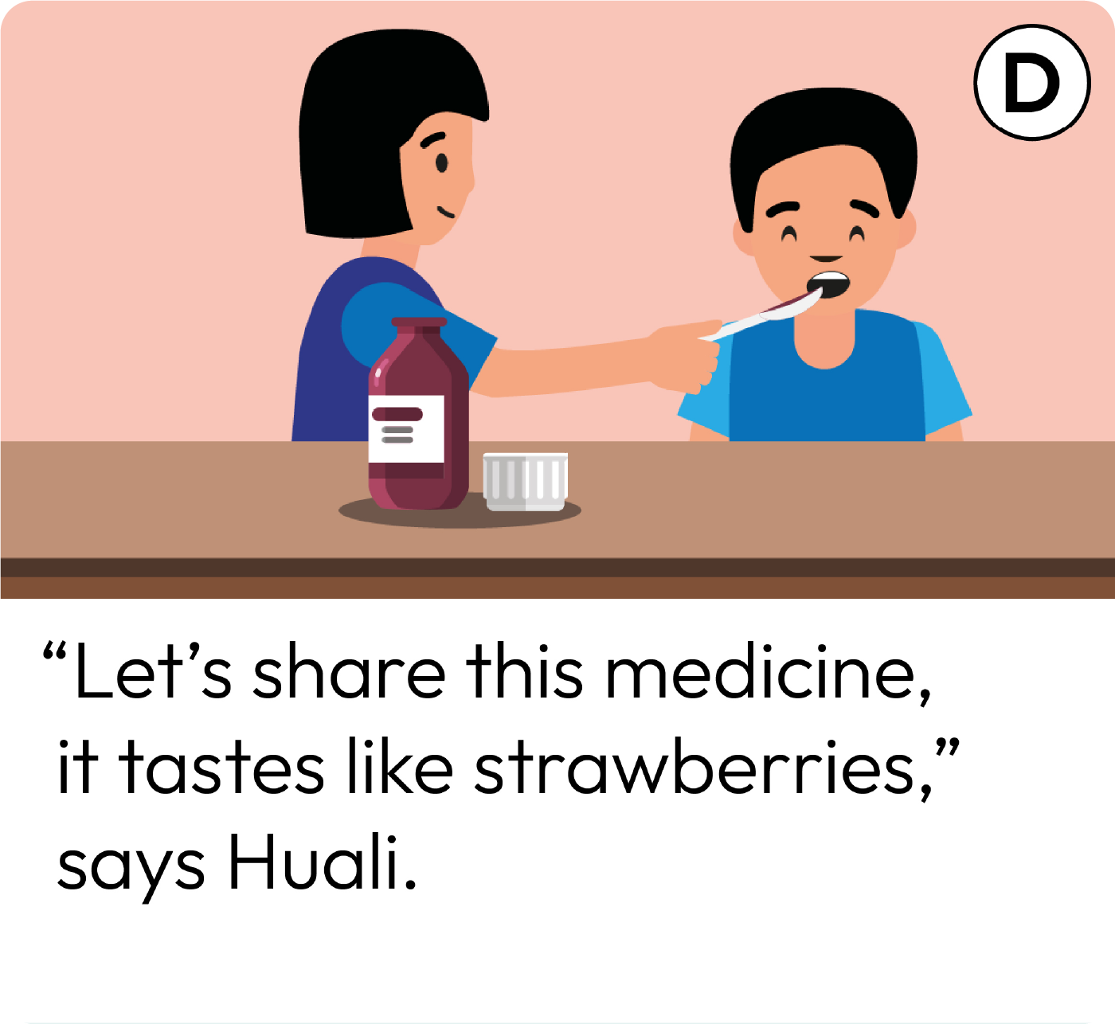
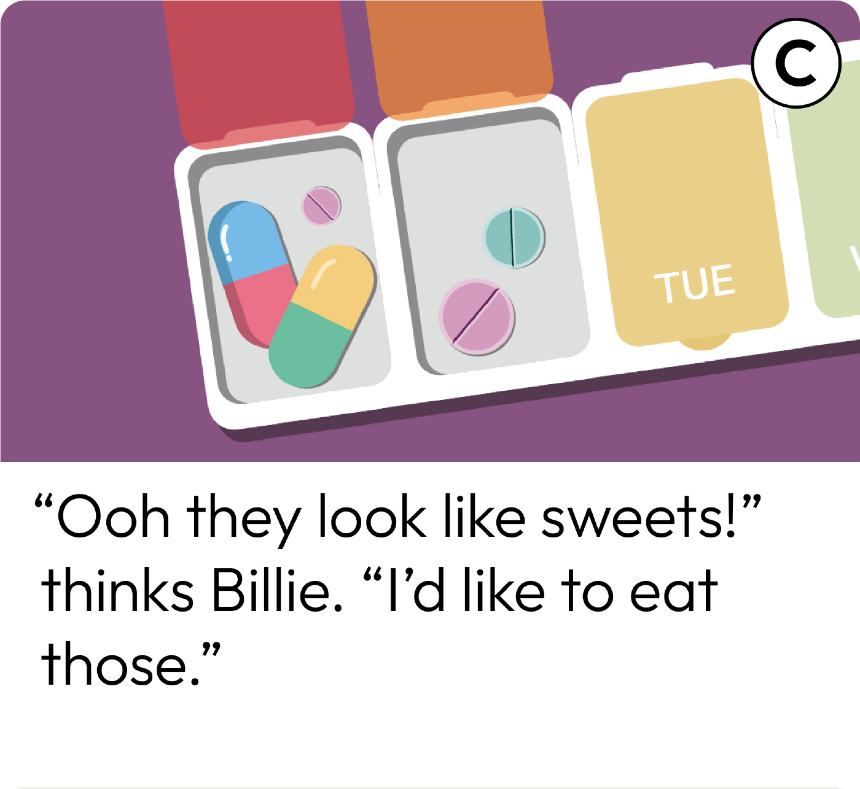
Risks and actions
Read the Risk cards with your group.
Then talk about:
Why is it unsafe?
What could the character(s) do to help prevent something unsafe or dangerous happening?
Notes:
Teacher notes – Risks and actions (15 mins)
In groups, give pupils the sentence cards with pictures in Resource 2: Risk cards. Ask them to discuss what the risk or danger might be in the scenario.
Why is it unsafe?
What could the character(s) do to help prevent something unsafe or dangerous happening?
Support: Give pupils a scenario from Resource 2: Risk cards and Resource 2a: Action cards. They look at the action cards and organise them into things the character should do and things the character should not do in the situation. Challenge: Ask pupils to complete the activity and then write a safety rule to match each scenario. The following sentence starters could support pupils:
Always...
You should never…
It is important to…
Remember to…
Pupils might suggest: Labels and hazard symbols printed on boxes and bottles; where the product should be kept and how it should be used to keep people safe; a parent/carer says they are not allowed to touch it; can make someone ill if they have too much (e.g. sweets).

Slide 18
What if…?
Listen to the matching Risk card and ‘What if…’ scenario.
How might the character feel with the added pressure?
Would it make it easier or harder to keep safe?
How should they handle the situation to help prevent (or stop) an accident from occurring?
Notes:
Teacher notes – What if…? (15 mins)
Choose some of the scenarios from activity 2 (Resource 2: Risk cards). Find the matching ‘What if…?’ statement on Resource 3: Pressure cards.
Read aloud the scenario on the risk card and then the corresponding pressure statement. Invite pupils to role play the character managing the situation positively.
With the class discuss:
how might the character feel with the added pressure?
would it make it easier or harder to keep safe?
how should they handle the situation to help prevent (or stop) an accident or something unsafe from occurring?
To ensure role play is managed sensitively, choose pupils who feel confident to role play and be sure to provide a signal or countdown for pupils stepping ‘into role’ and another for coming ‘out of role’.

Slide 19
Who can help?
Remember to tell a trusted adult if an accident happens, or if you think one is going to happen. If there is an emergency and no adults are available, phone 999.
Talk to a trusted adult at home or at school if you are not sure about touching a household product or medicine.
I need your help with something . . .
Something's worrying me, can I talk to you?
I have something that’s been bothering me . . .
Notes:
Teacher notes – Signposting support (5 mins)
Discuss the importance of telling an adult if there is a likelihood of an accident and that if an accident has happened, the importance of getting help quickly. If there is an emergency and no adults are available, they should phone 999. If there is something they are not sure about, such as whether to touch a household product or medicine, they should not be persuaded to do it, but should always seek help from a trusted adult at home or school first.

Slide 20
What have we learnt?
Talk to your partner about the safety rules in the lesson. What can you remember?
Now, meet with another pair and share your ideas.
Are there any safety rules you have learnt that you didn’t know before?
Notes:
Teacher notes - Reflection and endpoint assessment (5 mins)
In pairs, ask pupils to discuss what they can remember about the safety rules they have learned during the lesson, then meet with another pair, share and compare ideas.
Ask pupils, are there any they have learnt that they did not know before?
Use this to gauge the class’s learning and to inform future teaching.

Slide 21
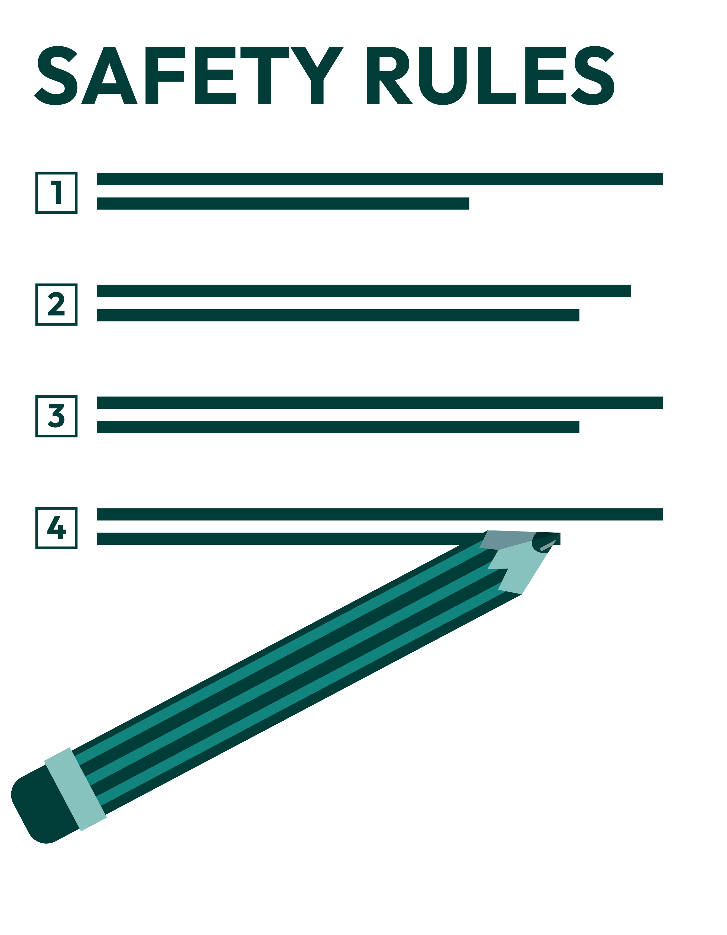
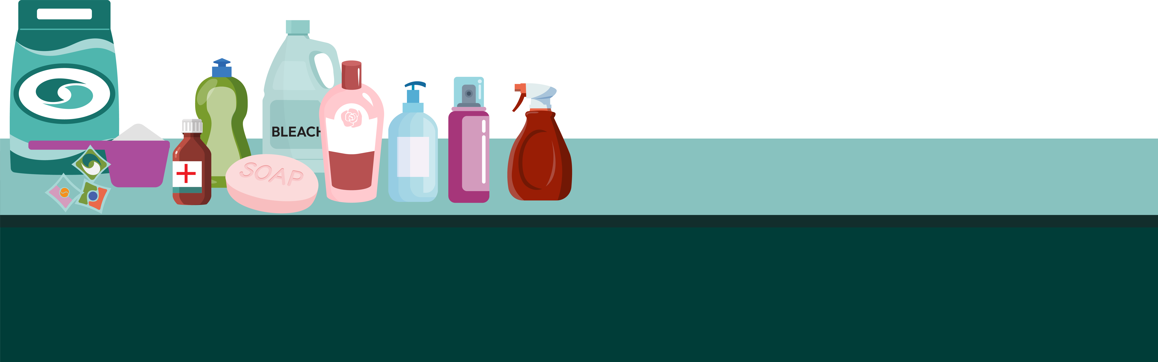
Rules to help stay safe
Make a list of safety rules about household products and medicines for a display.
Notes:
Teacher notes – Extension activity
Make a class list of safety rules about household products and medicines for display.

