Slide 1
Drug education
Medicines and household products
Year 3-4: Lesson 1

Slide 2
Using this PowerPoint
The slides in this presentation are divided into two sections:
Teacher slides (purple) – provide key information regarding lesson preparation.
Pupil slides – provide a visual focus point for pupils during the lesson and delivery notes for teachers about the activities. Click ‘notes’ to view these.
Ensure that you select ‘Use Presenter View’ under the ‘Slide Show’ tab – this will allow you to preview the teaching notes on your monitor while the main presentation is displayed on a screen/smartboard.

Slide 3
Support and challenge
The lesson includes suggestions for challenge and support activities, to help you differentiate appropriately for your class.
Support activities are adapted to be more accessible for those who need it.
Challenge activities deepen and extend learning for those who need more challenge or who finish the activity quickly.
Look for these icons on the pupil slides. See delivery notes for details of the activities.
Challenge
Support

Slide 4
Context
This is the first of two drug education lessons, for year 3–4. This lesson focuses on the reasons why we use household products and medicines and the importance of using them safely. Pupils explore a range of medicine labels and instructions, and assess how to minimise risk and help prevent accidents.

Slide 5
Developing subject knowledge
Key information on content related to these lessons can be found in the Year 3–4 Knowledge Organiser.
Advice on safe practice, dispelling common misconceptions, visitors to the classroom and other important information can be found in Teacher Guidance: Drug and alcohol education.
Data sources to inform your planning can be found within our document that outlines the approach of these lessons Evidence Review: Effective drug and alcohol education, along with advice regarding how to talk to young people about addiction, dependency and problematic substance use.

Slide 6
To learn about the safe use of medicines and household products.
explain the importance of taking medicines correctly and using household products safely
identify risk in relation to the use of medicines and household products, and suggest what action to take to help prevent or minimise harm
recognise sources of information and whom to ask for help with medicine safety

Slide 7
Box or envelope for questions
Empty medicines packaging (boxes and clean, washed bottles) and instruction leaflets from over the counter and prescribed medicines such as paracetamol, travel sickness tablets or cold and flu tablets, cough medicine, eye/ear drops, skin creams. Ensure that personal information on printed labels from prescribed medicine is deleted.
Resource 1: Benefits and risks [one per pupil, or pupils can create this grid in their books or on a piece of paper]
Resource 2: A day in the life [one per class]
Resource 3: Medicine safety scenarios [one scenario per small group of three or pair]
Notes:
Be aware that some pupils in the class may have experienced accidents with medicines and household products in the home.
This lesson includes pupils acting ‘in role’. To ensure role play is managed sensitively, provide a signal or countdown for pupils stepping ‘into role’ and another for coming ‘out of role’.

Slide 8
Lesson summary
Activity | Description | Timing
Baseline assessment activity | To be completed before the lesson. Establish ground rules. Pupils write down the benefits and risks of using different household products and medicines and suggest how risk of harm can be reduced. | 15 mins
Introduction | Remind pupils of ground rules and introduce the learning objective and outcomes. Pupils note how a family use medicines and household products safely and how they help. | 10 mins
A day in the life | Pupils discuss the importance of following instructions for using medicines before exploring medicine labels and instructions. | 10 mins
Freeze frame | Pupils use scenarios to create freeze frames about risks involving medicines, household products and safety. | 10 mins
Roleplay | Pupils role play how the characters in the scenario can best manage the risk. | 15 mins
Signposting support | Pupils are reminded that adults should administer medicines to children. Highlight who can help with medicines and what to do in an emergency. | 5 mins
Reflection and endpoint assessment | Pupils return to their list from the baseline assessment and add to or amend their ideas to demonstrate their learning. Pupils then share one thing this lesson has made them think about medicine safety | 10 mins

Slide 9
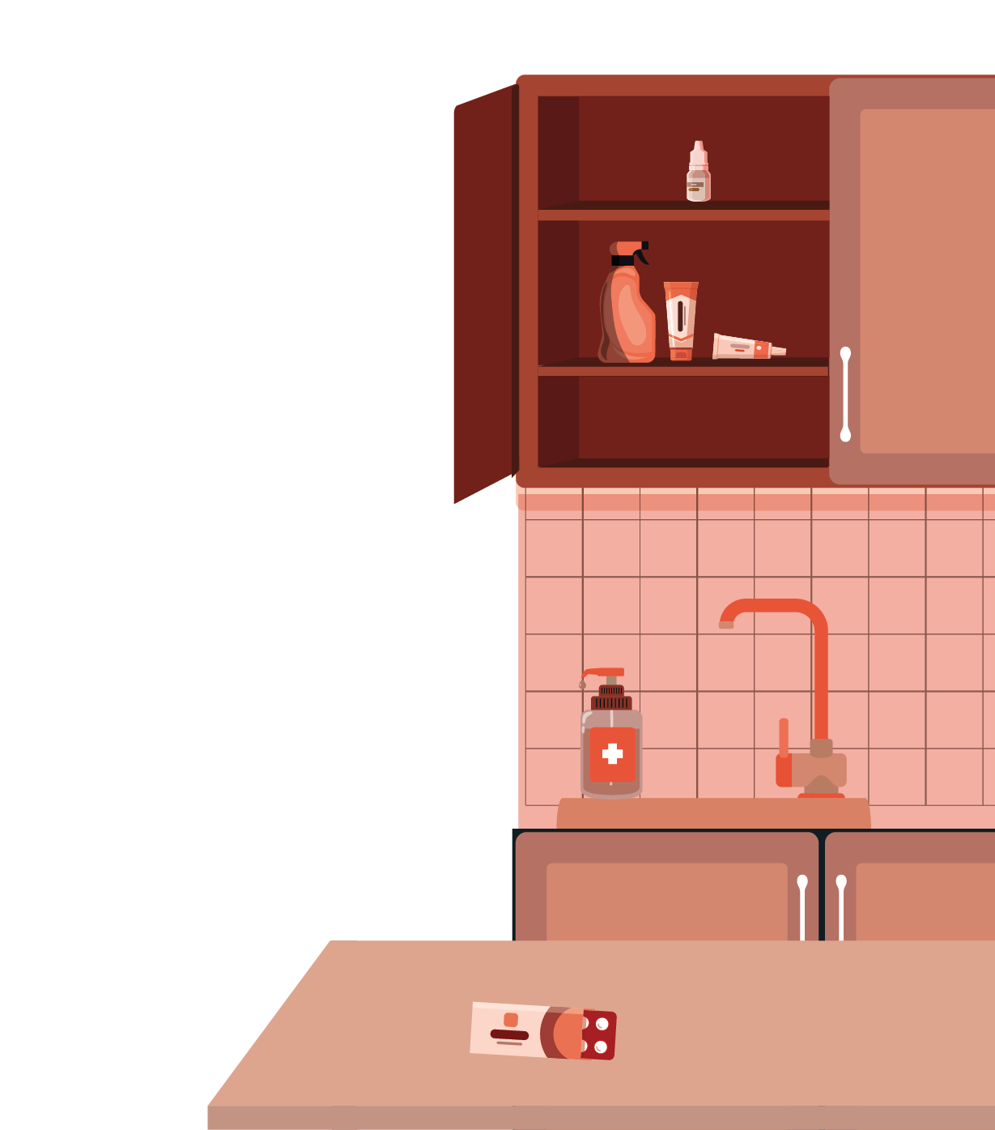
Medicines and household products
Lesson 1

Slide 10
What’s our starting point?
Use the benefits and risks list sheet to answer these questions about household products and medicines:
How do these help us?
Are there any risks from using these products? What are the risks?
What will help reduce the risks?
Notes:
Teacher notes - Baseline assessment (15 mins) This activity should be completed before the lesson. This allows time to look through the pupils’ work and gain a sense of their current understanding. Before setting this activity, ensure that ground rules for PSHE education lessons have been developed and shared with the class.
Display or provide copies of Resource 1: Benefits and risks.
Ask pupils the following questions:
How do these help us?
Are there any risks from using these products? What are the risks?
What will help reduce the risks?
Ask pupils to record their ideas on Resource 1, or in their exercise books.

Slide 11
Notes:
Teacher notes – Introduction (10 mins, slides 11-13) Remind pupils of the ground rules for PSHE education lessons.

Slide 12
To learn about medicines, and the people who help someone to stay healthy.
explain the importance of taking medicines correctly and using household products safely
identify risk in relation to the use of medicines and household products, and suggest what action to take to help prevent or minimise harm
recognise sources of information and whom to ask for help with medicine safety
Notes:
Teacher notes – Introduction (10 mins, slides 11-13)
Introduce the learning objective and outcomes and outcomes and explain that this lesson will focus on household products, especially medicines and the importance of people using these safely. In the lesson they will be looking at packaging from real medicines and that these have been emptied (and washed if required).

Slide 13
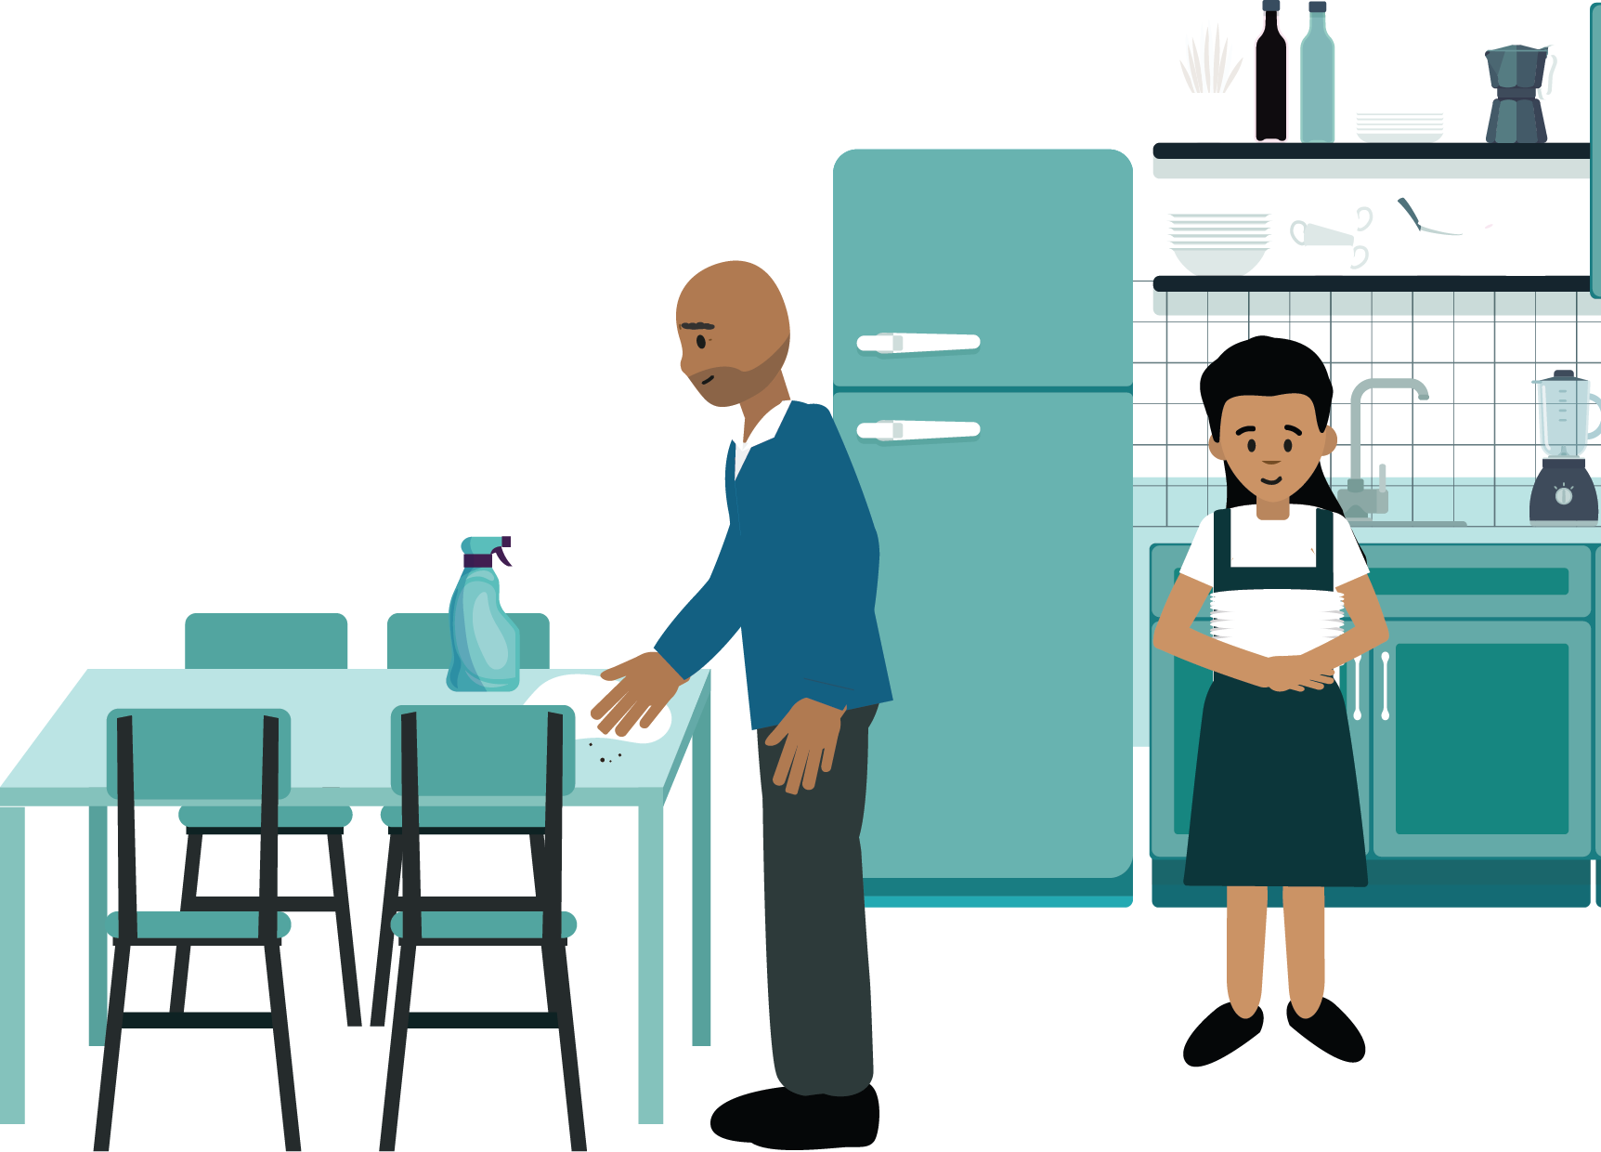
Introduction
Listen to ‘A day in the life’ about the Grech family.
What different items are used by the family?
How are they used safely?
Notes:
Teacher notes – Introduction (10 mins, slides 11-13)
Show and read Resource 2: A day in the life to the class.
Ask pupils to note the different items used by the family and how they use them safely, discussing in pairs and then feeding back. Take responses, and circle in a coloured pen on Resource 2, the different items, pointing out any safety aspects.
Suggestions to support pupils’ learning:
Benefits:
Medicines and other products can help someone feel better if they are ill (e.g. paracetamol), protect them from becoming ill (e.g. vaccinations protect people from disease and sun-creams protect the skin from harmful sun rays), or help them stay healthy (e.g. if someone has asthma, medicines help them keep well; pets and farm animals might also need medicines to help them keep well)
Household products (such as cleaning sprays, liquids and capsules) help keep the house clean and free from germs, and keep bodies clean and protected from germs too (e.g. soap, shampoo and toothpaste).
Safety considerations:
Whilst some medicines can be bought in supermarkets and shops; pharmacists, doctors and nurses prescribe medicines and give medicines like vaccinations; it is important to read the instructions before using medicines and other household products; medicines and household products should be kept out of reach of children and disposed of carefully; spillages should be cleaned up immediately; if accidents occur, the product should be washed off; gloves may be needed to use some household products and these should only be used by adults.

Slide 14
A day in the life
Think back to ‘A day in the life’ when Aunt Lusia had a headache. Before taking the tablets, she read the instructions on the medicine packet.
Why was it important for her to do this?
Now, look at the empty medicine packaging with your partner. Find all the information someone would need before taking the medicine.
Notes:
Teacher notes – A day in the life (slides 14-16, 10 mins)
Refer back to Resource 2: A day in the life, when Aunt Lusia has a headache. Point out that one of the things she does is read the instructions on the medicine’s packet before she takes the tablets.
Ask pupils: Why was it important for her to do this? Take some suggestions.
Pupil responses might include: So that she knows what the medicine is, to know how many to take and when (e.g. with a meal), to know if they are suitable (the right medicine for her), so she doesn’t take too many, to check it is safe to take with other medicines, to check the ‘use-by ’date (medicines may become ineffective if out-of-date, or - like food and drink - may go bad).
Using real empty medicine packaging, pupils work in pairs to analyse the labels and instructions leaflets – noticing the information provided. Take feedback and make a list to display. As a class, discuss unfamiliar vocabulary and why instructions are printed on the medicine packaging/leaflets for safety.
Support: Pupils find just three different pieces of information on the medicine packaging label.
Challenge: Pupils are challenged to find ten different pieces of information on the medicine packaging label.

Slide 15
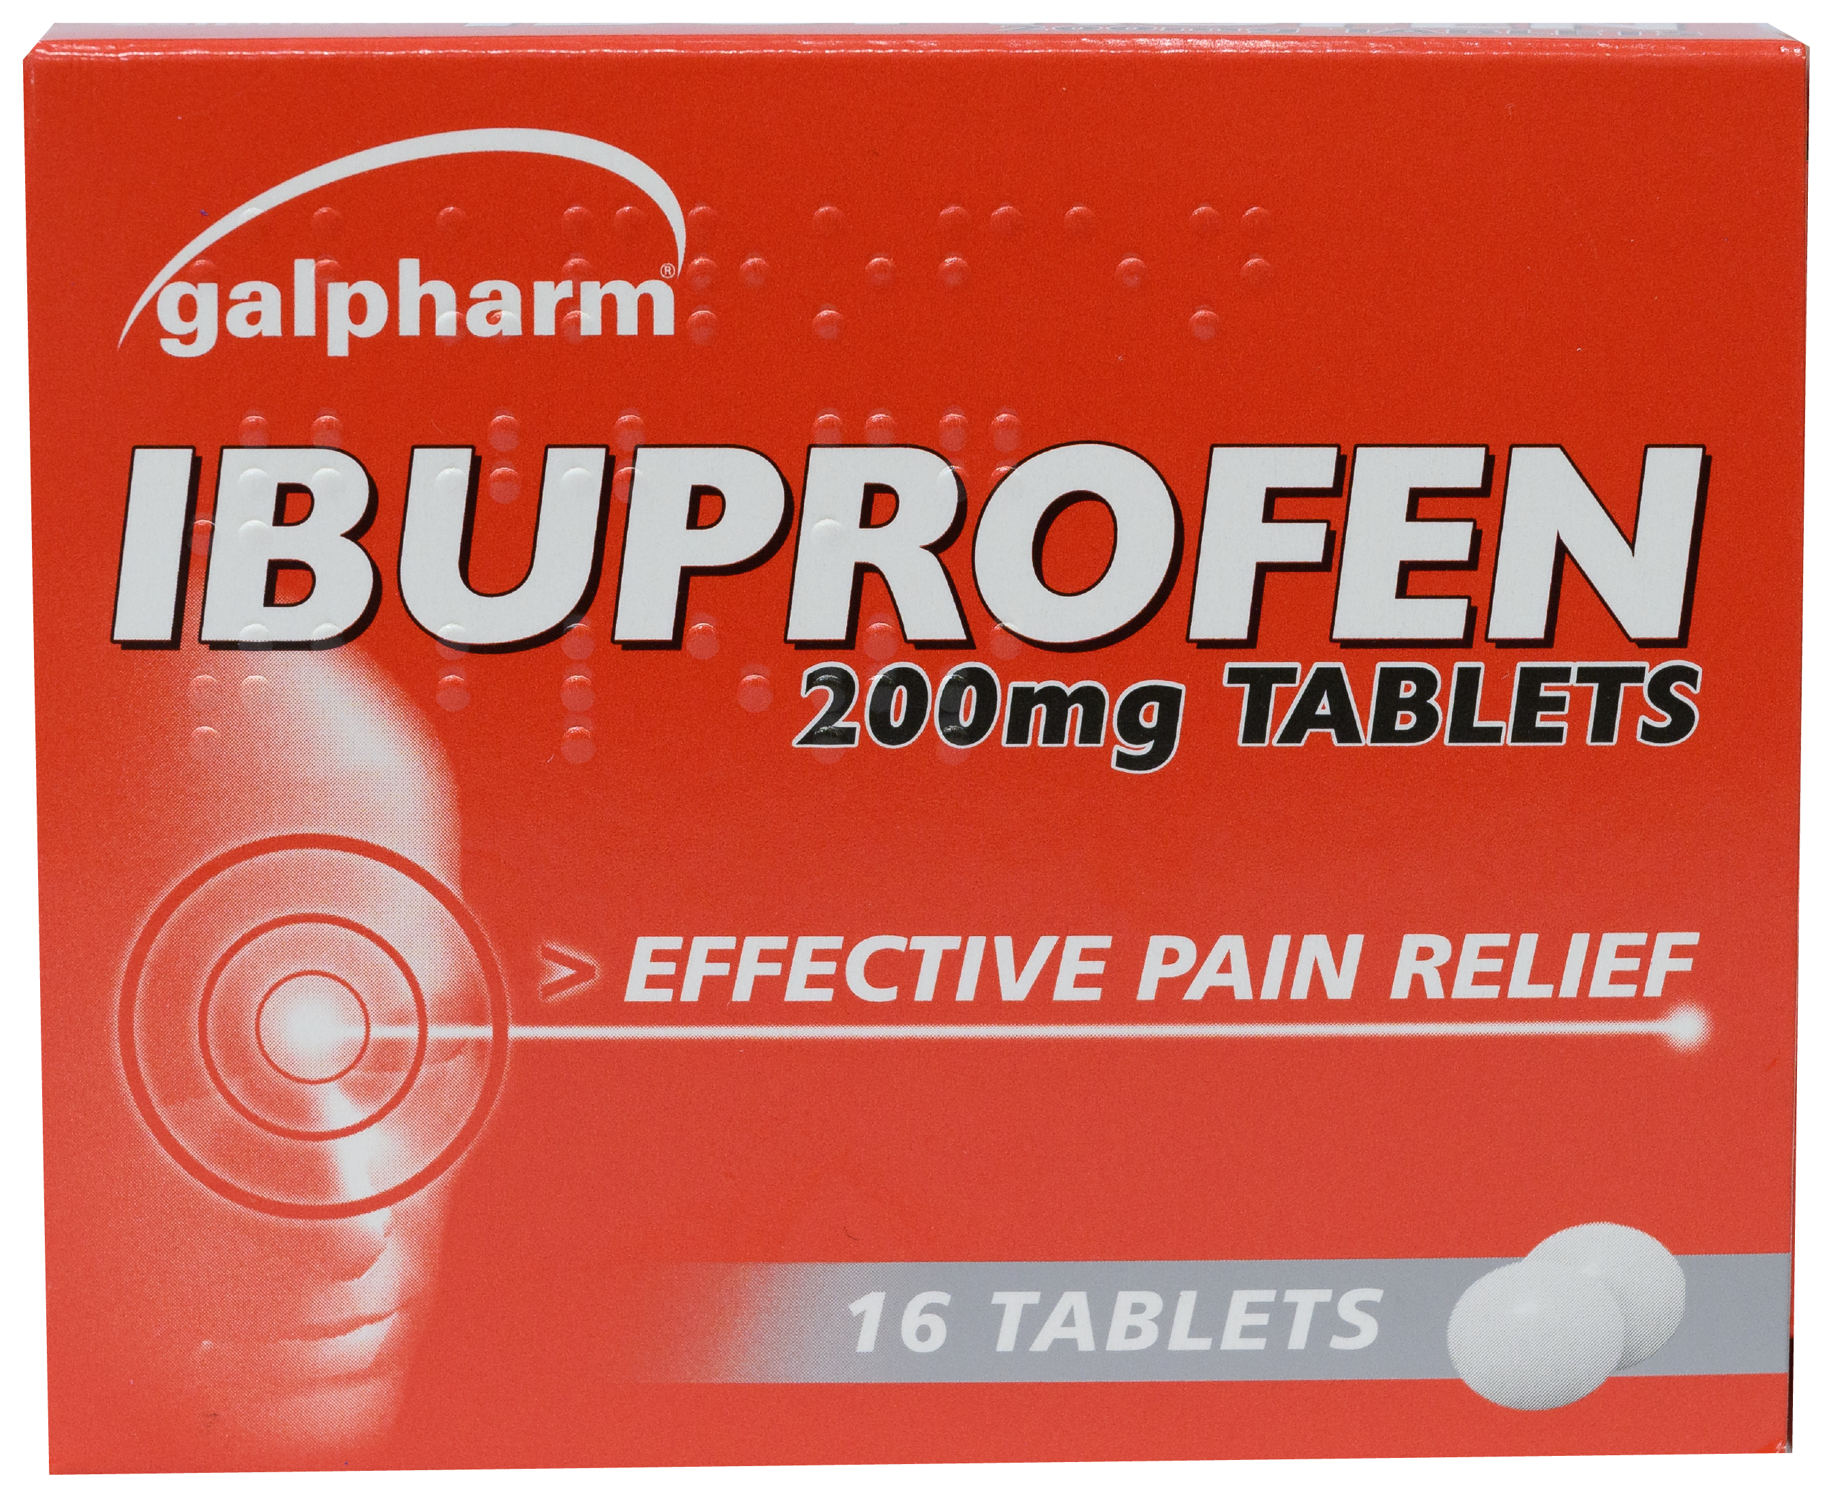
A day in the life
Name and type of medicine
Ingredients
Manufacturer
How many in the packet
Expiry date
Notes:
Teacher notes – A day in the life (slides 14-16, 10 mins)
Use this slide to take pupils’ feedback about what they have found. When showing this example, ensure pupils understand that other brands of ibuprofen are available, and the packaging of other products may vary depending on where/when they were purchased.
Point out that sometimes medicines are removed from their original packaging and put in ‘pill boxes’ for example, which might have the days of the week or times of day on them. These are often used by a person who needs to take medicines regularly to help them remember when to take the medicine. Before they are dispensed into these pots, the adult responsible will be aware of the correct ways to take the medicine.
Discuss how some medicines can be bought in shops or pharmacies, and some must be prescribed by a doctor or nurse. Explain that prescribed medicine is prepared for a specific individual but that medicines available to buy could be for anyone who is experiencing the illness. If possible, compare two different packages to demonstrate this.
For example:
Name and type of medicine
How much / How many in the packet
Uses - What it does, how it helps
Who the medicine is meant for
Dose - How much to take
How to use
Safety warning and instructions
Where and how to store the medicine
Side effects
Ingredients
Expiry date
Manufacturer

Slide 16
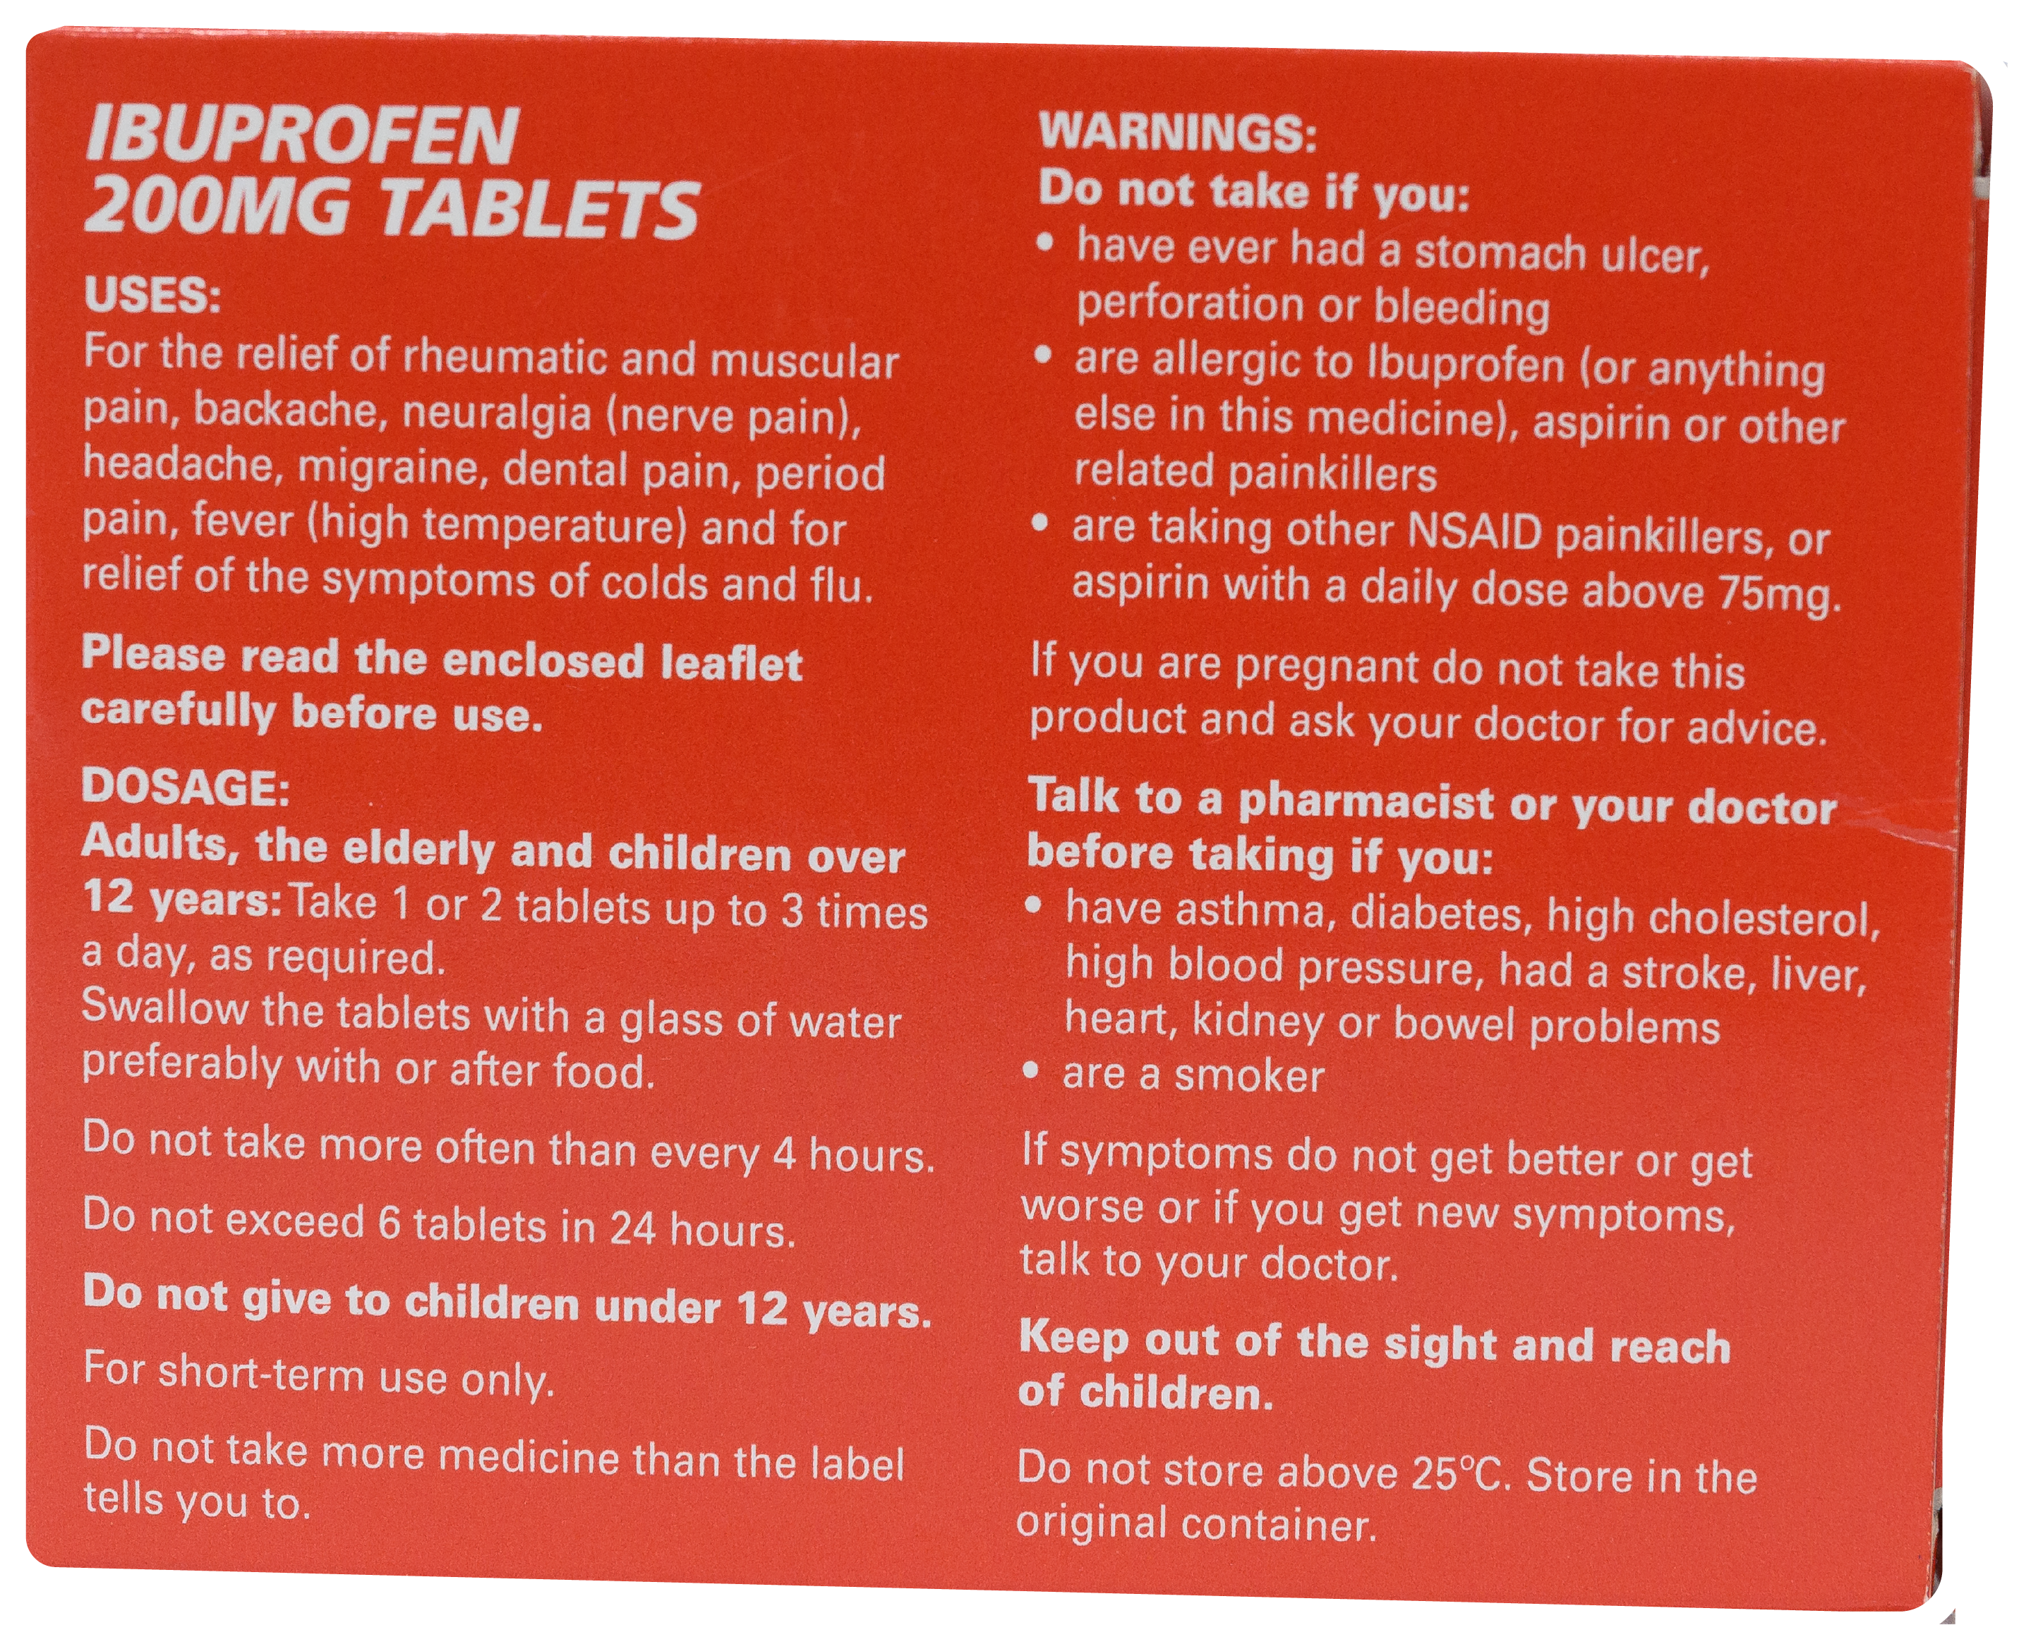
A day in the life
What it does
What it does
Safety warnings and instructions
Possible side effects
How much to take and how to use it
Who the medicine is meant for
Where and how to store the medicine
Notes:
Teacher notes – A day in the life (slides 14-16, 10 mins)
Use this slide to take pupils’ feedback about what they have found.
Point out that sometimes medicines are removed from their original packaging and put in ‘pill boxes’ for example, which might have the days of the week or times of day on them. These are often used by a person who needs to take medicines regularly to help them remember when to take the medicine. Before they are dispensed into these pots, the adult responsible will be aware of the correct ways to take the medicine.
Discuss how some medicines can be bought in shops or pharmacies, and some must be prescribed by a doctor or nurse. Explain that prescribed medicine is prepared for a specific individual but that medicines available to buy could be for anyone who is experiencing the illness. If possible, compare two different packages to demonstrate this.
For example:
Name and type of medicine
How much / How many in the packet
Uses - What it does, how it helps
Who the medicine is meant for
Dose - How much to take
How to use
Safety warning and instructions
Where and how to store the medicine
Side effects
Ingredients
Expiry date
Manufacturer

Slide 17
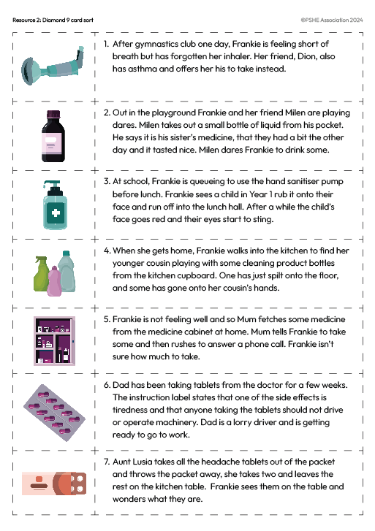
Freeze frame
In your pair or group, read the medicine safety scenario.
Choose a role with your partner/group and create a freeze frame of the scenario.
Once you’re ‘out of role’, talk about the risk in the scenario:
What is the risk?
What might happen?
Notes:
Teacher notes – Freeze frame (10 mins)
Organise pupils into small groups (of three) or pairs. Give each group a scenario from Resource 3: Medicine safety scenarios, ensuring an even spread of examples across the class.
Ask the pupils, in their groups, to read some examples of situations involving medicines and safety rules, then get ‘into role’ and make a ‘freeze frame’, as if someone had taken a photograph of the scenario.
If working in groups of three, one pupil can become the ‘director’ of the scene, rather than acting ‘in role’. To ensure role play is managed sensitively, provide a signal or countdown for pupils stepping ‘into role’ and another for coming ‘out of role’.
Once ‘out of role’, groups discuss the risk in the situation, answering the following questions:
What is the risk?
What might happen?
Support: Choose scenarios that are likely to have a more obvious outcome (such as scenarios 2, 4 and 7). Challenge: Extend pupils’ thinking by asking, if this happens, how could this affect the health of the person or people in the situation?

Slide 18
Roleplay
Think about your scenario with your group.
What should the characters do now to prevent any further risk?
Who could help? Where could the person get more support or advice?
Stepping back ‘into role’, role play what the characters should do to reduce any further risk and identify who could help.
Notes:
Teacher notes – Roleplay (15 mins)
Next, ask pupils to discuss the following two questions for their given scenario:
What should the characters do now to prevent any further risk?
Who could help? Where could the person get more support or advice?
Stepping back ‘into role’, ask pupils to role play what the characters should do to reduce any further risk and identify who can help.
Some of the groups can show their role plays to the class. The class feedback on whether they think the characters did the right thing to help prevent any further risk and share further ideas.
Suggestions to support pupils’ learning:
Frankie, Sam and the inhaler – prescribed medicines should not be shared, as the prescription (which medicine and how much they should take) may differ for individuals; some medicines are only prescribed to individuals, whereas others can be taken by anyone with that condition. Using someone else’s inhaler may cause a bad reaction. This should only ever be done in an emergency and under the guidance of a trained adult or medical professional. Frankie should move away from any triggers, sit up straight, try to remain calm and control her breathing. Sam should go and get help.
Frankie, Milen and the bottle of liquid – it is important not to take medicine that is not meant or prescribed for you; they do not know what the liquid is or the effect it will have on their bodies if they drink it, and it could make them ill. Frankie should refuse to drink the liquid and suggest Milen puts it back where he found it. Frankie should tell a teacher that Milen has the bottle of liquid, in case Milen decides to drink some.
Frankie, the Year 1 child and the hand sanitiser – using a cleaning product incorrectly can be harmful, in this case, the product is not meant for use on the face and may have caused an allergic reaction. Frankie should alert a teacher, and the child should let a teacher/parent or carer know what happened. It is likely the teacher/parent or carer will suggest the child washes their face with water in the first instance to remove the product from their skin. If it has gone in the child’s eyes, the adult should help them rinse their eyes with water immediately. If it worsens, they may need to see a doctor or pharmacist.
Frankie, her cousin and the cleaning products – children should not play with cleaning products, if some goes onto their skin or into their mouth this could be very harmful. Frankie should alert an adult immediately; the baby’s skin should be washed under water to remove the product; the spillage should be cleaned up quickly so as not to cause further accidents; the cleaning products put away and safely out of reach of children.
Frankie, Mum and the medicine – children should be supervised by an adult when taking medicines, the amount to use should be checked by reading the instructions and not guessing – taking too much can make someone more ill. Frankie should wait until Mum comes off the phone to help.
Dad and the tablets – some medicines can cause ‘side effects’; Dad is at risk of causing an accident if he is too tired to drive. Dad should check the instructions and side effects warnings; he could ask a pharmacist or call the NHS helpline (111) to find out if it is safe for him to drive and work if he is still not sure.
Frankie, Aunt Lusia and the tablets on the table – leaving medicines around is dangerous because people might mistake them for something else (e.g. sweets) which, if eaten, could cause a bad reaction or make someone ill; it is important to dispose of unwanted medicines correctly -unused prescribed medicines should be disposed of properly by taking them back to the pharmacist. Frankie should alert an adult that the tablets have been left on the table. The adult should throw them away correctly or put them back into a correctly labelled box.

Slide 19
Who can help?
Remember that medicines are helpful for health but only if they are used correctly. Trusted adults should give medicine to children.
If you are unsure about using a medicine, ask a trusted adult.
I need your help with something . . .
Something's worrying me, can I talk to you?
I have something that’s been bothering me . . .
Notes:
Teacher notes – Signposting support (5 mins)
Reiterate that medicines are helpful for health but only if they are used correctly and stored/disposed of safely. Adults should administer medicines to children; there are some medicines children can use on their own if they have been trained to do so (such as inhalers) but usually adults should give medicines to children. Adults can find help with using medicines on the medicine packets, from a doctors’ surgery or pharmacy or by phoning the NHS helpline – dial 111.
Explain that if they are ever unsure about using a medicine, they should ask a trusted adult and if they are ever in a situation where a medicine has caused illness and a trusted adult is not available, they should call the emergency services by dialling 999.

Slide 20
What have we learnt?
Go back to the questions from your benefits and risks list.
Is there anything you would like to change?
Is there anything you would like to add?
Use a different colour pen or pencil.
Notes:
Teacher notes - Reflection and endpoint assessment (slides 20-21, 10 mins)
Pupils return to their baseline assessment activity, benefits and risks list and the questions they answered:
How do these help us?
Are there any risks from using these products? What are the risks?
What will help reduce the risks?
Thinking about their learning from the lesson, ask pupils to add to or amend their ideas. They can do this on the original sheet using a different colour pencil or pen or start a clean page if preferred.

Slide 21
What have we learnt?
Share one thing this lesson has made you think about medicine safety. It could be:
Something new you have learnt
Something you think is important to remember in the future
Notes:
Teacher notes - Reflection and endpoint assessment (slides 20-21, 10 mins)
Ask pupils to share one thing this lesson has made them think about medicine safety – something new they have learnt or something they think is important for them to remember in the future.

Slide 22
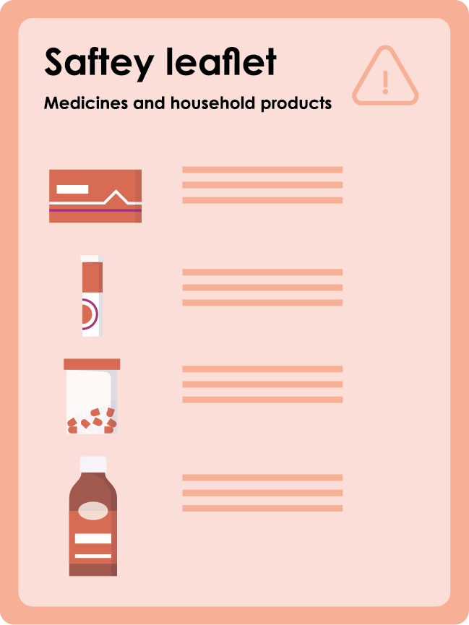
Safety leaflet
Make a leaflet designed for the Grech family about safety with medicines and household products.
Notes:
Teacher notes – Extension activity
Make a leaflet designed for the Grech family about safety with medicines and household products.

