Slide 1
Drug education
Medicines
Year 5-6: Lesson 1

Slide 2
Using this PowerPoint
The slides in this presentation are divided into two sections:
Teacher slides (purple) – provide key information regarding lesson preparation.
Pupil slides – provide a visual focus point for pupils during the lesson and delivery notes for teachers about the activities. Click ‘notes’ to view these.
Ensure that you select ‘Use Presenter View’ under the ‘Slide Show’ tab – this will allow you to preview the teaching notes on your monitor while the main presentation is displayed on a screen/smartboard.

Slide 3
Support and challenge
The lesson includes suggestions for challenge and support activities, to help you differentiate appropriately for your class.
Support activities are adapted to be more accessible for those who need it.
Challenge activities deepen and extend learning for those who need more challenge or who finish the activity quickly.
Look for these icons on the pupil slides. See delivery notes for details of the activities.
Challenge
Support

Slide 4
Context
This is the first of four drug education lessons, for year 5–6. This lesson focuses on using medicines correctly and safely, and how they contribute to people’s health and wellbeing, both every day and in emergency situations. Pupils also develop their knowledge and understanding of how vaccinations and immunisation can work to stop disease spreading and protect people from infection.

Slide 5
Developing subject knowledge
Key information on content related to these lessons can be found in the Year 5-6 Knowledge Organiser.
Advice on safe practice, dispelling common misconceptions, visitors to the classroom and other important information can be found in Teacher Guidance: Drug and alcohol education
Data sources to inform your planning can be found within our document that outlines the approach of these lessons Evidence Review: Effective drug and alcohol education, along with advice regarding how to talk to young people about addiction, dependency and problematic substance use.

Slide 6
To learn how the correct use of medicines, and vaccinations, can help to maintain health and wellbeing.
describe how medicines, when used responsibly, can support health and wellbeing
explain how preventative medicines such as vaccinations can stop disease from spreading
explain the safe use of medicines to help manage illness and allergies
identify where to find further advice and guidance about the correct use of medicines

Slide 7
Box or envelope for questions
Large pieces of paper and marker pens for group work
Resource 1: Thinking bubbles [Pupils write in their books or complete the sheet – one copy per pupil]
Resource 2: Vaccination cards [one sheet per group]
Resource 3: Case studies [one set per group]
Notes:
It is important to consider sensitivities and prior knowledge about specific pupils’ circumstances. Pupils in the class will have a range of experience and understanding of the use of medicines, and some may be experiencing or have family members with health conditions. If any safeguarding issues arise during this lesson, these should be reported to the Designated Safeguarding Lead.

Slide 8
Lesson summary
Activity | Description | Timing
Baseline assessment activity | Remind pupils of ground rules. Individually, pupils write down what they already know about managing illness, allergies and disease. | 10 mins
Introduction | Introduce the learning objective and outcomes. Pupils are reminded of the role of medicines. | 5 mins
Vaccination card game | In groups, pupils play a card game to develop their understanding of vaccination and immunity. | 15 mins
Rainbow groups | Pairs of pupils read medicine case studies, then in groups they make a chart about what they have learnt. | 15 mins
Signposting support | Pupils reflect on how medicines are administered safely and are provided with guidance on where to get further information and advice. | 5 mins
Reflection and endpoint assessment | Pupils go back to their baseline assessments, add to or amend them to demonstrate their new learning. | 10 mins

Slide 9
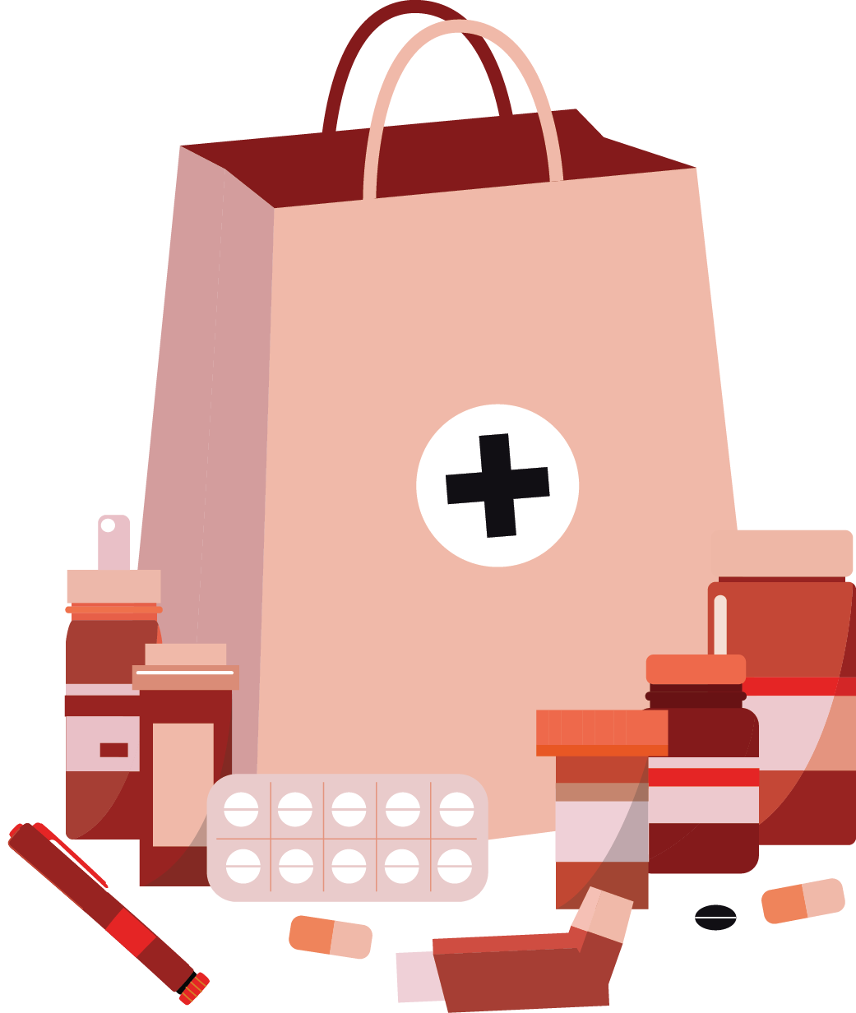
Medicines
Lesson 1

Slide 10
Notes:
Teacher notes – Baseline assessment (slides 10-11, 10 mins) Remind pupils of ground rules, pointing out any especially useful to remember for this lesson, such as not putting people on the spot by asking them personal questions about medication they use.

Slide 11
What’s our starting point?
Write down what you think we can do to manage:
illness
allergies
infectious diseases
Notes:
Teacher notes – Baseline assessment (slides 10-11, 10 mins) In their exercise books or using Resource 1: Thinking bubbles, ask pupils to write what they know already about what can be done to manage illness, allergies or infectious diseases, by writing their ideas around these words.
Do not prompt the pupils or give examples. Reassure them that if they don’t have much to add to their sheets at the moment, it doesn’t matter, as they will be learning about this in the lesson and this activity is to find out what they already know and think. They should ensure their ideas are their own and not work with others. Circulate the room as the pupils complete this to gauge their starting point.

Slide 12
To learn how the correct use of medicines, and vaccinations, can help to maintain health and wellbeing.
describe how medicines, when used responsibly, can support health and wellbeing
explain how preventative medicines such as vaccinations can stop disease from spreading
explain the safe use of medicines to help manage illness and allergies
identify where to find further advice and guidance about the correct use of medicines
Notes:
Teacher notes – Introduction (Slides 12-13, 5 mins)
Introduce the learning objective and outcomes.

Slide 13
Introduction
The use of a medicine depends on the type of disease or illness someone has. Medicines can:
Prevent someone from becoming ill or stop a disease from spreading
Help someone feel better and relieve pain, such as from a headache
Help someone manage an ongoing health condition, such as asthma or diabetes
Help the body recover from illness
Notes:
Teacher notes – Introduction (Slides 12-13, 5 mins)
Explain that the use of a medicine depends on the type of disease or illness someone has. Medicines can:
help someone feel better and relieve pain, such as from a headache
help the body recover from illness
help someone manage an ongoing health condition, such as asthma or diabetes
prevent someone from becoming ill or stop a disease from spreading.

Slide 14
Vaccination card game
Place all cards face down on the table (except the card with the red dot).
Notes:
Teacher notes – Vaccination card game (slides 14-18, 15 mins)
Explain that to keep some diseases caused by viruses (for example, measles and flu) under control, people can be given a vaccine so that they become immune to it, even if others around them have the virus. To successfully stop a virus from spreading, nearly all people in the population need to have the vaccine. To demonstrate this, play the card game using Resource 2: Vaccination cards.
Give small groups, of up to six pupils, cards from either scenario 1, 2 or 3 (aim to ensure an even spread across the class). Let pupils know that the cards represent a population (the number of people in a particular area).
Ask pupils to place all the cards face down on the table except for the card with the red dot. Explain that the card with the red dot represents a virus and the other cards which are face down represent people that the virus is going to come into contact with. One person takes the card with the red dot and puts it next to another face-down card. They then turn over the face-down card:
If it has a V on it, that person is vaccinated against the virus, so will not catch it. The V card can be put to one side.
If the card that is turned over has a circle on it, that person is not vaccinated so catches the virus. The pupil colours in the circle in red to make a second virus card.
Now each of the virus cards is matched to one of the remaining face-down cards and repeat the process – as before, if the card has a V on it, put it to one side, if it has a circle, colour it red so it becomes another virus card to be paired with one of the remaining face-down cards. Continue matching the virus cards with face-down cards until all the cards have been turned over.

Slide 15
Vaccination card game
One person takes this card and places it next to another face-down card. Then they turn over the face-down card.
Notes:
Teacher notes – Vaccination card game (slides 14-18, 15 mins)
Explain that to keep some diseases caused by viruses (for example, measles and flu) under control, people can be given a vaccine so that they become immune to it, even if others around them have the virus. To successfully stop a virus from spreading, nearly all people in the population need to have the vaccine. To demonstrate this, play the card game using Resource 2: Vaccination cards.
Give small groups, of up to six pupils, cards from either scenario 1, 2 or 3 (aim to ensure an even spread across the class). Let pupils know that the cards represent a population (the number of people in a particular area).
Ask pupils to place all the cards face down on the table except for the card with the red dot. Explain that the card with the red dot represents a virus and the other cards which are face down represent people that the virus is going to come into contact with. One person takes the card with the red dot and puts it next to another face-down card. They then turn over the face-down card:
If it has a V on it, that person is vaccinated against the virus, so will not catch it. The V card can be put to one side.
If the card that is turned over has a circle on it, that person is not vaccinated so catches the virus. The pupil colours in the circle in red to make a second virus card.
Now each of the virus cards is matched to one of the remaining face-down cards and repeat the process – as before, if the card has a V on it, put it to one side, if it has a circle, colour it red so it becomes another virus card to be paired with one of the remaining face-down cards. Continue matching the virus cards with face-down cards until all the cards have been turned over.

Slide 16
Vaccination card game
If it has a V on it, that person is vaccinated against the virus, so will not catch it. The V card can be put to one side.
If the card that is turned over has a circle on it, that person is not vaccinated so catches the virus. Colour the circle in red to make a second virus card.
Notes:
Teacher notes – Vaccination card game (slides 14-18, 15 mins)
Explain that to keep some diseases caused by viruses (for example, measles and flu) under control, people can be given a vaccine so that they become immune to it, even if others around them have the virus. To successfully stop a virus from spreading, nearly all people in the population need to have the vaccine. To demonstrate this, play the card game using Resource 2: Vaccination cards.
Give small groups, of up to six pupils, cards from either scenario 1, 2 or 3 (aim to ensure an even spread across the class). Let pupils know that the cards represent a population (the number of people in a particular area).
Ask pupils to place all the cards face down on the table except for the card with the red dot. Explain that the card with the red dot represents a virus and the other cards which are face down represent people that the virus is going to come into contact with. One person takes the card with the red dot and puts it next to another face-down card. They then turn over the face-down card:
If it has a V on it, that person is vaccinated against the virus, so will not catch it. The V card can be put to one side.
If the card that is turned over has a circle on it, that person is not vaccinated so catches the virus. The pupil colours in the circle in red to make a second virus card.
Now each of the virus cards is matched to one of the remaining face-down cards and repeat the process – as before, if the card has a V on it, put it to one side, if it has a circle, colour it red so it becomes another virus card to be paired with one of the remaining face-down cards. Continue matching the virus cards with face-down cards until all the cards have been turned over.

Slide 17
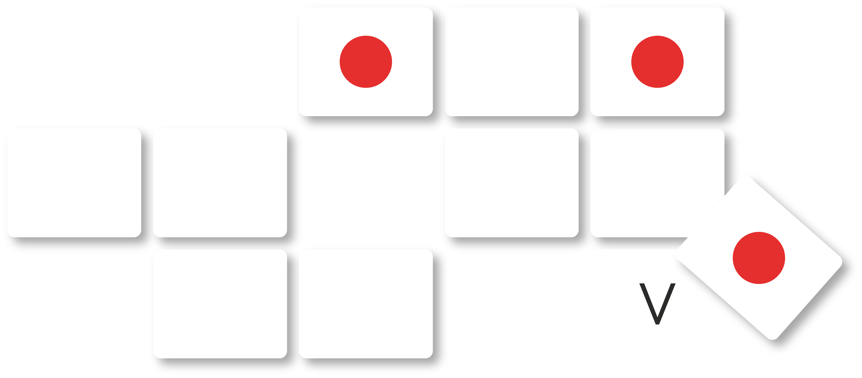
Vaccination card game
Take it in turns to place a virus card next to another face-down card and repeat the process.
Notes:
Teacher notes – Vaccination card game (slides 14-18, 15 mins)
Explain that to keep some diseases caused by viruses (for example, measles and flu) under control, people can be given a vaccine so that they become immune to it, even if others around them have the virus. To successfully stop a virus from spreading, nearly all people in the population need to have the vaccine. To demonstrate this, play the card game using Resource 2: Vaccination cards.
Give small groups, of up to six pupils, cards from either scenario 1, 2 or 3 (aim to ensure an even spread across the class). Let pupils know that the cards represent a population (the number of people in a particular area).
Ask pupils to place all the cards face down on the table except for the card with the red dot. Explain that the card with the red dot represents a virus and the other cards which are face down represent people that the virus is going to come into contact with. One person takes the card with the red dot and puts it next to another face-down card. They then turn over the face-down card:
If it has a V on it, that person is vaccinated against the virus, so will not catch it. The V card can be put to one side.
If the card that is turned over has a circle on it, that person is not vaccinated so catches the virus. The pupil colours in the circle in red to make a second virus card.
Now each of the virus cards is matched to one of the remaining face-down cards and repeat the process – as before, if the card has a V on it, put it to one side, if it has a circle, colour it red so it becomes another virus card to be paired with one of the remaining face-down cards. Continue matching the virus cards with face-down cards until all the cards have been turned over.

Slide 18
Vaccination card game
Once all the cards have been turned over, share the outcome of your game.
How many people were infected?
How many people were vaccinated?
Do you think your population is protected from the virus?
Notes:
Teacher notes – Vaccination card game (slides 14-18, 15 mins)
Once all the cards have been turned over, ask pupils to share the outcome of their games. How many people are now infected and how many were vaccinated? Do they think their population is protected from the virus? (scenario 1: 10% vaccinated, scenario 2: 50% vaccinated, scenario 3: 95% vaccinated). The group(s) which had scenario 3 will find that they have only coloured in one additional card and all the rest were vaccinated. So even when they had two virus cards, neither of these could infect anyone else as everyone else was vaccinated and protected from the virus.
Explain that about 95% of the population would need to be vaccinated to stop a virus from spreading and so scenario 3 (19 vaccinated cards) would be the population most protected from the disease.
Explain that vaccinations for lots of diseases are available from a doctor or nurse. Most are given to babies or children so that they develop immunity early on and some to older adults, or those who are more at risk, who may need extra protection from diseases like flu. In some cases, a vaccinated person may still be affected by an illness they have been vaccinated against, but the vaccine can lessen the severity of the illness. Vaccine boosters may also be required. Generally, when a new virus occurs, it can take some time for scientists to create and test a vaccine that they know is safe and will protect people.
(Note: The threshold proportion for the number of people who need to be vaccinated to prevent a disease spreading depends on how contagious a virus is. This is an illustrative example for measles which is highly contagious, meaning a higher number of the population need to be vaccinated, and is typical for similar viral diseases.)
Support: Use Resource 2a support: Vaccination diagram to help visually demonstrate the concept of immunity through vaccinations.
Challenge: Ask pupils to write a paragraph or draw a diagram to show how a virus can be prevented from spreading by using a vaccination.

Slide 19
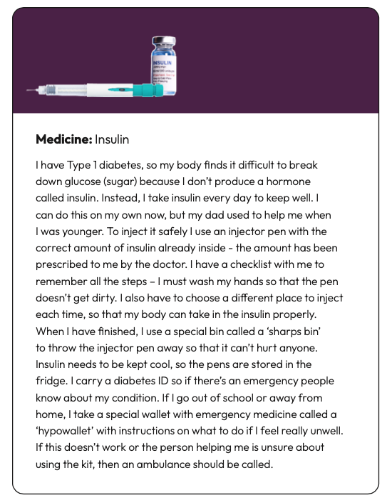
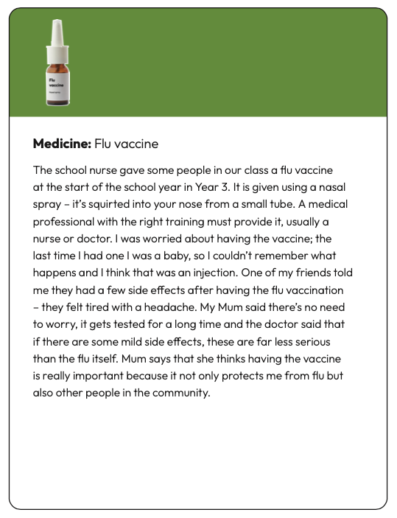
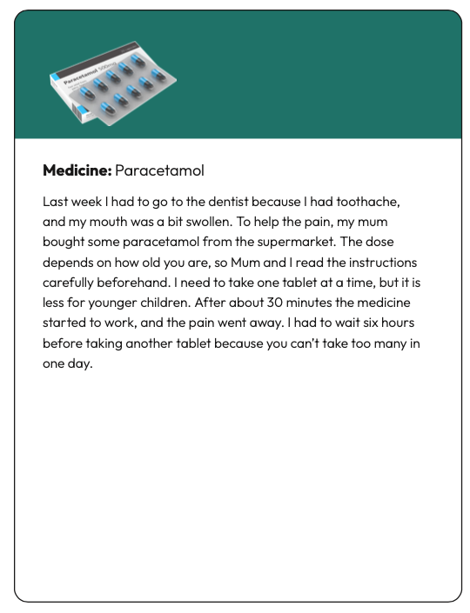
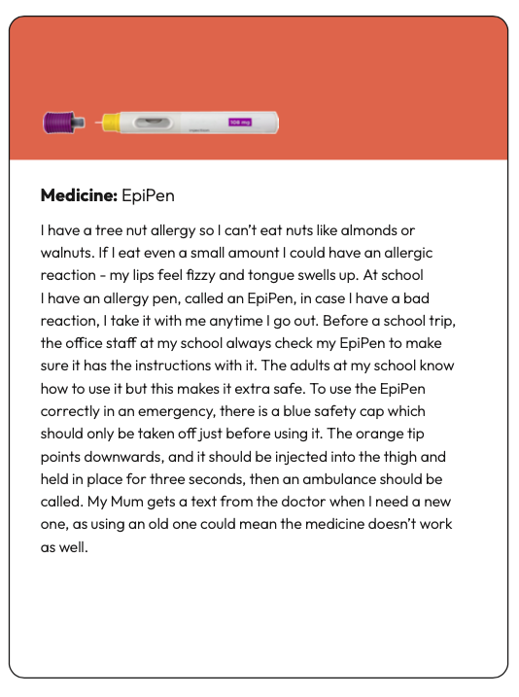
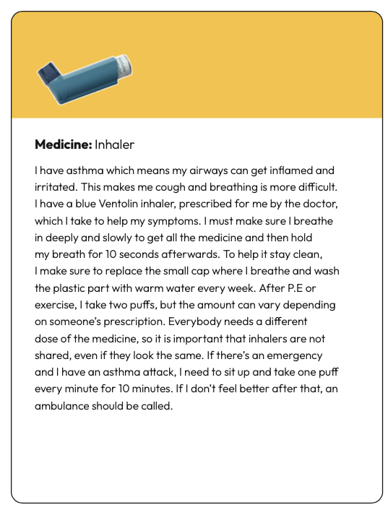
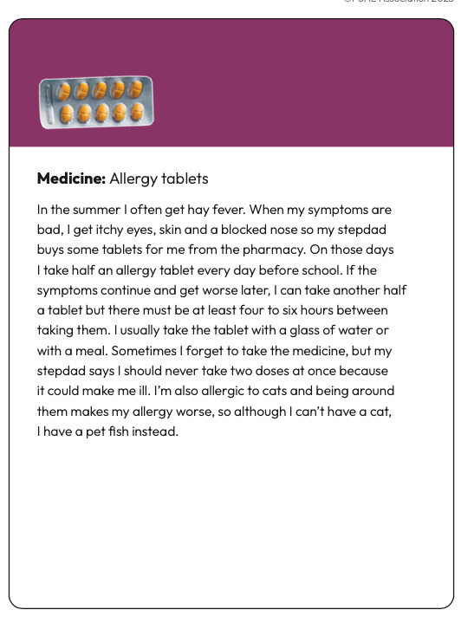
Rainbow groups
In your groups, read the case study.
Now discuss these questions with your group:
What is the medicine?
Why is it used?
How is it used?
Is it used for every day/sometimes, for emergencies, or both? (If both, explain how)
Notes:
Teacher notes – Rainbow groups (slides 19-20, 15 mins)
Organise pupils into groups and label each group a different colour (e.g. yellow, blue, red, green, purple and orange). Give each group a different case study to read and discuss – select these from Resource 3: Case studies. Ask pupils to focus on the following questions:
What is the medicine?
Why is it used?
How is it used?
Is it used for every day/sometimes, for emergencies, or both (if both, explain how)?

Slide 20
Rainbow groups
In your Rainbow group, draw a grid with the following headings.
Add the information about the medicines to the grid.
Name of medicine | What? | Why? | How? | Everyday /emergency
Notes:
Teacher notes – Rainbow groups (slides 19-20, 15 mins)
Next, pupils make ‘rainbow groups’ ensuring that each group includes one person from each colour of the rainbow and so that each person in the group has read a different case study.
You may want to keep one of the case studies back to model the following activity.
In their rainbow groups, ask pupils to draw a grid on a large piece of paper with the following headings across the top: ‘What?’, ‘Why?’, ‘How?’, ‘Every day/Emergency’, and the names of the medicines down the left-hand side.
Pupils discuss the different medicines in their new groups and add the information to the grid.

Slide 21
Who can help?
Medicines are helpful for health but only if used, stored and disposed of correctly. Only trusted adults should give medicine to children. If you’re ever unsure about using a medicine, ask a trusted adult for help.
Further information and support about the health conditions in the lesson can be found here:
National Eczema Society
Asthma UK
Diabetes UK
Allergy UK
I need your help with something . . .
Something's worrying me, can I talk to you?
I have something that’s been bothering me . . .
Notes:
Teacher notes – Signposting support (5 mins)
Reiterate that people use medicines differently depending on the type of illness they have. Some young people, such as those with diabetes and asthma, live with their health conditions every day and have been trained by a doctor or nurse to be able to take their medicines on their own.
Remind pupils that medicines are helpful for health but only if used correctly and stored/disposed of safely. Adults should administer medicines to children (with the exception of those mentioned above). Make pupils aware of the following webpages which offer advice and support for the health conditions in this lesson: National Eczema Society, Asthma UK, Diabetes UK and Allergy UK.
Explain that if they are ever unsure about using a medicine, they should ask a trusted adult. And if they are ever in an emergency situation and a trusted adult is not available, then they should call the emergency services on 999.

Slide 22
What have we learnt?
Go back to your thinking bubbles from the beginning of the lesson.
Use a different colour pen or pencil to add to or change your ideas.
illness
allergies
infectious diseases
Notes:
Teacher notes - Reflection and endpoint assessment (10 mins)
Ask pupils to return to their baseline assessment activity and add to each thinking bubble in a different coloured pencil/pen, reflecting on what they have learnt in the lesson about what can be done to manage illness, allergies and infectious diseases. Use this as evidence of learning and progress and to inform further teaching.

Slide 23
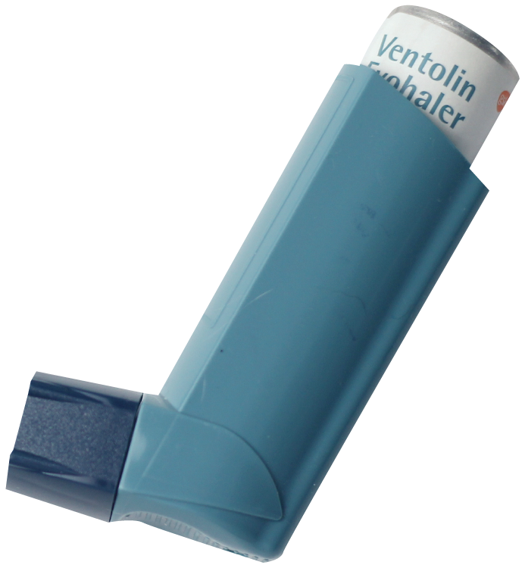
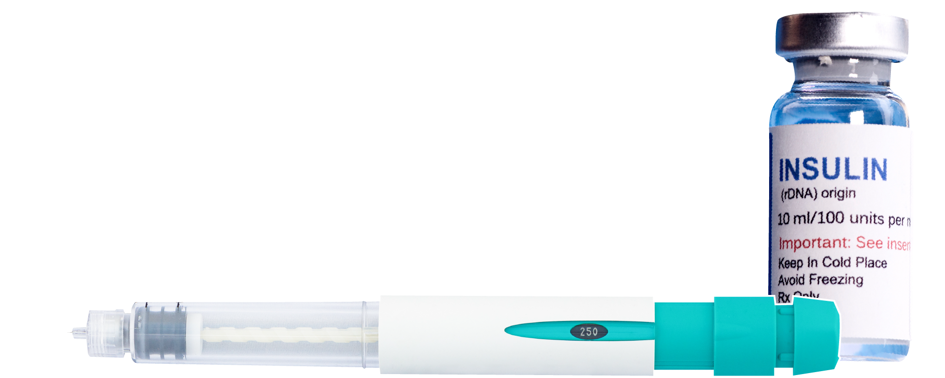
Medicines in emergency situations
Choose one medicine from the lesson that might be used in an emergency.
Write the steps for their safe use in an emergency.
Step 1.
Inhaler
Step 2.
EpiPen
Step 3.
Insulin
Notes:
Teacher notes – Extension activity
Ask pupils to identify those medicines that might be used in an emergency and focus on one medicine - inhaler, EpiPen or insulin, and then write the steps for their safe use in an emergency situation.
For example, asthma attack:
Step 1: Sit upright
Step 2: Take one puff every minute for 10 minutes
Step 3: If attack continues call an ambulance

