Slide 1
Drug education
Influences and pressure
Year 5-6: Lesson 3

Slide 2
Using this PowerPoint
The slides in this presentation are divided into two sections:
Teacher slides (purple) – provide key information regarding lesson preparation.
Pupil slides – provide a visual focus point for pupils during the lesson and delivery notes for teachers about the activities. Click ‘notes’ to view these.
Ensure that you select ‘Use Presenter View’ under the ‘Slide Show’ tab – this will allow you to preview the teaching notes on your monitor while the main presentation is displayed on a screen/smartboard.

Slide 3
Support and challenge
The lesson includes suggestions for challenge and support activities, to help you differentiate appropriately for your class.
Support activities are adapted to be more accessible for those who need it.
Challenge activities deepen and extend learning for those who need more challenge or who finish the activity quickly.
Look for these icons on the pupil slides. See delivery notes for details of the activities.
Challenge
Support

Slide 4
Context
This is the third of four drug education lessons, for year 5–6. This lesson focuses on the reasons why someone may or may not choose to use a drug, through analysing different influences. Pupils also explore ways to manage these influences and ways to respond, including how to do so assertively in a range of situations.

Slide 5
Developing subject knowledge
Key information on content related to these lessons can be found in the Year 5-6 Knowledge Organiser.
Advice on safe practice, dispelling common misconceptions, visitors to the classroom and other important information can be found in Teacher Guidance: Drug and alcohol education
Data sources to inform your planning can be found within our document that outlines the approach of these lessons Evidence Review: Effective drug and alcohol education, along with advice regarding how to talk to young people about addiction, dependency and problematic substance use.

Slide 6
To learn about the reasons why people use drugs, and how to manage peer influence.
explain why people may choose to use or not use a drug, and the different factors that might influence them
analyse what is most likely to influence a person to use or not use a drug
describe strategies for managing peer influence in situations that might involve drugs
explain how to ask for help from a trusted adult if they have any worries about drugs and why this is important

Slide 7
Box or envelope for questions
Post-it notes
Resource 1: Bus stop conversation [one per pupil]
Resource 2: Influences diamond 9 cards [one set per group]
Resource 3: Pressure scenario cards [one set per class]
Resource 4: Responses prompts [one per pair, as required]
Resource 4a: Responses prompts – teacher guide [teacher copy]
Notes:
It is important to consider sensitivities and prior knowledge about specific pupils’ experiences in relation to drugs, alcohol, tobacco and vaping. Pupils’ exposure to different influences will depend on their individual, family and social circumstances. Ensure that ground rules refer to not sharing personal stories and keeping confidentiality. If concerns around personal safety arise during this lesson, these should be reported to the Designated Safeguarding Lead.

Slide 8
Lesson summary
Activity | Description | Timing
Baseline assessment activity | To be completed before the lesson. Reinforce ground rules. Pupils then complete speech and thought bubbles about tobacco, vapes, alcohol or other drugs. | 15 mins
Introduction | Remind pupils of the ground rules and introduce the learning objective and outcomes. Pupils discuss reasons why someone may use a drug. | 5 mins
Diamond 9: Part 1 | Pupils rank places or things that might influence someone to use a drug. | 10 mins
Diamond 9: Part 2 | Pupils consider reasons why someone might choose not to use a drug. | 10 mins
Strategies for managing pressure | Pupils identify influences and pressure in a scenario and explore what is meant by a passive, aggressive and assertive response. | 10 mins
Responding to pressure | Pupils read scenarios and suggest ways the character can manage the influence or pressure in the situation, giving examples of an assertive response. | 10 mins
Signposting support | Pupils decide if, when and how a character can seek support. Highlight sources of support. | 5 mins
Reflection and endpoint assessment | Pupils write a ‘take-away’ sentence about their learning on drugs, alcohol, tobacco and vaping, pressure and how to manage it. | 10 mins

Slide 9
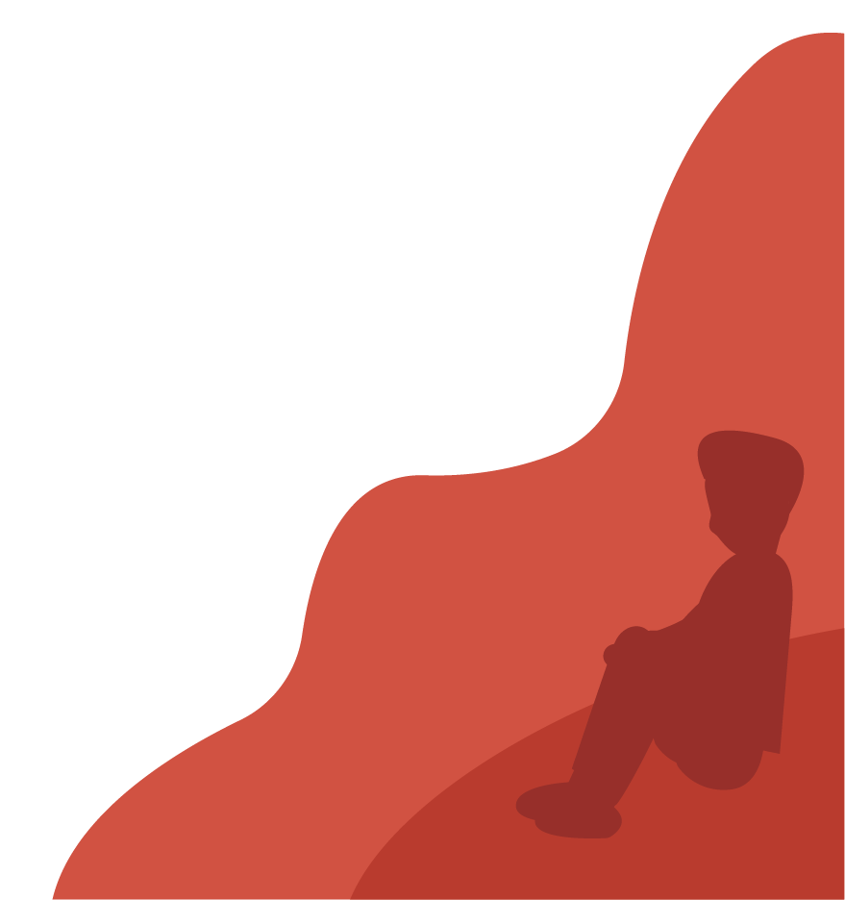
Influences and pressure
Lesson 3

Slide 10
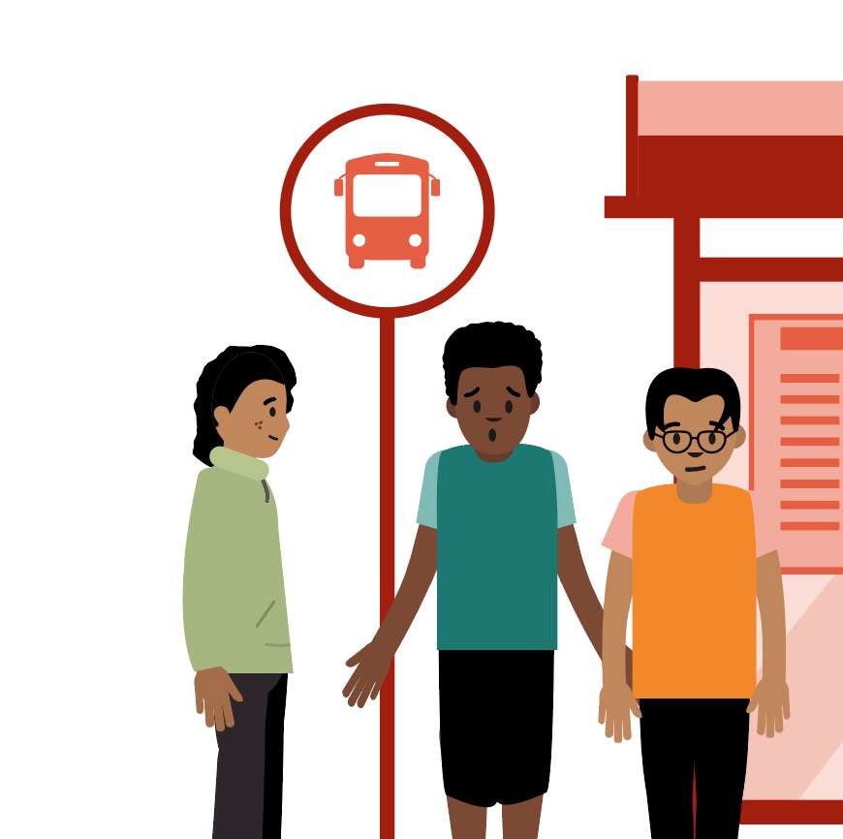
What’s our starting point?
Some young people are having a conversation about why people use drugs, smoke tobacco, vape, or drink alcohol.
What might they be saying?
What could someone do or say if they didn’t want to use drugs, smoke tobacco, vape, or drink alcohol?
Write your ideas on the sheet.
Notes:
Teacher notes – Baseline assessment (slides 10-11, 15 mins)
This activity should be completed before the lesson. This allows time to look through pupils’ work and note any patterns or misconceptions prior to teaching the lesson.
Explain that some young people are having a conversation about why people use drugs, smoke tobacco, vape, or drink alcohol.
Ask: What might they be saying?
Then ask: What could someone do or say if they didn’t want to use drugs, smoke tobacco, vape, or drink alcohol?
Pupils use Resource 1: Bus stop conversation to record their ideas. Collect these in and use responses to inform this lesson and future teaching about drugs, alcohol, tobacco and vaping.
Pupil responses might include:
They are saying: to try it out and see what it’s like, because they feel they need it, are addicted, because their friends are doing it, they think smoking is cool, to relax, they think vaping doesn’t harm you
If someone didn’t want to, they could: say no; walk away; explain their reasons for not wanting to; avoid the situations or places where it happens.

Slide 11
Notes:
Teacher notes – Baseline assessment (slides 10-11, 15 mins) Remind pupils of the importance of the shared ground rules for these lessons, including that it is important to accept that people have different opinions and beliefs and to be respectful of each other’s views in the lesson.

Slide 12
To learn about the reasons why people use drugs, and how to manage peer influence.
explain why people may choose to use or not use a drug, and the different factors that might influence them
analyse what is most likely to influence a person to use or not use a drug
describe strategies for managing peer influence in situations that might involve drugs
explain how to ask for help from a trusted adult if they have any worries about drugs and why this is important
Notes:
Teacher notes – Introduction (slides 12-13, 5 mins)
Introduce the learning objective and outcomes.

Slide 13
Introduction
Think of a drug.
Why might a person use that drug?
Notes:
Teacher notes – Introduction (slides 12-13, 5 mins)
Ask pupils to think of a drug and why a person might use that drug. Record the pupils’ ideas on the board or flipchart.
To maintain a safe climate for learning, it is important that pupils know they do not need to name the drug or the person, just to give the reason.

Slide 14
Diamond 9: Part 1
Discuss the different people, places or things that might influence someone to use a drug.
In your group, think of a drug and discuss what would most influence whether a person would use the drug. Then, use the diamond 9 to rank them from most to least influence.
Most influence
Least influence
Notes:
Teacher notes – Diamond 9: Part 1 (10 mins)
Ask pupils to discuss the different people, places or things that might influence someone to use a drug. Make a list on the board.
Responses might include: where they are; who they are with; what they have seen/heard about the drug; their health; how they get the drug.
Ask pupils to think of a drug and work in groups to consider what would most influence whether a person would use the drug.
Ask pupils to rank the following influences from most to least influence in a diamond 9: friends; family; online gamer/influencer; religion/beliefs; money; health advice (e.g. from a doctor); the situation; their feelings/emotions (mental health); their physical health – using Resource 2: Influences diamond 9 cards. The card at the top of the diamond should represent what they think is the greatest influence and the card at the bottom of the diamond should represent what they think is the least influence. The cards in the middle section are placed in rows that they think are ‘equally important’.
Compare responses from different groups. If there are any other influences that may not have been included on the cards, that pupils discussed, highlight these with the class.
Pupil responses at the top of the diamond 9 might include:
Friends - people might feel more pressure to use a drug if their friends are also doing so.
Situation - if the person is in a situation where the drug is readily available, or in which they feel nervous.
Online gamer/influencer - if someone they look up to online is shown using the drug too.
Other influences pupils might highlight could include magazine/news articles or the person’s own beliefs on whether it is right or wrong to use the drug.
Support: Ask pupils to work with a reduced number of influences in a diamond 5. Challenge: Ask pupils to suggest another influence and add it to the blank card in Resource 2: Influences diamond 9 cards. Where would they place their suggestion in the diamond?

Slide 15
Diamond 9: Part 2
Now, think about why someone might choose not to use a drug.
Thinking about the same drug, repeat the diamond 9 activity but this time rank what is mostly likely to influence someone not to use the drug.
Which examples are the most influential and why?
Most influence
Least influence
Notes:
Teacher notes – Diamond 9: Part 2 (10 mins)
Now ask pupils to consider reasons why someone might choose not to use a drug (any drug, including medicines).
Record their responses on the board, next to the original list of reasons why someone may use a drug. Note whether the pupils think the influences for or against using a drug are similar or very different.
Pupil responses might include:
Their physical health or mental health - it is harmful to their body or mind
Religion/beliefs - it is against their religion/beliefs
Friends - their friends don’t use the drug, so they don’t feel pressure to either
Family - their family does not use the drug, so they are not used to people using the drug
Pupils repeat the diamond 9 activity, thinking about the same drug but this time considering what is most likely to influence someone not to use the drug.
Take feedback, drawing out what happened to the diamond 9 cards and noting whether the cards change position or remain similar.
It is likely that family, religion, health advice will be higher in this version of the diamond 9, whilst friends and online influencers will be lower.
Ask pupils to discuss which examples they think are the most influential and why.

Slide 16
Strategies for managing pressure
Passive
Accepting or allowing what happens or what others do without actively responding.
Assertive
Standing up for oneself or someone else, calmly and positively, or getting a point across without causing upset.
Aggressive
Being ready or likely to confront or attack others or what others do.
Notes:
Teacher notes – Strategies for managing pressure (slides 16-17, 10 mins)
Write the following words on the board: passive, aggressive, assertive (or show slide X) and discuss what they mean. For example:
Passive: accepting or allowing what happens or what others do, without actively responding
Aggressive: being ready or likely to confront or attack others or what others do
Assertive: standing up for oneself or someone else, calmly and positively, or getting a point across without causing upset

Slide 17
Strategies for managing pressure
Listen to the pressure scenario.
With your partner, discuss who or what the character is being influenced by and whether they are feeling pressure, including peer pressure.
Now, think about how the character could respond:
What would be an example of a passive response?
What would be an example of an aggressive response?
What would be an example of an assertive response?
Notes:
Teacher notes – Strategies for managing pressure (slides 16-17, 10 mins)
Show and read aloud one of the scenarios from Resource 3: Pressure scenario cards. Working in pairs, ask pupils to identify who or what the character is being influenced by and whether they are feeling pressure, including peer pressure (pressure from those around them).
Then, ask pupils to consider the different ways the character could respond:
What would be an example of a passive response? For example, joining in with the group to feel included
What would be an example of an aggressive response? For example, shouting “no” and being rude to others
What would be an example of an assertive response? For example, saying a calm, firm but polite “no thanks”
Support: Use Resource 4a: Responses prompts – teacher guide if pupils need some support to give examples of different responses.

Slide 18
Responding to pressure
Read the pressure scenario cards with your partner or group.
What are the risks for the character?
Who or what are they being influenced by?
Are they feeling pressure and if yes, what/who from?
In what ways can they manage the situation?
What would be an example of an assertive response?
Notes:
Teacher notes – Responding to pressure (10 mins)
Working in pairs or small groups, give pupils copies of Resource 3: Pressure scenario cards. Choose the scenario cards that best fit the needs of your class, using baseline assessments and local data on the key issues for the local area.
Ask pupils to work through the rest of the character scenarios, identifying:
What are the risks for the character?
Who or what are they being influenced by? (There could be more than one in each situation)
Are they feeling pressure and if yes, what/who from?
In what ways can they manage the situation?
What would be an example of an assertive response?
Take feedback, discussing strategies that could be used and which would be the most effective in the different situations.
Support: Ask pupils to use Resource 4: Responses prompts to identify the assertive responses and match them to the scenarios.
Challenge: Challenge pupils to find two different assertive responses for each scenario and say which they think will be the most effective in each situation.

Slide 19
Who can help?
Think about the characters from the pressure scenarios:
Do you think any of the characters should get help?
If so, when should they seek help?
Who should they talk to and what should they say?
Why is this important in this situation?
I need your help with something . . .
Something's worrying me, can I talk to you?
I have something that’s been bothering me . . .
Notes:
Teacher notes – Signposting support (slides 19-20, 5 mins)
Discuss whether any of the characters should get help, either in the situation or afterwards. When should they seek help? Who should they talk to and what should they say? Why is this important in this situation?
For example, Jamie – they should tell a trusted adult what they have been asked to do – giving away or selling illegal drugs is against the law and could be dangerous.

Slide 20
Who can help?
If you have any worries or concerns:
Talk to a trusted adult
Contact Childline 0800 1111
Contact the police using 101 or ring 999 if someone is in immediate danger
I need your help with something . . .
Something's worrying me, can I talk to you?
I have something that’s been bothering me . . .
Notes:
Teacher notes – Signposting support (slides 19-20, 5 mins)
Remind pupils that no-one should feel pressured into doing something unsafe or illegal, especially a young person, and that if they have any worries or concerns, they should:
Talk to a trusted adult at home or school
Contact a children’s advice line such as ChildLine 0800 1111
Contact the police 101 or emergency services if someone is in immediate danger 999.

Slide 21
What have we learnt?
Think about your learning on:
drugs, alcohol, tobacco and vapes
feeling pressure and peer pressure
ways to respond to pressure
Write a sentence about what you think is the most important thing that you will take away from the lesson about drugs, alcohol, tobacco and vaping, pressure and how to manage it.
Notes:
Teacher notes - Reflection and endpoint assessment (10 mins)
Ask pupils to think about their learning on:
drugs, alcohol, tobacco and vapes
feeling pressure and peer pressure
ways to respond to pressure
Ask them to then write a sentence on a post-it note (without adding their name) about what they think is the most important thing to ‘take-away’ from the lesson about drugs, alcohol, tobacco and vaping, pressure and how to manage it.
These can be typed up and displayed for whole class reflection and kept as assessment of learning.

Slide 22
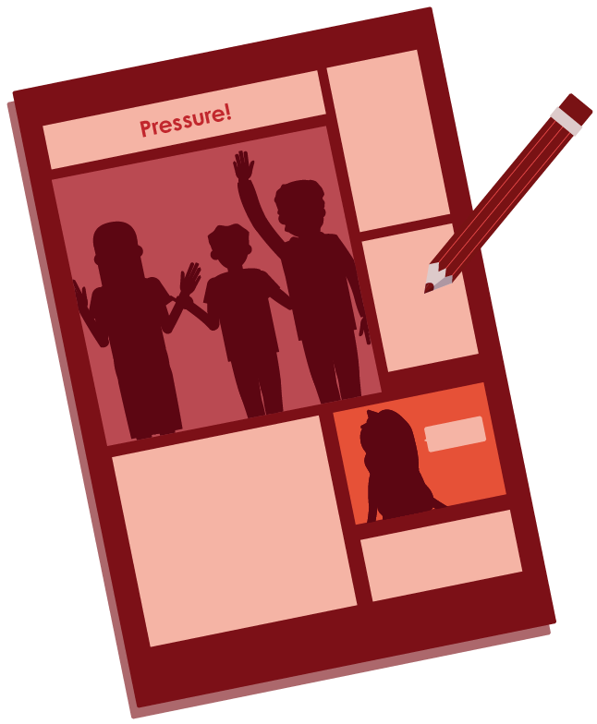
Assertive responses
Draw a cartoon of one of the pressure scenarios:
Add in speech and thought bubbles
Show an assertive response
Notes:
Teacher notes – Extension activity
Ask pupils to draw a cartoon to depict one of the scenarios they have discussed, adding speech and thought bubbles. They should focus on depicting the character demonstrating an assertive response to the situation that will help them to stay healthy and safe.

