Slide 1

Drug education
Tobacco, vaping and alcohol in the media
Year 5-6: Lesson 4

Slide 2
Using this PowerPoint
The slides in this presentation are divided into two sections:
Teacher slides (purple) – provide key information regarding lesson preparation.
Pupil slides – provide a visual focus point for pupils during the lesson and delivery notes for teachers about the activities. Click ‘notes’ to view these.
Ensure that you select ‘Use Presenter View’ under the ‘Slide Show’ tab – this will allow you to preview the teaching notes on your monitor while the main presentation is displayed on a screen/smartboard.

Slide 3


Support and challenge
The lesson includes suggestions for challenge and support activities, to help you differentiate appropriately for your class.
Support activities are adapted to be more accessible for those who need it.
Challenge activities deepen and extend learning for those who need more challenge or who finish the activity quickly.
Look for these icons on the pupil slides. See delivery notes for details of the activities.
Challenge
Support

Slide 4
Context
This is the fourth of four drug education lessons, for year 5–6. This lesson focuses on media messages and influences in relation to tobacco, vaping and alcohol. Pupils assess the reliability of sources and learn how to access reliable and accurate advice and information about alcohol, tobacco and vaping (e-cigarettes).

Slide 5
Developing subject knowledge
Key information on content related to these lessons can be found in the Year 5-6 Knowledge Organiser.
Advice on safe practice, dispelling common misconceptions, visitors to the classroom and other important information can be found in Teacher Guidance: Drug and alcohol education
Data sources to inform your planning can be found within our document that outlines the approach of these lessons Evidence Review: Effective drug and alcohol education, along with advice regarding how to talk to young people about addiction, dependency and problematic substance use.

Slide 6
To learn how mixed messages about drug use in the media can influence opinions and decisions.
identify mixed messages in the media in relation to tobacco, vapes and alcohol
analyse key messages, suggest who they are targeted at and why
describe how these messages might affect a person’s thoughts, feelings and actions
explain what would help a person to make informed decisions about health, and where they could find reliable information

Slide 7
Box or envelope for questions
Resource 1: Mixed message posters [one set enlarged and displayed per class or one set per small group]
Resource 2: Think, feel, do [one per pair]
Resource 3: Sources of information cards [one set per group or one set enlarged for whole class use]
Notes:
Pupils will have experienced varying levels of exposure to media. Some may never have noticed media regarding tobacco, vapes or alcohol and others will be very aware, especially with increasing exposure to social media platforms as they get older. If necessary, remind pupils that most social media platforms require users to be aged 13 years and over. This lesson uses re-produced images rather than real adverts which may include upsetting or inspirational images, so please use these resources rather than source your own.

Slide 8
Lesson summary
Activity | Description | Timing
Baseline assessment activity | To be completed before the lesson. Remind pupils of ground rules. Pupils draw or write a response to an advert, film or TV programme about tobacco, vapes or alcohol. | 10 mins
Introduction | Reinforce ground rules and introduce the learning objective and outcomes. Pupils identify where they see messages relating to drugs in the media. | 5 mins
Analysing media messages | Working in small groups, pupils analyse a media excerpt to identify the key messages it is giving. | 15 mins
Think, feel, do | Pairs of pupils imagine a young person looking at one of the media excerpts and discuss what it might make them think, feel, do (or want to do). | 15 mins
Accurate information continuum | Pupils rank different sources of information on a continuum from least to most accurate and reliable. | 10 mins
Giving advice | Pupils return to their think, feel, do sheets and give advice to the young person looking at the media advert. | 5 mins
Signposting support | Highlight sources of support at home and at school. | 5 mins
Endpoint assessment | Pupils complete sentences to further reflect on and demonstrate their learning for this lesson. | 5 mins

Slide 9

Tobacco, vaping and alcohol in the media
Lesson 4

Slide 10



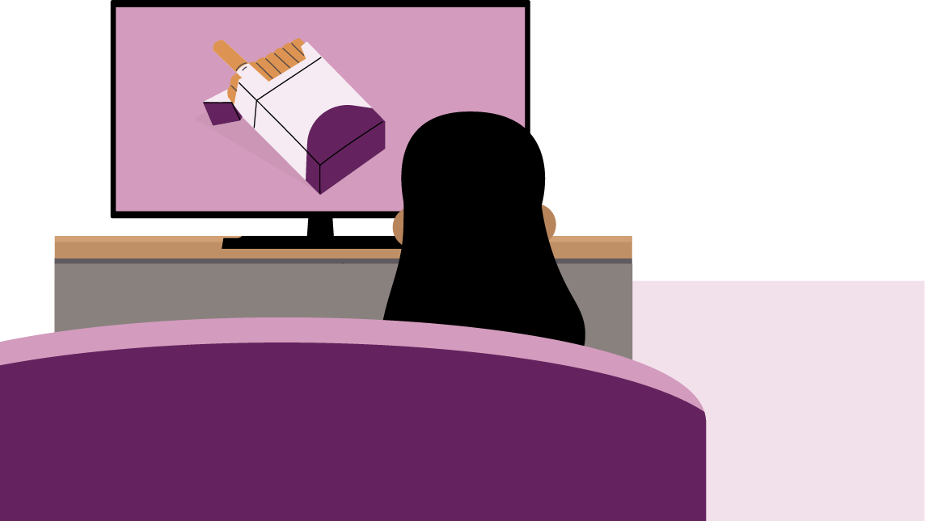
What’s our starting point?
A young person (aged about 13) is looking at an advert, film or TV programme which features tobacco (e.g. in cigarettes), vapes or alcohol.
Draw or write about what they are seeing. In a ‘think bubble’ write what they are thinking about this.
Notes:
Teacher notes – Baseline assessment (10 mins)
This activity should be completed before the lesson. This allows time to look through pupils’ work and gain a sense of their current understanding and experiences of media messages. Remind pupils of the ground rules for these lessons before completing the following activity.
Read aloud the following instructions, without giving any additional prompts or examples:
A young person (aged about 13) is looking at an advert, film or TV programme which features tobacco (for example in cigarettes), vapes or alcohol. Draw or write about what they are seeing and, in a ‘think bubble’, write what they are thinking about this.
Ask pupils to draw and/or write their responses in their book or on a blank piece of paper, working on their own, without discussing with anyone else. Stress that there is no ‘right answer’ – you just want to know their initial ideas.
Collect these in and use them to identify pupils’ starting points and to inform your approach to the lesson.

Slide 11
Notes:
Teacher notes – Introduction (slides 11-13, 5 mins)
Reinforce ground rules and point out any that are especially pertinent, such as being respectful to each other’s views and opinions, accepting these may be different to our own and recognising that we may have different thoughts or experiences.

Slide 12
To learn how mixed messages about drug use in the media can influence opinions and decisions.
identify mixed messages in the media in relation to tobacco, vapes and alcohol
analyse key messages, suggest who they are targeted at and why
describe how these messages might affect a person’s thoughts, feelings and actions
explain what would help a person to make informed decisions about health, and where they could find reliable information
Notes:
Teacher notes – Introduction (slides 11-13, 5 mins)
Introduce the learning objective and outcomes.

Slide 13


Introduction
Where might a person see or hear messages related to drugs?
Notes:
Teacher notes – Introduction (slides 11-13, 5 mins)
Ask the class to identify different places where a person might see or hear messages related to drugs, and make a list on the board. This might be any drug for now but later in the lesson the focus will be on tobacco, vapes and/or alcohol.
For example: films, TV documentaries, advertisements, posters, shops, health warning posters, drug packaging, newspapers and magazines, radio, social media.

Slide 14
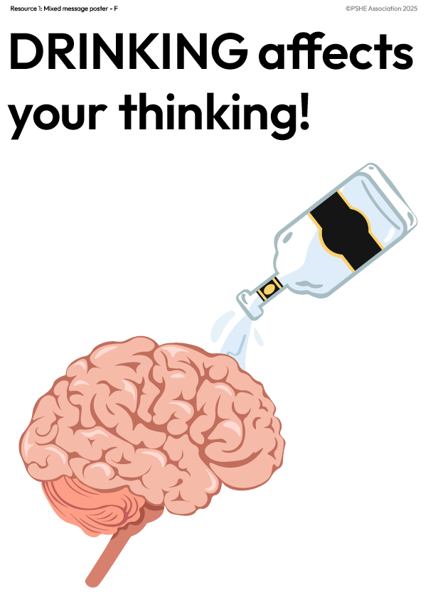



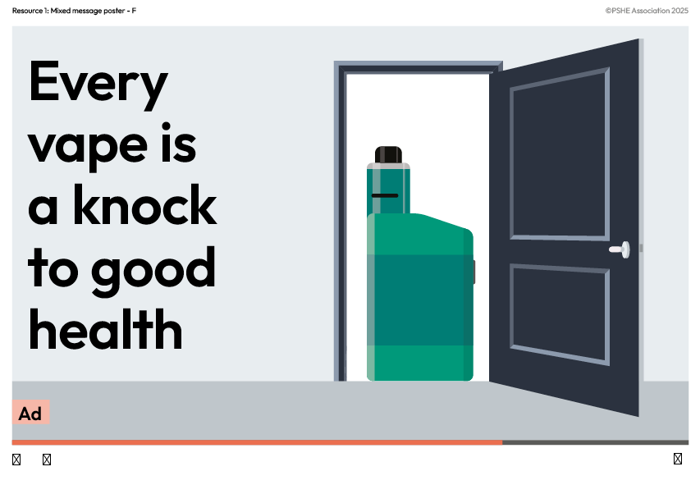

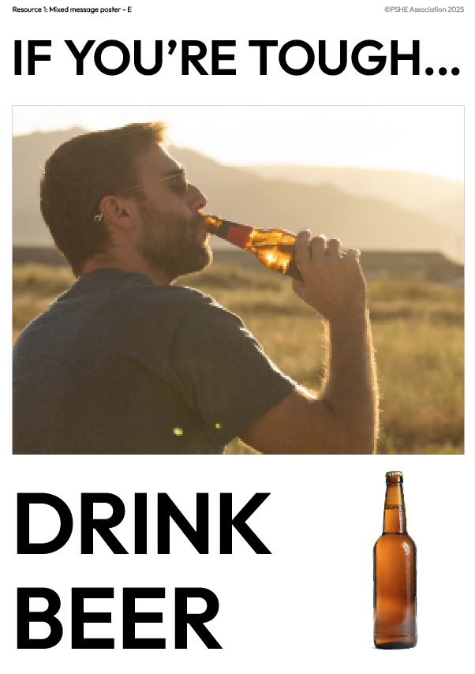


Analysing media messages
Look at the posters with your group and identify the key messages in each one.
Why do you think there are mixed messages about alcohol, tobacco and vapes in the media?
Notes:
Teacher notes - Analysing media messages (slides 14-21, 15 mins)
Display around the classroom, or provide each group with, copies of Resource 1: Mixed message posters. In their groups, or moving around the room, ask pupils to analyse the media excerpt to identify the key messages in each.
Before taking feedback on each poster, ask pupils why they think there are mixed messages about tobacco, vapes and alcohol.
Suggestions might include:
It depends whose message it is – advertisers want to sell a product so will give positive messages about it; the government, health service, charities etc. are more likely to focus on risks and harmful effects to discourage people from using tobacco, vapes and alcohol.
Then, using slides 15-21, take feedback on each poster.
Support: Using each poster from Resource 1: Mixed message posters, ask pupils to identify which are encouraging and which are discouraging people to use the drug (tobacco, vapes or alcohol) and, if possible, explain their thinking.
Challenge: Ask pupils to discuss what lifestyle choices these adverts are promoting.

Slide 15
Analysing media messages
Smoking is bad for your health
Smoking could lead to death or fatal diseases
Smoking is a waste of money
Don’t smoke
Anything else?
Notes:
Teacher notes - Analysing media messages (slides 14-21, 15 mins)
Use slides 15-21 to discuss possible key messages pupils may have suggested for each poster. They may have also suggested additional ideas.

Slide 16
Analysing media messages
It’s easy to become addicted (or chained) to smoking
Smoking is a hard habit to break
Don’t smoke
Anything else?
Notes:
Teacher notes - Analysing media messages (slides 14-21, 15 mins)
Use slides 15-21 to discuss possible key messages pupils may have suggested for each poster. They may have also suggested additional ideas.

Slide 17
Analysing media messages
Vapes are quite interesting gadgets
Lots of different types to choose from
It’s encouraging vaping
Anything else?
Notes:
Teacher notes - Analysing media messages (slides 14-21, 15 mins)
Use slides 15-21 to discuss possible key messages pupils may have suggested for each poster. They may have also suggested additional ideas.

Slide 18
Analysing media messages
Parties always include alcohol
If you drink, you’ll have a good time
There are certain times of day to drink
Alcohol is fun
It’s encouraging drinking alcohol
Anything else?
Notes:
Teacher notes - Analysing media messages (slides 14-21, 15 mins)
Use slides 15-21 to discuss possible key messages pupils may have suggested for each poster. They may have also suggested additional ideas.

Slide 19
Analysing media messages
Only men drink beer
Beer is the best drink for men
Men should drink beer
It encourages drinking alcohol
Anything else?
Notes:
Teacher notes - Analysing media messages (slides 14-21, 15 mins)
Use slides 15-21 to discuss possible key messages pupils may have suggested for each poster. They may have also suggested additional ideas.

Slide 20
Analysing media messages
Alcohol will affect your brain badly
Drinking alcohol is unhealthy
Don’t drink alcohol
Anything else?
Notes:
Teacher notes - Analysing media messages (slides 14-21, 15 mins)
Use slides 15-21 to discuss possible key messages pupils may have suggested for each poster. They may have also suggested additional ideas.

Slide 21
Analysing media messages
Vaping is bad for your health
Vaping might affect your health
Don’t vape
Anything else?
Notes:
Teacher notes - Analysing media messages (slides 14-21, 15 mins)
Use slides 15-21 to discuss possible key messages pupils may have suggested for each poster. They may have also suggested additional ideas.

Slide 22




Think, feel, do
With your partner, choose one of the posters and imagine a young person looking at it.
Discuss what it might make the young person think, feel or do (or want to do).
Now ‘pair/share’ with another pair who chose the same example as you. Do you agree?
Next, do the same with another pair who chose a different example and discuss your responses.
Think
Feel
Do
Notes:
Teacher notes – Think, feel, do (15 mins)
In pairs, ask pupils to choose one example from Resource 1 and imagine a young person looking at it. Then, discuss what it might make the young person think, feel, and do (or want to do) and complete Resource 2: Think, feel, do.
Ask them then to ‘pair/share’, first with another pair who have chosen the same example as them, to compare responses and see if they concur, then with a pair who chose a different example, and compare responses for similarities and differences.
Bring the class together to feedback and draw some conclusions from their findings. For example, pupils might say: The adverts might make them think that all young people vape. However, it is important to draw out that actually most young people choose not to use these drugs at all.
Highlight the following positive social norms:
The number of young people in England (aged 11-15) who smoke tobacco regularly (smoking at least one cigarette a week) is very low at 1%.
Some people might think that lots of people use vapes but actually only 4% of young people (aged 11-15) use them regularly (at least once a week).
We might think that lots of teenagers drink alcohol, but actually 60% of young people (aged 11-15) say they have never drunk alcohol.
Reference: Smoking, drinking and drug use among young people in England 2021 (NHS)

Slide 23





Accurate information continuum
Which sources of information do you think will give the most reliable and accurate information about drugs?
Organise the cards on a continuum from least to most likely to be reliable and accurate.
advert on social media
friend
teacher/PSHE lesson
www.nhs.uk/live-well
parent/carer
TV documentary
news story
story in a film/book
Least likely
Most likely
1
2
3
4
5
6
7
8
9
10
Notes:
Teacher notes – Accurate information continuum (10 mins)
Show Resource 3: Sources of information cards. Explain what they are, how someone could access them, and what information they might find out by doing so.
As a whole class, or in small groups (each with a set of cards), ask pupils to discuss which will give the most reliable and accurate information, explaining their thinking, then organise the cards on a continuum from least to most likely to be accurate and reliable.
For example: up-to-date health advice should be available on the NHS website; PSHE education lessons teach the facts; a friend may not really know best; an advert on social media might be trying to persuade someone to buy something and may not give all the information about the product, such as health risks.

Slide 24

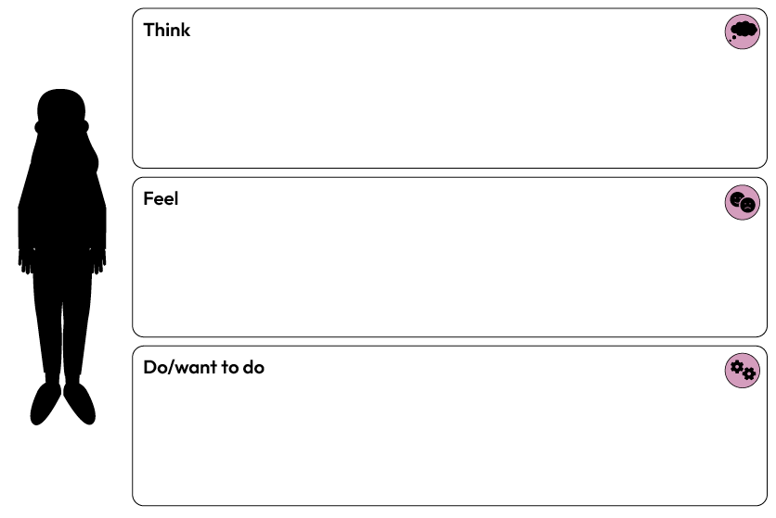

Giving advice
Go back to your think, feel, do sheet and imagine you are giving advice to the young person looking at the media advert.
Write them a message using the sentence starters:
You might think that…
But this might not be reliable because…
Some facts about the effects of tobacco/vaping/drinking alcohol are…
Somewhere you could get more information is…
Notes:
Teacher notes – Giving advice (5 mins)
Ask pupils to return to their think, feel, do sheets (Resource 2) and imagine they are giving advice to the young person looking at the media advert. Ask them to use the sentence starters below to write them a message and take feedback.
You might think that…
But this might not be reliable because…
Some facts about the effects of tobacco/vaping/drinking alcohol are…
Somewhere you could get more information is…

Slide 25


Who can help?
If you have any worries or concerns about drugs, tobacco, vapes or alcohol, it’s important to talk to a trusted adult at home or at school.
You can also contact Childline on 0800 1111.
I need your help with something . . .
Something's worrying me,
can I talk to you?
I have something that’s been bothering me . . .
Notes:
Teacher notes – Signposting support (5 mins)
Remind pupils that if they have any worries or concerns about drugs, tobacco (e.g. in cigarettes), vapes, or alcohol, they should talk to a trusted adult at home or in school. They can also contact Childline on 0800 1111.

Slide 26


What have we learnt?
Complete the following sentences:
The lesson has made me think about…
The mixed messages in the media about tobacco, vaping and alcohol include…
People should…
I have learnt that...
Notes:
Teacher notes - Endpoint assessment (5 mins)
Ask pupils to complete all or some of the following sentence starters in their books, as evidence of their learning:
The lesson has made me think about…
The mixed messages in the media about tobacco, vapes and alcohol include…
People should…
I have learnt that...

Slide 27




Informing young people
Design material that accurately informs young people about the risks of tobacco/vaping/drinking alcohol.
It could be:
A poster
Film or radio clip
Public health social media message
Notes:
Teacher notes – Extension activity
Using one of the ‘positive’ social norms statistics as inspiration, ask pupils to design material aimed at accurately informing young people about the risks of tobacco/vaping/drinking alcohol. It should avoid using stereotypes, shock or scare tactics and instead aim to be informative and convey correct information. It could take the form of a poster, film/radio clip or Public Health social media message.

