Slide 1

Drug education
Understanding drugs
Year 7-8: Lesson 1

Slide 2
Using this PowerPoint
The slides in this presentation are divided into two sections:
Teacher slides (purple) – provide key information regarding lesson preparation.
Student slides – provide a visual focus point for students during the lesson and delivery notes for teachers about the activities. Click ‘notes’ to view these.
Ensure that you select ‘Use Presenter View’ under the ‘Slide Show’ tab – this will allow you to preview the teaching notes on your monitor while the main presentation is displayed on a screen/smartboard.

Slide 3


Support and challenge
The lesson includes suggestions for challenge and support activities, to help you differentiate appropriately for your class.
Support activities are adapted to be more accessible for those who need it.
Challenge activities deepen and extend learning for those who need more challenge or who finish the activity quickly.
Look for these icons on the pupil slides. See delivery notes for details of the activities.
Challenge
Support

Slide 4
Context
This is the first of three drug education lessons, for year 7–8. This lesson introduces concepts of substance use through a focus on the risks and effects of caffeine consumption.

Slide 5
Developing subject knowledge
Key information on content related to these lessons can be found in the Year 7-8 Knowledge Organiser.
Advice on safe practice, dispelling common misconceptions, visitors to the classroom and other important information can be found in Teacher Guidance: Drug and alcohol education.
Data sources to inform your planning can be found within our document that outlines the approach of these lessons Evidence Review: Effective drug and alcohol education, along with advice regarding how to talk to young people about addiction, dependency and problematic substance use.

Slide 6
To learn about substance use and the risks and effects of caffeine consumption.
Students will be able to:
assess and evaluate their prior knowledge, beliefs and attitudes regarding substance use
describe the effects of caffeine consumption
explain the risks associated with caffeine consumption
evaluate strategies to reduce caffeine consumption

Slide 7
Box or envelope for questions
Large sheets of paper (to create ‘graffiti walls’ around the room)
Resource 1: Caffeine scenario
[one per small group]
Resource 2: Diamond 9
[one cut up set per small group]
Resource 3: Draw and write analysis
[one per small group]

Slide 8
Lesson summary
Activity | Description | Timing
Baseline assessment activity | Students complete a draw and write activity about drugs, the associated risks and consequences. | 10 mins
Introduction | Negotiate or revisit ground rules and introduce learning objective and outcomes. | 2 mins
Caffeine graffiti walls | Students respond to four questions about caffeine on graffiti walls. | 10 mins
Effects of caffeine | Students read a scenario and consider effects, risks and laws relating to caffeine consumption. | 10 mins
Caffeine reduction | Students complete a diamond 9 of strategies to reduce consumption of caffeine, before revising graffiti walls. | 10 mins
Draw and write analysis | Class compare and analyse their draw and write activity, reviewing this against their new learning. | 10 mins
Reflection and endpoint assessment | Students revisit the draw and write baseline and add key learning from the lesson. | 5 mins
Signposting support | Remind students how to access further advice, guidance and support related to substance use. | 3 mins

Slide 9

Understanding drugs
Lesson 1
Notes:
Teacher notes – Lesson title

Slide 10

What’s our starting point?
Draw someone who uses drugs
Now add the drugs they use
Draw or write
what the drugs look like and how they
are used
Add any ideas you have about why this person uses them
Add any of the effects of taking
the drugs
Add what the consequences might be for the person using the drugs
Notes:
Teacher notes – Baseline assessment activity (10 mins)
Working on their own without any discussion with neighbours, ask students to draw and write their responses to the following instructions:
Draw someone who uses drugs
Now add the drugs they use
Draw or write what the drugs look like and how they are used
Add any ideas you have about why this person uses them
Add any of the effects of taking the drugs
Add what the consequences might be for the person using the drugs
As this is a baseline assessment, it is important to use neutral, non-guiding language and avoid giving any further information until the activity has been completed. Tell students that there is no ‘right answer’; it does not matter if they don’t know or are unsure about something; the accuracy of spelling and grammar (or artistic ability) is not important here either; and that slang terms may be used as well as the correct terms (if they know them).
Whilst students complete this activity, move around the room to monitor their responses and establish their starting points in relation to the lesson outcomes.
Ask students to put these to one side as they will return to them later in the lesson.

Slide 11
Notes:
Teacher notes – Introduction (2 mins, slides 11-12)
Ensure ground rules are established with the group before teaching this lesson and make students aware of the question box, which will be available throughout the lesson. Explain that if they have worries or questions during or after the lesson, that they do not want to raise in front of the class, they can write their question on a piece of paper, anonymously or with their name, and put it in the question box.

Slide 12
To learn about substance use and the risks and effects of caffeine consumption.
We will be able to:
assess and evaluate prior knowledge, beliefs and attitudes regarding substance use
describe the effects of caffeine consumption
explain the risks associated with caffeine consumption
evaluate strategies to reduce caffeine consumption
Notes:
Teacher notes – Introduction (2 mins, slides 11-12)
Introduce the learning objective and outcomes and explain to students that they will be exploring caffeine consumption, its effects, and strategies to reduce caffeine intake.

Slide 13
Caffeine: graffiti walls
How is it the same or different from other drugs?
Move around the room and add your knowledge, understanding, opinions and beliefs to the four graffiti walls.
What do you want or need to know about caffeine?
What do you know or believe about caffeine?
How is caffeine advertised/
marketed, including to young people?
Notes:
Teacher notes – Caffeine graffiti walls (10 mins)
Place four graffiti walls around the room with the following headings (one heading on each):
What do you know or believe about caffeine?
What do you want or need to know about caffeine?
How is it the same or different from other drugs?
How is caffeine advertised/marketed, including to young people?
Explain to students that, as a starting point to this series of lessons, they are going to explore caffeine consumption. Ask them to move around the room and respond to the questions on each graffiti wall. Briefly review these to gauge students’ current understanding and beliefs.

Slide 14
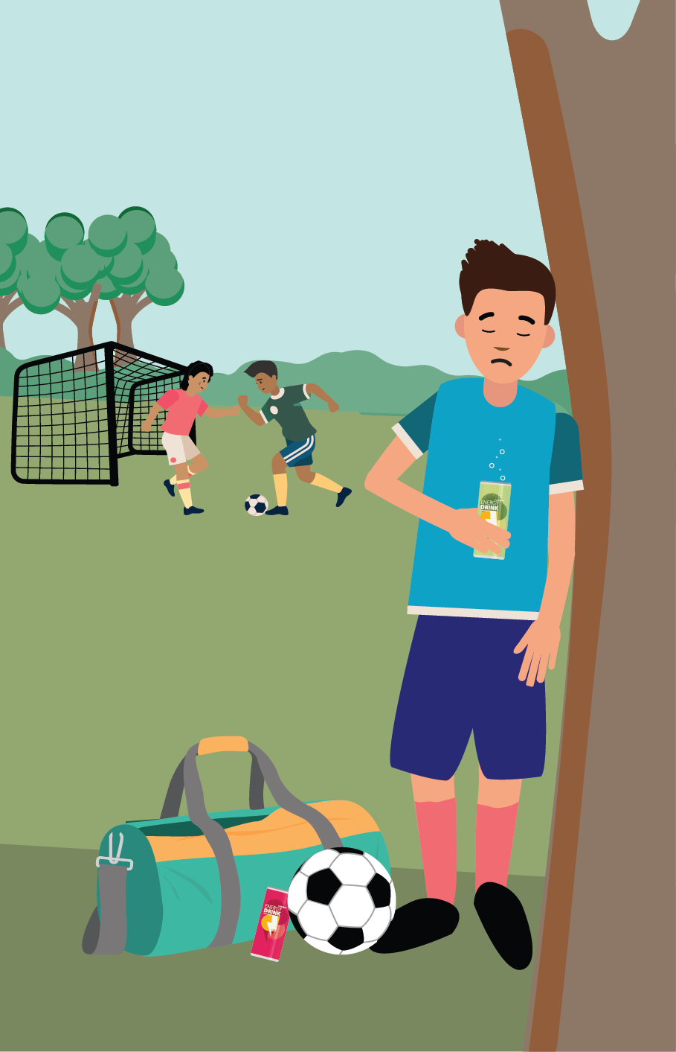


Effects of caffeine
Why is Jordan drinking
energy drinks?
How do you think they are affecting his health?
What are the risks if he continues to consume them?
Are there any laws or recommendations on caffeine Jordan should be aware of?
What advice could you give Jordan to help him reduce/stop drinking energy drinks?
Notes:
Teacher notes – Effects of caffeine (10 mins)
Explain that caffeine is a stimulant often found in drinks such as tea, coffee, cola, energy drinks, sports drinks and some medicines. Energy drinks often contain high levels of caffeine and sugar and may also contain other stimulants. They contain a higher amount of caffeine than many other beverages as they are aimed at boosting energy (caffeine causes a feeling of alertness). However, this is normally very short-lived, and a person often finds they feel the need for further caffeine to address the energy ‘slump’ they experience afterwards.
In small groups, ask students to read Resource 1: Caffeine scenario and discuss the questions.
Why is Jordan drinking energy drinks?
How do you think they are affecting his health?
What are the risks if he continues to consume them?
Are there any laws or recommendations on caffeine Jordan should be aware of?
What advice could you give Jordan to help him reduce/stop drinking energy drinks?
Take feedback, drawing out the key learning:
Jordan started to drink energy drinks because he thought consuming them might help him to play for the school sports team. However, due to continued use, his sleep suffered and he began to drink them to make him feel more alert in the day.
Effects to his health may include: anxiety, insomnia, headaches, stomach upset. Can lead to heart palpitations.
Social/environmental risks might include: impact on studies, school behaviour causing problems, knock-on impact on sports performance. There are up to 21 teaspoons of sugar in an energy drink (despite the maximum recommended daily guideline being six teaspoons). These drinks are taxed under the Soft Drinks Industry Levy, known as the 'sugar tax’ due to their high sugar content. Regular use therefore carries additional health risks including obesity, dental health issues, acne and type 2 diabetes.
Caffeine carries fewer legal restrictions than other drugs, although supermarkets have banned the sale of energy drinks to children under 16 and the government has proposed introducing a legal ban. Some medicines which contain caffeine are only available on a doctor's prescription.
Students might suggest Jordan completely stops drinking any energy drinks. This may help him to stop quickly but there might be some short-term effects, such as headaches and tiredness whilst his body adjusts to a lack of caffeine. Alternatively, students may suggest reducing the use of energy drinks over time until Jordan is able to stop completely. This might avoid the effects of a sudden lack of caffeine, but will take Jordan longer to stop using the drinks. If Jordan finds it hard to reduce or stop drinking energy drinks, students might suggest he seeks support – this could be from family members or healthcare professionals.
Students may wonder what the difference is between energy drinks and sports drinks: the key ingredient difference in energy drinks is caffeine. Sports drinks contain carbohydrates and electrolytes which feed muscles and replace chemicals lost during sweating, possibly helping someone to sustain physical activity for long periods. They are specifically designed for athletes or those who do vigorous physical activity for a session longer than an hour. Sports drinks are not needed for day-to-day activity and it is best to have sports drinks occasionally, rather than every time someone engages in physical activity. Water is a healthier option as it helps keep people more hydrated and it does not contain sugar, sweeteners or preservatives that sports drinks will have. Young people tend to have higher levels of energy than an adult and therefore water and a balanced diet are generally sufficient.
Support: Ask students to focus on answering questions 1, 2 and 5.
Challenge: What other factors should be considered when selecting snacks and products to boost energy? Other health considerations include sugar, salt and fat levels. Energy drinks contain high levels of sugar which, again, provide a temporary energy boost but disrupt energy levels over time. Foods such as porridge oats, nuts or fruit are more likely to provide energy in a sustained way.

Slide 15

Caffeine reduction
Complete the diamond 9 to evaluate the different strategies that could be used to help someone reduce their consumption of caffeine.
Most important
Least important
Notes:
Teacher notes – Caffeine reduction (10 mins)
Explain the guidelines around caffeine consumption:
Based on current scientific opinions on the safety of caffeine, children and young people are advised to only consume caffeine in moderation. For a 10-year-old child weighing 30kg, this would work out to around 90mg of caffeine, which is approximately the equivalent of one 250ml can of energy drink, or two to three cans of cola, or a mug of instant coffee. Stress that this is the maximum a young person should consume and not a recommendation. It is important to also bear in mind the additional health risks already discussed, including those associated with consuming the quantity of sugar contained in such drinks.
Ask each group to use Resource 2: Diamond 9 to evaluate the different strategies that could be used to help someone reduce their consumption of caffeine. The card at the top of the diamond should represent what they think the best strategy is and the card at the bottom of the diamond should represent what they think the least useful strategy is. The cards in the middle section should be placed in rows that they think are ‘equally important’.
Ask each group to feedback their top idea, or any discussion points on a card they disagreed over and explain that reduction in consumption might be achieved through a combination of strategies.
Then, revisit the graffiti walls by placing them at the front of the room and reviewing whether all the students’ questions have been answered and if students can now add anything new.
Support: Give students 4 or 5 cards to create a smaller diamond.
Challenge: Ask students to script the opening to a conversation with Jordan, suggesting what he could do to reduce his caffeine intake in the future.

Slide 16





Draw and write analysis
Working in groups – and without adding anything new to your work at this stage – share your Draw and Write baseline activity with each other.
Discuss and note down in your books your responses to the questions on the next slide.
Notes:
Teacher notes – Draw and write analysis (10 mins, slides 16-17)
Ask students to return to their draw and write activity from the start of the lesson. Explain that they should not add to, or change, anything about their answers at this stage. Ask the class how many of them had included caffeine in their draw and writes and take feedback.

Slide 17
Draw and write analysis
What do your drawings have in common?
Is a wide range of people represented, or have common
stereotypes been used?
If people in your group have drawn stereotypical images of someone who uses drugs, does this mean that nobody else uses them?
What types of drugs have the group focused on? Are they mainly restricted or illegal drugs, or have you included medicinal drugs and other legal substances? Has everyone identified similar drugs, or is there variation?
What were the most common reasons given for the user taking drugs?
What drug effects have been identified in your group?
Is there anything your group would like to know more about as a result of doing this activity?
Notes:
Teacher notes – Draw and write analysis (10 mins, slides 16-17)
Then, give each group Resource 3: Draw and write analysis (or show the slide), which has questions for the groups to discuss.
Take some feedback, identifying key similarities in attitudes, understanding and misconceptions across the class (for some misconceptions to listen for and how to address these, please read the ‘addressing misconceptions’ section of the teacher guidance), such as:
Drugs only being used by certain groups of people – young people may have stereotyped ideas about what a ‘drug-user’ looks like (e.g. young, ‘scruffy’ male or high-profile celebrity) and may not recognise that many people will use a drug at some point in the form of caffeine, medicine, alcohol etc.
The idea that all drugs are illegal, or that only illegal substances can cause harm – young people may not recognise the damaging effects that caffeine, nicotine, medicines etc. can have.
Even widely available substances like energy drinks carry risks and can cause harm to an individual - while government guidelines and the law help us to assess risk, the effects of caffeine can still include mental as well as physical symptoms.
Use the insights from this to gauge students’ current understanding, beliefs, attitudes, any misconceptions, gaps in knowledge, and stereotypes depicted, to adapt teaching throughout this series of lessons.

Slide 18

What have we learnt?
Now use a different coloured pen to change or add any key learning from this lesson to your draw and write.
Notes:
Teacher notes – Reflection and endpoint assessment (5 mins)
On their own, ask students to use a different coloured pen to revisit their initial draw and write activity, changing or adding any key learning from this lesson to their work. These should be kept safe as they will be used in lesson 3 to demonstrate further progress and can also be used to inform future teaching.

Slide 19


Sources of support
To access further advice, guidance and support related to substance use, you can:
speak to a parent/carer, tutor or pastoral lead, or other trusted adult
contact Childline: www.childline.org.uk, 0800 1111
visit www.nhs.uk for further information on healthy choices
I need your help with something . . .
Something's worrying me,
can I talk to you?
I have something that’s been bothering me . . .
Notes:
Teacher notes – Signposting support (3 mins)
Explain that if students have worries or concerns about anything explored in the lesson, they can:
speak to a parent/carer, tutor or pastoral lead, or other trusted adult
contact Childline: www.childline.org.uk, 0800 11 11
visit www.nhs.uk for further information on healthy choices.

Slide 20
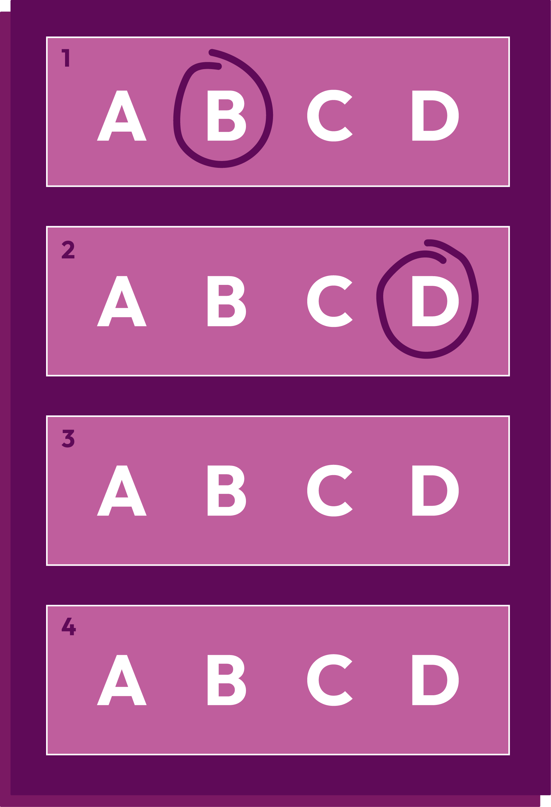

Caffeine quiz
Design a multiple-choice quiz based on what you have learnt in today’s lesson, to help educate other young people about caffeine.
Notes:
Teacher notes – Extension activity
Ask students to design a multiple-choice quiz based on what they have learnt over the lesson, to help educate other young people about caffeine. These could be used in future lessons to check learning.

