Slide 1

Drug education
Tobacco and nicotine
Year 7-8: Lesson 2

Slide 2
Using this PowerPoint
The slides in this presentation are divided into two sections:
Teacher slides (purple) – provide key information regarding lesson preparation.
Student slides – provide a visual focus point for students during the lesson and delivery notes for teachers about the activities. Click ‘notes’ to view these.
Ensure that you select ‘Use Presenter View’ under the ‘Slide Show’ tab – this will allow you to preview the teaching notes on your monitor while the main presentation is displayed on a screen/smartboard.

Slide 3


Support and challenge
The lesson includes suggestions for challenge and support activities, to help you differentiate appropriately for your class.
Support activities are adapted to be more accessible for those who need it.
Challenge activities deepen and extend learning for those who need more challenge or who finish the activity quickly.
Look for these icons on the pupil slides. See delivery notes for details of the activities.
Challenge
Support

Slide 4
Context
This is the second of three drug education lessons, for year 7-8. This lesson focuses on specific risks relating to tobacco and nicotine products and strategies to manage influences regarding use of these substances.

Slide 5
Developing subject knowledge
Key information on content related to these lessons can be found in the Year 7-8 Knowledge Organiser.
Advice on safe practice, dispelling common misconceptions, visitors to the classroom and other important information can be found in Teacher Guidance: Drug and alcohol education.
Data sources to inform your planning can be found within our document that outlines the approach of these lessons Evidence Review: Effective drug and alcohol education, along with advice regarding how to talk to young people about addiction, dependency and problematic substance use.

Slide 6
To learn about and manage influences relating to tobacco and nicotine product use.
Students will be able to:
identify a range of risks related to tobacco use and vaping (e-cigarette use)
analyse a range of potential influences on young people to smoke or vape
demonstrate strategies for managing peer influence in situations involving tobacco and vapes (e-cigarettes)

Slide 7
Box or envelope for questions
Post-it notes
Resource 1: Attitude continuum
[one per student]
Resource 2: Effects of using tobacco card sort [one cut up set per pair]
Resource 2a: Effects of using tobacco card sort – teacher answer sheet [teacher copy]
Resource 3: Identifying influences statements [one per student]
Resource 3a: Spotting influences
[support option, as required]

Slide 8
Lesson summary
Activity | Description | Timing
Introduction | Introduce learning objective and outcomes, and revisit ground rules. | 5 mins
Baseline assessment activity | Students complete an attitude continuum about tobacco, alcohol and other drugs. | 15 mins
Effects of tobacco | In pairs, students sort cards into physical, mental and social/legal effects of using tobacco. | 10 mins
Spotting influences | Students identify the potential influences on young people’s decisions about smoking. | 10 mins
Managing peer influence | Students provide a range of strategies to manage peer influence. | 10 mins
Reflection and endpoint assessment | Students reflect on what they have learnt in the lesson using the prompts. | 5 mins
Signposting support | Remind students how to access further advice, guidance and support related to tobacco, alcohol and other drugs. | 5 mins

Slide 9

Tobacco and nicotine
Lesson 2
Notes:
Teacher notes – Lesson title

Slide 10
Notes:
Teacher notes – Introduction (5 mins, slides 10-11)
Ensure ground rules are established with the group before teaching this lesson and make students aware of the question box, which will be available throughout the lesson. Remind students that if they have worries or questions during or after the lesson, that they do not want to raise in front of the class, they can write their question on a piece of paper, anonymously or with their name, and put it in the question box.

Slide 11
To learn about and manage influences relating to tobacco and nicotine product use.
We will be able to:
identify a range of risks related to tobacco use and vaping (e-cigarette use)
analyse a range of potential influences on young people to smoke or vape
demonstrate strategies for managing peer influence in situations involving tobacco and vapes (e-cigarettes)
Notes:
Teacher notes – Introduction (5 mins, slides 10-11)
Introduce the learning objective and outcomes, explaining to students that in this lesson they will be learning about the risks and influences related to tobacco and nicotine use.

Slide 12
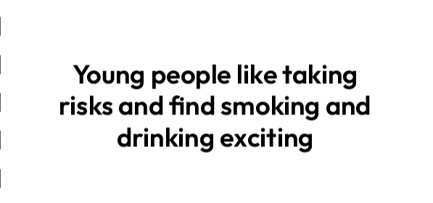
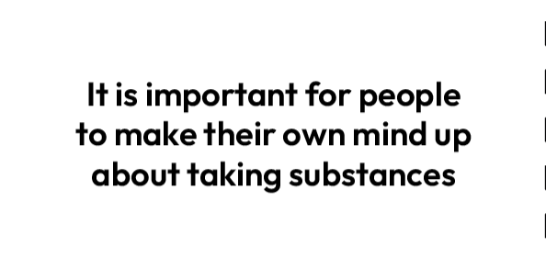
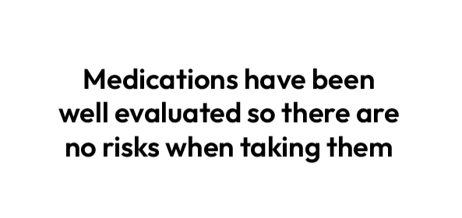
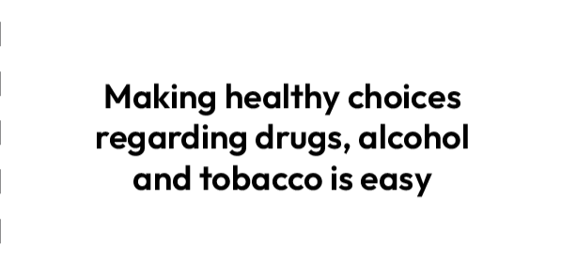
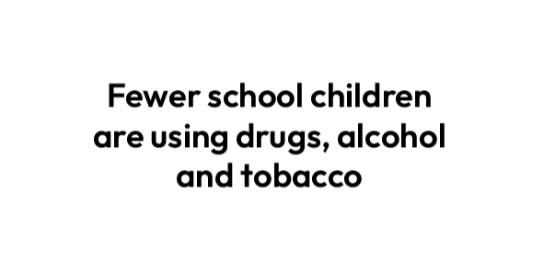

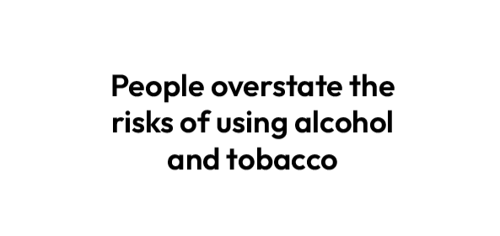
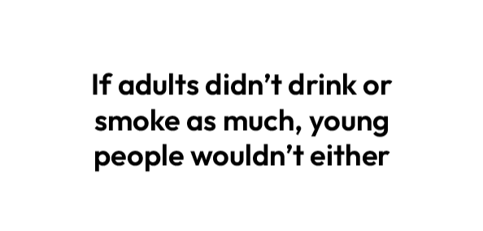
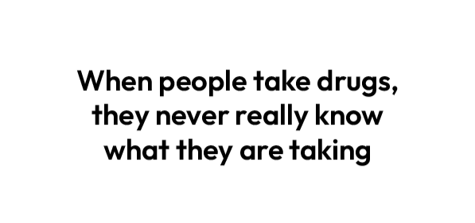
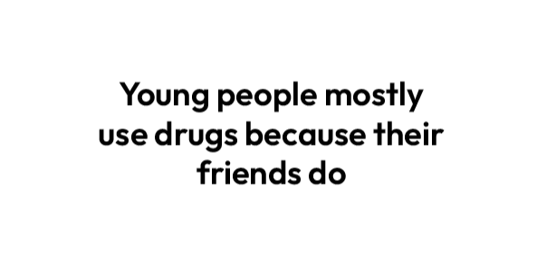
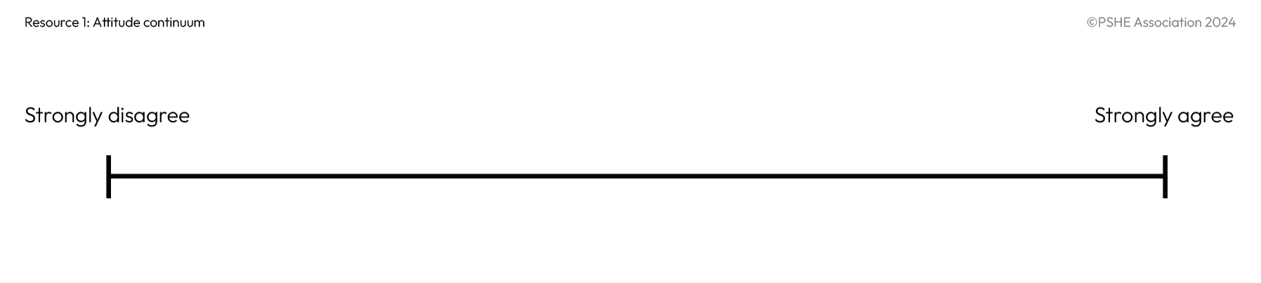
What’s our starting point?
Cut out the statements and place each where you think it falls on the continuum.
Notes:
Teacher notes – Baseline assessment activity (15 mins, slides 12-13)
Hand out Resource 1: Attitude continuum, ask students to cut out each statement and the continuum and place the statements on the continuum (alternatively, students could draw the continuum in their books and write the statements along it.) Whilst students complete this activity, move around the room to monitor their responses and establish their starting points.
Take feedback, ensuring the following key points are covered:
A range of influences impact on substance use decisions – parents/family, other adults, peers, the media, industry and advertising, perceptions of public opinion. It is important to think about what we value most. Good health, positive relationships, fun and future aspirations are key considerations for many people but what those look like and the order of priority will be different for each person.
Medications are well researched but still carry risks – hence medical supervision is required for prescribed drugs, and over-the-counter drugs carry specific instructions on use which must be followed. Each person must make a decision based on their own health, values and understanding of the substance in question.
The data on illicit use of tobacco, alcohol and other drugs, shows use among young people is declining.

Slide 13
What’s our starting point?
What percentage of young people aged 11–13 have never tried smoking cigarettes?
94%
What percentage of young people aged 1–13 say they are regular smokers?
1%
What percentage of young people aged 11–13 are regular users of vapes (e-cigarettes)?
2%
What percentage of young people aged 11–13 said they had never taken drugs?
93%
Notes:
Teacher notes – Baseline assessment activity (15 mins, slides 12-13)
To explore this further, ask students to write down their answers to the social norms quiz below and shown on the slide, which uses data from the Smoking, Drinking and Drug Use Survey in England (SDDU) 2023. Go through the correct percentages after all the questions have been answered, rather than after each one, so that they do not influence students’ subsequent answers.
What percentage of young people aged 11-13 have never tried smoking cigarettes? [94%]
What percentage of young people aged 11-13 say they are regular smokers? [1%]
What percentage of young people aged 11-13 are regular users of vapes (e-cigarettes)? [2% - so 98% are not]
What percentage of young people aged 11-13 said they had never taken drugs? [93%]
Students often overestimate their peers’ engagement in unhealthy behaviours due to media messaging, interactions with only a small section of society which skews perceptions, and some young people claiming to have participated when they haven’t. Correcting this perception of their peers’ behaviour supports students to resist internal pressure to ‘fit in’. Refer to the accompanying evidence briefing paper for further guidance about using positive social norms with care.
¹All percentages calculated as a weighted average to account for SDD methodology (larger cohort sizes in older age groups.)

Slide 14


Effects of tobacco
Physical
What is the difference between nicotine and tobacco?
Sort the risks into physical, mental/emotional and social/legal effects of using tobacco.
Mental / Emotional
Social / Legal
Notes:
Teacher notes – Effects of tobacco (10 mins, slides 14-15)
Ask students to discuss, then feedback what they think the difference is between nicotine and tobacco.
Explain that nicotine is an addictive stimulant found in tobacco and other products such as vapes (e-cigarettes) and nicotine replacement products such as patches and gum. Tobacco is a plant grown for its leaves and is used in cigarettes, pipes, cigars, chewing tobacco and shisha. When tobacco is manufactured for cigarettes, other substances are added to enhance the addictive properties of nicotine. While nicotine gets people ‘hooked’ on cigarettes, it’s the thousands of other chemicals in tobacco smoke, including tar and carbon monoxide, that cause almost all of the harm from smoking.
Hand out Resource 2: Risks of using tobacco card sort and ask students to work in pairs to categorise the risks into physical, mental/emotional and social/legal effects of using tobacco.
Use Resource 2a: Risks of using tobacco card sort – teacher answer sheet to check answers.
Support: Students who need additional support can be given fewer cards to sort. Ensure the cards are selected to provide a range of effects across the three headings.
Challenge: Ask students to further sort the cards into short-term and long-term effects of tobacco use.

Slide 15
Effects of tobacco
Are there any risks that could fall under more than one category?
Are there any short-term risks that may lead to other longer-term risks?
Why do you think tobacco has a legally imposed age restriction?
Why do you think the number of young people who smoke cigarettes has decreased year on year for the last 30 years?
Notes:
Teacher notes – Effects of tobacco (10 mins, slides 14-15)
Develop learning by asking students:
Are there any risks that could fall under more than one category?
Are there any short-term risks that may lead to other longer-term risks?
Why do you think tobacco has a legally imposed age restriction?
Why do you think the number of young people who smoke cigarettes has decreased year on year for the last 30 years?
Take feedback, drawing out key learning:
Students may refer to the fact that bad breath, smelling of smoke, stained teeth, infertility and wrinkling of skin are physical risks that could have social impacts due to treatment by others, family life, etc. Physical illnesses or social risks could lead to mental health issues e.g. cigarette costs can lead to financial difficulties/limitations or being diagnosed with a serious illness could lead to depression.
Whilst students may identify that a person might become ‘addicted’ to a substance (e.g. when discussing ‘wanting to smoke more frequently’), it may be useful to explore here what they mean by this, as the features of addiction have not been discussed in the lesson and they may have some misconceptions about this term. For example, do they mean that the person might experience withdrawal symptoms, feel cravings or that they might repeatedly prioritise buying cigarettes over other things they enjoy and miss out on these? When challenging pupils’ stereotypes or misconceptions of addiction it may be helpful to share the features of the clinical diagnosis of substance use disorder (commonly referred to as ‘addiction’) – please see the evidence briefing for these.
Students may refer to lung problems developing into cancer, or gum disease to mouth cancer. They may also draw links between second-hand smoke and physical health risks. Whilst the most serious harms associated with tobacco will emerge in the long-term (e.g. cancers) and so may be more easily discounted by pupils, short term use can also present problems which pupils might be concerned about – e.g. smell, expense, falling out with friends/family. Students could also be reminded that as smoking is so harmful, they shouldn’t be subjecting their friends to pressure to smoke either.
Students might suggest there is an age limit because of the health impact tobacco can have and in an attempt to prohibit children from using it. It is important to reiterate that the minimum age of sale for tobacco products in the UK is 18 years. Police can confiscate cigarettes from someone under 16, and it is illegal for an adult to smoke in a vehicle with someone under 18 in it. Over time, the government plans to make it illegal for anyone to buy tobacco. Under the new law, each year the legal age for cigarette sales - currently 18 - will increase by one year. It means that people born in or after 2009 will never be able to legally buy cigarettes, effectively leading to a ban.
Students may refer to education, scientific research, the impacts of banning advertising of tobacco and introducing standardised packs with no attractive branding. Students may also refer to alternatives to smoking cigarettes e.g. vapes (e-cigarettes). It is important to explain that these products might be used as a way to quit smoking, but that the National Institute for Health and Care Excellence (NICE) recommends that vaping should be discouraged in children and young people who have never smoked.
Support: Students who need additional support can be given fewer cards to sort. Ensure the cards are selected to provide a range of effects across the three headings.
Challenge: Ask students to further sort the cards into short-term and long-term effects of tobacco use.

Slide 16




Spotting influences
Read through the statements and discuss the influences on each character.
Then, annotate each statement with your ideas.
Notes:
Teacher notes – Spotting influences (10 mins)
Working on their own, ask students to read through and discuss the influences on each character in Resource 3: Identifying influences statements. They should annotate each statement with their ideas about what influences are acting on the characters.
Take feedback, drawing out the following influences and key points:
Curiosity, perception that vapes (e-cigarettes) are not/less harmful, or smoking being normalised at home, are possible influences. Reinforce that vapes are a replacement source of nicotine for those who want to quit smoking (along with alternatives, like nicotine patches), but they have no other benefits. Reusable vapes do not contain as much nicotine as a packet of 20 cigarettes, but NICE recommends that vaping should be discouraged in children and young people who have never smoked. If a non-smoker starts using vapes that contain nicotine, they risk developing a nicotine addiction and the long-term health implications are not understood yet. Remind students it is illegal in the UK to sell vapes (e-cigarettes) to someone under the age of 18.
Peers can have a strong influence, particularly when the rest of the group have chosen to smoke.
Looking up to an ‘older crowd’, feeling intimidated or being concerned with impressing others, can influence rational decision-making.
Perceptions of what is culturally ‘normal’ and the desire to fit in with this and be included, and the ‘party atmosphere’ would be strong influences. Shisha smoking is not a safe alternative as it still exposes users to carbon monoxide and many other toxins. It is also important to mention it is illegal to allow the smoking of shisha pipes inside enclosed cafes/bars due to the health risks related to second-hand smoke.
Role models and the media can influence decision making. While vaping is less harmful than smoking, it is not risk free. Both can be addictive, mostly due to the presence of nicotine and the ease with which it can be taken and become part of someone’s daily routine. Quitting therefore can be difficult, costly and require several attempts to be successful. There are several ways a person can get support to quit smoking and more information can be found at NHS Better Health – quit smoking: www.nhs.uk/better-health/quit-smoking.
Support: Give students a copy of Resource 3a: Spotting influences which provides a range of suggestions students can use to annotate each character’s statement.

Slide 17






Managing peer influence
Read the scenario you have been given.
What advice could you give about how the character could manage the influence?
Notes:
Teacher notes – Managing peer influence (10 mins, slides 17-20)
Remind the class that ‘peer pressure’ is when people feel pressurised by their peers to do something that they might not want to do. ‘Peer influence’ does not just refer to a peer pressurising someone to do something, but also includes internal pressures to fit in, or do what the person thinks is expected in a situation. Is it important to acknowledge that peer influence is part of growing up, and we are influenced in many different areas, e.g. the teams we support, the music we like, or the clothes we buy – but this can extend to substance use behaviours as well.
Split the class into small groups and assign each group one of the scenarios from the ‘Spotting Influences’ activity. Ask students to give the character advice about how they could manage the influence.

Slide 18

Managing peer influence - strategies
assertively refusing, with or without
providing a further reason
using humour to deflect from the situation
removing oneself from the situation
using an excuse to avoid using a substance
telling a ‘white lie’
Notes:
Teacher notes – Managing peer influence (10 mins, slides 17-20)
Collect some ideas and reinforce the following strategies:
assertively refusing, with or without providing a further reason
using humour to deflect from the situation
removing oneself from the situation
using an excuse to avoid using a substance
telling a ‘white lie’
discussing intentions with a trusted friend so they can support in pressurised situations
planning with family members to help by coming to pick them up if away from home
organising alcohol-free social events
blocking and reporting unwanted approaches on social media
unfollowing and reporting accounts with unwanted content on social media

Slide 19
Managing peer influence - strategies
discussing intentions with a trusted friend so they can support in pressurised situations
planning with family members to help by coming to pick them up if away from home
organising alcohol-free social events
blocking and reporting unwanted approaches on social media
unfollowing and reporting accounts with unwanted content on social media
Notes:
Teacher notes – Managing peer influence (10 mins, slides 17-20)
Collect some ideas and reinforce the following strategies:
assertively refusing, with or without providing a further reason
using humour to deflect from the situation
removing oneself from the situation
using an excuse to avoid using a substance
telling a ‘white lie’
discussing intentions with a trusted friend so they can support in pressurised situations
planning with family members to help by coming to pick them up if away from home
organising alcohol-free social events
blocking and reporting unwanted approaches on social media
unfollowing and reporting accounts with unwanted content on social media

Slide 20
Managing peer influence
How can the character in statement 2 say “no” in response to peer influence?
Write three quotes on
your post-its.
Notes:
Teacher notes – Managing peer influence (10 mins, slides 17-20)
Give each group three post-its and ask them to think carefully and creatively about how the character in statement 2 can say “no” in response to peer influence, using the strategies below (stress that it is always best to start with a polite, friendly but assertive ‘No thanks’). Students then write their three quotes on individual post-it notes:
Giving an honest, open reason for saying no
Using humour
Using an excuse or telling a ‘white lie’.
Students can choose to come up to the board (divided into three) and stick their suggestions into the relevant section of the board. Share some of the best suggestions.
If time allows, ask pupils to rehearse some responses.

Slide 21
Managing peer influence - strategies
Thumb: Something from today’s lesson that helped you feel more confident
1
3
2
4
Index finger: A strategy you learned today that you could use in the future
2
5
Middle finger: An interesting fact you learned this lesson
3
1
Fourth finger: Reflection on whether and how your opinion on smoking has changed. (If not, why not?)
4
Little finger: One way you can support others to resist peer influence
5
Notes:
Teacher notes – Reflection and endpoint assessment (5 mins)
In their books, ask students to draw around their hand and write the following on each finger:
Thumb: Something from today’s lesson that helped them feel more confident.
Index finger: Describe a strategy they learned today that they could use in the future.
Middle finger: An interesting fact they learned this lesson.
Fourth finger: Reflection on whether and how their opinion on smoking has changed. (If not, why not?)
Little finger: One way they can support others to resist peer influence.
As this is a personal reflection, tell students they do not need to share their responses with the rest of the class, although some may choose to share their thoughts.

Slide 22


Sources of support
To access further advice, guidance and support related to smoking or nicotine use, you can:
speak to a parent/carer, tutor, pastoral lead, or other trusted adult
contact Childline: www.childline.org.uk, 0800 1111
visit NHS Better Health - quit smoking: www.nhs.uk/better-health/quit-smoking
visit www.talktofrank.com
I need your help with something . . .
Something's worrying me,
can I talk to you?
I have something that’s been bothering me . . .
Notes:
Teacher notes – Signposting support (5 mins)
Ensure that students know where they can seek help and advice - both now and in the future - if they are concerned about their own, or others’ nicotine use. Students can:
speak to a parent/carer, tutor, pastoral lead, or other trusted adult
contact Childline www.childline.org.uk 0800 1111
visit NHS Better Health – quit smoking: www.nhs.uk/better-health/quit-smoking
visit www.talktofrank.com

Slide 23

Storyboard
Create a storyboard about one of the characters from the ‘spotting influences’ statements showing why they felt influenced and how they managed it successfully.
You could use thought bubbles and speech bubbles to show your ideas.
Notes:
Teacher notes – Extension activity
Ask students to create a storyboard about one of the characters from the ‘Spotting influences’ statements showing why they felt influenced and how they managed it successfully. Students can be encouraged to use both thought bubbles and speech bubbles to show their ideas.

