Slide 1
Drug education
Vaping
Year 9: Lesson 1

Slide 2
Using this PowerPoint
The slides in this presentation are divided into two sections:
Teacher slides (purple) – provide key information regarding lesson preparation.
Student slides – provide a visual focus point for students during the lesson and delivery notes for teachers about the activities. Click ‘notes’ to view these.
Ensure that you select ‘Use Presenter View’ under the ‘Slide Show’ tab – this will allow you to preview the teaching notes on your monitor while the main presentation is displayed on a screen/smartboard.

Slide 3
Support and challenge
The lesson includes suggestions for challenge and support activities, to help you differentiate appropriately for your class.
Support activities are adapted to be more accessible for those who need it.
Challenge activities deepen and extend learning for those who need more challenge or who finish the activity quickly.
Look for these icons on the pupil slides. See delivery notes for details of the activities.
Challenge
Support

Slide 4
Context
This is the first of five drug education lessons, for year 9. This lesson explores the consequences of vaping and the influences that might impact young people’s behaviour relating to vaping.

Slide 5
Developing subject knowledge
Key information on content related to these lessons can be found in the Year 9 Knowledge Organiser.
Advice on safe practice, dispelling common misconceptions, visitors to the classroom and other important information can be found in Teacher Guidance: Drug education.
Data sources to inform your planning can be found within our document that outlines the approach of these lessons Evidence Review: Effective drug education, along with advice regarding the effective use of positive social norms and how to talk to young people about substance use.

Slide 6
To learn about different influences and consequences that might affect decisions relating to vaping.
Students will be able to:
assess the potential impact of influences and marketing on young people’s behaviour related to vaping
explain the consequences of vaping, including the environmental cost
analyse ways to challenge influences and misconceptions about vaping

Slide 7
Box or envelope for questions
Resource 1: Baseline mind map
Resource 2: Timeline [one per pair]
Resource 2a: Timeline summary [support option, as required]
Resource 2b: Teacher answers [teacher copy]
Resource 3: Card sort [one per pair or small group]
Resource 4: Consequences of vaping – teacher feedback [optional – if not using PowerPoint]
Resource 5: Challenging misconceptions [support option, as required]

Slide 8
Lesson summary
Activity | Description | Timing
Baseline assessment activity | Students complete a mind-map activity, recording their initial ideas about drugs, the associated risks and the law. | 15 mins
Introduction | Introduce the learning objective and outcomes, and revisit ground rules. | 3 mins
Influences and impact | Pairs review a timeline of a young person’s day and examine the influences and impact experienced at each stage. | 10 mins
Consequences of vaping | Students sort cards into environmental, legal, health, other consequences of vaping. | 10 mins
Challenging misconceptions | Students assess a range of strategies to challenge influences and misconceptions about vaping. | 10 mins
Endpoint assessment | Students draw on what they have learnt in this lesson to write a response to an overheard conversation. | 10 mins
Signposting support | Remind students how to access further advice, guidance and support related to substance issues. | 2 mins

Slide 9
Vaping
Lesson 1

Slide 10
What’s our starting point?
On your mind map, respond to the four questions about drugs.
Slang terms can be used as well as the correct terms (if you know them.)
Keep this safe! We will revisit your mind map in a few lessons’ time.
Notes:
Teacher notes – Baseline assessment activity (15 mins)
Working on their own, ask students to write their responses to the four questions on Resource 1: Baseline mind-map.
As this is a baseline assessment, it is important to use neutral, non-guiding language and avoid giving any further information until the activity has been completed. Tell students that the accuracy of spelling and grammar does not matter and that slang terms may be used as well as the correct term (if they know it).
Whilst students complete this activity on their own, move around the room to monitor their responses and establish their starting points in relation to the lesson outcomes, using this information to adapt teaching throughout this series of lessons.
Collect this work from students and keep it safe as they will return to it at the end of Lesson 5.

Slide 11
Notes:
Teacher notes – Introduction (3 mins, slides 11-12)
Ensure ground rules are established with the group before teaching this lesson and make students aware of the question box, which will be available throughout the lesson. Explain that if they have worries or questions during or after the lesson, that they do not want to raise in front of the class, they can write their question on a piece of paper, anonymously or with their name, and put it in the question box.

Slide 12
We will learn about different influences and consequences that might affect decisions relating to vaping.
We will be able to:
assess the potential impact of influences and marketing on young people’s behaviour related to vaping
explain the consequences of vaping, including the environmental cost
analyse ways to challenge influences and misconceptions about vaping
Notes:
Teacher notes – Introduction (3 mins, slides 11-12)
Introduce the learning objective and outcomes and explain that today’s lesson will focus on the consequences of vaping and the influences that might impact young people’s behaviour relating to vaping.
Explain that ‘vapes’ are also known as e-cigarettes. Different types include vape pens, vape bars, pod devices, ‘mods’, and ‘cigalikes’; some are rechargeable, while others are disposable, although the law is set to change to ban disposable vapes. They work by heating a liquid that can then be inhaled. The liquid typically contains nicotine, propylene glycol, vegetable glycerine, and flavourings, but not tobacco. They therefore do not produce tar or carbon monoxide (two of the most damaging elements in tobacco smoke). Vaping is substantially less harmful than smoking, but that does not mean that it is harmless.

Slide 13
Influences and impact
Read the timeline of TJ’s day and answer the questions on your sheet.
TJ gets ready for school
TJ on the way to school
TJ at lunch
TJ after school
Notes:
Teacher notes – Influences and impact (10 mins)
In pairs, give students Resource 2: Timeline, which outlines what a young person sees throughout the day related to vaping. Ask them to respond to the three questions about each stage.
Take feedback, using Resource 2b: Teacher answers to help guide discussions.
Support: Give students Resource 2a: Timeline summary.
Challenge: Ask students to evaluate what they think has the greatest influence on TJ and explain why, and then consider how and why this might be different to other characters in the timeline.

Slide 14
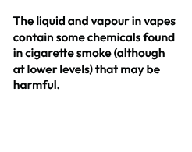
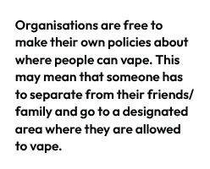
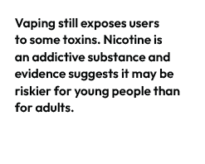
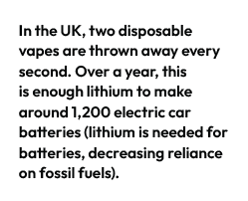
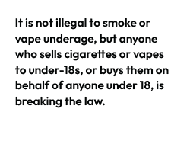
Consequences of vaping
Draw the four-square grid shown below. Then, sort the consequences cards by deciding which category each fact should come under.
Notes:
Teacher notes – Consequences of vaping (10 mins, slides 14-19)
In pairs or small groups, ask students to sort the consequences cards from Resource 3: Card sort into a four-square grid (shown on the slide). Students should decide on which of the following categories each fact about vaping should come under: environmental impact, health impact, legal impact, other impact.
Support: If required, share some example answers with students:
Environmental - More than half of people who buy single-use vapes bin them and some of the biggest vaping brands do not take any specific steps to promote recycling. The government are planning to ban disposable vapes and place limitations on the variety of flavours.
Health - The long-term risks of vaping are unclear. While vaping is far less harmful than smoking (the risks from which are well-evidenced), it is not risk free.
Legal - It is not illegal to smoke or vape underage, but anyone who sells cigarettes or vapes to under-18s, or buys them on behalf of anyone under 18, is breaking the law. Over time, the government plans to make it illegal for anyone to buy tobacco. Under the new law, each year the legal age for cigarette sales will increase by a year. It means that people born in or after 2009 will never be able to legally buy cigarettes.
Other - Vapes can help someone to quit smoking, by providing a replacement source of nicotine for those who want to quit smoking (although they are not recommended for non-smokers).
Challenge: Ask students to discuss which category is most likely to influence a young person’s decision to vape or not and why.

Slide 15
Consequences of vaping
Environmental impact
In the UK, two disposable vapes are thrown away every second. Over a year, this is enough lithium to make around 1,200 electric car batteries (lithium is needed for batteries, decreasing reliance on fossil fuels).
More than half of people who buy single-use vapes bin them and some of the biggest vaping brands do not take any specific steps to promote recycling.
In the UK, vapes require specialist recycling. If they aren’t recycled, the lithium-ion batteries can start fires when crushed in a waste truck or at a waste-processing plant.
The government is planning to ban disposable vapes and place limitations on the variety of flavours.
Notes:
Teacher notes – Consequences of vaping (10 mins, slides 14-19)
Take feedback, using PPT slides 15-18, or Resource 4: Consequences of vaping – teacher feedback to help guide discussions and draw out key learning.

Slide 16
Consequences of vaping
Health impact
The long-term risks of vaping are unclear. While vaping is far less harmful than smoking (the risks from which are well-evidenced), it is not risk free.
Vaping can be addictive, mostly due to the presence of nicotine and the ease with which it can be taken and become part of someone’s daily routine.
The liquid and vapour in vapes contain some chemicals found in cigarette smoke (although at lower levels) that may be harmful.
Vaping still exposes users to some toxins. Nicotine is an addictive substance and evidence suggests it may be riskier for young people than adults.
Notes:
Teacher notes – Consequences of vaping (10 mins, slides 14-19)

Slide 17
Consequences of vaping
Legal impact
It is not illegal to smoke or vape underage, but anyone who sells cigarettes or vapes to under-18s, or buys them on behalf of anyone under 18, is breaking the law.
Vapes are an age-restricted product because there is potential for users to become addicted to nicotine-containing vapes, and because the long-term effects of vaping on health are unknown.
The previous government planned to make it illegal for anyone to buy tobacco over time. Under the new law, each year the legal age for cigarette sales would increase by a year. It meant that people born in or after 2009 would never be able to legally buy cigarettes. If approved by parliament, this would come into force as law from 2027.
Notes:
Teacher notes – Consequences of vaping (10 mins, slides 14-19)

Slide 18
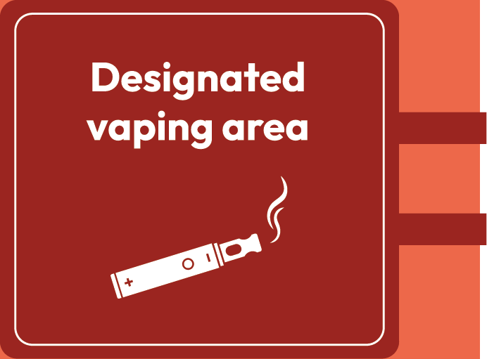
Consequences of vaping
Other impact
Vapes can help someone to quit smoking, by providing a replacement source of nicotine (although they are not recommended for non-smokers).
The vaping industry continues to grow (with some vaping companies backed by the tobacco industry) and is solely focused on making a profit.
Organisations are free to make their own policies about where people can vape. This may mean that someone has to separate from their friends/family and go to a designated area where they are allowed to vape.
Notes:
Teacher notes – Consequences of vaping (10 mins, slides 14-19)

Slide 19
Personal reflection
Privately reflect on what you think the most significant impact is.
Think about which consequences would be most likely to influence your own decisions about vaping…
Notes:
Teacher notes – Consequences of vaping (10 mins, slides 14-19)
Then, ask students to reflect for themselves and evaluate what they think the most significant impact is, based on which they think would be most likely to influence their own decisions about vaping. As this is a personal reflection task, students should not share their answers with the rest of the class.

Slide 20
Challenging misconceptions
In small groups, look at TJ’s timeline again…
How might someone challenge negative influences and misconceptions related to vaping?
Brainstorm any strategies that you think TJ and TJ’s friends could use to manage influence, or anything they could say or do to challenge any misconceptions about vaping.
Hint: Think about the facts about vaping from the last activity!
TJ gets ready for school
TJ on the way to school
TJ at lunch
TJ after school
Notes:
Teacher notes – Challenging misconceptions (10 mins)
In small groups, ask students to return to the timeline in Resource 2 and discuss how someone might challenge negative influences and misconceptions related to vaping. On flipchart paper, they should brainstorm any strategies they think TJ and their friends could use to manage influence, or anything they could say or do to challenge any misconceptions about vaping, drawing on the facts from the previous activity.
Take feedback from each group, drawing out the following key learning:
TJ’s misconceptions might include: vaping is a safe, social activity, because some other people from school do it; vaping is harmless for children because the packaging and smells seem to make it appeal to young people; vaping can’t be that bad for the environment because there’s not much information about how to recycle vapes; vaping is the same as smoking cigarettes, so there’s no point in Mum switching to vapes from cigarettes; most young people try vaping at some point in their lives; if Ben gets some vapes, TJ has to try them. [Stress to students that these are all misconceptions and therefore untrue].
However, while vaping can benefit someone who is trying to quit smoking, it has no other benefits. Vapes can provide a replacement source of nicotine for those who want to quit smoking, (along with alternatives, like nicotine patches), but are not recommended for non-smokers. Disposable vapes do not contain as much nicotine as a packet of 20 cigarettes, but the National Institute for Health and Care and Excellence (NICE) recommends that vaping should be discouraged in children and young people who have never smoked.
Vaping companies are focused on making profits and will market products with this in mind, rather than raising awareness about the unknown health effects, long-term financial cost of vaping, or environmental impact.
Depending on the influence/pressure someone is experiencing about vaping, someone might say a polite but assertive ‘no thanks’ to offers of vaping; talk to friends/peers about their intention not to vape; agree to respect others’ decisions not to vape; access help and support if required. Remind students that sometimes people might be going along with others because of influences including peers, celebrities/influencers, social media, advertising, but it can just take one person to ‘break ranks’ for others to admit they feel the same about what is happening. They should also remember that the vast majority of young people do not vape – according to ASH (2023), in 11-17-year-olds, only 3.6% vape more than once a week, and 3.9% vape less than once a week.
Support: Give students the writing frame provided in Resource 5: Challenging misconceptions to help them identify TJ’s misconceptions and negative influences, and then consider how to overcome these.
Challenge: Ask students to assess which point they think most effectively challenges one or more misconceptions, and which they think is most effective to challenge negative influences.

Slide 21
What have we learnt?
Think about what you have learnt in this lesson and write a response from Jaz, declining Tobi’s offer.
I've heard they're safe
Really? Don't you have to be 18 to buy them though?
Tobi
I don't know - people in our year have them... And I've seen loads of flavours online - there's bound to be one we'll like. Besides, they're disposable so we can just bin them if we don't like them. So, shall we give it a try?
Jaz
Tobi
Notes:
Teacher notes – Reflection and endpoint assessment (10 mins)
Ask students to consider the following overheard conversation (shown on the slide):
Working on their own, ask students to draw on what they have learnt in this lesson to write a response from Jaz, declining Tobi’s offer.
This can be used to demonstrate progress and inform future teaching.

Slide 22
Sources of support
To access further advice, guidance and support related to substance use, you can:
Speak to a parent/carer or a member of staff in school such as your form tutor, head of year, school nurse, or a member of the safeguarding team
Speak to a GP
I need your help with something . . .
Something's worrying me, can I talk to you?
I have something that’s been bothering me . . .
Notes:
Teacher notes – Reflection and endpoint assessment (10 mins, slides 22-23)
Remind students that they can access support at home, and both in school (through their form tutor, pastoral lead, or school nurse) and out of school, through their GP, local and national organisations.

Slide 23
Sources of support
To access further advice, guidance and support related to substance use, you can visit:
Childline - www.childline.org.uk Phone: 0800 1111
FRANK- www.talktofrank.com/drug/vapes Phone: 0300 1236600
National Smokefree Helpline: 0300 123 1044
Better Health – Quit Smoking www.nhs.uk/better-health/quit-smoking/NHS
I need your help with something . . .
Something's worrying me, can I talk to you?
I have something that’s been bothering me . . .
Notes:
Teacher notes – Reflection and endpoint assessment (10 mins, slides 22-23)
Share the following websites and phone numbers with students:
Childline - www.childline.org.uk 0800 1111
FRANK -www.talktofrank.com/drug/vapes 0300 1236600
National Smokefree Helpline: 0300 123 1044
Better Health – Quit Smoking www.nhs.uk/better-health/quit-smoking/NHS

Slide 24
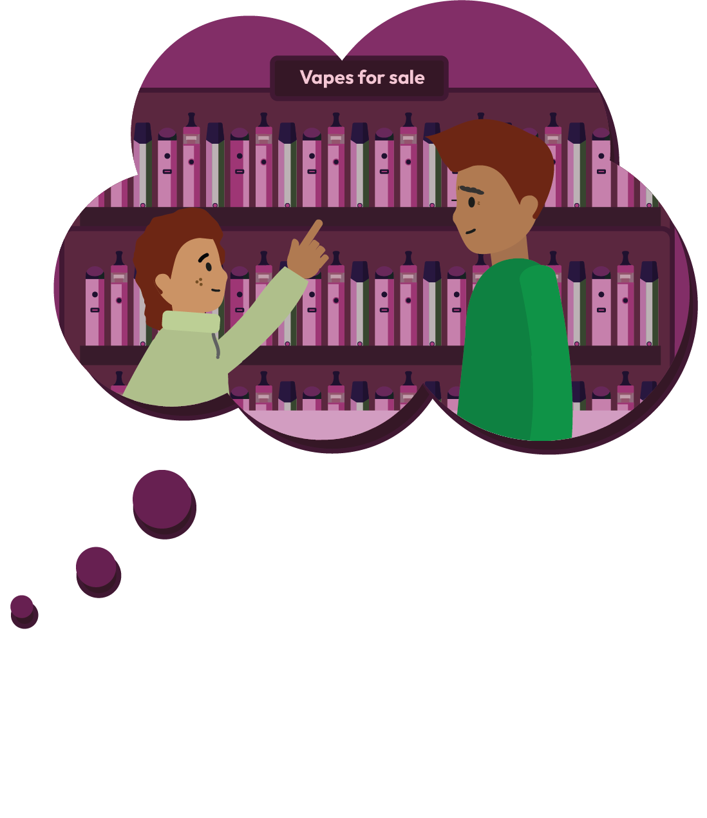
More activities
Imagine that TJ’s friend Ben has decided to ask his brother to buy him a vape (even though TJ no longer wants one).
Write a response from Ben’s brother explaining why he won’t buy him a vape.
Notes:
Teacher notes – Extension activity
Ask students to imagine that TJ’s friend Ben has decided to ask his brother to buy him a vape (even though TJ no longer wants one) and write a response from Ben’s brother explaining why he won’t buy him a vape, drawing on their key learning from today’s lesson.

