Slide 1
Drug education
The law and managing risk
Year 9: Lesson 3

Slide 2
Using this PowerPoint
The slides in this presentation are divided into two sections:
Teacher slides (purple) – provide key information regarding lesson preparation.
Student slides – provide a visual focus point for students during the lesson and delivery notes for teachers about the activities. Click ‘notes’ to view these.
Ensure that you select ‘Use Presenter View’ under the ‘Slide Show’ tab – this will allow you to preview the teaching notes on your monitor while the main presentation is displayed on a screen/smartboard.

Slide 3
Support and challenge
The lesson includes suggestions for challenge and support activities, to help you differentiate appropriately for your class.
Support activities are adapted to be more accessible for those who need it.
Challenge activities deepen and extend learning for those who need more challenge or who finish the activity quickly.
Look for these icons on the pupil slides. See delivery notes for details of the activities.
Challenge
Support

Slide 4
Context
This is the third of five drug education lessons, for year 9. This lesson focuses on the law in relation to drugs, the legal consequences of possessing or supplying drugs and how police officers enforce these laws in practice.

Slide 5
Developing subject knowledge
Key information on content related to these lessons can be found in the Year 9 Knowledge Organiser.
Advice on safe practice, dispelling common misconceptions, visitors to the classroom and other important information can be found in Teacher Guidance: Drug education.
Data sources to inform your planning can be found within our document that outlines the approach of these lessons Evidence Review: Effective drug education, along with advice regarding the effective use of positive social norms and how to talk to young people about substance use.

Slide 6
To learn about the potential legal consequences of using illegal drugs.
Students will be able to:
explain the legal terms ‘possession’, ‘supply’ and ‘intent to supply’ in relation to drugs
explain the short and long-term legal consequences of being found in possession of, using, selling or supplying different classes of drugs

Slide 7
Box or envelope for questions
Resource 1: Drug class card sort [one per pair]
Resource 1a: Drug class card sort answers [teacher copy]
Resource 2: Picture cards [two copies of each card per class]
Resource 2a: Teacher information sheet [teacher copy]
Resource 3: Outcomes [one per small group]

Slide 8
Lesson summary
Activity | Description | Timing
Baseline assessment activity | Students respond to an overheard conversation, sharing their initial ideas about drugs and the law. | 8 mins
Introduction | Introduce learning objective and outcomes, and revisit ground rules. | 2 mins
Drug class | Students match situations involving drugs with the class of drug and maximum penalty. | 10 mins
Picture analysis | In small groups, students identify risks relating to drug use in a scenario. | 10 mins
Predicting outcomes | Students sort different legal outcomes by likelihood of occurrence. | 10 mins
Ongoing consequences | Class predicts the long-term consequences for someone who has been arrested for drug offences. | 10 mins
Endpoint assessment | Students revisit the overheard conversation and add new learning to demonstrate progress. | 5 mins
Signposting support | Remind students how to access information and support, including how to contact the police and report a crime. | 5 mins

Slide 9
The law and managing risk
Lesson 3

Slide 10
Notes:
Teacher notes – Baseline assessment activity (8 mins, slides 10-11)
Ensure ground rules are established with the group before teaching this lesson and make students aware of the question box, which will be available throughout the lesson. Remind students that if they have worries or questions during or after the lesson, that they do not want to raise in front of the class, they can write their question on a piece of paper, anonymously or with their name, and put it in the question box.

Slide 11
What’s our starting point?
What do you think Person A and Person B are talking about?
Which person do you think is right? Why?
What might the consequences be for Person B?
A
You can get into real trouble for having that in your bag!
B
It’s fine, I’m not going to use it. I’m giving it to a mate.
A
That’s going to be even worse! It’s dealing!
B
It’s not dealing if they don’t pay for it.
Notes:
Teacher notes – Baseline assessment activity (8 mins, slides 10-11)
Share the following overheard conversation (also shown on the slide) with students:
Person A: “You can get into real trouble for having that in your bag!”
Person B: “It’s fine, I’m not going to use it. I’m giving it to a mate.”
Person A: “That’s going to be even worse! It’s dealing!”
Person B: “It’s not dealing if they don’t pay for it.”
In pairs, ask students to discuss and note down in their books, their responses to these questions:
What do you think Person A and Person B are talking about?
Which person do you think is right? Why?
What might the consequences be for Person B?
Take feedback from the class. This will help you gauge students’ current understanding about drugs and the law. Use this to adapt teaching and correct any misconceptions during the lesson.

Slide 12
We will learn about the potential legal consequences of using illegal drugs.
We will be able to:
explain the legal terms ‘possession’, ‘supply’ and ‘intent to supply’ in relation to drugs
explain the short and long-term legal consequences of being found in possession of, using, selling or supplying different classes of drugs
Notes:
Teacher notes – Introduction (2 mins)
Introduce the learning objective and outcomes and explain that today’s lesson will look at the law about drugs, and the short and long-term impact of possessing or supplying drugs.

Slide 13
Drug class
Sort the situation cards into the table using the definitions below:
Possession means that an individual is caught with a controlled drug for personal use. The person does not have to be using it, just to have it in their possession.
Possession with intent to supply means that a person is planning to give controlled drugs to someone else. This includes selling, sharing or giving for free.
Supply means that a person distributes or gives someone else controlled drugs. This can be selling, giving for a reward of some form, sharing or giving for free.
Using the decoder, suggest what the maximum legal penalty for each scenario might be.
Notes:
Teacher notes – Drug class (10 mins, slides 13-14)
In pairs, ask students to sort the cards from Resource 1: Drug class card sort into the table. They should decide on the class of the drug and the type of offence shown (possession, possession with intent to supply, or supply).
Clarify the meaning of these terms by sharing these definitions:
Possession means that an individual is caught with a controlled drug for personal use. The person does not have to be using it, just to have it in their possession.
Possession with intent to supply means that a person is planning to give controlled drugs to someone else. This includes selling, sharing or giving for free.
Supply means that a person distributes or gives someone else controlled drugs. This can be selling, giving for a reward of some form, sharing or giving for free.
Circulate amongst groups, checking their responses using the answer sheet in Resource 1a: Drug class card sort teacher answers.

Slide 14
Smoking some cannabis in the park.
Selling anabolic steroids to a stranger.
Possession of a Class B drug
Supply of a Class C drug
Having a small amount of cocaine in a plastic bag.
Picking up some magic mushrooms to drop off later at a friend's house
Possession of a Class A drug
Intent to supply a Class A drug
Keeping a few ecstasy pills in a school locker.
Sharing a synthetically made substance, that feels a bit like cannabis, with friends.
Possession of a Class A drug
Depending on the contents, possession of a Class B drug or illegal under the Psychoactive Substances Act
Using a nitrous oxide balloon at home.
Giving some ketamine to a friend at a party.
Possession of a Class C drug
Supply of a Class B drug
Notes:
Teacher notes – Drug class (10 mins, slides 13-14)
Take feedback and share the correct answers the slide.
Then, using the legal penalties decoder at the bottom of Resource 1, ask students to suggest what the maximum legal penalty would be for each scenario. Take feedback and share the solution and penalty from Resource 1a: Drug class card sort answers.
Key learning:
Substances fall into class categories: A, B, C and psychoactive substances. (This refers to substances covered by the Psychoactive Substances Act 2016.)
‘Possession’ can lead to an unlimited fine and/or a prison sentence for drug classes A, B and C. (See legal penalty decoder in Resource 1a for a further breakdown of prison sentences.)
In the UK being intoxicated/’high’ is not an offence, but any resultant disorderly behaviour may be illegal. There are also traffic offences related to this. It may also be grounds for a police search. Be aware that discussion around police stop and search powers may raise concerns about ethnicity-based prejudice. See the teacher guidance document for further support.
Both ‘Possession with intent to supply’ and ‘Supply’ can lead to an unlimited fine and/or a prison sentence for drug classes A, B, C and psychoactive substances. (See legal penalty decoder in Resource 1a for a further breakdown of prison sentences.)
There is no possession offence for Psychoactive Substances (unless in custodial settings or on education premises, such as schools), however this does not mean they are ‘safer’ and students should understand that there are still personal and health risks to their use, as well as the risk of confiscation of the substance by police officers.
It is important to note that for small amounts of cannabis or khat, a warning for possession may be given initially if a person is over 18 and has no prior record of drug-related offences. Further offences can lead to on-the-spot fines or arrest.

Slide 15
Picture analysis
Imagine a police officer is nearby the situation on the picture card. As a group discuss the following questions:
What risks are present?
Swap your picture with another group and discuss the situation on the new card.
Who is most at risk in the picture?
Without intervention from the police officer, what might happen next?
Notes:
Teacher notes – Picture analysis (10 mins, slides 15-19)
Working in small groups, give students one of the images from Resource 2: Picture cards and ask them to imagine a police officer is nearby. Ask them to discuss the following questions:
What risks are present?
Who is most at risk in the picture?
Without intervention from the police officer, what might happen next?
Encourage students to use the legal terms ‘possession’, ‘intent to supply’ and ‘supply’ in their discussion when possible. If time allows, rotate picture cards so students have an opportunity to discuss different situations.
Images reproduced with kind permission of Sussex Police
Take feedback, drawing out the key learning from Resource 2a: Teacher information sheet and highlighting the following:
Substance use can affect the individuals involved, as well as other members of the public. Young people might also be vulnerable to ongoing harms from the drug trade, such as being drawn into supply through exploitation including offers of ‘gifts.’
Levels of risk will vary in each scenario and could be dependent on factors we don’t know about, such as substances being mixed. We also do not know if the individuals in the pictures are there of their own volition, or if they are being coerced.
Answers students give will vary; however, students should recognise that the role of the police is to ensure the safety of the young people in each scenario as well as that of the general public.
It is important to point out that for most young people involved in drugs, supply will be through friends and siblings (and for alcohol, sometimes from the family home). Involvement with ‘dealers’ does happen, but it is relatively rare.
Support: Select pictures A, B and C for students who need more support. Scaffold the activity using questioning e.g. What can you see? What might be happening? Are there any questions you might want to ask about the picture? Students can annotate or circle features of the picture in response to these questions.
Challenge: Ask students to write a blog about why laws exist in relation to drugs and alcohol.

Slide 16
Notes:
Teacher notes – Picture analysis (10 mins, slides 15-19)

Slide 17
Notes:
Teacher notes – Picture analysis (10 mins, slides 15-19)

Slide 18
© PSHE Association 2025
Notes:
Teacher notes – Picture analysis (10 mins, slides 15-19)

Slide 19
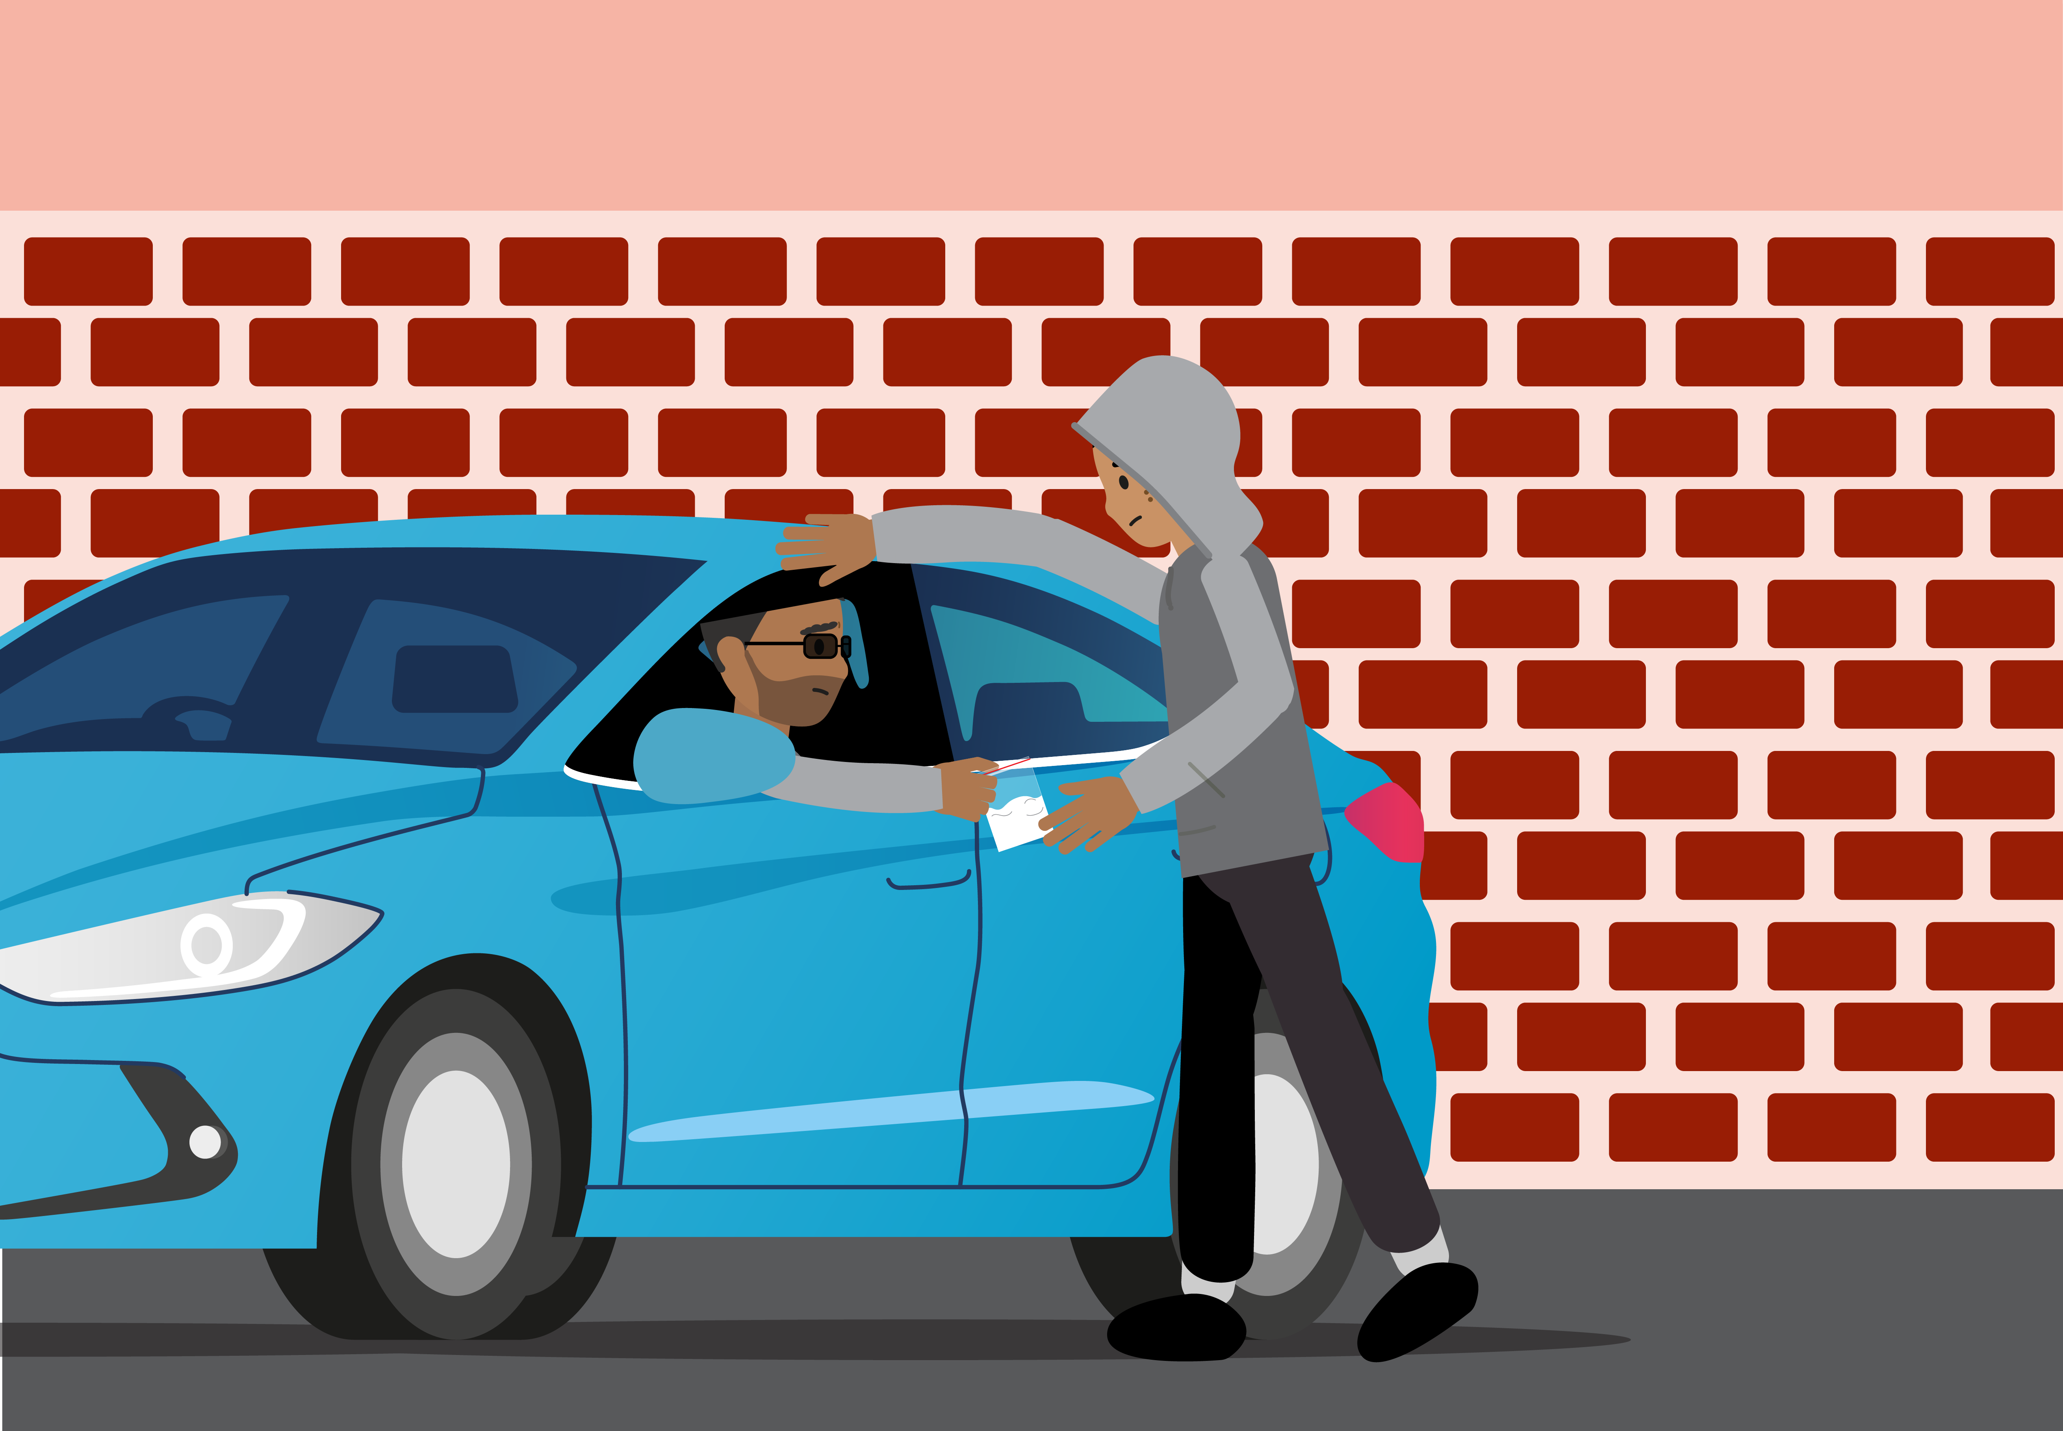
© PSHE Association 2025
Notes:
Teacher notes – Picture analysis (10 mins, slides 15-19)

Slide 20
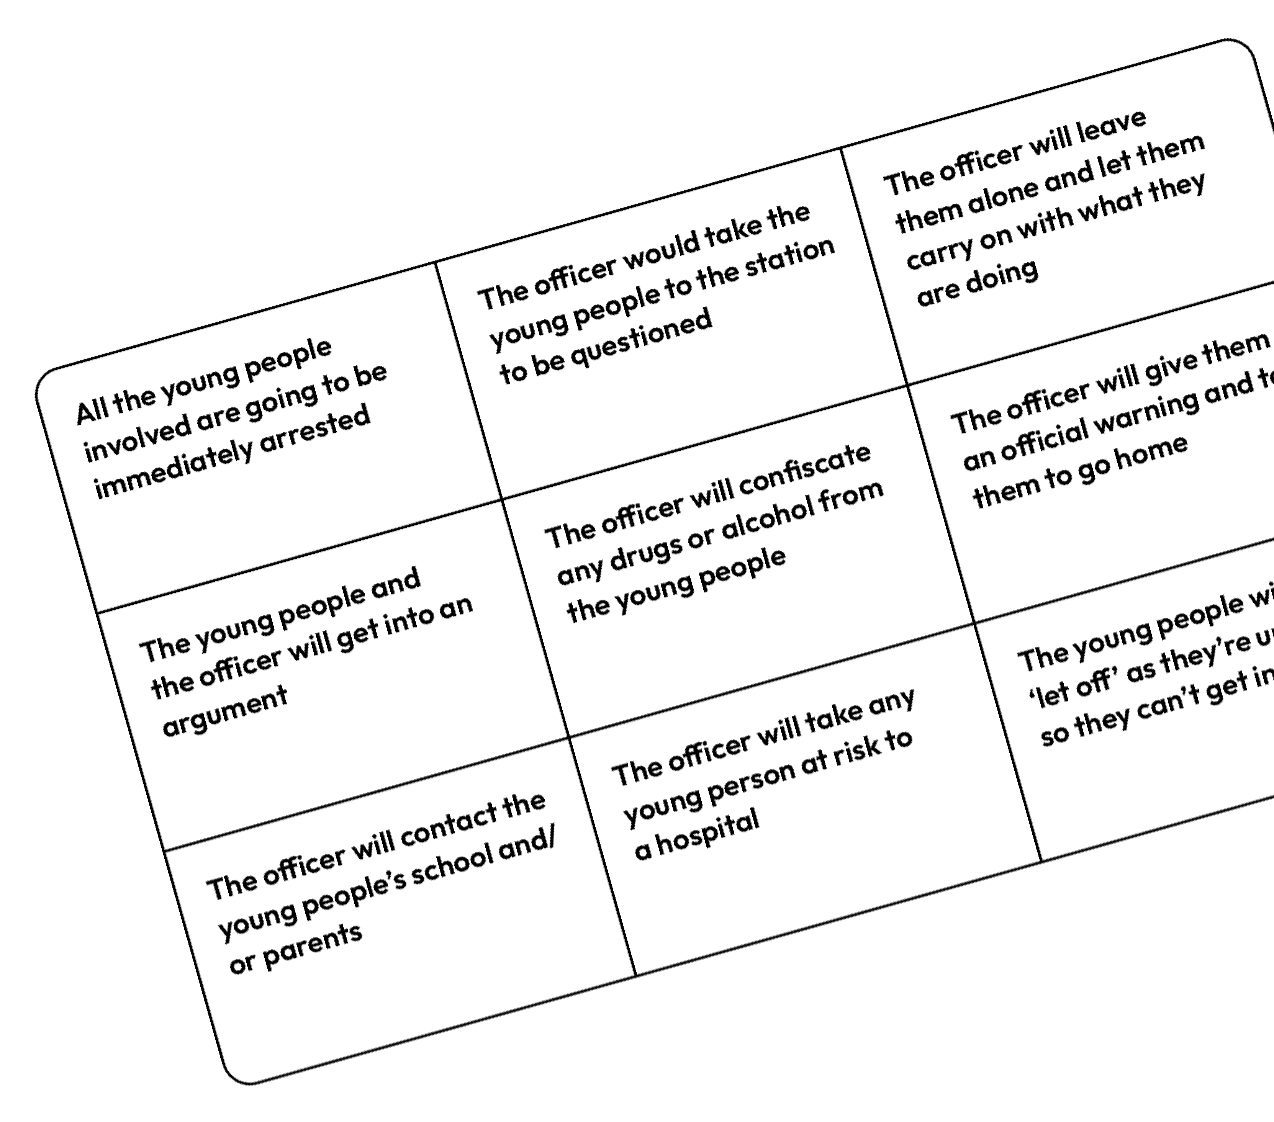
Predicting outcomes
Focussing on the scenario your group currently has, read each of the outcomes on your sheet.
Shade each box based on how likely you think it is.
Key:
Green will definitely happen
Orange will sometimes happen
Red will rarely or never happen
Notes:
Teacher notes – Predicting outcomes (10 mins)
Still using their picture scenario, ask students to decide what they think might happen next. Give groups Resource 3: Outcomes and ask them to shade in each card based on likelihood as follows:
Green – Definitely
Orange – Sometimes
Red – Rarely
Answers will vary based on the scenario and different groups’ perceptions. As feedback on this activity could be lengthy, encourage students to only share their ‘most likely’ and ‘least likely’ idea, or to share a card they disagreed over during the activity and explain why they had different views.
Ensure students understand that officers can and do arrest young people for drug offences, particularly for supply of drugs, but that the police use their powers of discretion in many circumstances, in the wider interests of society. Note that in some police force areas, police are now operating diversionary schemes, whereby drug possession offences lead to referral to drugs education rather than processing through the criminal justice system. In regard to official warnings, it is important to note that after the age of 18 official warnings can be given for the possession of small amounts of cannabis or khat.
Support: Give students fewer cards to sort (e.g. 5 or 6) rather than 9.
Challenge: Ask students to suggest which factors might affect possible outcomes to the situation (e.g. the way the young people respond to the officer, how inebriated they are, the class of the drug, the time of day, who else is around).

Slide 21
Ongoing consequences
Divide your page into four sections and write each of the following headings:
Personal
Friends and family
Career
Travel
As a group, write down any consequences having a drug-related criminal record might have on each of these aspects of a person’s life.
Personal | Friends & family
Career | Travel
Notes:
Teacher notes – Ongoing consequences (10 mins, slides 21-22)
Still in their groups, ask pupils to split their page into a grid of four and write in the spaces the headings ‘Personal’, ‘Friends and Family’, ‘Career’ and ‘Travel’. Ask students to write down any consequences of having a criminal record for drug offences on each of these aspects of a person’s life.

Slide 22
Personal
Personal:
might feel regret or guilt,
less confident about new challenges
worried what others will think
damage to personal reputation
might have to spend time in prison
Friends and family:
may be disappointed or worried about their own reputation and spend less time together
might be more worried about their friend/family member’s decisions and safety in future
Friends and family
Career
Travel
Career:
might be less likely to get a job
might not be able to work in certain professions anymore
time in prison can disrupt studies and career path
Travel:
entry to some countries refused if someone has a drugs-related conviction (e.g. USA)
might limit options and opportunities in the future (e.g. to live or work abroad)
Notes:
Teacher notes – Ongoing consequences (10 mins, slides 21-22)
Take feedback, using the slide and drawing out the following key points:
Personal - might feel regret or guilt, less confident about new challenges, worried what others will think, damage to personal reputation, might have to spend time in prison.
Friends and family - may be disappointed, friends might not want to spend time together anymore due to concerns about their own reputations, might be more worried about their friend/family member’s decisions and safety in future, might have to be away from family and friends while in prison.
Career - have to disclose criminal offences when applying for jobs, so might be less likely to get a job, might not be able to work in certain professions anymore, time in prison can disrupt studies and career path.
Travel - entry to some countries refused if someone has a drugs-related conviction (e.g. USA), might limit options and opportunities in the future (e.g. to live or work abroad).

Slide 23
What have we learnt?
On your own, think about the overheard conversation from the start of the lesson.
Write a short script of how you might respond to Person B.
How can you explain the law to them and the consequences of their actions?
A
You can get into real trouble for having that in your bag!
B
It’s fine, I’m not going to use it. I’m giving it to a mate.
A
That’s going to be even worse! It’s dealing!
B
It’s not dealing if they don’t pay for it.
Notes:
Teacher notes – Endpoint assessment (5 mins)
Ask students to revisit the overheard conversation from the start of the lesson and script a response to Person B, convincing them of the consequences of their actions. Students should try to include different legal terms relating to illegal drugs: ‘possession’, ‘intent to supply’ and ‘supply’. They should also include different short and long-term consequences in their response.
Take feedback to assess the extent to which the learning outcomes have been met.

Slide 24
Sources of support
To access further advice, guidance and support related to substance use, you can:
Speak to a parent/carer or a member of staff in school such as your form tutor, head of year, school nurse, a school police officer or community support officer.
I need your help with something . . .
Something's worrying me, can I talk to you?
I have something that’s been bothering me . . .
Notes:
Teacher notes – Signposting support (5 mins, slides 24-25)
Remind students that they can access support at home, and both in school (through their form tutor, pastoral lead, school nurse or school police officer/police community support officer) and out of school, through local and national organisations.

Slide 25
Sources of support
To access further advice, guidance and support related to substance use, you can also contact:
Childline: www.childline.org.uk or 0800 11 11
FRANK: www.talktofrank.com/get-help
To contact the police:
in an emergency call 999
to report a non-urgent crime call 101
to anonymously report a crime, visit www.fearless.org
I need your help with something . . .
Something's worrying me, can I talk to you?
I have something that’s been bothering me . . .
Notes:
Teacher notes – Signposting support (5 mins, slides 24-25)
Share the following websites and phone numbers with students:
Childline - www.childline.org.uk Phone: 0800 1111
Talk to Frank - www.talktofrank.com/get-help Phone: 0300 123 6600
Remind students that if they need to contact the police, they can:
get help in an emergency by calling 999
report a non-urgent crime by calling 101
anonymously report a crime by visiting www.fearless.org

Slide 26
More activities
Create a leaflet for young people highlighting the key legal risks relating to drug use.
This should include:
definition of key terms
provide examples of legal terms
suggest possible consequences
Notes:
Teacher notes – Extension activity
Ask students to create a leaflet for young people highlighting the key legal risks relating to drug use. This should define key terms, provide examples of each and suggest possible consequences.

