Slide 1
Drug education
Alcohol and cannabis
Year 9: Lesson 4

Slide 2
Using this PowerPoint
The slides in this presentation are divided into two sections:
Teacher slides (purple) – provide key information regarding lesson preparation.
Student slides – provide a visual focus point for students during the lesson and delivery notes for teachers about the activities. Click ‘notes’ to view these.
Ensure that you select ‘Use Presenter View’ under the ‘Slide Show’ tab – this will allow you to preview the teaching notes on your monitor while the main presentation is displayed on a screen/smartboard.

Slide 3
Support and challenge
The lesson includes suggestions for challenge and support activities, to help you differentiate appropriately for your class.
Support activities are adapted to be more accessible for those who need it.
Challenge activities deepen and extend learning for those who need more challenge or who finish the activity quickly.
Look for these icons on the pupil slides. See delivery notes for details of the activities.
Challenge
Support

Slide 4
Context
This is the fourth of five drug education lessons, for year 9. This lesson explores the effects of different patterns of alcohol use, and the health risks associated with alcohol and cannabis use.

Slide 5
Developing subject knowledge
Key information on content related to these lessons can be found in the Year 9 Knowledge Organiser.
Advice on safe practice, dispelling common misconceptions, visitors to the classroom and other important information can be found in Teacher Guidance: Drug education. This includes direction to further guidance regarding police stop and search powers, should this discussion arise during the lesson.
Data sources to inform your planning can be found within our document that outlines the approach of these lessons Evidence Review: Effective drug education including advice regarding how to talk to young people about alcohol.

Slide 6
To learn about the short and long-term effects of alcohol and cannabis use on individuals.
Students will be able to:
analyse the factors that might affect someone’s decision to use or not use substances
describe some of the health risks associated with occasional and problematic substance use
identify and challenge misconceptions related to cannabis use and drinking alcohol

Slide 7
Box or envelope for questions
Flip chart paper and markers
Resource 1: Alcohol patterns [one per small group of 3-4 students]
Resource 1a: Alcohol patterns and risks [support option, as required]
Resource 2: Continue the conversation [one per pair]
Resource 2a: Find the response [support option, as required]

Slide 8
Lesson summary
Activity | Description | Timing
Introduction | Introduce the learning objective and outcomes, and revisit ground rules. | 2 mins
Baseline assessment activity | Students create a mind map on the risks associated with the use of alcohol and other drugs. | 8 mins
Factors affecting decisions | Students evaluate how a person’s environment can affect their choice to drink alcohol or use other drugs. | 15 mins
Alcohol patterns | Students explore alcohol drinking patterns and analyse levels of risk. | 10 mins
Continue the conversation | Students identify and correct misconceptions in relation to cannabis. | 10 mins
Reflection and endpoint assessment | Students revisit their mind map, adding new learning to demonstrate progress. Students reflect on questions they still have. | 10 mins
Signposting support | Remind students how to access further advice, guidance and support related to drugs issues. | 5 mins

Slide 9
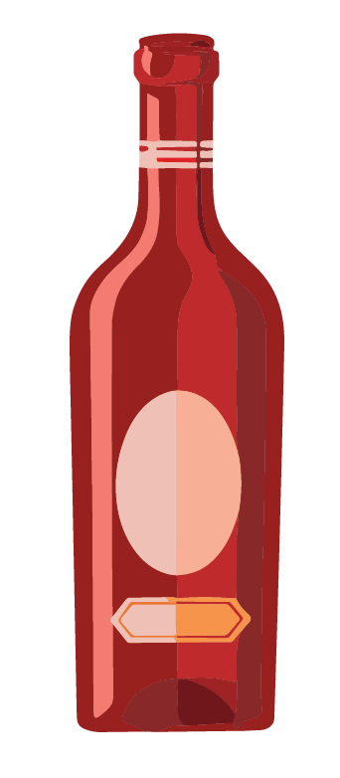
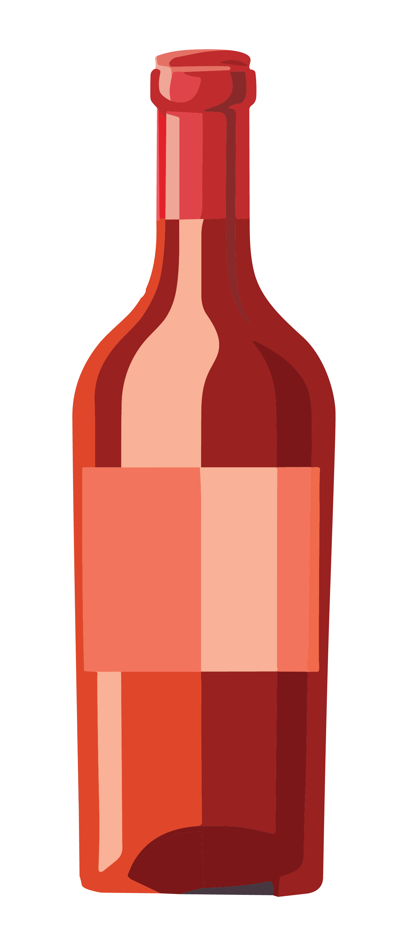
Alcohol and cannabis
Lesson 4

Slide 10
Notes:
Teacher notes – Introduction (2 mins, slides 10-11)
Ensure ground rules are established with the group before teaching this lesson and make students aware of the question box, which will be available throughout the lesson. Remind students that if they have worries or questions during or after the lesson, that they do not want to raise in front of the class, they can write their question on a piece of paper, anonymously or with their name, and put it in the question box.

Slide 11
We will learn about the short and long-term effects of alcohol and cannabis use on individuals.
We will be able to:
analyse the factors that might affect someone’s decision to use or not use substances
describe some of the health risks associated with occasional and problematic substance use
identify and challenge misconceptions related to cannabis use and drinking alcohol
Notes:
Teacher notes – Introduction (2 mins, slides 10-11)
Introduce the learning objective and outcomes and explain that today’s lesson will explore the effects of drug use on mental and physical health, with a focus on alcohol and cannabis.

Slide 12
What’s our starting point?
Create a mind map responding to the question:
What are the potential risks of using alcohol or other drugs?
Keep this safe! We will revisit your mind map in a few lessons’ time.
Notes:
Teacher notes – Baseline assessment activity (8 mins, slides 12-13)
Ask students to create a mind map around the following question: What are the potential risks of using alcohol or other drugs?
As this is a baseline assessment, students should complete their mind map individually and without any input or prompting. The activity is intended to measure what students currently perceive as a risk.
Take feedback from students but remind them not to add to their mind map while taking suggestions from the class.

Slide 13
What’s our starting point?
Can you put any of the risks into categories?
For example:
Short or long-term
Physical, emotional, social, financial or legal
Risks to the person using drugs, to their family and friends or to the community
Are there any situations that might increase or decrease these risks?
Notes:
Teacher notes – Baseline assessment activity (8 mins, slides 12-13)
Then, as a class, discuss what categories the risks might fall into, for example: short or long-term; physical, emotional, social, financial or legal; risks to the person using the drug, their family and friends, their community. Ask students if they think there are any situations that might increase or decrease the risk associated with drug or alcohol use.

Slide 14
Factors affecting decisions
As a group, imagine that a young person is deciding whether to drink alcohol or use other drugs in the scenario you have been given. On your paper, write responses to the following questions:
What effect (if any) might the situation have on whether the young person decides to drink alcohol or use other drugs?
How might the situation affect the risks the young person faces if they do choose to drink alcohol or use other drugs?
How might the situation be made safer and/or where could the young person get support?
Notes:
Teacher notes – Factors affecting decisions (15 mins)
Write each of the situations below on separate pieces of flipchart paper, divide the class into six groups and give each group one of the sheets:
Meeting someone unfamiliar
Preparing for exams
Dancing at a crowded party
Being in an unfamiliar place
Having had a stressful day
Being at home alone
Ask students to imagine that a young person is deciding whether to use a drug or drink alcohol in each of these scenarios. In their groups, students should write on the flipchart paper their responses to the following questions:
What effect (if any) might the situation have on whether the young person decides to use a drug or drink alcohol?
How might the situation affect the risks the young person faces if they do choose to use a drug or drink alcohol?
How might the situation be made safer and/or where could the young person get support?
Afterwards, ask the groups to swap their sheets so that they can add any additional ideas to each other’s situations.
Gather feedback from the groups. Students might suggest:
A person might be more likely to use drugs or drink alcohol in situations where many people are drinking or using drugs, such as at a party; or where they want to ‘impress’ someone they have just met.
Each of the situations may have a different effect on different people. For example, if a person felt stressed about their upcoming exams they may use unhealthy coping mechanisms, such as drugs or alcohol. Alternatively, in the same situation a person may consider their upcoming exams to be a reason that they do not want to drink alcohol or use a drug, as they need to care for their physical and mental health at this time and maximise time for study and preparation.
Support could be sought in school through a teacher, member of pastoral staff or school counsellor; or outside of school such as through a parent, friend or contacting Childline or a similar service. They may also suggest ways to reduce risk in the immediate situation, for example by the person removing themselves from the situation; making a plan with friends before going out, for keeping each other safe; or using healthy coping strategies to deal with stress and anxiety.
The level of risk would vary depending on whom the person was surrounded by, for example the risk from using a drug would be especially high if a person was alone and needed medical support.
Challenge: Ask students to write down any other factors they can think of that might affect the level of risk a person experiences in relation to drug, alcohol or tobacco use.

Slide 15
Alcohol patterns
The Chief Medical Officer provides guidance on how to manage risk in relation to alcohol. We are going to consider what this advice might look like for an adult over the age of 18 over the course of a week, if they chose to drink alcohol.
The Chief Medical Officer advises that an alcohol-free childhood is the healthiest choice.
Read the guidance on your sheet, then draw or write the number of alcoholic drinks that an adult who chooses to drink alcohol could drink whilst keeping the risks relatively low.
Note: this guidance is intended as a maximum and not a target.
Notes:
Teacher notes – Alcohol patterns (10 mins)
Remind students that many people do not drink alcohol for religious or cultural reasons, that statistics show that alcohol use amongst all young people is declining, and that most young people choose not to drink alcohol. For those who do choose to drink alcohol, whilst all alcohol consumption carries a degree of risk, there are ways to reduce the risk of harm.
Give students Resource 1: Alcohol patterns and ask them to read the first part of the sheet that outlines what can be considered lower risk drinking and explain that whilst not drinking alcohol at all is the healthiest choice, drinking alcohol in a lower risk way reduces the chance of illness or injury, including lower risks of alcohol-related cancers, and short-term injuries or misjudgement of risks than higher risk drinking habits.
Next, ask students to draw or write the number of alcoholic drinks that an adult could drink to be considered a ‘lower-risk’ drinker in the table on the lower half of the sheet using the information they have read. They should also decide on three key points they think would keep the risks to an adult low. For example, they may wish to consider how much or how often a person may want to drink or if there are further strategies to lower the risks present while drinking.
Take feedback, drawing out key learning:
It is important to note that advice from the Chief Medical Officer states that an alcohol-free childhood is the healthiest choice.
For adults, drinking fewer than 14 units of alcohol per week constitutes lower-risk drinking and this should be spread over time rather than all on one or two days.
Lower-risk drinking reduces the risk of short-term injuries or illness such as accidents or misjudgements of risk that lead to injury or illness, and alcohol poisoning. It also reduces the long-term risks to health such as liver or heart disease, some cancers and damage to the brain or nervous system.
Limiting the amount of drinking in one session, for example over an evening, also lowers the risk of short-term health risks including accidents and vulnerability to others. Students may also add that a person can ensure they have a plan to get home and stay in a group with people they trust, as a way to reduce vulnerability and risk.
Students may have suggested a range of further strategies to lower a person’s risk whilst drinking. For example, if a person chose to have multiple drinks in one session, then spacing drinking alcohol with non-alcoholic beverages, can reduce the number of alcoholic drinks consumed in total and can give the body time to process the alcohol as it slows drinking. However, students should understand that this does not prevent the effects of alcohol completely.
Students may have also identified that eating food with drinking alcohol could be a strategy used to reduce risk in relation to drinking, as it allows the body to process alcohol gradually by slowing the alcohol entering the bloodstream. Students should understand that this will not negate the effects of alcohol and eating food after heavy drinking will not ‘sober up’ a person who is drunk. With higher levels of alcohol, it could also increase risk as the person may be sick which could present a choking hazard.
Support: Give students Resource 1a: Alcohol patterns and risks and ask them to comment on what is helpful and what is risky about each pattern. They should also circle the pattern they think is lowest risk.

Slide 16
Continue the conversation
Read each opinion in speech bubbles and match them to the correct response.
Opinion
Response
A
A
B
C
A
A
Notes:
Teacher notes – Continue the conversation (10 mins, slides 16-25)
Explain that drugs such as cannabis also have an impact on physical and mental health. Give pairs of students Resource 2: Continue the conversation and ask them to match each opinion (on the first page) with the correct response (on the second page).
Support: Give students Resource 2a: Find the response to match the replies, as this has reduced and simplified language.
Challenge: Ask students to draft a brief social media post of no more than two sentences that a charity could post to address one of the opinions and its response shared in the activity.

Slide 17
Continue the conversation
A
Prosecution for possession, supply or intent to supply cannabis follows the same process if the plants are being grown at home as if a person either possessed, supplied, or intended to supply prepared cannabis that they had purchased.
I don’t think a person can get in trouble for growing cannabis at home.
Notes:
Teacher notes – Continue the conversation (10 mins, slides 16-25)
Explain that drugs such as cannabis also have an impact on physical and mental health. Give pairs of students Resource 2: Continue the conversation and ask them to match each opinion (on the first page) with the correct response (on the second page).
Support: Give students Resource 2a: Find the response to match the replies, as this has reduced and simplified language.
Challenge: Ask students to draft a brief social media post of no more than two sentences that a charity could post to address one of the opinions and its response shared in the activity.

Slide 18
Continue the conversation
B
Smoking cannabis can cause breathing difficulties, and increases the risk of lung cancer, even if tobacco is not used.
Cannabis can harm mental health including reducing motivation, impairing memory and cognitive function, as well as causing paranoia and anxiety.
Using cannabis can also harm relationships and affect a person’s studies/work.
I think cannabis can cause harm.
Notes:
Teacher notes – Continue the conversation (10 mins, slides 16-25)
Explain that drugs such as cannabis also have an impact on physical and mental health. Give pairs of students Resource 2: Continue the conversation and ask them to match each opinion (on the first page) with the correct response (on the second page).
Support: Give students Resource 2a: Find the response to match the replies, as this has reduced and simplified language.
Challenge: Ask students to draft a brief social media post of no more than two sentences that a charity could post to address one of the opinions and its response shared in the activity.

Slide 19
Continue the conversation
C
Medicines based on cannabis are now prescribed in very rare cases by a small number of specialists in the UK.
Medical cannabis has lower levels of the compound THC that gives users the ‘high’ associated with cannabis use.
I heard that cannabis is used medicinally so it must be safe.
Notes:
Teacher notes – Continue the conversation (10 mins, slides 16-25)
Explain that drugs such as cannabis also have an impact on physical and mental health. Give pairs of students Resource 2: Continue the conversation and ask them to match each opinion (on the first page) with the correct response (on the second page).
Support: Give students Resource 2a: Find the response to match the replies, as this has reduced and simplified language.
Challenge: Ask students to draft a brief social media post of no more than two sentences that a charity could post to address one of the opinions and its response shared in the activity.

Slide 20
Continue the conversation
D
In 2021, only 7% of 11-15-year-olds had ever tried cannabis (meaning 93% had not).
This is a distinct decline from previous years and demonstrates that most young people do not use cannabis.
I think most people use cannabis
Notes:
Teacher notes – Continue the conversation (10 mins, slides 16-25)
Explain that drugs such as cannabis also have an impact on physical and mental health. Give pairs of students Resource 2: Continue the conversation and ask them to match each opinion (on the first page) with the correct response (on the second page).
Support: Give students Resource 2a: Find the response to match the replies, as this has reduced and simplified language.
Challenge: Ask students to draft a brief social media post of no more than two sentences that a charity could post to address one of the opinions and its response shared in the activity.

Slide 21
Continue the conversation
E
Cannabis is a Class B drug. Previously it had been downgraded to Class C, however it was reclassified to Class B again in 2009.
This means that penalties include a prison sentence of up to 5 years for possession and up to 14 years for intent to supply or supply.
In both cases there can also be an unlimited fine.
I heard cannabis is a Class B drug
Notes:
Teacher notes – Continue the conversation (10 mins, slides 16-25)
Explain that drugs such as cannabis also have an impact on physical and mental health. Give pairs of students Resource 2: Continue the conversation and ask them to match each opinion (on the first page) with the correct response (on the second page).
Support: Give students Resource 2a: Find the response to match the replies, as this has reduced and simplified language.
Challenge: Ask students to draft a brief social media post of no more than two sentences that a charity could post to address one of the opinions and its response shared in the activity.

Slide 22
Continue the conversation
F
Not everything that occurs naturally is inherently safe.
Different strains of cannabis have varying levels of the compounds CBD and THC. It’s hard to tell what the balance between these compounds will be and therefore difficult to judge how harmful a particular batch of cannabis will be.
I think it’s safe because it’s from a plant and natural
Notes:
Teacher notes – Continue the conversation (10 mins, slides 16-25)
Explain that drugs such as cannabis also have an impact on physical and mental health. Give pairs of students Resource 2: Continue the conversation and ask them to match each opinion (on the first page) with the correct response (on the second page).
Support: Give students Resource 2a: Find the response to match the replies, as this has reduced and simplified language.
Challenge: Ask students to draft a brief social media post of no more than two sentences that a charity could post to address one of the opinions and its response shared in the activity.

Slide 23
Continue the conversation
G
If a person has used cannabis they are at an increased risk of having an accident if they drive.
This is because cannabis decreases attention, reduces the speed of information processing and slows response times-all of which are essential for driving safely.
I think driving following cannabis use can increase the likelihood of car accidents
Notes:
Teacher notes – Continue the conversation (10 mins, slides 16-25)
Explain that drugs such as cannabis also have an impact on physical and mental health. Give pairs of students Resource 2: Continue the conversation and ask them to match each opinion (on the first page) with the correct response (on the second page).
Support: Give students Resource 2a: Find the response to match the replies, as this has reduced and simplified language.
Challenge: Ask students to draft a brief social media post of no more than two sentences that a charity could post to address one of the opinions and its response shared in the activity.

Slide 24
Continue the conversation
H
Cannabis has different long-term effects to alcohol, so it is often dangerous in different ways.
With varying THC levels in cannabis and higher levels in newer strains, it is impossible to compare the effects of all strains of cannabis to alcohol.
It is especially unsafe to mix alcohol and cannabis.
I heard cannabis is safer than alcohol
Notes:
Teacher notes – Continue the conversation (10 mins, slides 16-25)
Explain that drugs such as cannabis also have an impact on physical and mental health. Give pairs of students Resource 2: Continue the conversation and ask them to match each opinion (on the first page) with the correct response (on the second page).
Support: Give students Resource 2a: Find the response to match the replies, as this has reduced and simplified language.
Challenge: Ask students to draft a brief social media post of no more than two sentences that a charity could post to address one of the opinions and its response shared in the activity.

Slide 25
Continue the conversation
E-cigarettes contain a mix of chemicals, along with nicotine. Vapes are less harmful than smoking but that does not mean they are risk free and the risks may be increased when other chemicals are added.
Some contain CBD, which is found in cannabis plants but does not produce a high. Some illegally produced vapes have been found to contain illegal substances, such as THC, which is also found in cannabis. This produces a high and has also been linked to paranoia. The risks of these illegal vapes are much higher.
I
I think cannabis is added to some vapes so it must be ok to use
Did any responses surprise you?
Notes:
Teacher notes – Continue the conversation (10 mins, slides 16-25)
Ask students to share any opinions or responses they found surprising and reinforce the key learning given in the responses on the resource.
Support: Give students Resource 2a: Find the response to match the replies, as this has reduced and simplified language.
Challenge: Ask students to draft a brief social media post of no more than two sentences that a charity could post to address one of the opinions and its response shared in the activity.

Slide 26
What have we learnt?
Using a different coloured pen, can you add any new learning to your mind map from the start of the lesson?
Do you need to make any changes?
What are the potential risks of using alcohol or other drugs?
Notes:
Teacher notes – Reflection and end point assessment (10 mins, slides 26-27)
Ask students to revisit their mind maps from the baseline assessment and - using a different coloured pen - edit their ideas from the start of the lesson and add any new learning on the health risks associated with occasional and problematic substance use and how to challenge misconceptions about cannabis and alcohol use. Collect these and use them to check progress and assess future learning needs.
Take feedback from students on the aspects that they hadn’t considered. Are there any general themes to the risks they had missed? This may inform future planning on drug education.

Slide 27
Personal reflection
What is one positive thing that has happened this week so far?
What question(s) do you have about the lesson?
Notes:
Teacher notes – Reflection and end point assessment (10 mins, slides 26-27)
Finally, ask students to reflect privately about the lesson and on a piece of paper, ask them to:
write something unrelated to the lesson such as “What is one positive thing that has happened this week so far?”
write any questions they still have based on the lesson
This will ensure all students are writing and do not have to be seen to be asking a question.
Collect all responses in the question box or envelope and respond to them in the following lesson.

Slide 28
Sources of support
To access further advice, guidance and support related to substance use, you can:
Speak to a parent/carer or a member of staff in school such as your form tutor, head of year or school nurse.
Or contact:
Childline: www.childline.org.uk or 0800 11 11
FRANK: www.talktofrank.com/get-help
I need your help with something . . .
Something's worrying me, can I talk to you?
I have something that’s been bothering me . . .
Notes:
Teacher notes – Signposting support (5 mins)
Remind students that they can access support at home, and both in school (through their form tutor, pastoral lead, or school nurse) and out of school, through local and national organisations. Share the following websites and phone numbers with students:
Childline - www.childline.org.uk 0800 1111
Talk to Frank - www.talktofrank.com/get-help 0300 1236600

Slide 29
More activities
Design a campaign to help young people access accurate information about cannabis and alcohol use.
This could include:
Posters
A 60-second news bulletin
A short script for an advert
Notes:
Teacher notes – Extension activity
Students design a campaign to help young people access accurate information related to cannabis and alcohol use. This could include posters, a 60-second news bulletin or a script for a short advert.

