Slide 1
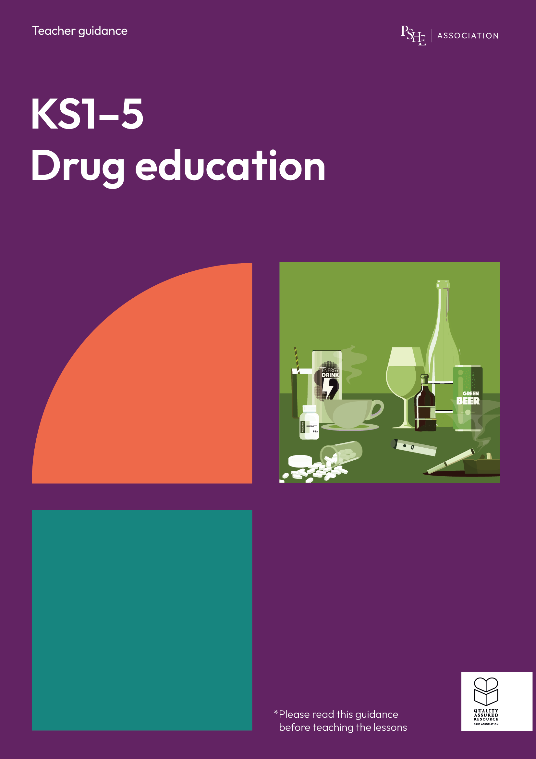
Drug education
Assessing risk
Year 10-11: Lesson 1

Slide 2
Using this PowerPoint
The slides in this presentation are divided into two sections:
Teacher slides (purple) – provide key information regarding lesson preparation.
Student slides – provide a visual focus point for students during the lesson and delivery notes for teachers about the activities. Click ‘notes’ to view these.
Ensure that you select ‘Use Presenter View’ under the ‘Slide Show’ tab – this will allow you to preview the teaching notes on your monitor while the main presentation is displayed on a screen/smartboard.

Slide 3
Support and challenge
The lesson includes suggestions for challenge and support activities, to help you differentiate appropriately for your class.
Support activities are adapted to be more accessible for those who need it.
Challenge activities deepen and extend learning for those who need more challenge or who finish the activity quickly.
Look for these icons on the pupil slides. See delivery notes for details of the activities.
Challenge
Support

Slide 4
Context
This is the first of three drug education lessons, for year 10 –11. This lesson focuses on how to identify and assess the risks and potential consequences of substance use, building on the key stage 3 lessons. Students also explore the effects of alcohol and other drug choices on personal safety.

Slide 5
Developing subject knowledge
Key information on content related to these lessons can be found in the Year 10–11 Knowledge Organiser.
Advice on safe practice, dispelling common misconceptions, visitors to the classroom and other important information can be found in Teacher Guidance: Drug and alcohol education.
Data sources to inform your planning can be found within our document that outlines the approach of these lessons Evidence Review: Effective drug and alcohol education including advice regarding how to talk to young people about alcohol.

Slide 6
To learn about the impact of substance use on risk-taking and personal safety.
Students will be able to:
analyse how alcohol and other drugs affect decision-making
assess the risks of substance use when travelling, socialising or alone
explain ways to keep safe and support friends when socialising in situations involving alcohol or other drugs

Slide 7
Box or envelope for questions
Post-it notes
Resource 1: Four key questions [one per student]
Resource 2: Increase, decrease, it depends [one per pair]
Resource 2a: Increase, decrease, it depends: Teacher notes [teacher copy]
Resource 3: Getting home [one per pair]
Resource 4: Getting help [one per small group]

Slide 8
Lesson summary
Activity | Description | Timing
Introduction | Introduce learning objective and outcomes and revisit ground rules. | 5 mins
Baseline assessment activity | Students complete a ‘four key questions’ activity exploring the effects and risks of using alcohol and other drugs. | 10 mins
Making decisions | Students assess the impact of substance use on risk in different contexts. | 10 mins
Getting home | Class evaluates a young person’s options for getting home safely. | 10 mins
Looking out for others | Groups assess the impact of different decisions on helping someone affected by drug use. | 15 mins
Reflection and endpoint assessment | Students create a 5-point action plan for how a young person could help to keep themselves and their peers safe when socialising. | 5 mins
Signposting support | Remind students how to access further advice, guidance and support related to substance use or personal safety. | 5 mins

Slide 9
Assessing risk
Lesson 1

Slide 10
Notes:
Teacher notes – Introduction (5 mins, slides 10-11)
Ensure ground rules are established with the group before teaching this lesson and make students aware of the question box, which will be available throughout the lesson. Explain that if they have worries or questions during or after the lesson, that they do not want to raise in front of the class, they can write their question on a piece of paper, anonymously or with their name, and put it in the question box.

Slide 11
To learn about the impact of substance use on risk-taking and personal safety.
We will be able to:
analyse how alcohol and other drugs affect decision-making
assess the risks of substance use when travelling, socialising or alone
explain ways to keep safe and support friends when socialising in situations involving alcohol or other drugs
Notes:
Teacher notes – Introduction (5 mins, slides 10-11)
Introduce the learning objective and outcomes and explain that today’s lesson will explore the impact of substance use on risk taking and personal safety.

Slide 12
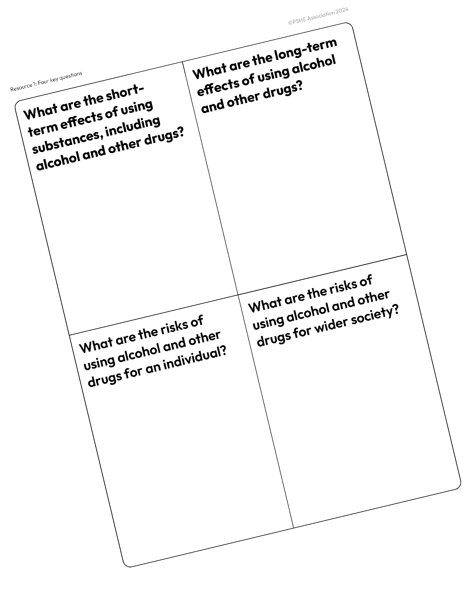
What’s our starting point?
Write down everything you know in response to the four key questions, about the effects and risks of using substances, including alcohol and other drugs.
Notes:
Teacher notes – Baseline assessment activity (10 mins)
Ask students to complete Resource 1: Four key questions, writing down all the effects and risks of using substances, including alcohol and other drugs that they know of. As this is a baseline assessment, they should work on their own, without any prompting or examples.
Afterwards, ask students to share their ideas as a class with you. Draw out any common ideas, misconceptions or stereotypes about drugs and alcohol emerging from their feedback. This will allow you to gauge students’ current attitudes and beliefs, as well as what they can remember from their earlier lessons.
Once completed, make sure students have added their names to their grids and collect in, as these will be revisited at the end of lesson 3 to demonstrate progress.

Slide 13
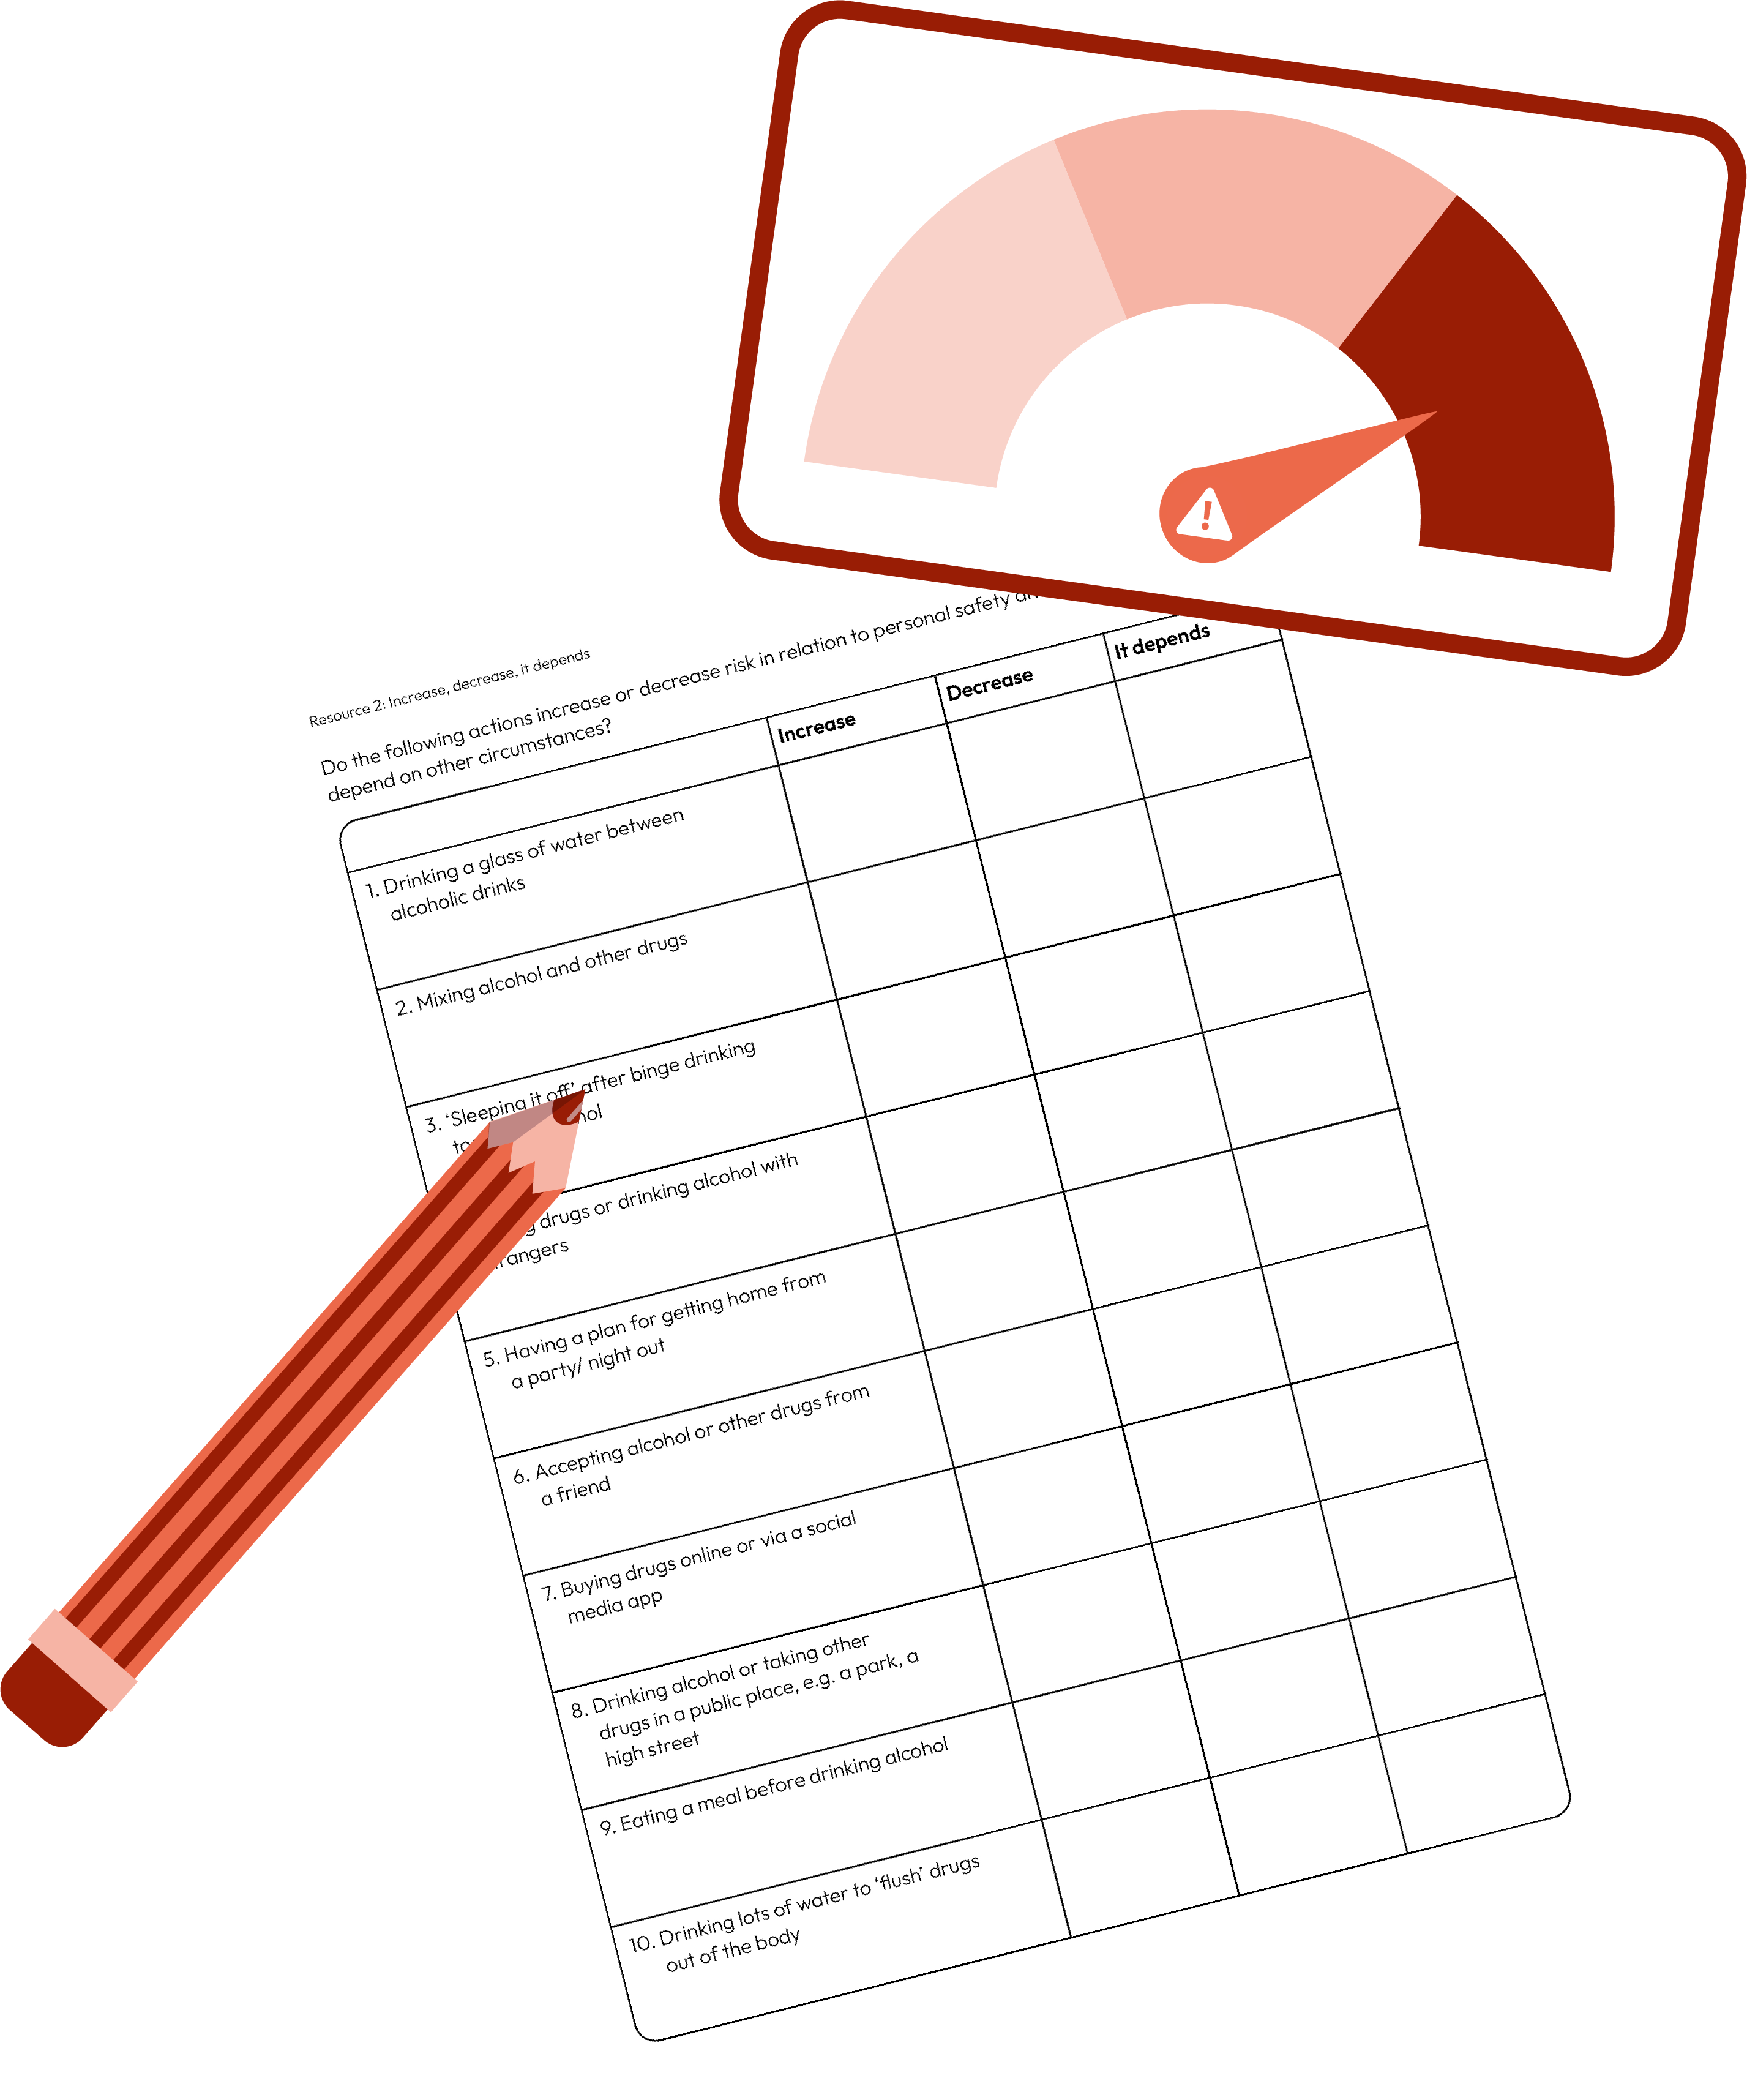
Making decisions
Complete the Increase, decrease, it depends activity about the effects of alcohol and other drugs on decision making.
If you have answered ‘it depends’ for any of the risks, explain your reasoning.
Notes:
Teacher notes – Making decisions (10 mins)
In pairs, ask students to complete Resource 2: Increase, decrease, it depends about the effects of alcohol and other drugs on decision making. You could use a thumbs up/thumbs down approach to class feedback. If students have answered ‘it depends’ for any of the risks, ask volunteers to explain their reasons for this. After each statement, share the answer and the supporting information, using Resource 2a: Increase, decrease, it depends: Teacher notes.
Then, explain to students that if more than one of these factors are added to a scenario, the level of risk increases, and an individual may become increasingly vulnerable.
N.B. A person’s vulnerability may increase when they are under the influence of drugs and alcohol, but it is important to avoid victim blaming when discussing the risks people face; being under the influence does not make them responsible, or to blame, for the actions of others towards them. Please refer to the Teacher guidance notes for more on how to respond to victim-blaming language.
Support: Give students statements 1-5 only.
Challenge: For each statement, ask students to explain their answer by identifying the reasons for the risk being increased or decreased.

Slide 14
Getting home
Read the scenario from Resource 3: Getting home
What options does Isla have? What are the risks involved?
Notes:
Teacher notes – Getting home (10 mins, slides 14-16)
Ask students to read the scenario from Resource 3: Getting home. Ask students to ‘think, pair, share’ the different options Isla has, and the risks involved in each, using the previous activity to help them (e.g. how many ‘risk factors’ are present in the scenario?). Create a whole class mind map of options.
Support: Provide students with Resource 3a: Isla’s options and ask them to select what they think the best option might be in this instance and why.
Challenge: Ask students to script a positive resolution to a conversation between Beth, Charlie and Isla in which Isla decides not to accept the lift due to Beth’s drinking.

Slide 15
Getting home
What is Isla’s best option? Why?
Notes:
Teacher notes – Getting home (10 mins, slides 14-16)
Then, in pairs, ask them to discuss what Isla’s best option might be and why.
Take feedback, drawing out key learning:
As Beth has had at least ‘several drinks’, her blood alcohol level will be over the legal limit to drive
Sometimes young people can feel that they have to engage in risky behaviour because there is no other option available to them. It’s important to make it clear that their safety is always a priority and that there is often another, safer option
In this instance, options might include: accepting the lift, trying to persuade Beth not to drive and Charlie not to accept the lift, going back into the party, going back into the house and finding a safe space, phoning a parent/carer/relative/friend, getting a taxi with a friend, walking home/to a safe place
Students should consider the consequences of each option and recognise that there may not be a ‘perfect’ solution, for example, walking home alone may carry its own risks
In this instance, the safest response is likely to be phoning a parent/carer/relative or friend, getting a taxi with a friend, or going back into the house and finding a safe space to wait in until somebody else collects them
Students will have different opinions about the best response – some may have concerns about whether refusing to accept the lift would upset Charlie or Beth, some may be worried about Isla going back into an unsafe environment, some might question whether Isla would get herself or her friends in trouble if she phoned a parent/carer/relative. It is important to stress that, while valid concerns, these do not outweigh the risks involved in accepting a lift from someone who is driving under the influence.
Support: Provide students with Resource 3a: Isla’s options and ask them to select what they think the best option might be in this instance and why.
Challenge: Ask students to script a positive resolution to a conversation between Beth, Charlie and Isla in which Isla decides not to accept the lift due to Beth’s drinking.

Slide 16
Getting home
Finish the story by writing what Isla could say to manage the moment and get home safely.
Notes:
Teacher notes – Getting home (10 mins, slides 14-16)
Then, in pairs, ask students to decide how to complete the story by writing down the words Isla could use to manage the moment and get home safely. Ask volunteers to share their ideas for what Isla should say and agree as a class her best course of action.
Support: Provide students with Resource 3a: Isla’s options and ask them to select what they think the best option might be in this instance and why.
Challenge: Ask students to script a positive resolution to a conversation between Beth, Charlie and Isla in which Isla decides not to accept the lift due to Beth’s drinking.

Slide 17
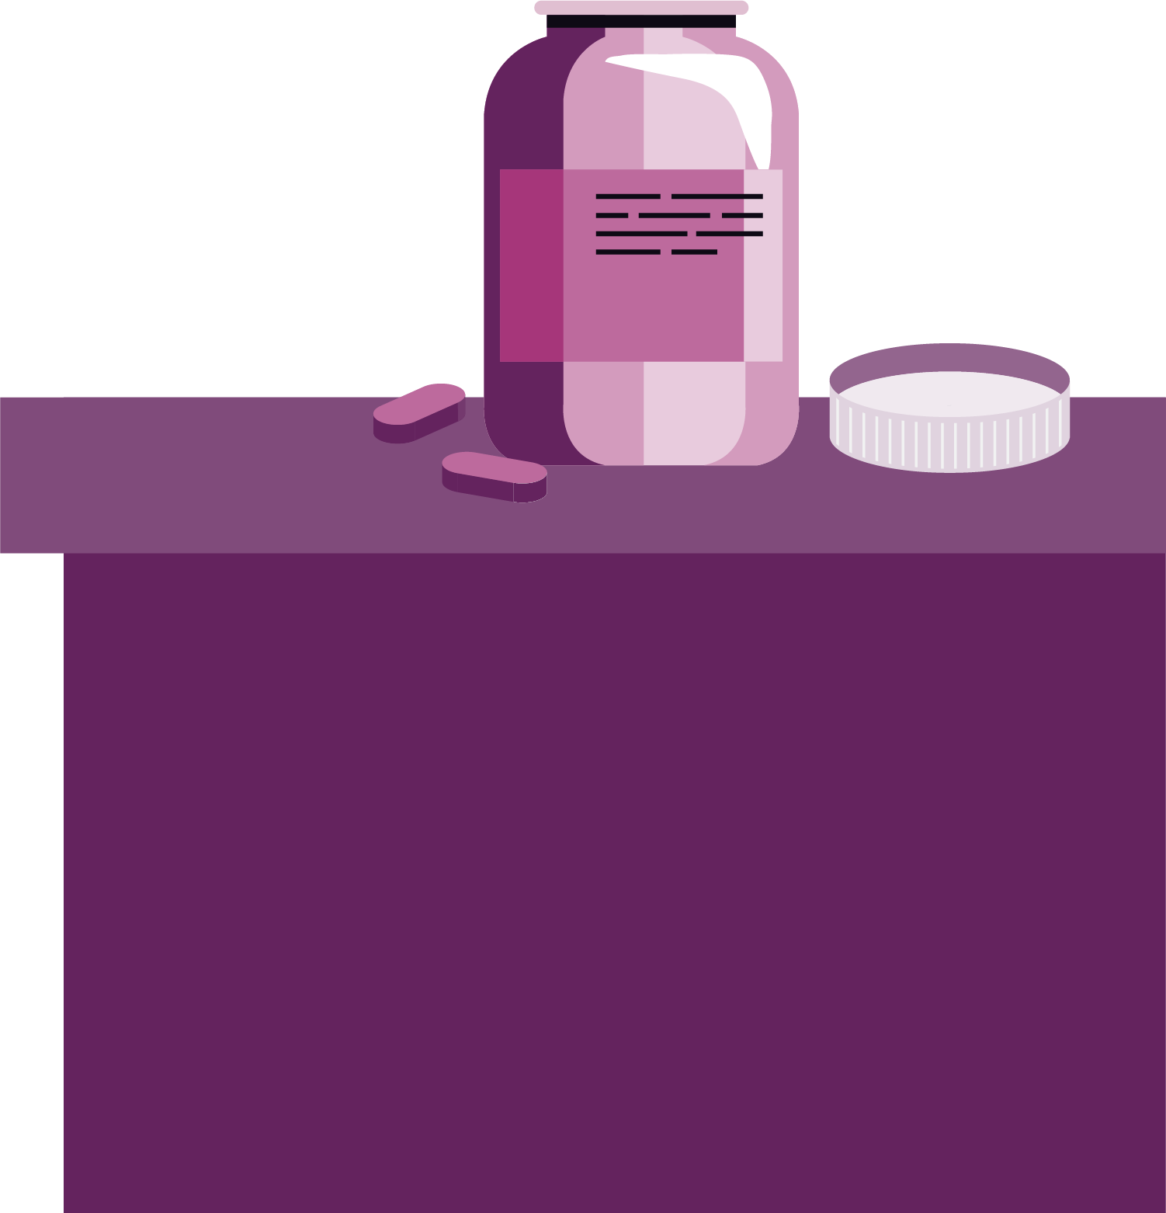
Getting help
Review the scenario from Resource 4: Getting help
What could Oscar do?
Notes:
Teacher notes – Looking out for others (15 mins, slides 17-18)
In small groups, ask students to review the scenario from Resource 4: Getting help. Gather feedback on the board to compile a whole-class list on what Oscar could do and then, as a class, vote on what his top three options might be.
Options might include: leaving Marek, staying with Marek, putting Marek into the recovery position, checking that Marek’s airways are clear and that he is breathing, telling someone else at the party, calling 999, calling a parent/carer/relative, calling Marek’s parents/carers. The ‘top’ options are likely to include: calling for help in some form and not leaving Marek unattended.

Slide 18
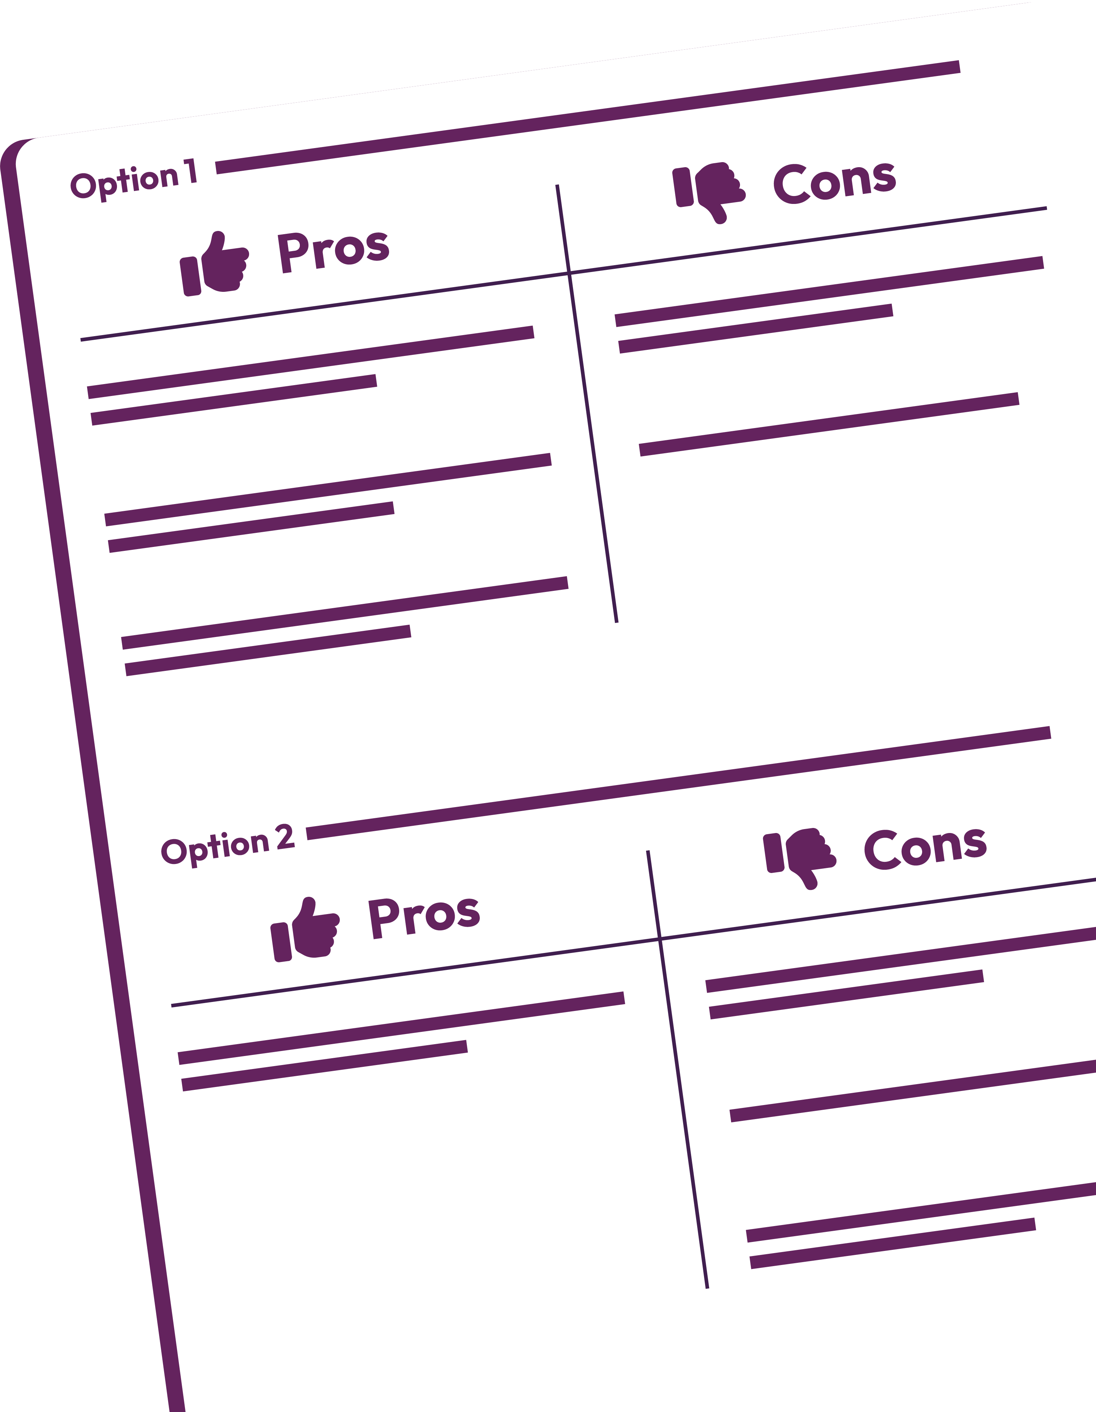
Getting help
What are the pros and cons of the top three options?
What is the best option in this scenario? Why?
How might Oscar manage a negative response from his friends for calling for help?
Notes:
Teacher notes – Looking out for others (15 mins, slides 17-18)
Then, in their groups, ask them to consider the pros and cons of the top three options and decide what they think the best option is in this scenario and why. Ask each group to feedback on their decision to the rest of the class.
Key learning:
It is important that students recognise that ensuring Marek’s safety is the most important factor in this scenario. Students may worry about getting into trouble if they call for help, but stress that in some circumstances, it is crucial that help is sought, as Marek might be in a life-threatening position – see teacher guidance section on ‘Penalties’ for further information
It is equally important that students understand that if they know, they must tell paramedics/ medical services accurate information about what drugs/alcohol Marek has consumed, so that appropriate help can be given. Even though Oscar doesn’t know whether Marek has taken any of the tablets he bought online, or what they are, he should still tell the paramedics/medical services that it is possible Marek has taken something.
Explain to students what would happen if they called 999. You may wish to use the following information to help you: www.londonambulance.nhs.uk/calling-us/calling-999, but key points that should be covered include:
Once connected to a call handler, they will have to say which service they need (i.e. ambulance, police, fire, or coast guard) and answer some questions to establish what is wrong, e.g. Where are they? What has happened? This will help the operator to decide on the most appropriate response. Dialling 999 doesn't necessarily mean an ambulance will be dispatched. The call handler will decide what's appropriate.
The caller should then stay on the phone, as the ambulance control room might have more questions, e.g. about the age and medical history of the person. The call handler will say when they have all the information they need.
The caller might also be given instructions about how to give first aid until the ambulance arrives.
There are a number of things people can do to assist the ambulance service, e.g. stay with the person until help arrives, call the ambulance service back if their condition changes, ask someone to wait by the door and let the paramedics in when they arrive, tell the paramedics what the individual has taken, any medication they might be on and any allergies they have.
Finally, ask students to discuss how Oscar might manage a negative response from his friends for calling for help – how might he respond to any teasing or criticism of his decision?
Suggestions might include: Showing confidence and assertiveness in his decision; using humour; asking his friends to empathise; ignoring them.

Slide 19
What have we learnt?
Use five separate post-it notes to write a 5-point action plan for peers in your year group, on how to stay safe and keep each other safe at social events that might involve alcohol and/or other drugs.
Staying safe
Notes:
Teacher notes – Reflection and endpoint assessment (5 mins)
Working on their own, ask students to write down a 5-point action plan on five separate post-it notes for peers in their year group on how to stay safe and keep each other safe at social events that might involve drugs and/or alcohol. Then, ask students to stick their post-it notes on the board. Group these into common themes and share common strategies with the class.

Slide 20
Sources of support
To access further advice, guidance and support related to substance use or personal safety, you can:
speak to a parent/carer, tutor, pastoral lead, or other trusted adult
contact Childline: www.childline.org.uk, 0800 1111
visit www.nhs.uk/live-well/alcohol-support
visit www.talktofrank.com, 0300 1236600
I need your help with something . . .
Something's worrying me, can I talk to you?
I have something that’s been bothering me . . .
Notes:
Teacher notes – Signposting support (5 mins)
Ensure that students know where they can seek help and advice, both now and in the future, if they are concerned about substance use or personal safety. Students wishing to seek further guidance can:
Speak to a tutor, pastoral lead or other trusted member of staff in the school
Contact Childline www.childline.org.uk 0800 1111
Visit www.talktofrank.com/0300 1236600
Visit www.nhs.uk/live-well/alcohol-support

Slide 21
Responding in an emergency
Create an awareness campaign about how to respond in an emergency situation, e.g. by putting an individual in the recovery position.
Use these sources to help.
www.nhs.uk/using-the-nhs/nhs-services/urgent-and-emergency-care/when-to-call-999/
www.talktofrank.com/get-help/what-to-do-in-an-emergency
Notes:
Teacher notes – Extension activity
Ask students to create an awareness campaign about how to respond in an emergency situation, e.g. by putting an individual in the recovery position, using www.nhs.uk/using-the-nhs/nhs-services/urgent-and-emergency-care/when-to-call-999/ and www.talktofrank.com/get-help/what-to-do-in-an-emergency to help them.

