Slide 1
Drug education
Help seeking
Year 10-11: Lesson 3

Slide 2
Using this PowerPoint
The slides in this presentation are divided into two sections:
Teacher slides (purple) – provide key information regarding lesson preparation.
Student slides – provide a visual focus point for students during the lesson and delivery notes for teachers about the activities. Click ‘notes’ to view these.
Ensure that you select ‘Use Presenter View’ under the ‘Slide Show’ tab – this will allow you to preview the teaching notes on your monitor while the main presentation is displayed on a screen/smartboard.

Slide 3
Support and challenge
The lesson includes suggestions for challenge and support activities, to help you differentiate appropriately for your class.
Support activities are adapted to be more accessible for those who need it.
Challenge activities deepen and extend learning for those who need more challenge or who finish the activity quickly.
Look for these icons on the pupil slides. See delivery notes for details of the activities.
Challenge
Support

Slide 4
Context
This is the third of three drug education lessons, for year 10–11. This lesson explores the journey of a drug to help students understand the wider consequences of drug use, and focuses on seeking help regarding substance use.
This lesson refers to self-medicating in response to mental health challenges, so teaching subsequent lessons about mental health would effectively build on this learning.

Slide 5
Developing subject knowledge
Key information on content related to these lessons can be found in the Year 10–11 Knowledge Organiser.
Advice on safe practice, dispelling common misconceptions, visitors to the classroom and other important information can be found in Teacher Guidance: Drug and alcohol education.
Data sources to inform your planning can be found within our document that outlines the approach of these lessons Evidence Review: Effective drug and alcohol education including advice regarding how to talk to young people about addiction and problematic substance use.

Slide 6
To learn about the potential consequences of drug production, sale and use, and support available for individuals with problematic substance use, including addiction and dependency.
Students will be able to:
describe the wider physical and psychological consequences of substance use
explain what addiction/dependency is and how it can affect individuals
identify sources of support and how to seek help for substance use and addiction
evaluate and challenge potential barriers to seeking support

Slide 7
Box or envelope for questions
Resource 1: Road map [one per student]
Resource 1a: Road map – teacher answers [teacher copy]
Resource 2: Information sheets [one per class]
Resource 3: Seeking support [one per pair]
Resource 4: Diamond 9 [one cut up set per small group]
Students’ baseline assessment activities from lesson 1 [Lesson 1, Resource 1: Four key questions]

Slide 8
Lesson summary
Activity | Description | Timing
Introduction | Introduce learning objective and outcomes and revisit ground rules. | 2 mins
Baseline assessment activity | Students respond to a question to establish their starting points. | 8 mins
Substance use disorder | Students identify features of substance use disorder. | 5 mins
Road map | Students explore the journey of a drug, from production to use, considering the impact at each stage. | 10 mins
Seeking support | Class review scenarios and support services, before giving advice to individuals seeking support. | 15 mins
Overcoming barriers | Students evaluate barriers someone might face in accessing support and how these might be overcome. | 10 mins
Reflection and endpoint assessment | Students return to the baseline assessment from lesson 1 and add ideas based on learning from this series of lessons. | 10 mins
Signposting support | Remind students how to access further advice, guidance and support related to substance use. | 5 mins

Slide 9
Help seeking
Lesson 3

Slide 10
Notes:
Teacher notes – Introduction (2 mins, slides 10-11)
Ensure ground rules are established with the group before teaching this lesson and make students aware of the question box, which will be available throughout the lesson. Explain that if they have worries or questions during or after the lesson, that they do not want to raise in front of the class, they can write their question on a piece of paper, anonymously or with their name, and put it in the question box.

Slide 11
To learn about the potential consequences of drug production, sale and use, and support available for individuals with problematic substance use, including addiction and dependency.
We will be able to:
describe the wider physical and psychological consequences of substance use
explain what addiction/dependency is and how it can affect individuals
identify sources of support and how to seek help for substance use and addiction
evaluate and challenge potential barriers to seeking support
Notes:
Teacher notes – Introduction (2 mins, slides 10-11)
Introduce the learning objective and outcomes and explain that today’s lesson explores the wider consequences of drug use and the strategies someone might need for seeking help in relation to substance use, including overcoming potential barriers to doing so.

Slide 12
What’s our starting point?
What signs might there be that someone needs support for their substance use?
?
?
?
?
?
?
Notes:
Teacher notes – Baseline assessment activity (8 mins)
In pairs, ask students to discuss and respond to the question: What signs might there be that someone needs support for their substance use? Share ideas as a class.
Responses might include:
How often they are using a substance
How much money they are spending
Relationships with others changing because of substance use
Concerns expressed by family/friends/colleagues etc. about substance use
Substance use having a detrimental effect on other interests or daily activities (e.g. school/work)
Indications of dependence e.g. cravings or withdrawal symptoms
Draw out any common responses and challenge misconceptions or stereotypes that students have identified in relation to substance use (see teacher guidance). This will allow you to find out what they recall and adapt the lesson accordingly.
Explain that there are sometimes different thresholds for seeking help for adults and young people (e.g. the Chief Medical Officers’ guidance¹ gives differences in safe alcohol use in young people versus adults), but that if anyone has concerns about their own or others’ substance use, it is always important to speak to a trusted adult for support.
¹https://assets.publishing.service.gov.uk/government/uploads/system/uploads/attachment_data/file/489795/summary.pdf

Slide 13
Substance use disorder
A substance use disorder has a number of features:
a strong internal drive to use substances
impaired ability to control substance use
priority is increasingly given to substance use over other activities
continued use of a substance despite psychological, physical and/or social harm or negative consequences
a subjective sensation of urge or craving to use the drug
physiological features of dependence may also be present, including:
tolerance to the effects of the drug
withdrawal symptoms following cessation or reduction in use of the drug
repeated substance use, to prevent or alleviate withdrawal symptoms
Notes:
Teacher notes – Substance use disorder (5 mins, slides 13-14)
Explain that addiction is a commonly used, but often misunderstood, term within our society. In some cases, it has been used as a term to label people (an 'addict'), so has contributed to stigma about substance use and related health issues. While some people might feel okay with labelling themselves as an 'addict', others should not use this label as it narrows a person’s identity to a single characteristic and makes assumptions about their situation.
Explain that substance use disorder (commonly referred to as addiction) has a number of features (also listed on the slide):
a strong internal drive to use substances
impaired ability to control substance use
priority is increasingly given to substance use over other activities
continued use of a substance despite psychological, physical and/or social harm or negative consequences
a subjective sensation of urge or craving to use the drug
physiological features of dependence may also be present, including:
tolerance to the effects of the drug
withdrawal symptoms following cessation or reduction in use of the drug
repeated substance use, to prevent or alleviate withdrawal symptoms
(adapted from the DSM-V²
²American Psychiatric Association, 2013. Diagnostic and statistical manual of mental disorders (DSM-5®).

Slide 14
Substance use disorder
What might these features look like in an individual?
For example, how might a person show they are prioritising substance use? What might withdrawal symptoms look like?
?
Notes:
Teacher notes – Substance use disorder (5 mins, slides 13-14)
Ask students what these features might look like in an individual, e.g. how might a person show they are prioritising substance use? What might withdrawal symptoms look like? This information will provide additional opportunities to challenge any misconceptions while reinforcing understanding of the potential consequences of substance use.
Take feedback. Students might suggest:
A person prioritising substance use might: miss out on commitments to family, friends, work or their studies; start spending more money on a substance and less on other things; continue to use the substance even though it has a negative effect on their health and/or wellbeing.
A person experiencing withdrawal symptoms might: show a range of physical symptoms such as sweating, having heart palpitations, headaches, tightness in the chest, tremors, nausea, vomiting or diarrhoea; show a range of psychological symptoms such as anxiety, restlessness, irritability, poor concentration, feeling ‘low’, insomnia.
It is important that students understand that harms can be experienced by anyone using substances and support services are available for all, not just for those who are ‘addicted’. It may be more beneficial to refer to problematic and harmful patterns or episodes of substance use instead. For further information and guidance, please refer to our evidence briefing: ‘How should we talk to young people about addiction and problematic substance use?’.

Slide 15
Road map
Explore the journey of a drug, from production to use.
At each stage, discuss the key questions about the different harms that may be caused by a substance.
Notes:
Teacher notes – Road map (10 mins)
Explain that while we often focus on the impact of substance use on individuals in a particular moment, we also need to explore the wider societal impacts of substance production, sale and use.
Using Resource 1: Road map, ask students to explore the journey of a drug, from production to use, by discussing the key questions at each stage about the different harms that may be caused by a substance.
Then share ideas as a class, using Resource 1a: Road map – teacher answers to guide the discussion.

Slide 16
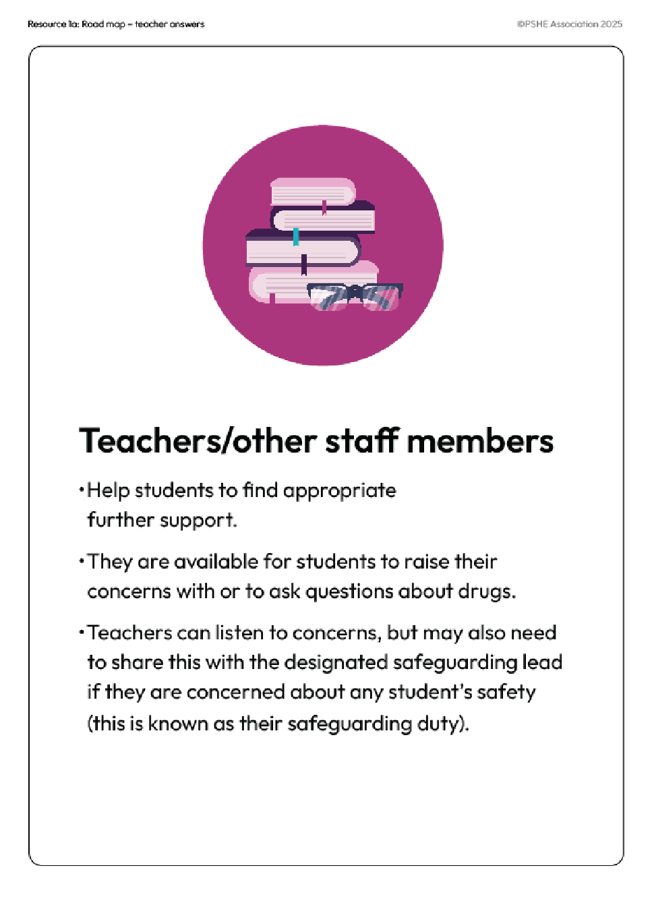
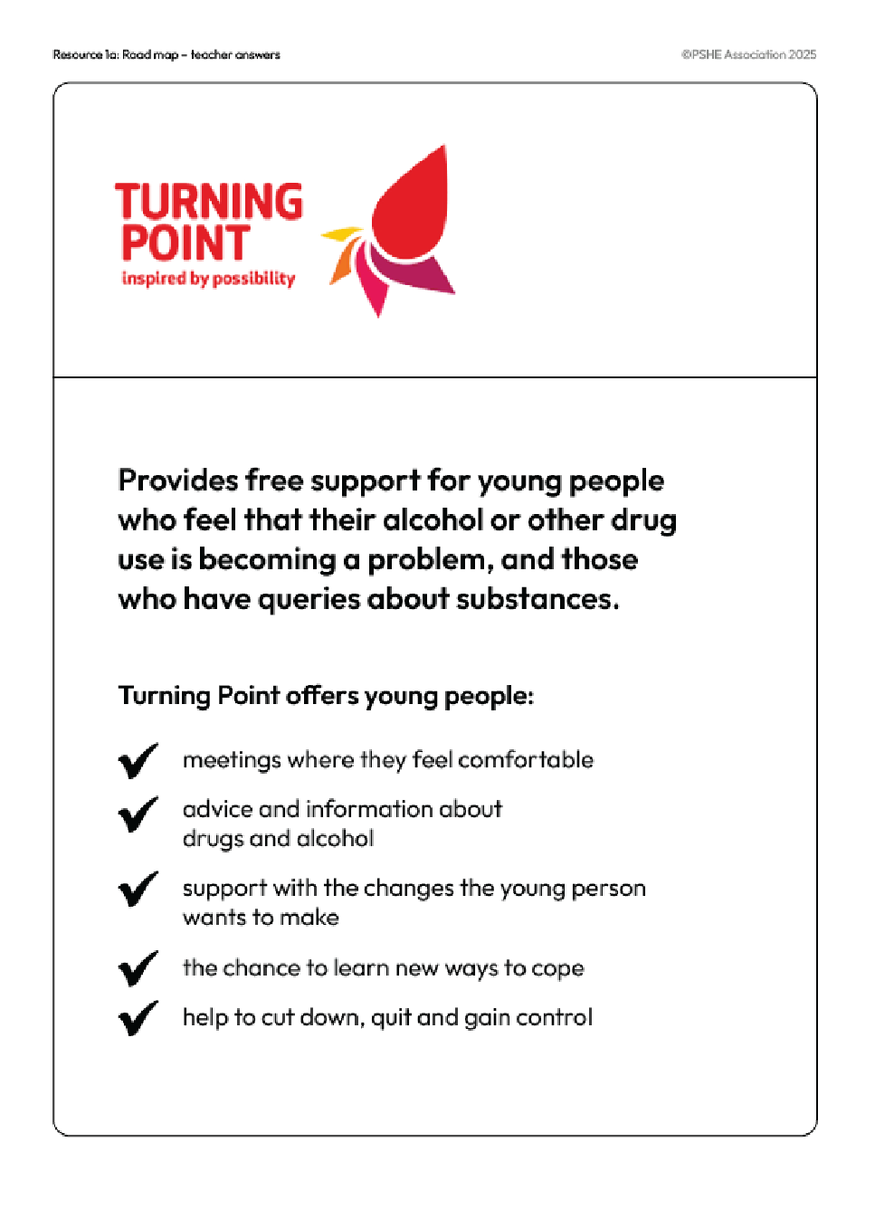
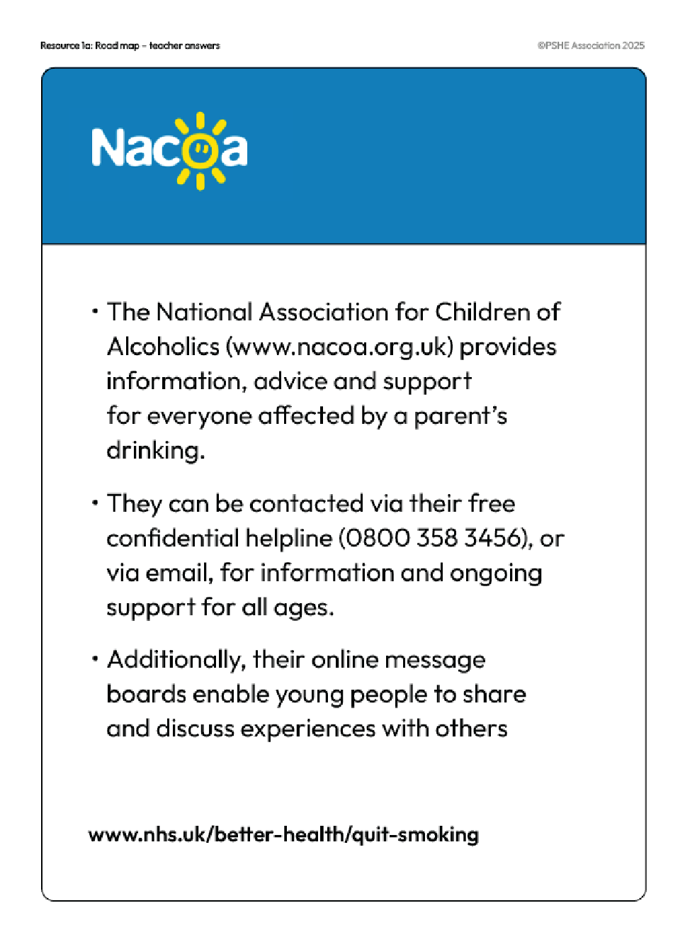
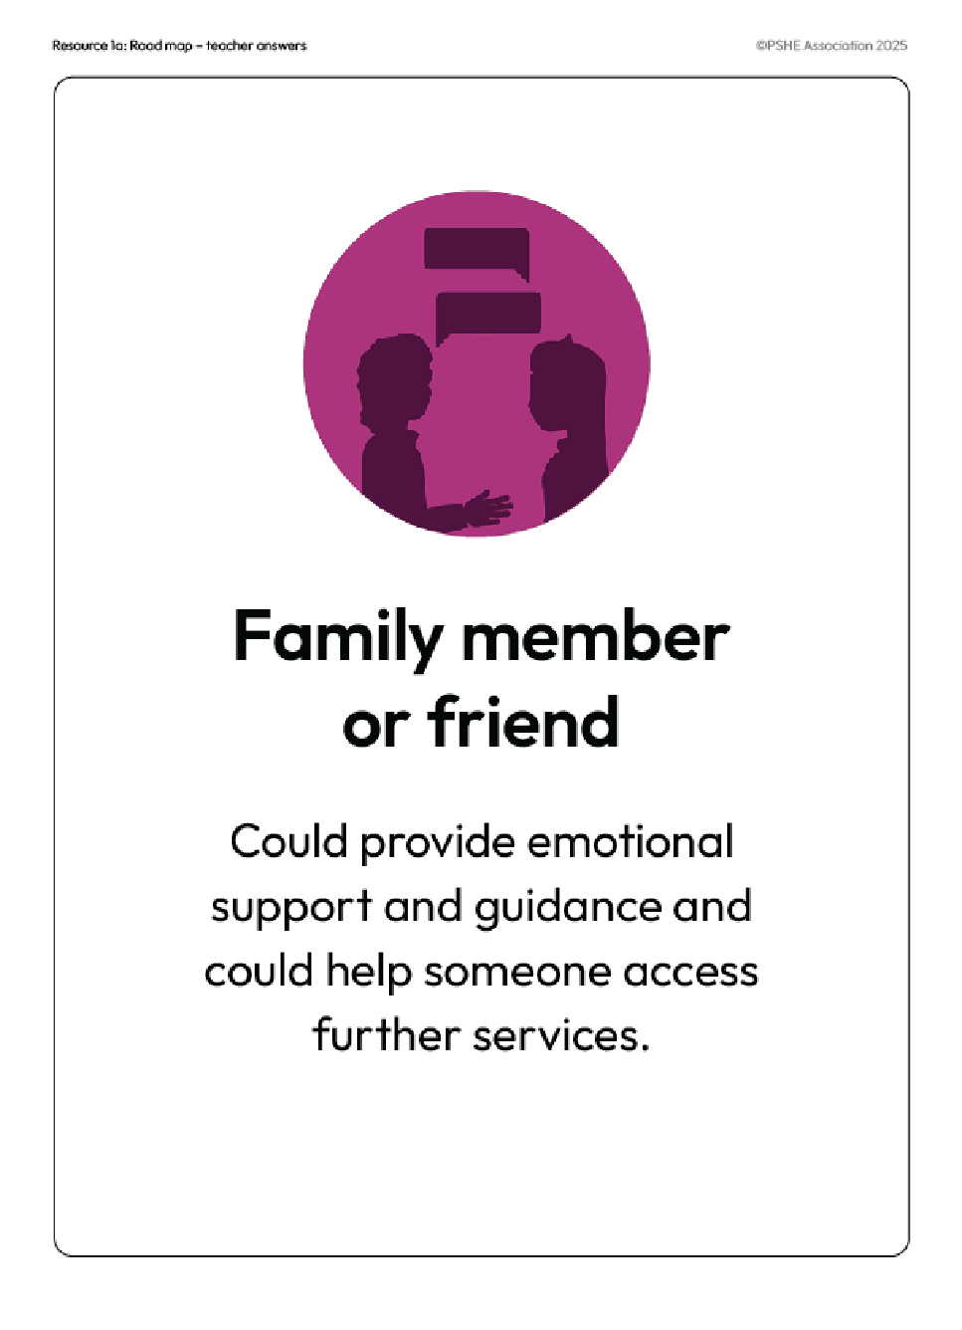
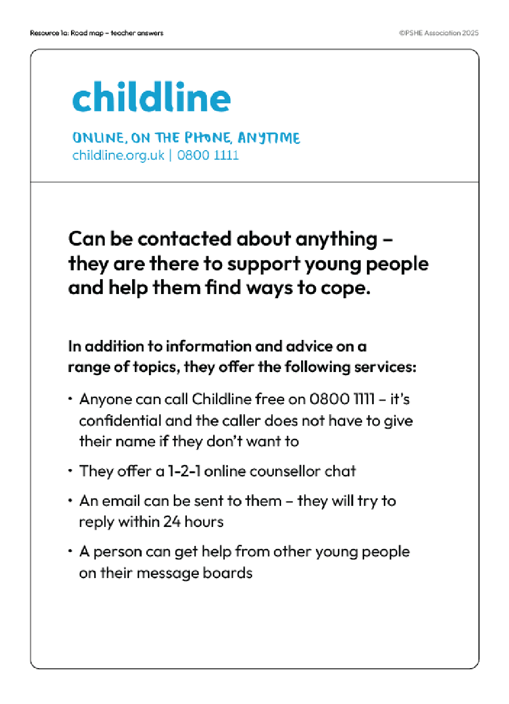
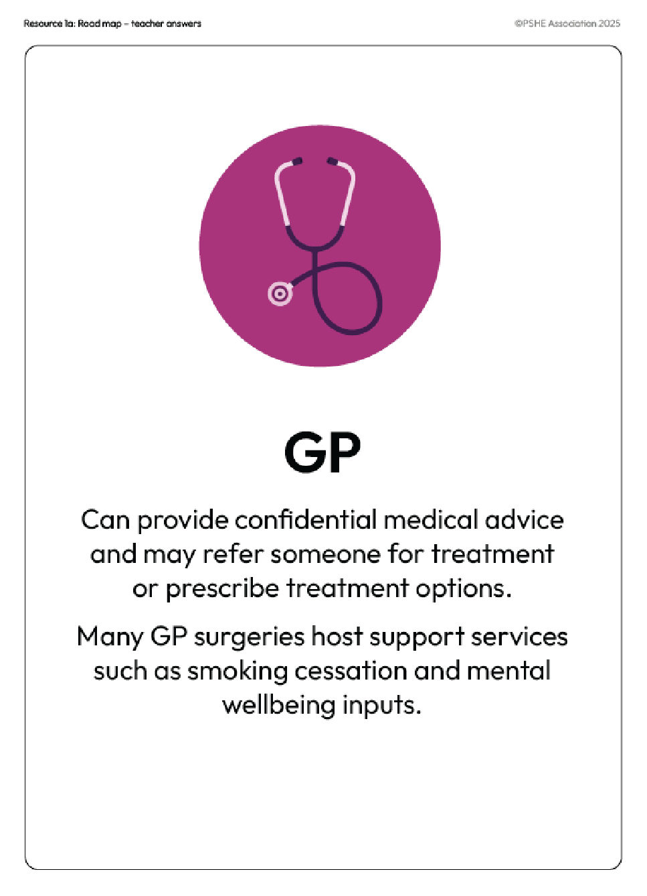
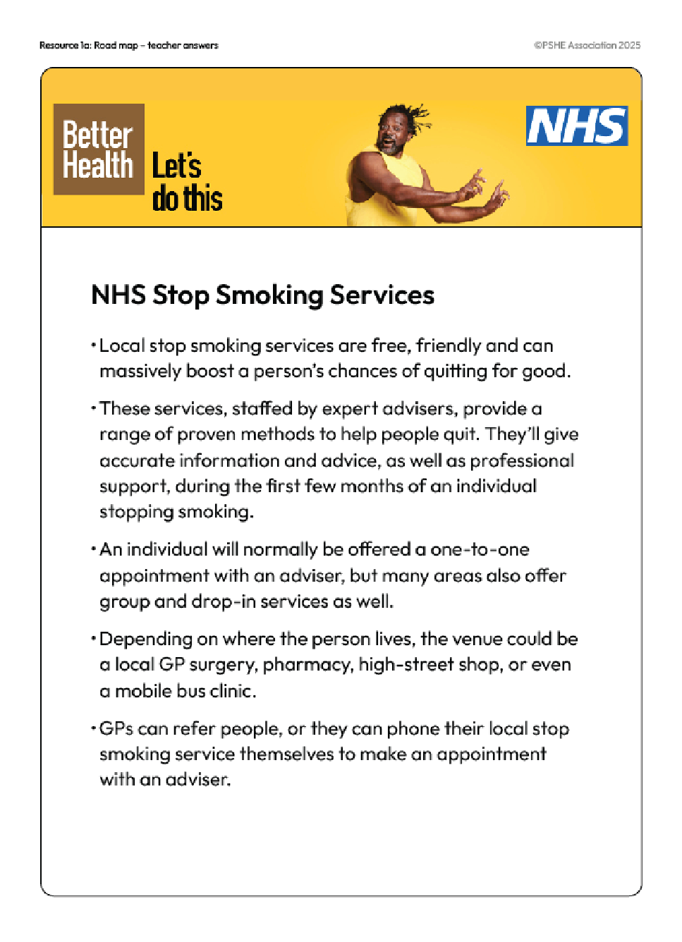
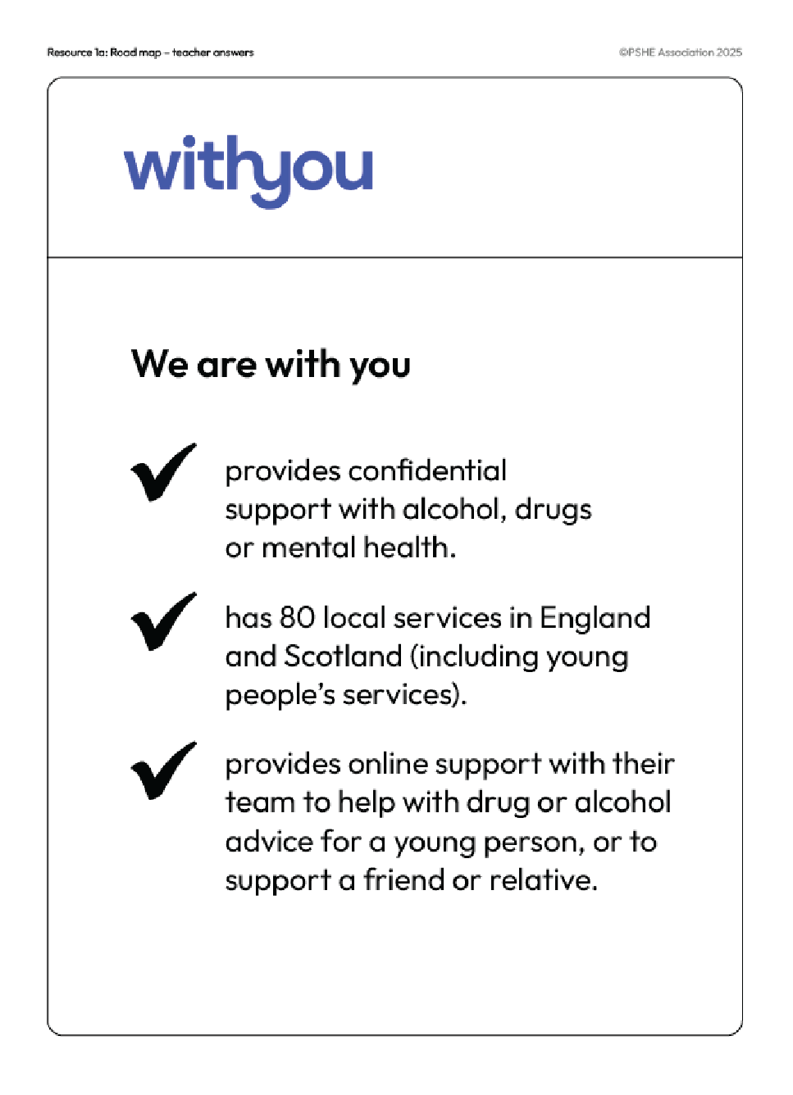
Seeking support
Use the information sheets to note down which source of support might be most helpful for each person on your sheet.
Choose one person to write back to.
Which support networks are available to them?
How can different people or organisations help them?
Notes:
Teacher notes – Seeking support (15 mins)
Display the information sheets (Resource 2: Information sheets) around the room. Ask students to read the speech bubble from each person in Resource 3: Seeking support and visit each information station, deciding and noting down what support might be most useful for each individual.
Feedback as a class on each problem, drawing out key learning:
Different forms of support may be needed by different individuals, and for some, this may mean long-term and multiple episodes of support. However, drug treatment and other forms of support are often effective, and many people can recover from problems they might be experiencing.
It is important that students recognise the benefits of seeking early support. For example, the ‘pills’ mentioned in scenario 3 may be prescribed by the doctor, or an illegal substance, but it is important that an adult is informed so that appropriate help can be provided if needed. It is also important that any underlying issues are also addressed – while support may initially be sought for substance use, services to help manage stress, grief, relationship issues, problems with family/friends, sexual health etc., may also be appropriate.
Students may also identify that sometimes people try to find their own solutions when experiencing mental health challenges. Emphasise the risks involved in taking drugs that have not been prescribed by a doctor – there might be serious side-effects, the drug might be mixed with other substances, or the drugs may not even contain the substance the seller claims they do. It is important that if someone is struggling to access support, they speak to someone about this, such as someone at home or their GP, and do not try to find medication themselves.
When discussing smoking cessation, it may be helpful to explain that vapes may be used by some smokers as a way of stopping. However, the National Institute for Health and Care and Excellence (NICE) recommends that vaping should be discouraged in children and young people who have never smoked. Whilst vaping is substantially less harmful than smoking, that does not mean that it is harmless. Some vapes are produced illegally so the levels of nicotine, other drugs or chemicals can be higher than UK law allows. These illegal vapes sometimes include illegal synthetic substances that are not regulated, which also increases the potential risks.
If time allows, ask students to select one individual from Resource 3 to write advice back to. Their response should explain the relevant support networks available to the individual and the ways in which different people or organisations might be able to help them.
Support: Ask students to respond to scenarios 1, 3 and or 5.
Challenge: Ask students to identify potential barriers to accessing these support services.

Slide 17
Overcoming barriers
Use the cards to form a diamond shape, ranking the barriers someone might face in seeking support for substance use.
How might people overcome each of the nine barriers to seeking support?
Most significant barrier
Least significant barrier
Notes:
Teacher notes – Overcoming barriers (10 mins)
Remind students that a number of substances can be addictive, for example alcohol and nicotine. In small groups, ask students to use Resource 4: Diamond 9 to rank the barriers someone might face in seeking support for substance use in a diamond shape. The card at the top of the diamond should represent what they think is the most significant barrier someone might face in accessing support, and the card at the bottom of the diamond should represent what they think is the least significant. The cards in the middle section are placed in rows that they think are equally important.
Ask each group to feedback their top idea, or any discussion points on a card they disagreed over.
Then, ask students to challenge these misperceptions around help-seeking and suggest ways to help people overcome each of the nine barriers to seeking support.
Take feedback, drawing out key learning:
Students will have different opinions on what they think the most significant barriers might be.
Young people whose religion or cultural practices prohibit drug or alcohol use are likely to have grown up having to balance conflicting cultural values and might find it especially difficult to seek help for substance use. They are likely to experience increased feelings such as shame, or fear of family/community disapproval.
Having stereotypical views about who experiences problems with substances (e.g. ‘addicts’) can create an additional barrier to accessing support. It is important to note here that substance use takes place across most segments of society.
Support can be accessed through a wide range of sources – through GPs, online, local drug and alcohol services for young people and adults, through apps, through support groups, through their own social networks, through school (in accordance with its drug policy) etc. – emphasise that no one should be afraid to seek help if needed and that many services are free, easy to access, confidential, non-judgemental and continue to provide support for people for as long as they need it. Acknowledge that waiting lists for appointments with GPs and other specialists can prevent someone from getting the support they need straight away, but that it is still important to seek this support at the earliest opportunity. While waiting for an appointment, someone might access other support, such as from someone at home, a member of staff at school, charities or local support groups. Talking to a trusted person, keeping a diary or journal, sticking to a sleep routine, listening to music, and spending time outside are all examples of strategies that might help someone to manage their emotions.
Whilst there may be barriers, the sooner someone seeks support, the more likely they are to be able to reduce the harms/problems they experience from substance use – harm-reduction mechanisms include stopping use, reducing use, addressing those issues which made problems from substance use more likely, therapeutic interventions such as counselling, support groups etc.
It is important to avoid creating a binary in which a person who uses substances is either ‘addicted’ or not, as this may contribute to the misconception that support services are only for those people who are ‘addicted’. This perception may act as a barrier to pupils accessing early help and support (this is especially the case when discussing alcohol use which is relatively normalised within the UK). For example, a single episode of use, 'binge use', mixing of substances and continued or regular use can all potentially be harmful and lead to problems – people should seek support if they need it as early as possible.

Slide 18
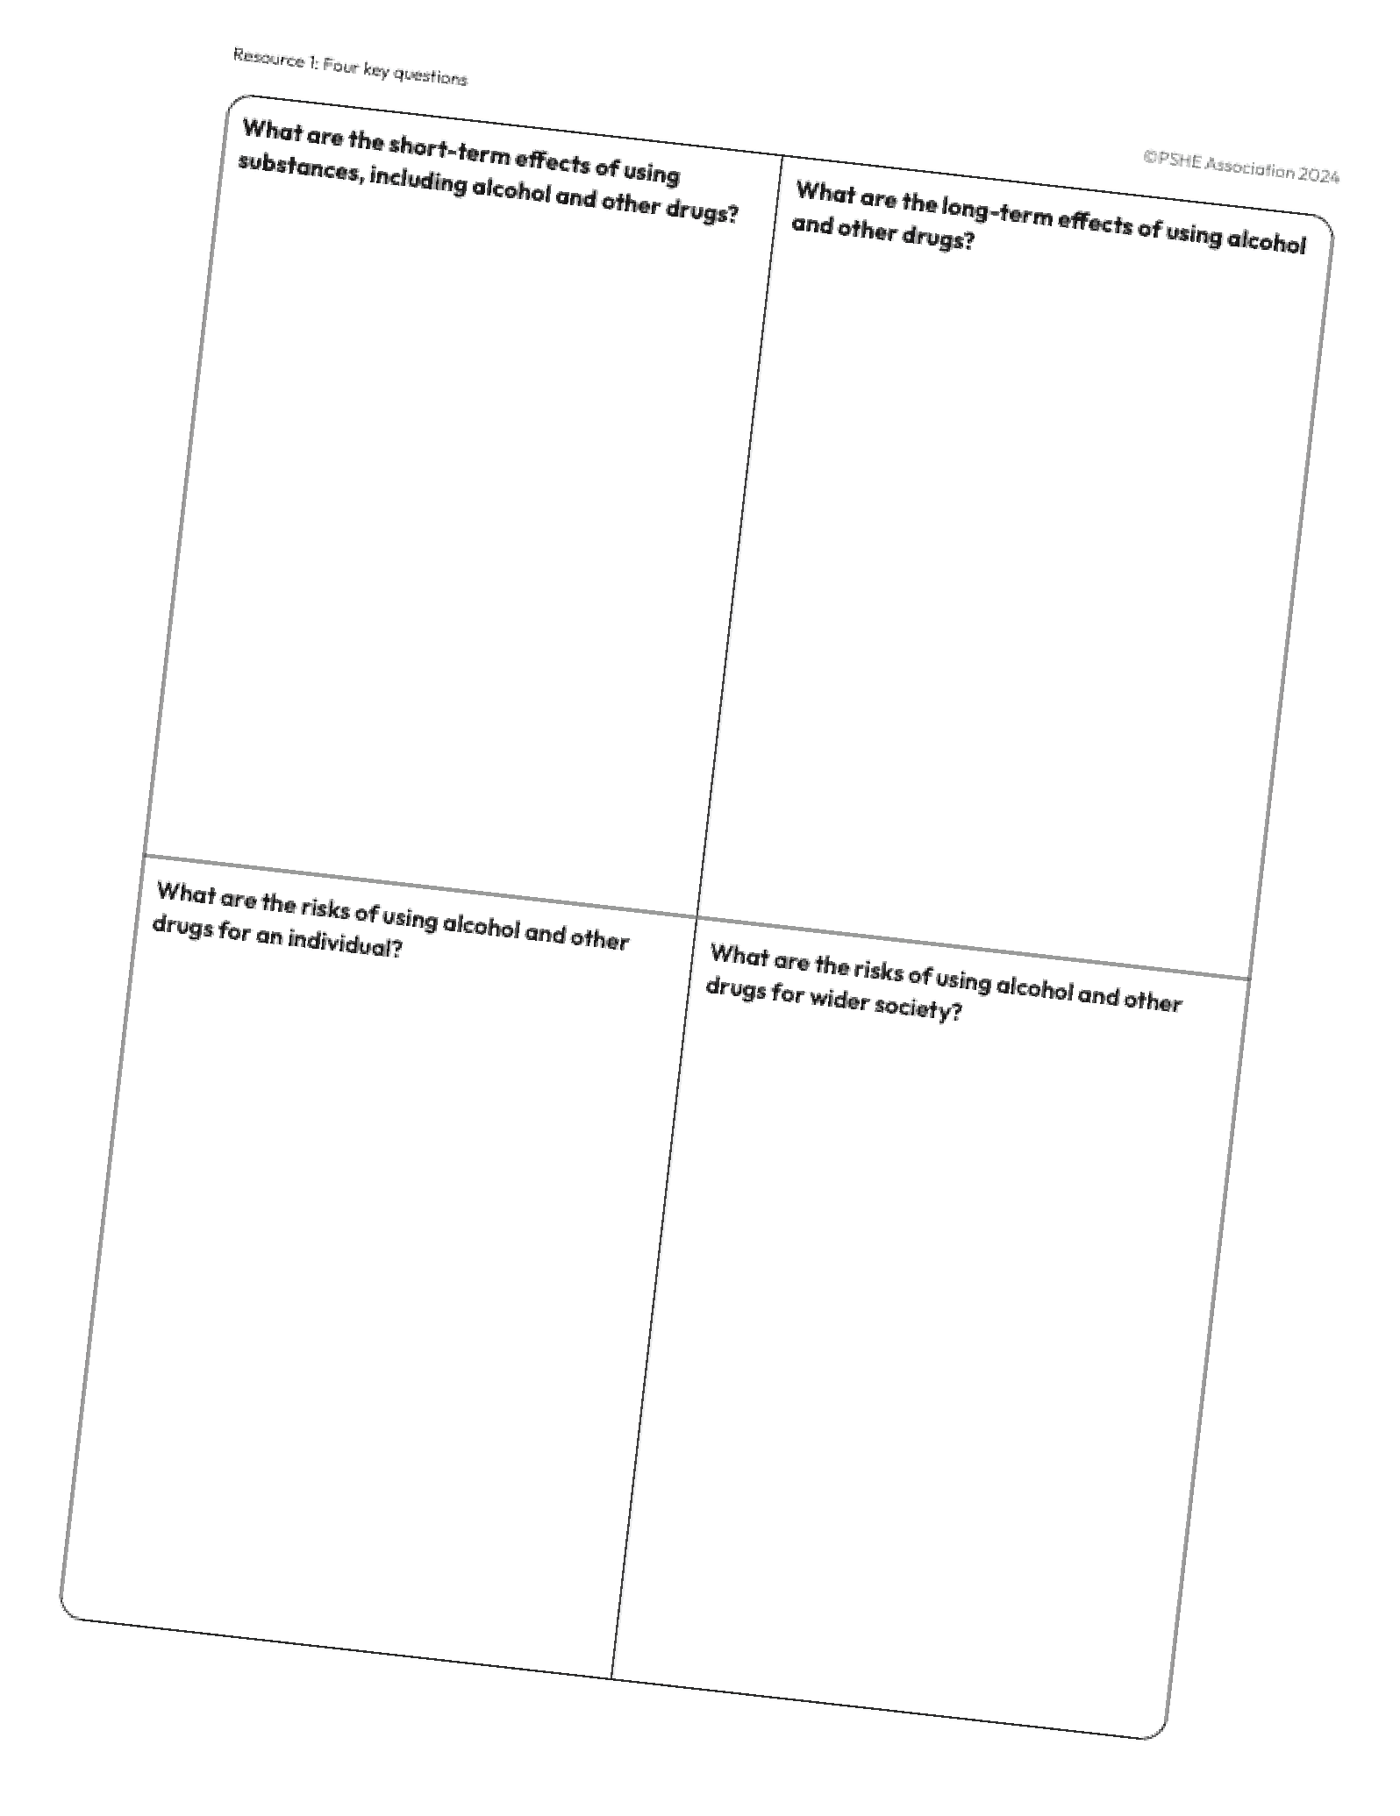
What have we learnt?
Return to the ‘Four key questions’ grid that you completed in lesson 1.
In another colour, add your key learning from the last three lessons.
Then, write an overall comment summarising what you have learnt.
Notes:
Teacher notes – Reflection and endpoint assessment (10 mins)
Ask students to return to the Four key questions baseline activity from lesson 1 and add their key learning from the last three lessons in another colour. They should then write an overall comment summarising what they have learnt.
This is an opportunity for you to gather evidence of students’ progress over the series of lessons and to inform your planning for subsequent learning.
Ensure that all questions in the question box have been addressed and allow time to take any final questions/comments from students.

Slide 19
Sources of support
To access further advice, guidance and support related to substance use, including drugs and alcohol, or peer influence, you can:
speak to a tutor, pastoral lead, or other trusted adult
contact Childline: www.childline.org.uk, 0800 1111
visit www.talktofrank.com
I need your help with something . . .
Something's worrying me, can I talk to you?
I have something that’s been bothering me . . .
Notes:
Teacher notes – Signposting support (5 mins)
Ensure that students know where they can seek help and further advice, both now and in the future, if they are concerned about substance use, including drugs and alcohol, or peer influence. Students wishing to seek further guidance can:
Speak to a tutor, pastoral lead or other trusted member of staff in the school
Contact Childline www.childline.org.uk 0800 1111
Visit https://www.talktofrank.com

Slide 20
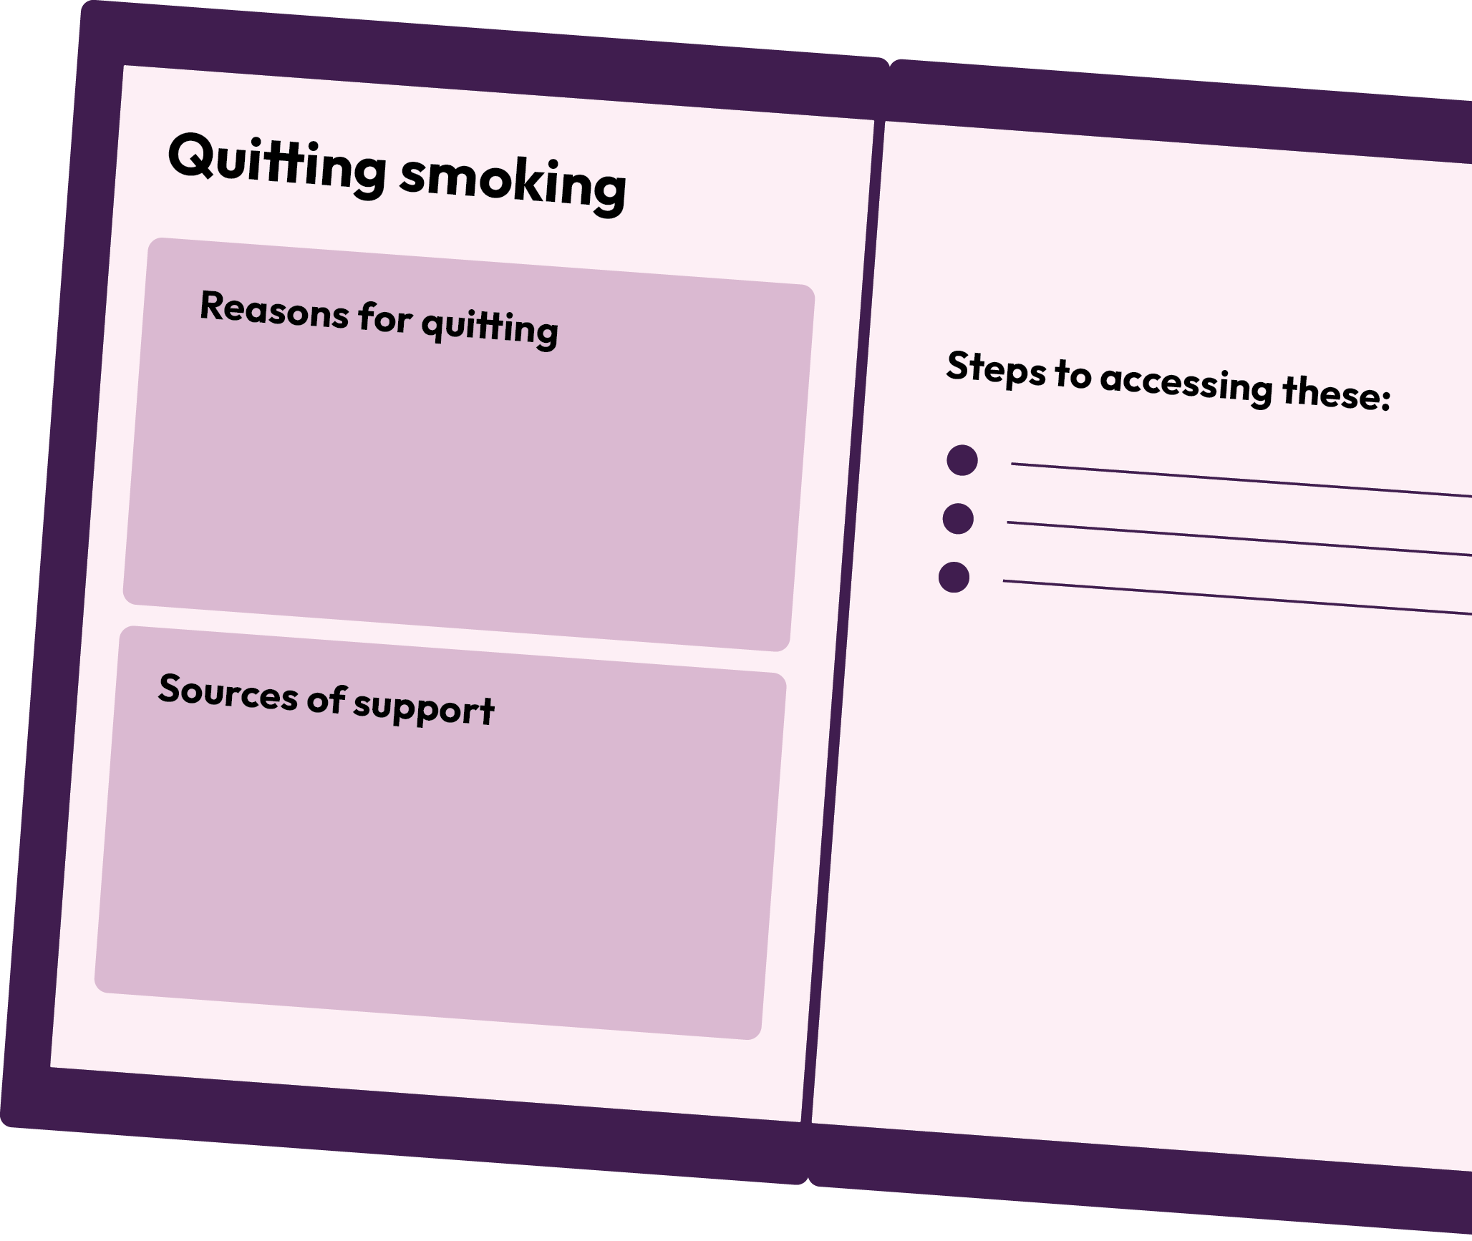
Quitting smoking
Create a booklet about quitting smoking, which includes reasons for quitting, sources of support and steps to accessing these.
Use these websites to help you: www.childline.org.uk/info-advice/you-your-body/drugs-alcohol-smoking/smoking
www.nhs.uk/better-health/quit-smoking/
Notes:
Teacher notes – Extension activity
Ask students to create a booklet about quitting smoking, which includes reasons for quitting, sources of support and steps to accessing these. Students should use the following websites to help them: www.childline.org.uk/info-advice/you-your-body/drugs-alcohol-smoking/smoking and www.nhs.uk/better-health/quit-smoking.
These websites provide suitable content; use caution when recommending alternative websites as some content may be less suitable for students or provide inaccurate or distressing information.

