Slide 1
A 15 minute ‘In the news’ Lesson
from Life Lessons - Autumn term 2024
This lesson has been created by Life Lessons Education Ltd with support from Chella Quint OBE, founder of Period Positive and author of Be Period Positive and Own Your Period.
Menopause Awareness
World Menopause Day 2024

Slide 2
This lesson is recommended for years 8-13. It requires basic knowledge of hormones and the menstrual cycle.
The lesson includes several activities that you can mix and match depending on the year group and class you are teaching.
For the activity on slide 19 you will need paper cups, markers and a vase or pitcher. As there will be spillage, bring towels as well.
Make sure to use inclusive language throughout and keep in mind that non-binary individuals and trans-men may undergo menopause as well as women. ‘People experiencing menopause’ or ‘people with periods’ can be useful terms to use rather than simply referring to ‘women’. Also people who experience the menopause may not be old.
Please check speaker notes for suggested answers to some questions or activities.

Slide 3
PRINT - Slide 23 activity: The grandmother theory
The grandmother hypothesis is an evolutionary theory that seeks to explain why people undergo menopause. According to this hypothesis, menopause evolved as an evolutionary advantage that allows older people to invest their time and resources in the survival of their grandchildren, rather than continuing to reproduce themselves.
The idea is that post-menopausal people, particularly grandmothers, increase the overall fitness of their family group by helping to care for grandchildren, gathering food, and passing on survival skills and cultural knowledge.
This support improves the likelihood that grandchildren will survive to adulthood, thereby indirectly enhancing the grandmother’s genetic legacy. By helping ensure the survival and success of their grandchildren, grandmothers can pass on their genes through their descendants more effectively than if they were to continue having children later in life, given the difficulties and risks of pregnancy and childbirth at an older age.
A lot more research is needed on the menopause transition to help us understand it more.
Did you know only a few species like orca whales and chimpanzees are known to experience menopause?
The Grandmother Theory is based on research and is one of several theories. Click below to see the research.
Reference:
Kristen Hawkes, The Grandmother Hypothesis and Human Evolution, 1997.
Notes:
Sources: https://www.scientificamerican.com/article/the-origin-of-menopause/, https://www.npr.org/sections/goatsandsoda/2019/02/07/692088371/living-near-your-grandmother-has-evolutionary-benefits , https://news.arizona.edu/news/researchers-find-first-proof-menopause-wild-chimpanzees

Slide 4
Main messages
It is important to learn about menopause to learn about what one's own body experiences, or the body of people close to you and to make informed decisions about your health.
The menopause transition is a time of change - similar to puberty. That is neither good nor bad, it just means things are starting to be different. It is a typical biological process, and it looks a bit different for different people, and there may be different reasons for why someone goes through it at a particular time.
Talking openly about menopause can fight stigma and makes it easier for people to talk about symptoms.
There are different ways to support people you know experiencing menopause. A big part of it is being informed, and showing empathy as masking symptoms can make people feel more snappy or anxious - creating a safe and open environment to talk about menopause is really helpful.

Slide 5
Key terms
Hormones | Hormones are chemical messengers made by glands in the body that help control how different parts of your body function, like growth, mood, and energy levels. They travel through your blood to send signals to organs and tissues to get to work.
Transitioning | Transitioning is the process some people go through to align their gender identity with their outward appearance - for example someone assigned female at birth may transition to be a transman. This can involve changes like adopting a new name or pronouns, dressing in a way that expresses their gender identity, taking hormones, or undergoing gender-affirming surgical procedures, depending on what feels right for the person.
Fertility | Fertility is the ability to have children by naturally conceiving a baby. It depends on both people involved in conceiving a baby having healthy reproductive systems that can produce sperm or eggs and support a pregnancy. Menopause is the end of natural fertility. Assisted fertility options are available for those who wish to have fertility support in order to start a family.
Non-binary | Non-binary is a gender identity where a person doesn’t exclusively identify as male or female, but may feel they are a mix of both or neither.
Intersex | Intersex refers to a person born with physical sex characteristics (like chromosomes, hormones, or anatomy) that don’t fit typical definitions of male or female. Someone might for example both have a penis and a uterus.
Click to reveal
Click to reveal
Click to reveal
Click to reveal
Click to reveal
Notes:
None click to reveal slide option

Slide 6
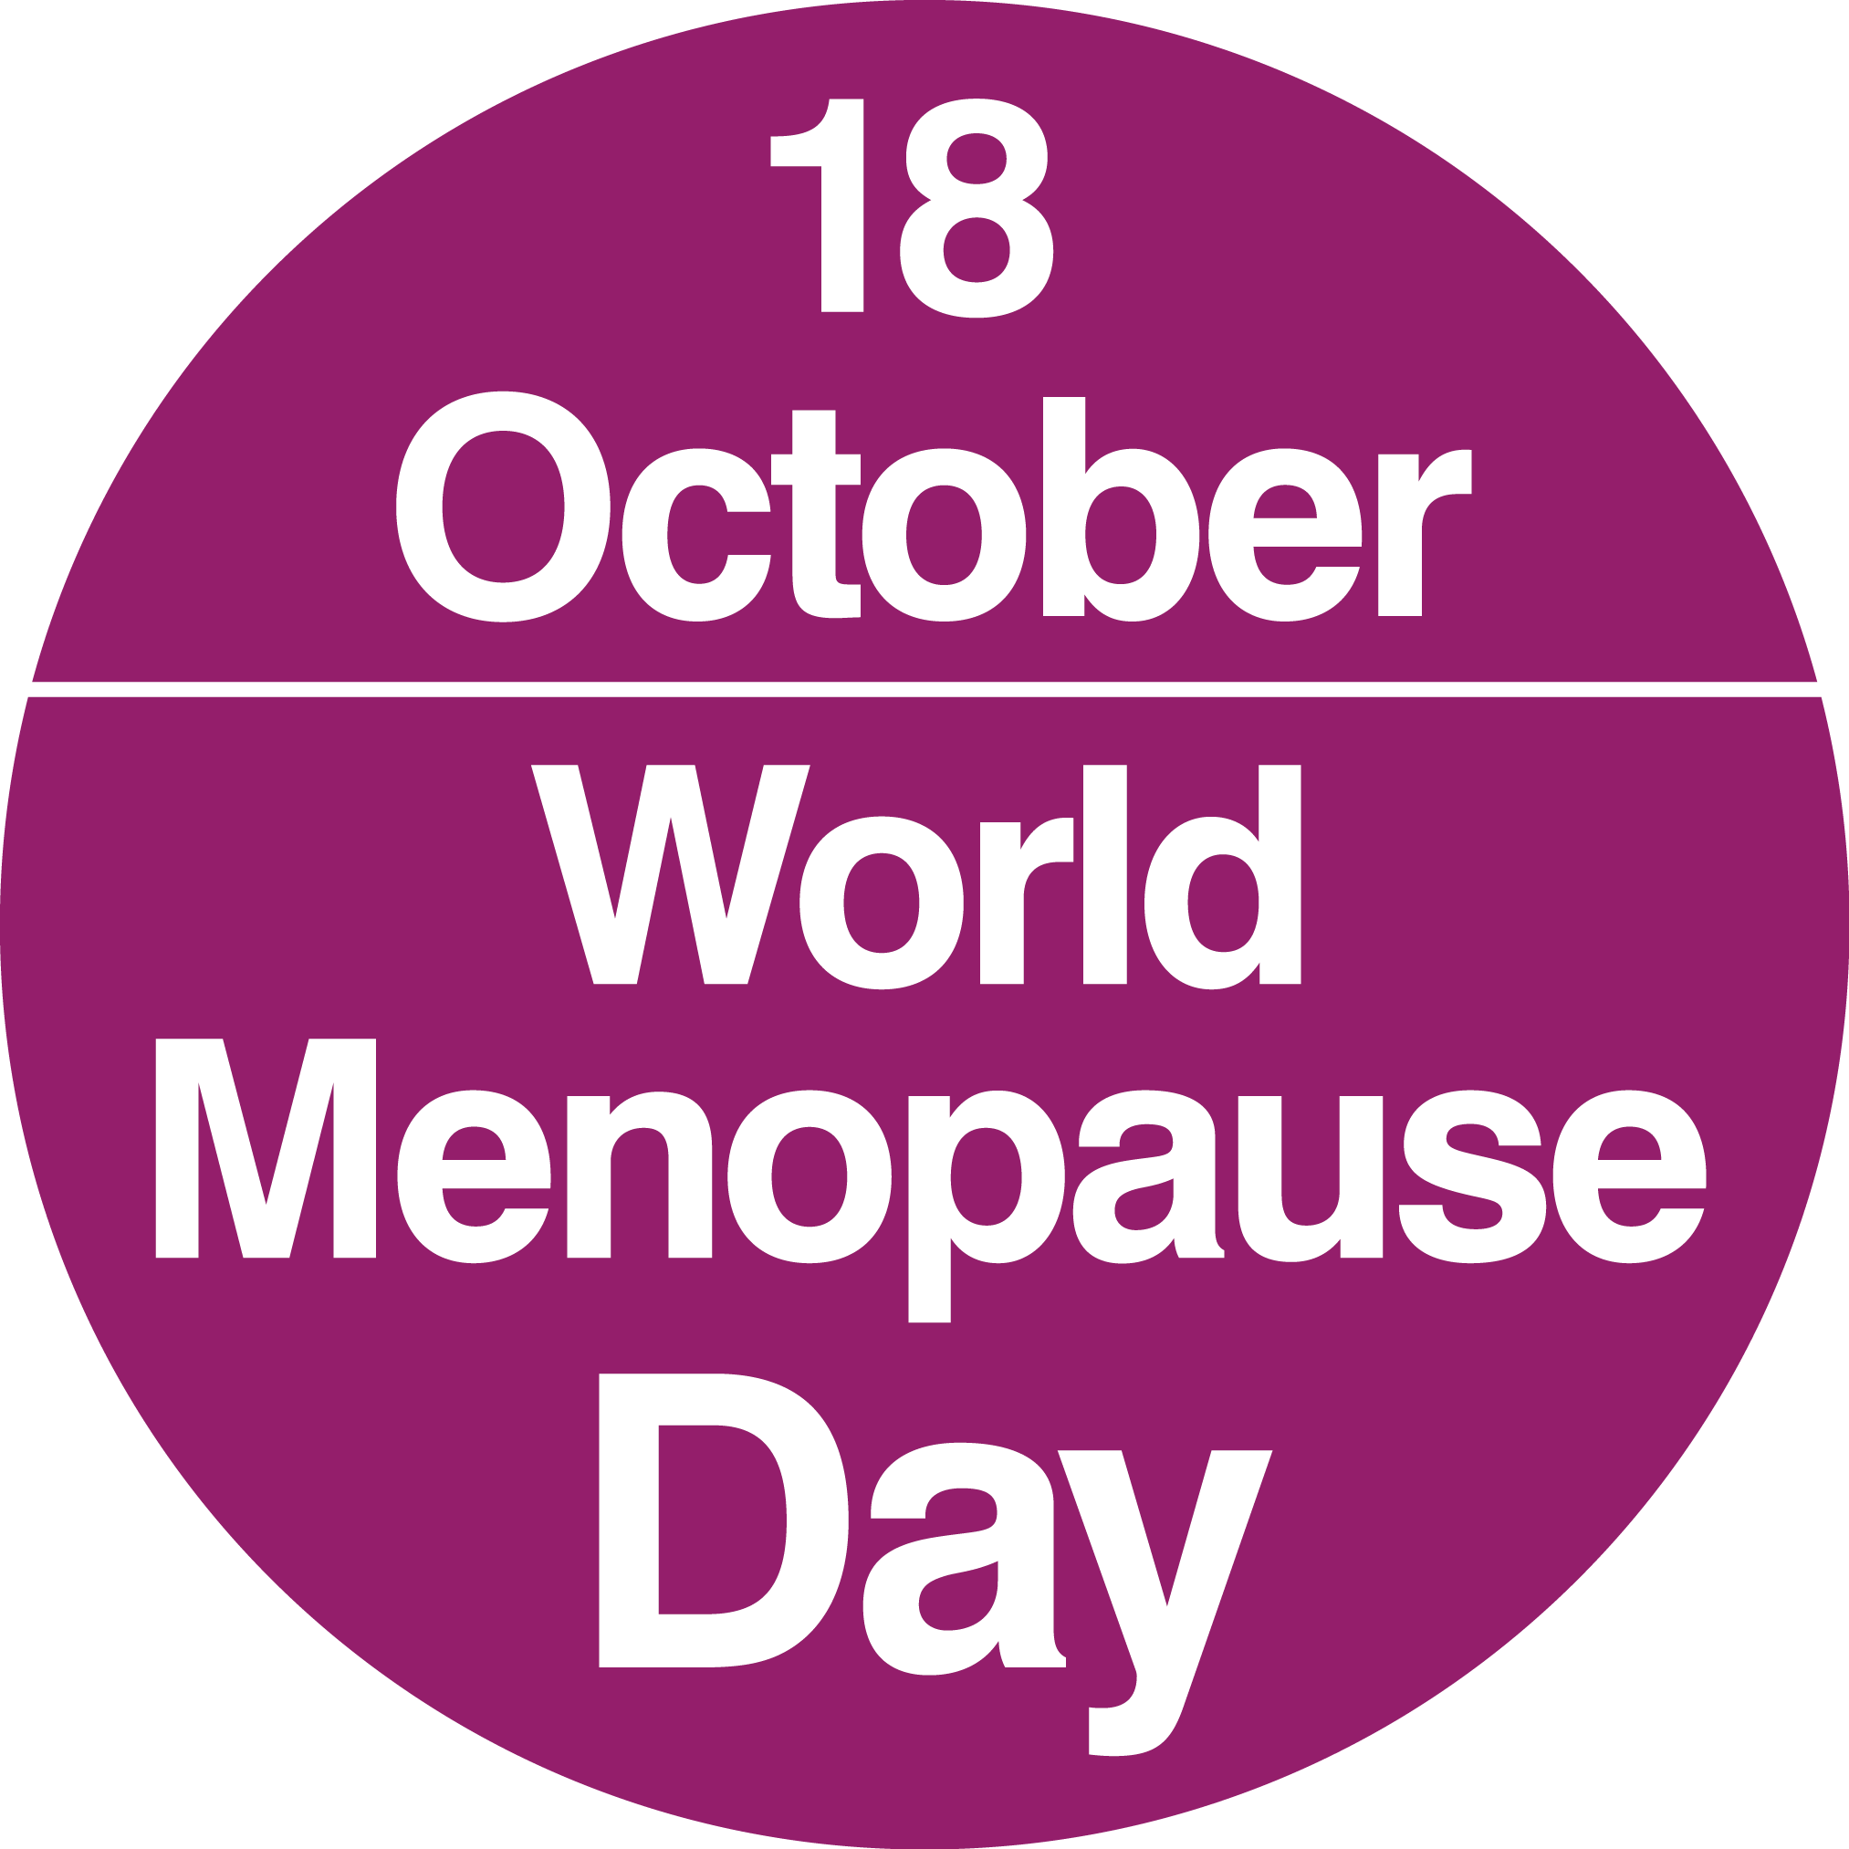
Let’s talk about the menopause transition
Menopause is the time when a person stops having their period - this means they are no longer able to naturally become pregnant, and they experience other changes in their body and mind, as well. For most, it happens between the ages of 45 and 55.
Menopause is often thought of as a new stage in life, a transition from one phase to the next. The transition begins with perimenopause, when the symptoms of the menopause begin but periods have not yet stopped.
You might have gone through times of transition already yourself!
What are other times of transition in one’s life? Brainstorm in pairs.
On World Menopause Day, we raise awareness about the menopause transition, what it can feel like, and the support available for those who wish to learn or talk more about it.
Notes:
Example answers:
Transition from primary to secondary, nursery to school, puberty, uni/training to work, retirement, having a child, changing careers…

Slide 7
Discuss together
Why do you think it’s important to learn about menopause - even if it’s something that usually happens later in life?
To what extent do you feel like menopause is something that is talked about either at home, at school, or online?
Notes:
Example answers
You might know people going through it (e.g. parents, family members etc.) and it is helpful to know what they’re going through to support them. It also might prepare you for what happens to you later on and gives you knowledge that empowers you to make decisions about your health. It’s also good to know about it as you might hear people around you discuss it. Overall, as it is a topic that sometimes comes with myths and stereotypes, it’s important to make sure we have accurate information, and that we can fight any taboo around the topic.

Slide 8
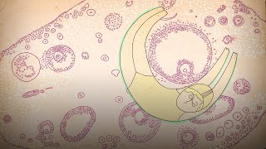
What is the menopause?
Watch from 0:40 until 3:45
Write down at least 3 things you learnt from the video.
Was there anything in the video that surprised you?
Check out the next slide for a summary!
https://www.youtube.com/watch?v=cheqkrcHkrI

Slide 9
Summary - What is the menopause?
Menopause is diagnosed one year after someone’s final period
The menopause transition refers to several years where periods become less frequent. Hormone levels like estrogen change and get out of balance. After menopause, estrogen levels remain stable and a lot lower than before
Symptoms during the menopause transition vary for different people - some might have trouble sleeping, feel irritable or depressed, or have hot flushes.
Experiencing menopause increases vulnerability to certain diseases, like heart disease, diabetes or osteoporosis (bones become more brittle)
There’s a wide range of experiences of menopause - everyone’s menopause will be different

Slide 10
Who experiences menopause?
Only people who have ovaries and a uterus experience the menopause. This includes women, as well as some non-binary and intersex people and trans-men (people who were assigned female at birth who transitioned to live as men).
On average, people have their last period between the ages of 44 and 56.
Some people experience menopause earlier - in their 20s or 30s. This is called premature ovarian insufficiency (POI).
An early menopause can be triggered by…
Something unknown - 90% of people who get an early menopause don’t know why
Surgery or medication - for example cancer treatment, or removal of the ovaries or uterus
Autoimmune diseases - some diseases like diabetes or thyroid conditions can impact the ovaries
💡

Slide 11
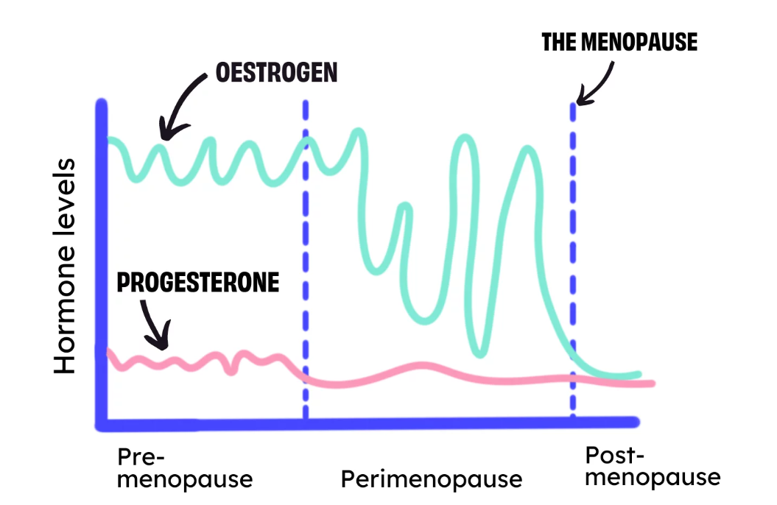
Stages of menopause - getting to grips with terminology
During the pre-menopause phase, people have regular menstrual cycles.
During perimenopause, hormones fluctuate a lot. Periods are less regular. This phase takes several years.
The menopause is the day on which the last period was exactly one year ago. But many people use this term for the whole phase of hormonal changes!
In post-menopause, hormone levels are more stable and lower than they used to be.
Describe the image - what can you see happens here?
Source: Brook

Slide 12
Menopause myths - true or false?
Which of these statements are true, which ones are false? Take a vote in class and see if you get it right.
You cannot get pregnant around the time of perimenopause.
Strictly speaking, the menopause is only one day long.
Symptoms during perimenopause are normal and you don’t need to go to the doctor.
Talking less about menopause means people’s symptoms go away.
Perimenopause can happen at a lot of different ages.

Slide 13
Menopause myths - true or false?
You cannot get pregnant around the time of perimenopause.
Strictly speaking, the menopause is only one day long.
Symptoms during perimenopause are normal and you don’t need to go to the doctor.
Talking less about menopause means people’s symptoms go away.
Perimenopause can happen at a lot of different ages.
False! While it is a lot less likely to get pregnant once menopause symptoms start and periods become less regular, hormonal changes mean one could still become pregnant.
Correct! Menopause refers to the day when one’s last period was.
False! While symptoms are normal, they can be very challenging and there are medications that can help.
False! Talking openly makes many people feel better than hiding their symptoms.
Correct! The age when the hormonal changes start varies from person to person, and can also be brought on by surgery or medication.

Slide 14
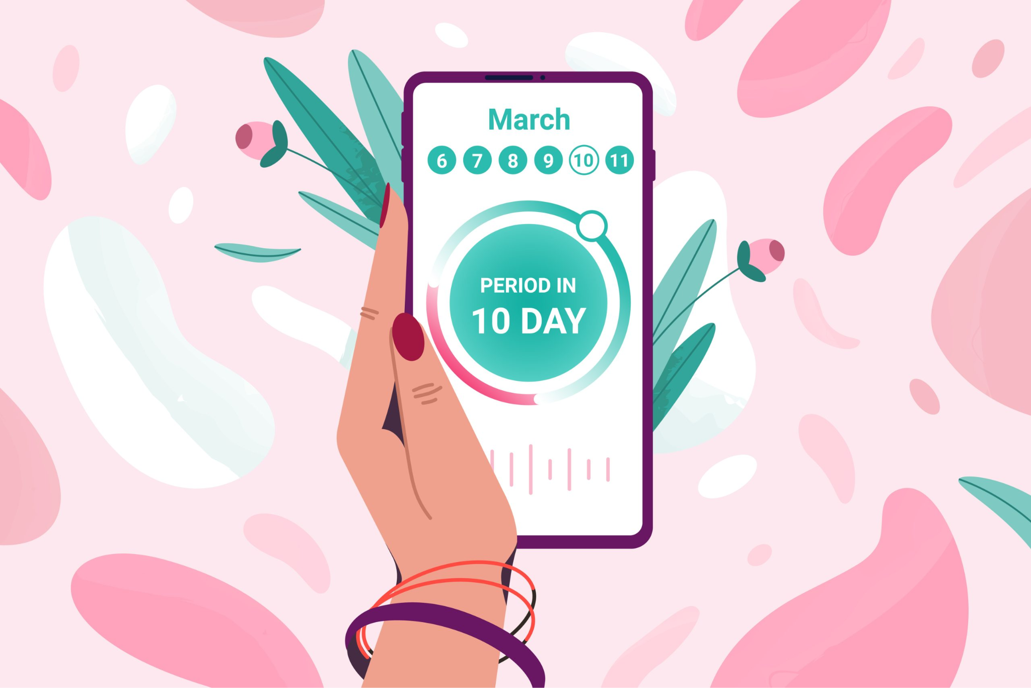
Cycle charting
Tracking and charting menstrual cycles can be a good way for people to identify whether they are experiencing perimenopause and help them to understand their symptoms.
Cycle charting involves tracking when a person is menstruating, when each cycle begins and ends, and other sensations that may help someone follow where they are in their cycle, for instance when they are ovulating or may be approaching their next period. A person can also track their symptoms and keep a log in case they want to change their routine or get advice from a doctor.
Tracking and charting the menstrual cycle is useful so that people know what is typical for them and to make it easier to identify when periods become irregular. Recognising irregularity in a person’s periods, along with accompanying symptoms, can make it easier to diagnose womb-related illnesses or recognise the signs of perimenopause
There are lots of different apps that you can use to track your cycle. You can also do it on paper, using a smartwatch or with a calendar. Do whatever works for you!

Slide 15
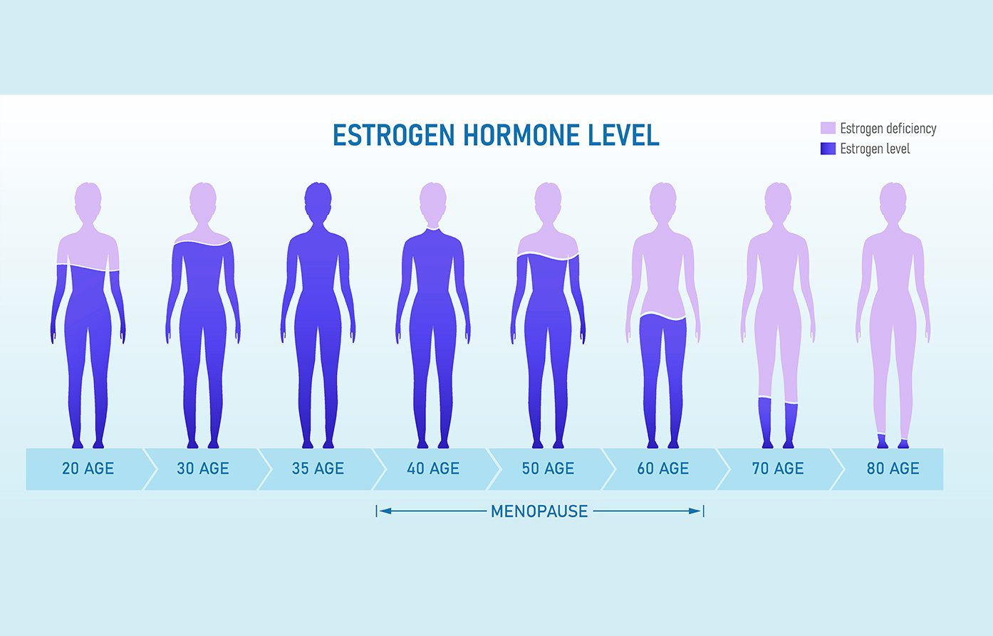
Menopause is part of a long journey!
Menopause is just one phase throughout the lifespan of people with ovaries - hormones change throughout their lives.
It is one part of the journey the reproductive system goes through - like puberty.

Slide 16
Symptoms during (peri)menopause
Menopause symptoms include…
Irregular periods that eventually stop completely
Hot flushes and night sweats
Brain fog
Low mood, irritability or anxiety
Decreased sex drive
Vaginal dryness
Weight gain
Loss of confidence
Hormone replacement therapy (HRT)
Some people choose to take artificial hormones to relieve their symptoms.
Some types of HRT are more and less suitable to different people who may have other health conditions.
Masking symptoms causes some of this and some of these issues interact with each other. No one person will necessarily get all these symptoms and no one symptom exists by itself.
Notes:
Find more about symptoms here: https://www.nhs.uk/conditions/menopause/symptoms/. Find out more about HRT here: https://www.nhs.uk/medicines/hormone-replacement-therapy-hrt/benefits-and-risks-of-hormone-replacement-therapy-hrt/

Slide 17
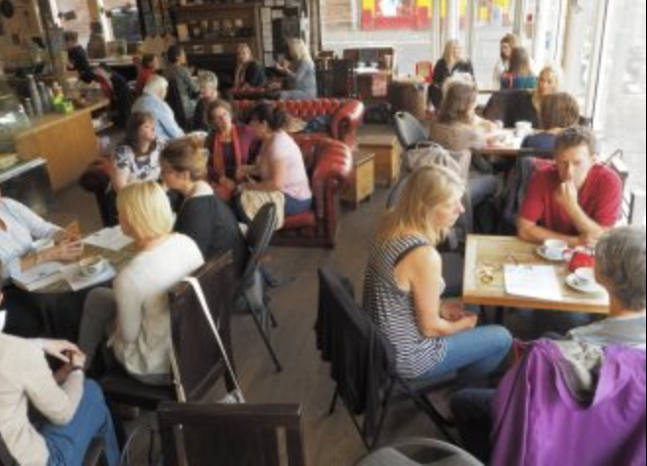
Managing transition - Menopause Café
Whether we are thinking about puberty, or perimenopause, times of hormonal transition can be uncomfortable. It’s important we find ways to manage these transition points so that we can feel positive and empowered about our bodies.
The Menopause Café holds meetings for people to discuss their experiences with perimenopause, menopause and supporting loved ones experiencing it.
Imagine you are at the Menopause café
Write 3 questions you would want to ask someone experiencing perimenopause or menopause.
Sentence starter ideas:
What has been your experience with…?
Do you wish people knew more about…?
How would you like friends, family and loved ones to support you with…?

Slide 18
Discuss together
What might be positive things about menopause? What might be challenging about menopause?
Why do you think it is important for everyone to learn about menopause, not just the people who experience it?
How do you think these meetings can positively empower people experiencing menopause?
Notes:
Example answers:
Positive things may be no more periods that might come with cramps, no need to worry about contraception, it may be a time to reevaluate and rediscover oneself and make changes to one’s life as necessary. Challenging things can be dealing with symptoms, that might also lead to changes in one’s work or relationships, and a feeling that one doesn’t have control over one’s body.
Like puberty, times of change can bring excitement and new things. However, the physical symptoms of menopause can be harder to deal with than those during puberty. Both might be challenging one’s identity, and necessitate some readjustment.

Slide 19
Overflow - when things get overwhelming
What is it like when you experience lots of different menopause symptoms?
Get together in small groups. Each group gets a paper cup.
With a pen or marker, write down a symptom of menopause. Fill your cup with water.
Groups pour the water into a pitcher provided. Explain how this symptom may affect someone experiencing menopause. For example, ‘anxiety might influence people’s relationships or confidence at work’.
Continue until it flows over.
Discuss as a class:
How does this process illustrate the experience of people experiencing menopause?
What might ‘overflowing’ look like in real life?
What do you think might help to avoid the overflow?
Anxiety
This activity was iterated from Period Pompeii/Magmapause, a lesson by Roundabout youth homelessness charity peer educators from the award-winning Menstrual Literacy For All design sprint developed through Period Positive alongside pupils from Sheffield High School, SAYiT and the Period Positive Youth Champions. You can find out more here. This content is freely available to be shared and distributed. Please share further iterations or feedback with Period Positive. Attribution to the original creators is required and this and other iterations may not be sold or used for commercial purposes.
Notes:
This activity was iterated from Period Pompeii/Magmapause, from the award-winning Menstrual Literacy For All design sprint developed through Period Positive alongside pupils from Sheffield High School, SAYiT and the Period Positive Youth Champions. You can find out more at www.periodpositive.com.

Slide 20
Reframing perimenopause
In Japan, the word ‘konenki’ is often used to describe the perimenopause and menopause.
This word has several meanings including:
renewal years
regeneration
energy
years of transition
new purpose and growth
Discuss together
Do you think the work “Konenki” is a positive way of describing the transition of perimenopause/ the menopause? Why?
Notes:
Sources: https://www.womenshealthnetwork.com/menopause-and-perimenopause/menopause-in-different-cultures/#:~:text=Menopause%20in%20Japan%2C%20or%20konenki,as%20both%20cultural%20and%20biological.

Slide 21
Discuss together
How might positive cultural messages about menopause influence the experience of people experiencing menopause?
Notes:
Example answers
Positive messaging can be beneficial for outlook and mental health - it reduces any taboo or stigma, and makes it easier to talk about menopause. Positive messages can encourage people to seek support and focus on physical and mental well-being rather than silently suffering through symptoms. Where there are positive messages, there is also often more support from the community, and feeling valued can prevent a loss of confidence and identity during this life phase, giving a sense of pride instead. Cultural messages that highlight the strength, beauty, and wisdom of aging can promote a positive body image during menopause.

Slide 22
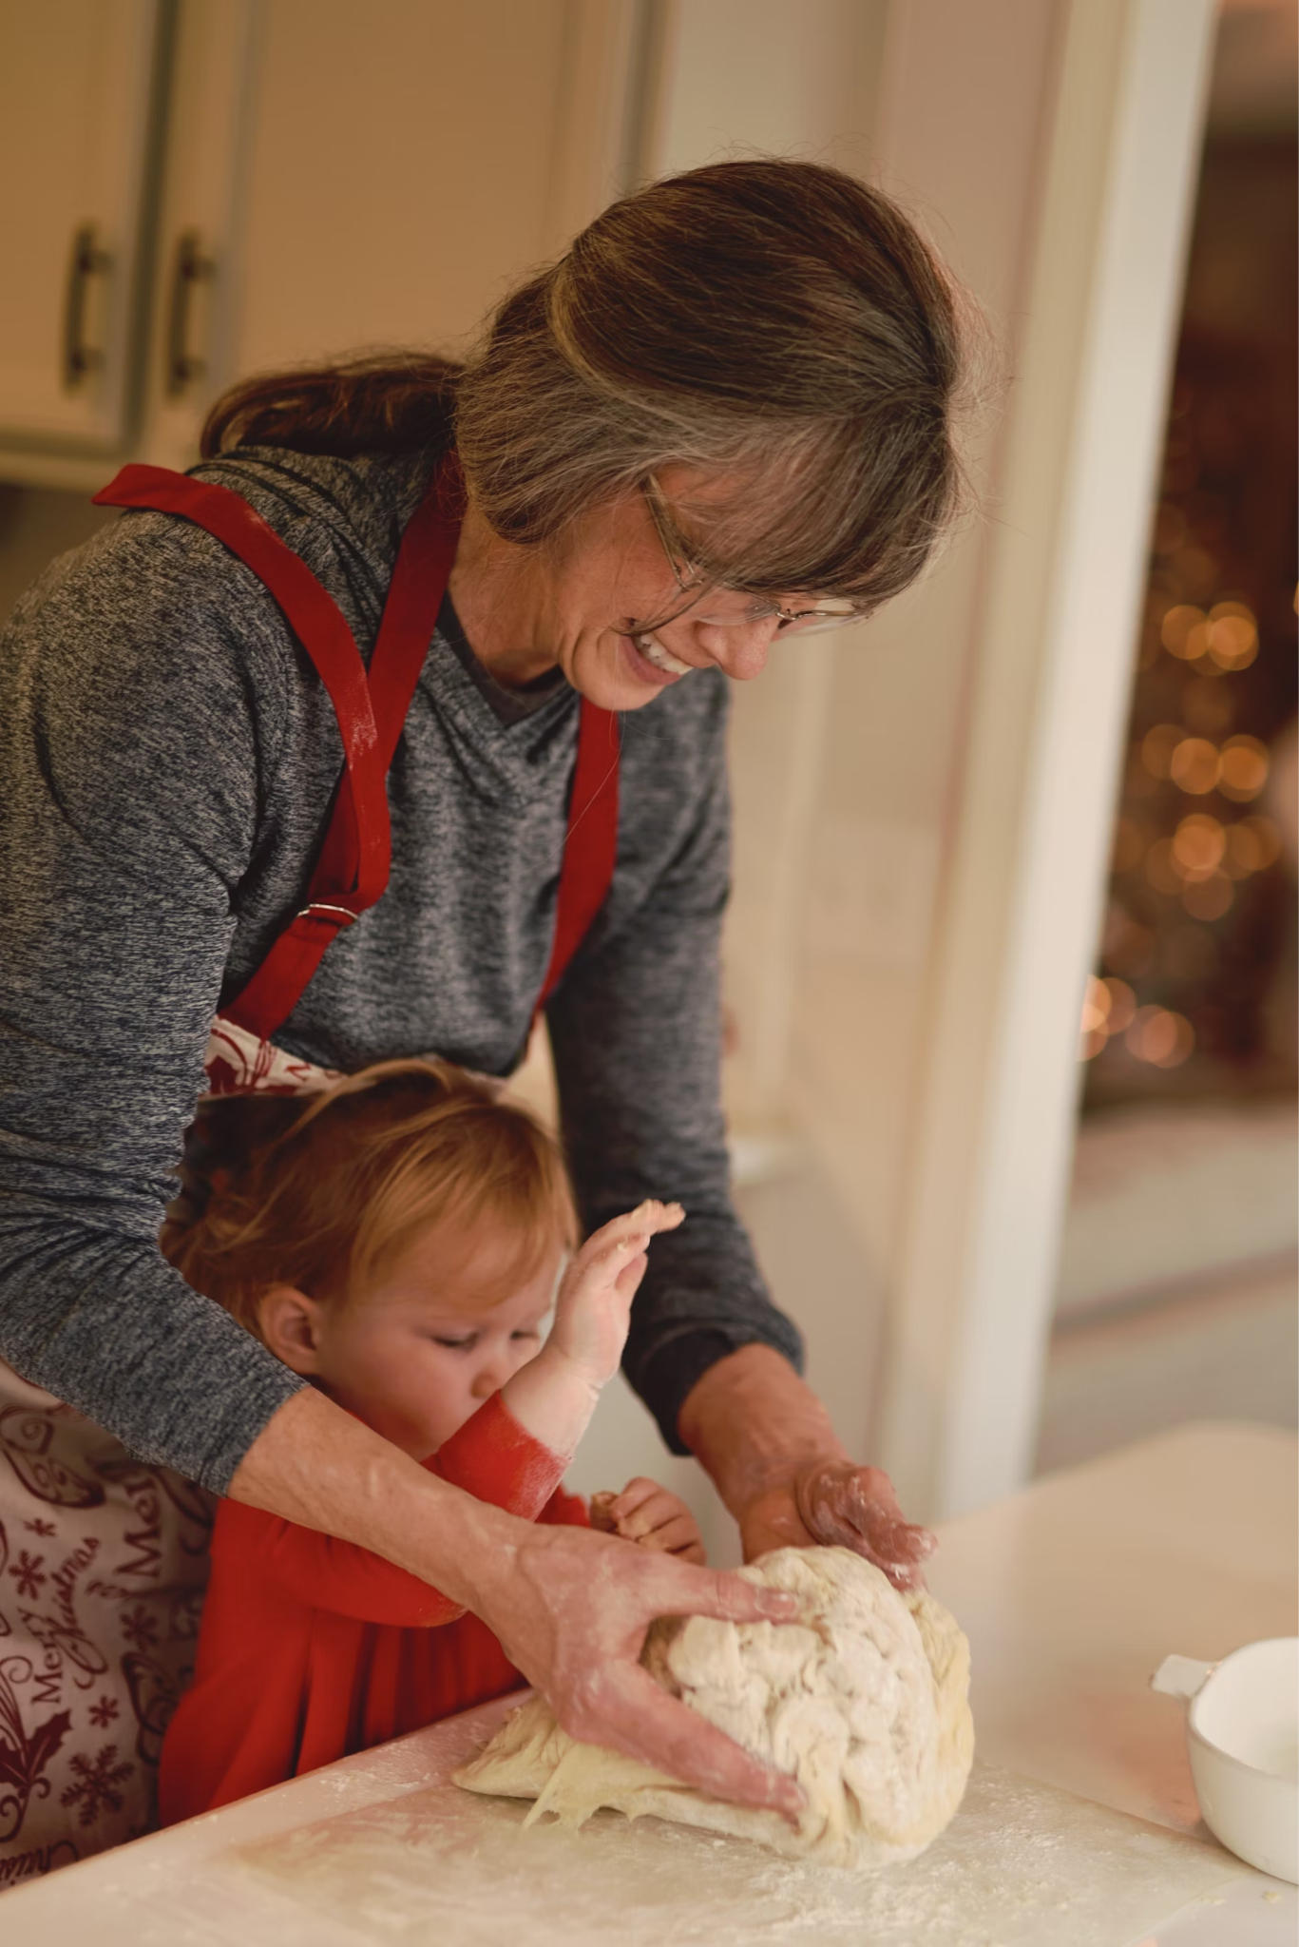
(Optional) Activity: The grandmother theory
Humans are somewhat unique in that they go through menopause. Many other species are able to reproduce until the end of their lives. So why, evolutionally, did menopause occur?
Scientists aren’t sure, and they have had different ideas over time. At the moment, there is no one idea that has been proven to be true.
Today, we explore one popular theory in more depth - the grandmother theory. You will read a short text about it, answer questions and write a response to it.
See the activity on the next slide →
Notes:
Grandmother theory - Hawkes et al. (1998) https://www.smithsonianmag.com/science-nature/how-much-did-grandmothers-influence-human-evolution-180976665/#:~:text=Hawkes%20found%20a%20correlation%20between,grandmother's%20work%2C%E2%80%9D%20she%20says.

Slide 23
(Optional) Activity: The grandmother theory
Read the text about the grandmother theory and answer the following questions:
How do grandmothers help the survival of grandchildren?
How does this help grandmothers pass on their genes?
What are other examples of species that experience perimenopause?
Write a paragraph - how can you relate the grandmother theory to your own life? Tell us about an important elder in your life.
Click here to read the Grandmother Theory text.

Slide 24
Discuss together
How do you think you could support someone experiencing menopause?
What kind of support would you want when you are older?
Notes:
Example answers:
Listen to concerns and provide a safe space, educate yourself to understand their experience, offering help with daily tasks, offering help with research or going to the doctor, being patient when mood swings occur, offering to participate together in activities that are healthy e.g. exercise, walks, healthy food, being supportive of their choices regarding potential treatment/HRT, celebrate achievements and strengths together.

Slide 25
Supporting others through menopause
Imagine you are a support worker at a local Doctors practice:
Read the scenarios below. Choose one of them.
Give advice- what could the person do in this situation to support their loved one through menopause?
My wife has told me she believes she’s experiencing menopause - she started to have night sweats and says she often feels hot. She’s been really snappy as well which I find difficult to deal with. I don’t know much about menopause, so what can I do to help? - Toby
My mum keeps complaining to me about all these things she’s feeling, like feeling anxious and feeling like she can’t think clearly - she even forgot that I had my exam the other week. She says it’s the menopause. But how am I supposed to do anything about that? - Sumaya

Slide 26
Let’s be menopause-itive!
Being menopause-positive involves embracing a supportive and empowering attitude towards the menopause transition and the experiences of those experiencing it and creating a society where people are literate about every aspect of the menstrual span, from pre-puberty to postmenopause. Here’s what we can do!
Be open about it and encourage others to talk about it, too. We can create a society where people have more literacy and understanding about all stages of the menstrual span
Educate yourself about menopause to understand the experience of it - that helps to fight myths and gives you more knowledge.
Support those who go through menopause in an understanding way.
When talking about health, always remember - it’s important to know your own body. You might have a different experience from others. Know what is typical for you, and seek help if things feel off!

Slide 27
More questions for discussion (if you have time)
What might be ways for couples where one or both people go through menopause to navigate this?
How might symptoms of perimenopause impact someone’s work life?
What do you think would be ways to make sure people are more educated about menopause?
To what extent do you feel like it’s acceptable to talk about health issues with others?
How can you start a conversation about your health with a trusted adult or a friend?
What can we do to make others feel comfortable in telling us about personal things and struggles?
How can you tell that you should see a doctor?
What can you do to get to know your own body better?
What are things you can do to take care of your body and your health?
Do you think information about health on social media is reliable? Why or why not?

Slide 28
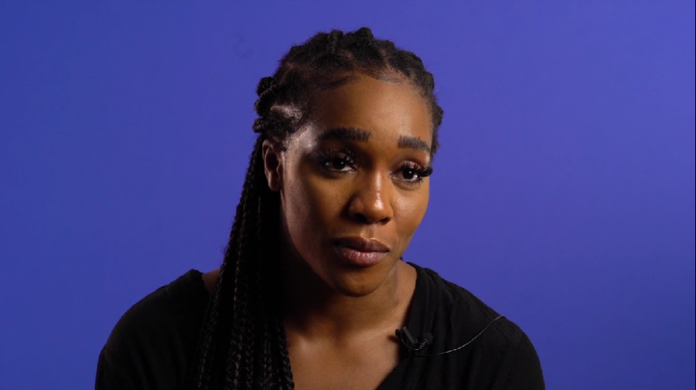
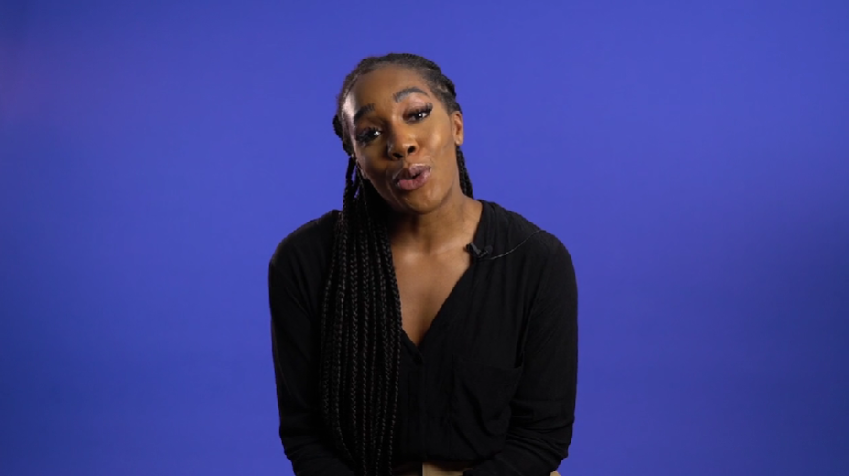
Videos to explore related topics further
How do hormones affect people assigned female at birth throughout their lives? (1m 49s)
How did/do you feel about getting your period? (3m 49s)
How did you feel about your body changing during puberty? (1m 49s)
How does fertility change with age? (1m 10s)

Slide 29
Where to get more information
The NHS website offers reliable information on all kinds of health issues, including hormonal health
www.nhs.uk
The Daisy Network is a charity providing information and support for those experiencing early menopause/premature ovarian insufficiency under 40
www.daisynetwork.org
The Menopause Charity have some great information on all things related to this topic.
https://www.themenopausecharity.org/
Menopause Café offers the opportunity for people to gather and discuss menopause. Menopause Cafés can be public or workplace-only events
https://www.menopausecafe.net/

Slide 30
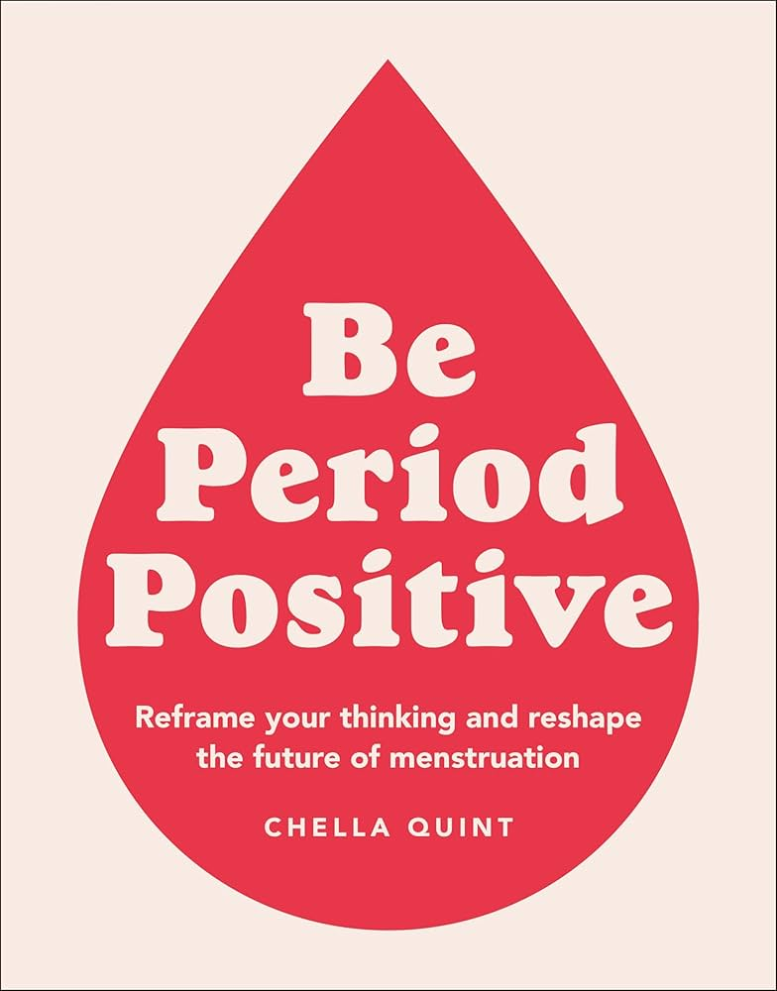
Book recommendation - learn more about menstruation and menopause
Chella Quint - Be Period Positive
Published by Dorling Kindersley
Period positivity starts with asking questions.
This informative and absorbing book covers all your period-related questions - why they're taboo (and needn't be) and how to navigate the whole bleeding thing, from first periods to fertility, euphemisms to uteruses, menstrual products to menopause.

Slide 31
Where to get support
If you notice any changes to your body or feel worried about a health issue, talk to your GP
Childline
The Mix
Call 0808 808 4994
Helpline for people under 25 and website with information on different topics
www.themix.org.uk
Call 0800 1111
Helpline for children to discuss personal issues
Chat online
www.childline.org.uk

Slide 32
Useful reference links and resources
World Menopause Day - International Menopause Society
Menopause - Brook
Menopause - NHS
Menopause cafe - Menopause cafe
A Period Positive National Curriculum for England
This resource follows the Period Positive pledge framework for inclusive menstruation to menopause education.
It meets the following criteria from the Period Positive Curriculum model which is a proposed national curriculum for menstrual literacy:
Key Stage 2: K5/U1/U2
Key Stage 3: S2/U1/U2
Key Stage 4: S2/S4/U8

Slide 33
Credits:
This lesson has been created by Life Lessons Education Ltd as part of their weekly ‘In the news’ series with support from Chella Quint OBE, founder of Period Positive and author of Be Period Positive and Own Your Period.
To learn more about Life Lessons and how they support schools visit www.lifelessons.co.uk

