Slide 2
Session objectives
Learning objective:
To help young people identify key features of blackmail online, understand the impact it can have, and learn how young people can access support about anything that happens online.
Learning outcomes:
I can explain what online blackmail is
I can describe the impact this may have
I can identify some controlling and manipulative behaviours online
I can explain how to get help, and different people and organisations who can provide support with problems young people face online.

Slide 3
Ground rules
Choose your words carefully. Use language that will not offend or upset anyone.
When you give an opinion, try to explain your reasons.
Listen to the views of others, and show respect.
If you disagree, comment on what was said, not the person who said it.
What is said in the room stays in the room. The only exception is if there is a risk to a child’s safety, in which case the session leader will report this.
If you’re worried about something that has happened to you or a friend, don’t share it with the whole group, but do make sure you talk to me or an adult you trust after the session.
If you feel upset or anxious at any point, raise your hand at any time and ask for ‘time out’.

Slide 4
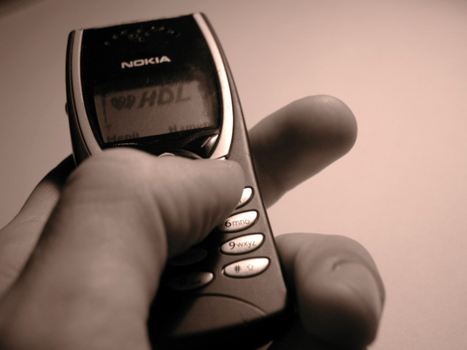
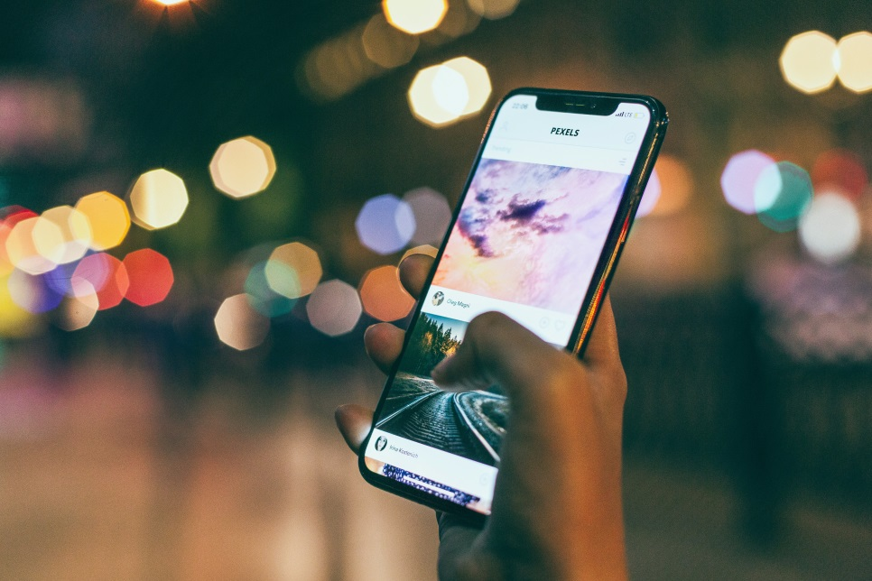
Starter activity
Nik’s phone
Al’s phone

Slide 5
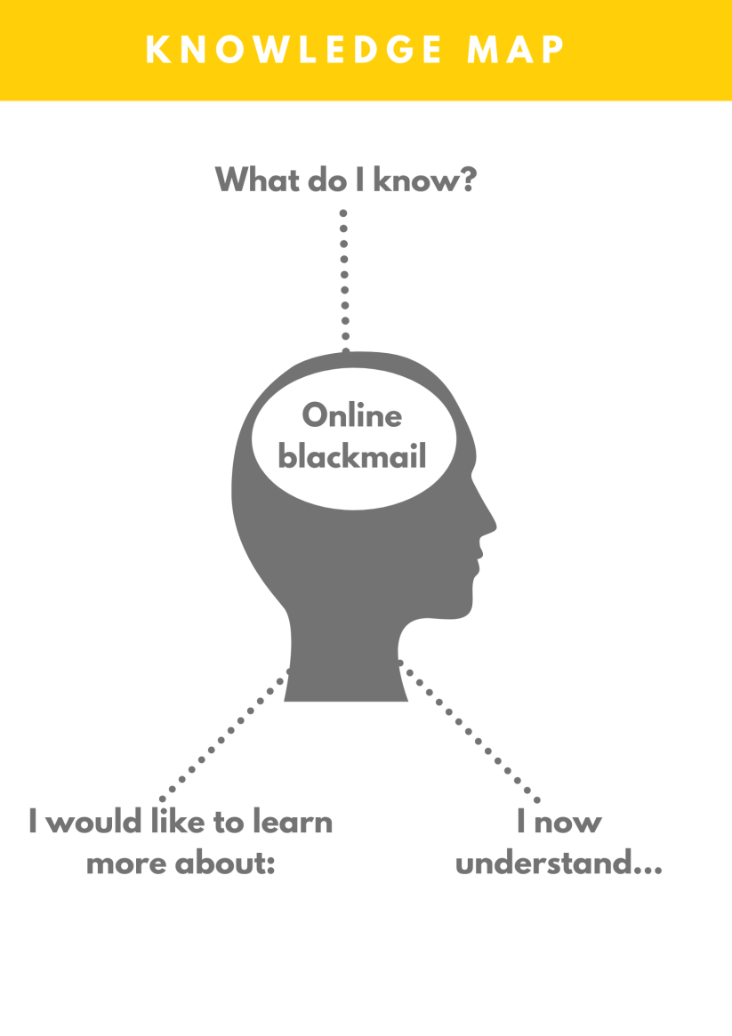
Baseline activity

Slide 6
What is online blackmail? - Article 1
In pairs, discuss the answers to the following questions:
Did you learn anything that you didn’t already know?
Did this article answer any of your questions?
Does it raise any further questions for you?

Slide 7
Extending understanding, exploring impact- Article 2
In pairs, discuss the answers to the following questions:
What similarities are presented in both articles?
Are there similarities in the way that the young people being blackmailed felt or responded in the different cases?

Slide 8
Help and support

Slide 9
Plenary

