Slide 1
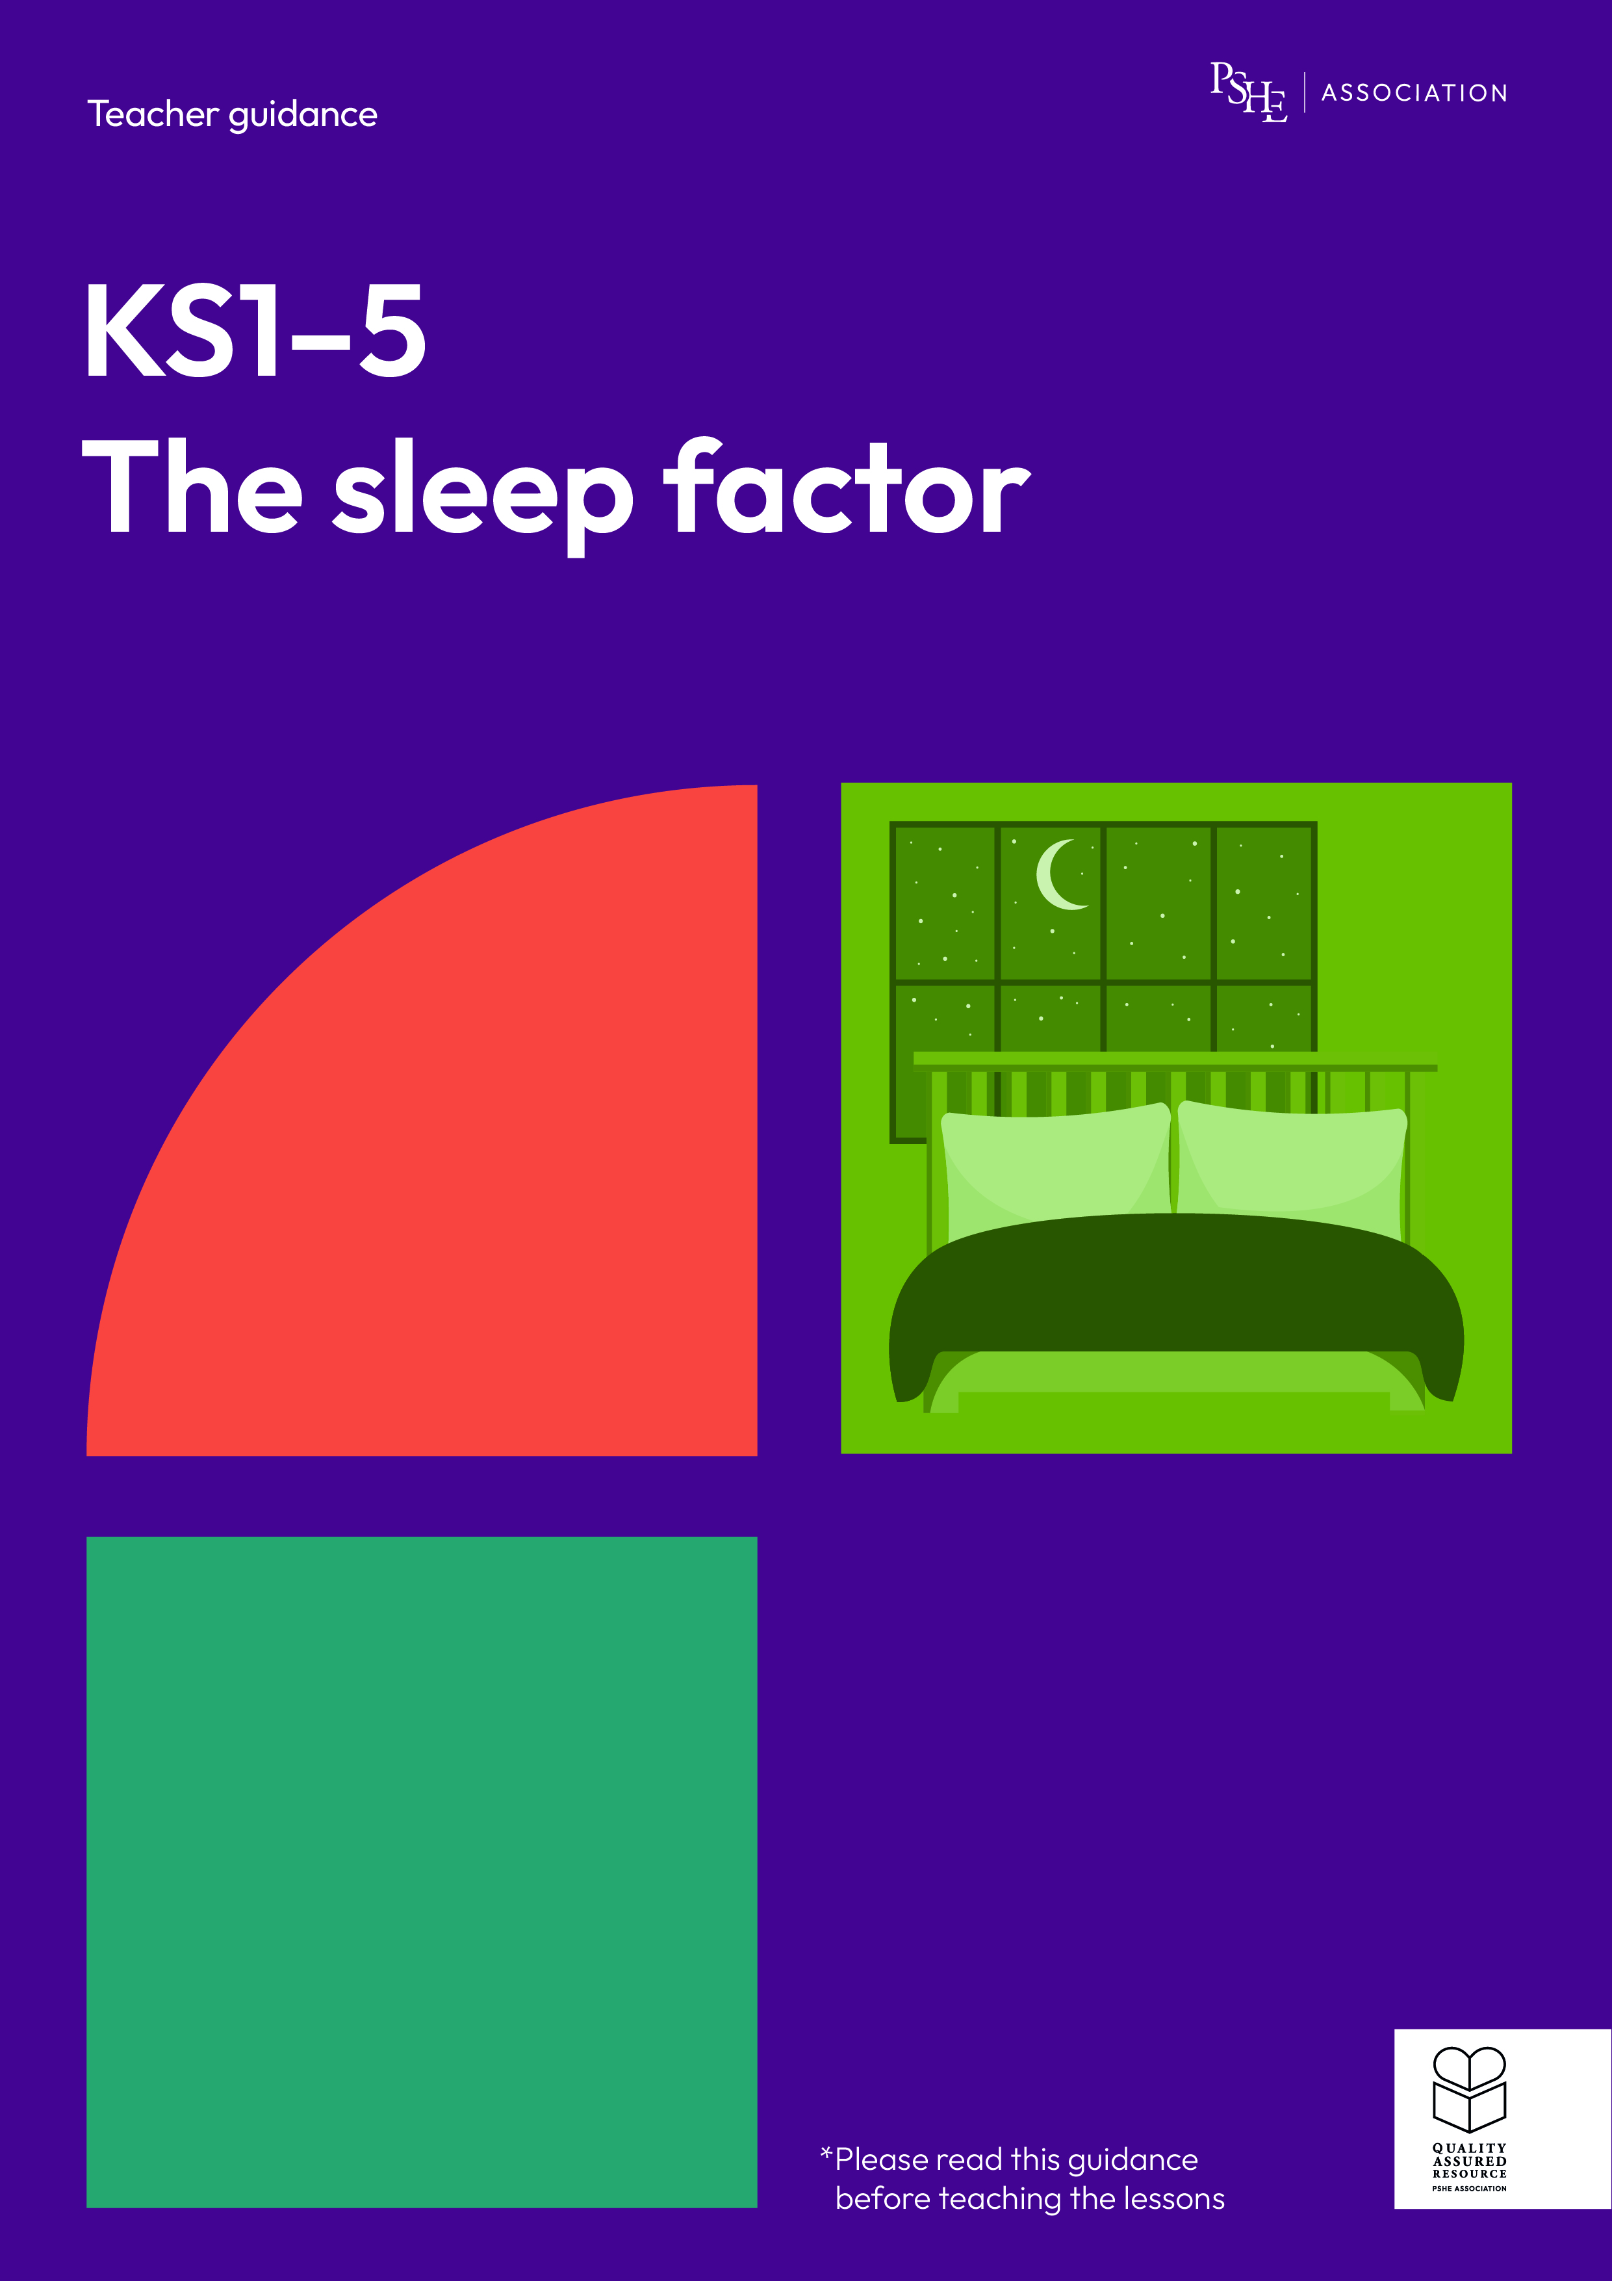
The sleep factor
Getting a good night’s sleep
KS2

Slide 2
Using this PowerPoint
The slides in this presentation are divided into two sections:
Teacher slides (purple) – provide key information regarding lesson preparation.
Pupil slides – provide a visual focus point for pupils during the lesson and delivery notes for teachers about the activities. Click ‘notes’ to view these.
Ensure that you select ‘Use Presenter View’ under the ‘Slide Show’ tab – this will allow you to preview the teaching notes on your monitor while the main presentation is displayed on a screen/smartboard.

Slide 3


Support and challenge
The lesson includes suggestions for challenge and support activities, to help you differentiate appropriately for your class.
Support activities are adapted to be more accessible for those who need it.
Challenge activities deepen and extend learning for those who need more challenge or who finish the activity quickly.
Look for these icons on the pupil slides. See delivery notes for details of the activities.
Challenge
Support

Slide 4
Context
This lesson for key stage 2 explores the importance of sleep and how sleep patterns change during puberty. It considers the foundations of good quality sleep and encourages children to establish helpful routines to support them with consistent sleeping patterns as they grow older and become more independent.
No lesson should be taught in isolation, but always as part of a planned, developmental PSHE education programme. This lesson would work best as part of broader learning on healthy, balanced lifestyles; preparing for transition to secondary school; or following lessons about the changes that occur to the body during puberty.

Slide 5
To learn about the importance of sleep and routines that support good quality sleep.
Pupils will be able to:
explain why sleep is important for a healthy lifestyle
identify how sleep patterns might change during puberty
describe habits, including bedtime routines, that can help improve sleep

Slide 6
Box or envelope for questions
Resource 1: Facts about sleep
[one or two sets per class]
Resource 2: My sleep fact file
[one per pair]
Resource 2a: My sleep fact file – teacher answers [for teacher reference only]
Resource 3: Sleep schedule
[one per group, printed A3]

Slide 7
Lesson summary
Activity | Description | Timing
Baseline assessment | Pupils complete a four corners activity to demonstrate their current understanding. | 5 mins
Introduction | Introduce learning objective and outcomes, set up the question box and revisit ground rules. | 10 mins
Fact hunt | Using posters displayed around the room, pairs discover facts about sleep and sleep patterns. | 20 mins
Sleep schedule | Groups create a daily routine to help a character get better sleep. | 15 mins
Endpoint assessment | Pupils revisit their baseline assessment activity and add or change learning, to demonstrate their progress. | 7 mins
Reflecting and signposting | Pupils reflect on their learning and where to seek support in and out of school. | 3 mins

Slide 8
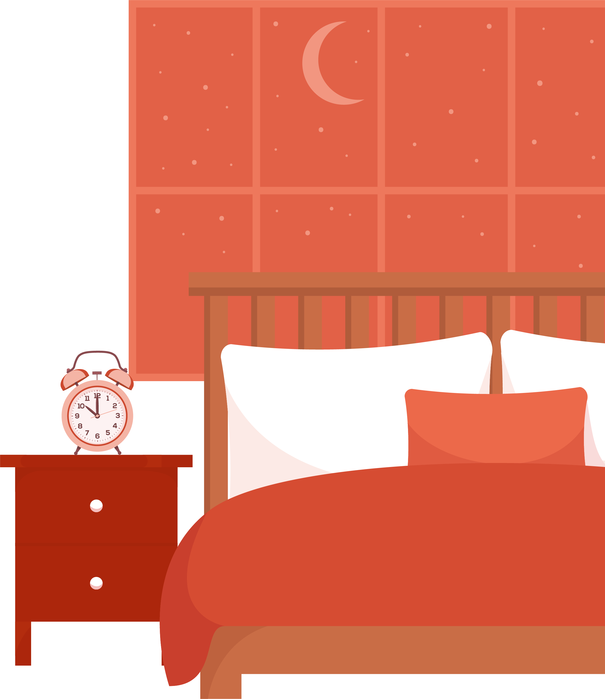
Getting a good night’s sleep
KS2

Slide 9
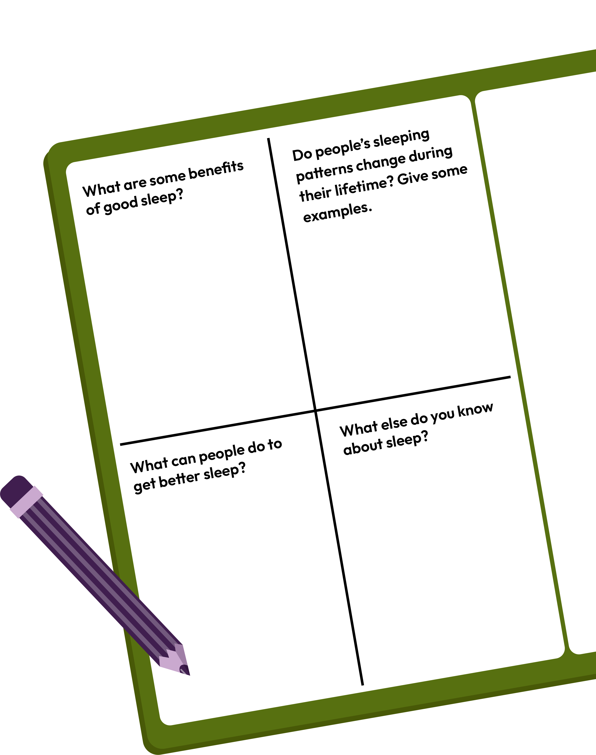
What’s our starting point?
Split a page in your exercise book into quarters and write one of these questions in each quarter.
In the remaining space, jot down your answer to each question. You could draw too,
if you wish.
Notes:
Teacher notes – Baseline assessment activity (10 mins)
Ask pupils to split a page in their exercise books into four quarters and write one of the four questions on the slide into each quarter, before writing or drawing their responses.
Pupils should work on their own without any further prompts or examples, to give a true reflection of their current understanding. Circulate during the activity to gauge pupils’ starting points and adapt the lesson as needed to address any gaps or misconceptions you identify. When finished, ask pupils to put their exercise books to one side – they will revisit these questions at the end of the lesson.

Slide 10
Notes:
Teacher notes – Introduction (5 mins, slides 10-11)
Establish or revisit ground rules. Explain that if pupils have worries or questions during or after the lesson that they do not want to raise in front of the class, they can speak to you individually or write their question on a piece of paper, anonymously or with their name, and put it in the question box.

Slide 11
We are learning about the importance of sleep and routines that support good quality sleep.
We will be able to:
explain why sleep is important for a healthy lifestyle
identify how sleep patterns might change during puberty
describe habits, including bedtime routines, that can help improve sleep
Notes:
Teacher notes – Introduction (5 mins, slides 10-11)
Introduce the learning objective and outcomes. Explain that today’s lesson will explore helpful sleep routines and consider why they are important for a healthy lifestyle.

Slide 12
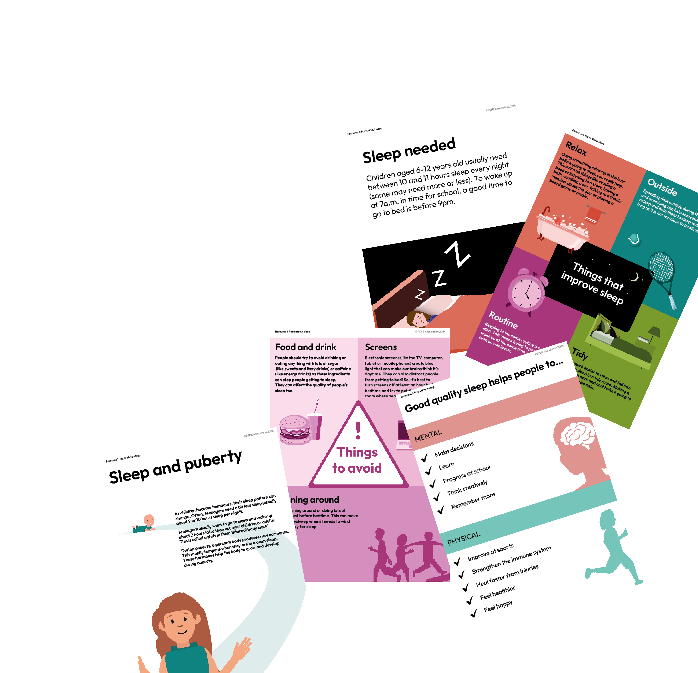
Fact hunt
Let’s go on a fact hunt…
Look at the posters displayed around the classroom.
Use the information shown to help answer the questions on your sleep fact file.
Notes:
Teacher notes – Fact hunt (20 mins)
Tell the class that they are going to go on a fact hunt to find out more about sleep (including why it’s important and how sleep patterns can change). Pin up posters from Resource 1: Facts about sleep around the classroom (depending on the size of the class, you may need more than one copy of each poster). Give each pair Resource 2: My sleep fact file and ask them to move around the room looking at the posters and hunting the ‘facts’ needed to answer the questions. They can also trade and share facts with other pairs as they discover more. Pupils could be encouraged to take home their completed sleep fact file to share with parents or family members.
Take feedback on each question and use Resource 2a: My sleep fact file – teacher answers to highlight the key learning.

Slide 13
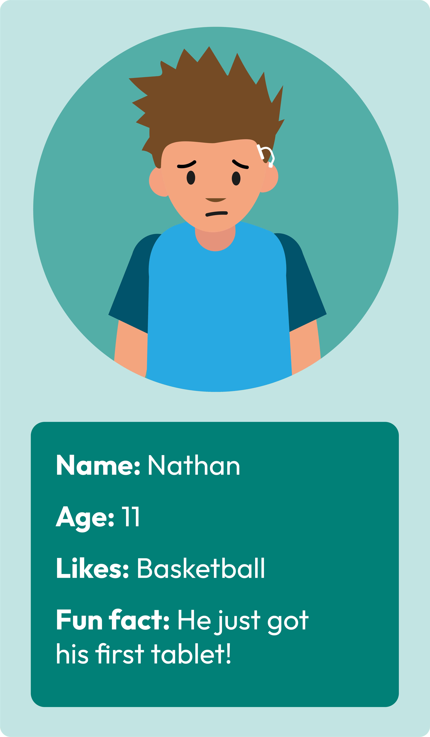


Sleep schedule
Habits or routines can support good quality sleep.
Nathan has noticed he is not sleeping too well recently.
Can you build a daily routine to help Nathan get better sleep?
Notes:
Teacher notes – Sleep schedule (15 mins, slides 13-15)
Explain that good quality sleep can be supported by the things people do often (in other words, their habits or routines). Use the slide to introduce Nathan (age 11) who wants to build a daily routine that helps him to get better sleep.

Slide 14
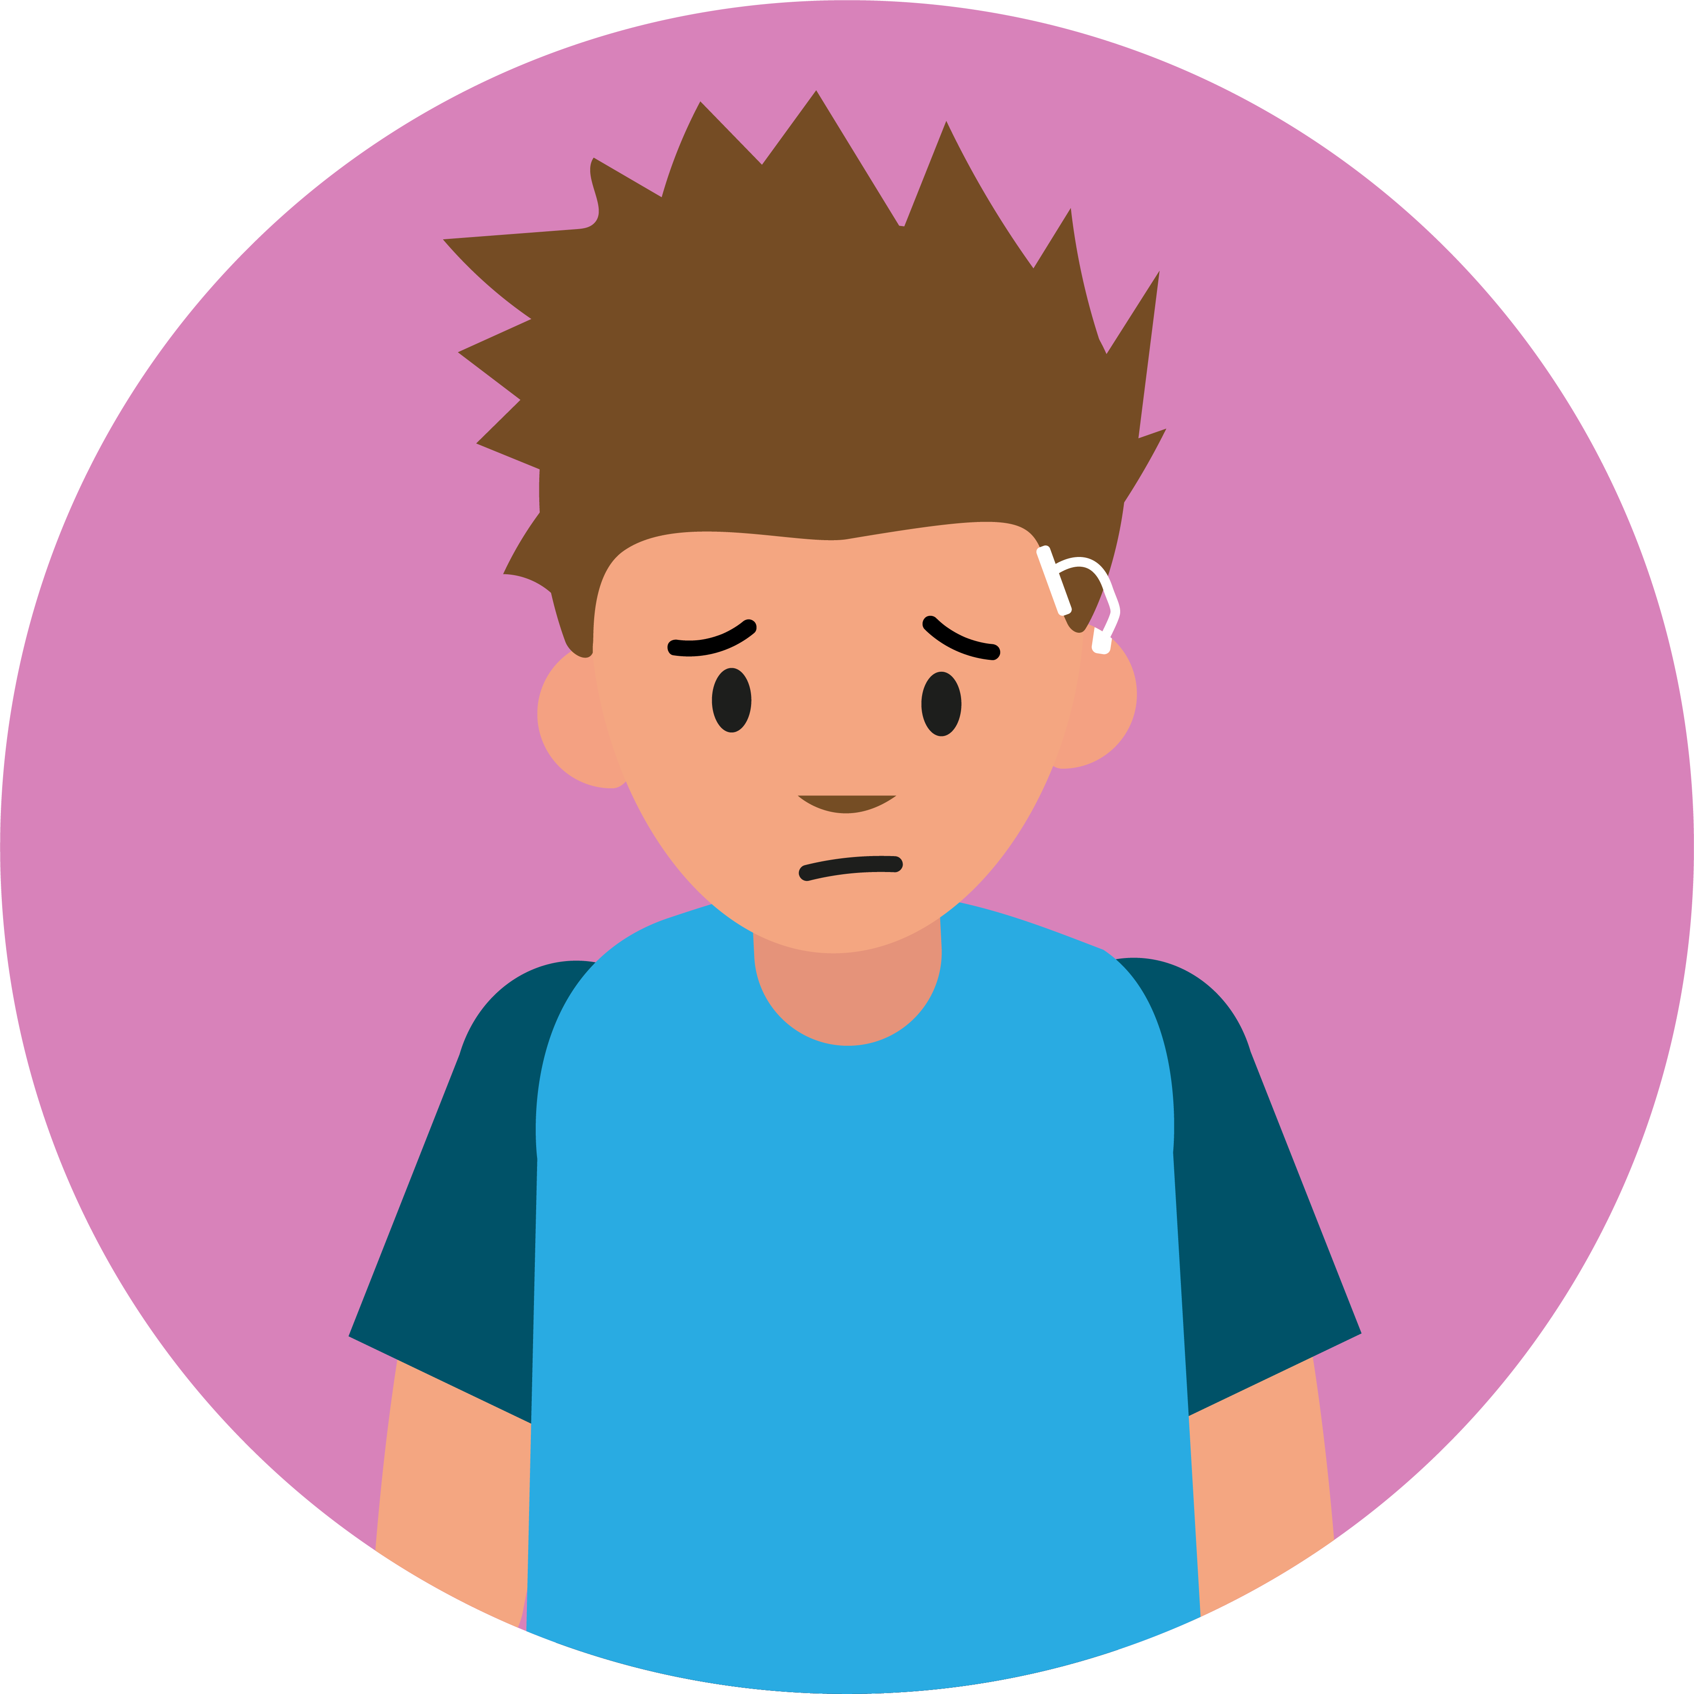
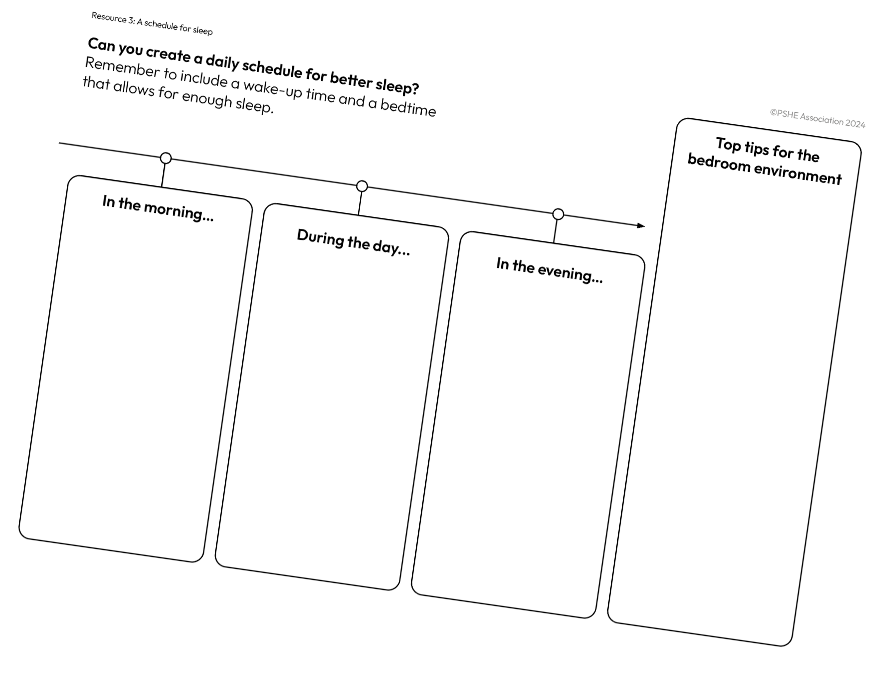



Helping Nathan
Our class tips for better sleep:
Notes:
Teacher notes – Sleep schedule (15 mins, slides 13-15)
Ask small groups to use what they learnt in the fact hunt activity to create a list of tips that could help Nathan with his sleep.
Take feedback and create a class list on the slide, making sure it includes ideas like:
a consistent routine – going to bed and getting up at the same time
going outside during the day (to get daylight)
avoiding screens before bedtime, and keeping them out of the bedroom
avoiding fizzy or sugary drinks
taking time to wind down before bed by doing calming activities (e.g. reading, talking with family, or listening to soothing music)
keeping the bedroom cool, dark and tidy
Ask groups to apply these ideas to create a routine for Nathan using Resource 3: Sleep schedule. They should annotate their schedule as they go, to explain how some of the ideas they have included could support Nathan’s sleep. To help with this, they could refer back to their fact files from the previous activity or take a look back at the posters around the room.
If time allows, ask groups to do a short learning walk to see how the schedule they created compares to others (considering what is similar and what is different).
Support: Pupils could draw and label their ideas on Resource 3: Sleep schedule.
Challenge: Ask groups to imagine that it is a few years later. Nathan is now 13, at secondary school, has his own mobile phone and needs a new sleep schedule! Groups should discuss how his daily routine might change.

Slide 15
A schedule for sleep
Top tips for the bedroom environment
Keeping the bedroom cool, tidy, quiet and screen-free could be helpful.
Everyone’s routines will look different, but you might have included things like:
In the morning…
Waking up at the
same time
Spending time outside
During the day…
Do some physical activity
Spend time outside
Avoid caffeine or too much sugary food and drink
In the evening…
Get off screens an hour before bed (he could put his tablet away in a drawer)
Do calming activities
Going to bed at the
same time
Going to bed early enough to get between 10 and 11 hours of sleep
Notes:
Teacher notes – Sleep schedule (15 mins, slides 13-15)
Take feedback and emphasise that people’s routines don’t have to be exactly the same, and that they might vary a little day to day. You may wish to use this slide to highlight some of the key elements that groups should have included.

Slide 16
Where are we now?
Can you add any new learning?
Is there anything you’d like to change?
Without sharing, think about one thing from today’s lesson that you’d like to try in your own routine.
Notes:
Teacher notes – Endpoint assessment and reflection (5 mins)
Remind pupils of the learning outcomes and ask them to return to their exercise books to revisit the baseline assessment activity from the start of the lesson. Ask them to add any new learning about sleep’s benefits, changing sleep patterns and tips for better sleep in a different colour pen or pencil. They may also want to change their original ideas, as a result of today’s learning.
This assessment activity will help provide information about pupils’ progress and highlight any gaps that may need addressing in future lessons.
Finally, ask pupils to quietly reflect on one thing they would consider changing about their own daily routine to help them get better sleep.

Slide 17


Who can help?
If you have trouble with sleep or have worries about sleep, speaking to an adult can help. You can:
speak to a parent, carer, or other trusted adult outside of school – someone you feel comfortable talking to
speak to a teacher, a helper,
or other trusted staff member
in school
There are also organisations like Childline that can help: www.childline.org.uk/kids
0800 1111
I need your help with something . . .
Something's worrying me,
can I talk to you?
I have something that’s been bothering me . . .
Notes:
Teacher notes – Signposting support (5 mins)
Reassure pupils that lots of people find it hard to get to sleep or wake up sometimes.
However, if it’s often difficult to get to sleep or stay asleep, or if they are experiencing worries related to sleep, make sure pupils know that they should:
speak to a parent, carer, or other trusted adult outside of school
speak to a teacher, or other trusted staff member in school
There are also organisations that can help, such as Childline:
www.childline.org.uk/kids
0800 1111
If any questions from the question box have not yet been answered, and if time allows, you may wish to address these now.

Slide 18

More activities
Give me 10!
Make a list of ten top tips for a good night’s sleep.
Can you create a five-minute presentation to share in a whole school assembly?
Notes:
Teacher notes – More activities: Give me ten, Sleep story
Give me ten: Ask pupils to compile a list of ten top tips for a good night’s sleep and use this to create a five-minute presentation to share in a whole school assembly.

Slide 19
More activities
Sleep story
Write a short story about a character who is struggling to get a good night’s sleep. Include advice for others about how they solved the problem.
Notes:
Teacher notes – More activities: Give me ten, Sleep story
Sleep story: Ask pupils to write a short story about a character who is struggling to get a good night’s sleep and include advice about how they solved the problem.

